Slide 1
C Programming.
Have you ever wondered how your favorite apps like Instagram, YouTube, or even your calculator work behind the scenes? Today, you're going to take the first step towards understanding how software is actually made.
Think about this — your mobile phone, smartwatch, ATM, even the microwave at home… all of them are controlled by code. But what is this 'code'? Today, we’ll begin learning the language that helps control machines —

Slide 2
Day 0: C Programming - Introduction & Setup
By Himayoun

Slide 3
Day 0: C Programming - Introduction & Setup
1. What is Programming?
Definition: A way to instruct the computer to perform specific tasks.
Sub-topics:
- Computers understand only binary (0s and 1s).
- Programming languages help humans give instructions in a readable form.
- Real-life analogy: Programming is like giving a recipe to a cook.
By Larry

Slide 4
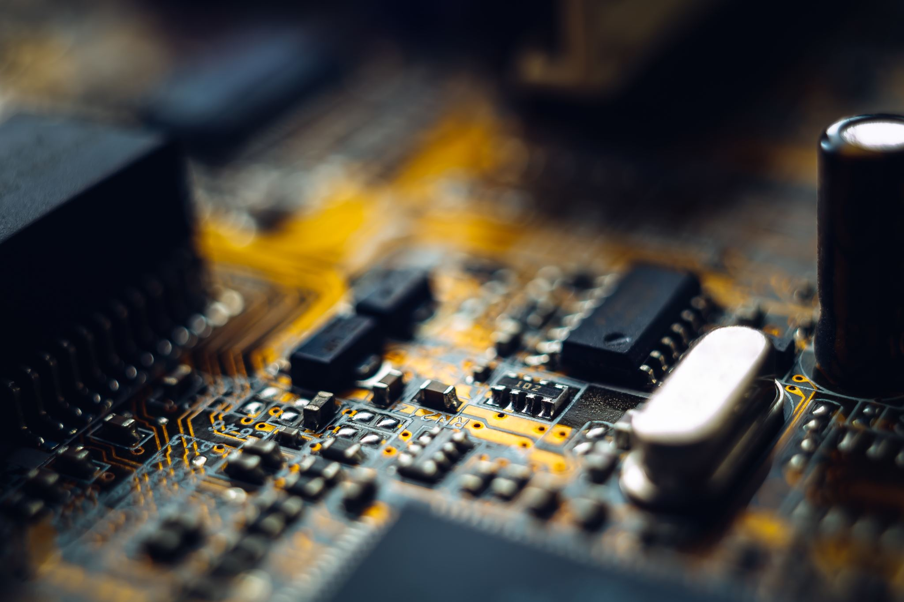
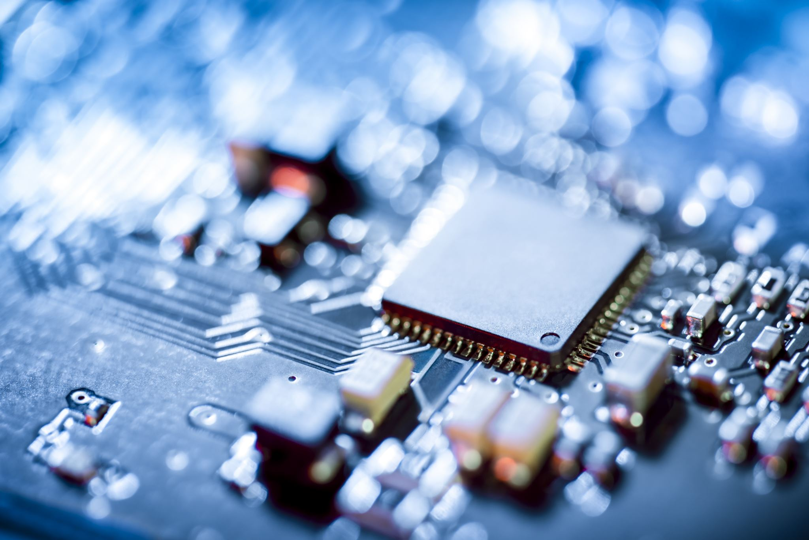
Day 0: C Programming - Introduction & Setup
2. What is C and Where is it Used?
Definition: C is a general-purpose, procedural programming language developed in the 1970s.
Sub-topics:
- Features: Fast, low-level memory access, structured language.
- Where it's used:
- Operating systems (UNIX/Linux)
- Embedded systems
- Microcontrollers
- System-level programming
By Larry

Slide 5
Day 0: C Programming - Introduction & Setup
3. Structure of a Basic C Program
#include<stdio.h>
int main() {
printf("Hello, World!\n");
return 0;
}
Sub-topics:
#include<stdio.h>: for input-output functions
int main(): Entry point
printf(): Print statement
return 0;
By Larry

Slide 6
Day 0: C Programming - Introduction & Setup
4. IDE Setup
You can teach Turbo C, Code::Blocks, or VS Code + GCC.
Turbo C:
- Traditional choice, simple for beginners
Code::Blocks:
- Clean UI, built-in compiler
VS Code + GCC:
- Modern and flexible
- Install VS Code, GCC
- Setup environment variables
- Install C/C++ extensions
By Larry

Slide 7
Day 0: C Programming - Introduction & Setup
5. Write and Run First Program
#include<stdio.h>
int main() {
printf("Hello Larry Batch!\n");
return 0;
}
Demonstrate:
- Save .c file
- Compile and run
- Show common syntax errors
By Larry

Slide 8
Day 0: C Programming - Introduction & Setup
Hands-on Practice
- Print your name using printf()
- Print Welcome message
- Create a syntax error and explain how to fix it
By Larry

Slide 9
Goals for the Day
- Understand what programming and C are
- Compile and run basic programs
- Understand program structure
- Get familiar with an IDE

