Slide 1
Detailed Project Report
Spam Ham Classifier

Slide 2
Objective
Development of a predictive model for classifying text as Spam or Ham.
The model will detect and filter the spam emails or SMS.
A web app will be created which will take input from the user in the form of text and almost instantly user will get to know whether the given text is a Spam or Ham (Not Spam).

Slide 3
Data Sharing Agreement
Sample file name
Number of columns : 2
Column names : Label & Message
Column Data Type : Object

Slide 4
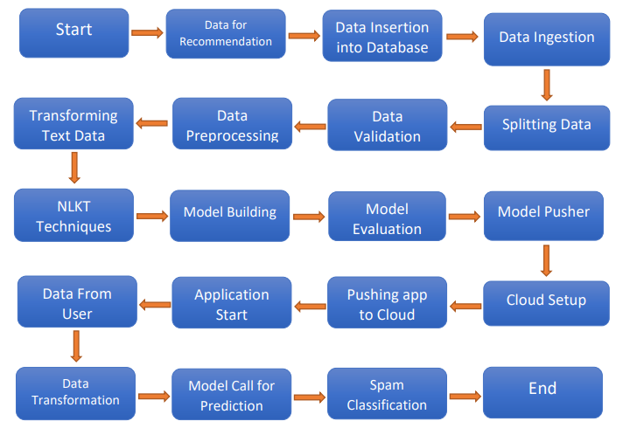
Architecture

Slide 5
Data Insertion in Database
Data is dumped in MongoDB in JSON format.
Database Name : SpamProject
Collection Name : classifier
All the records in the file are inserted into database.

Slide 6
Data Ingestion
Loaded data from MongoDB as a DataFrame (tabular format).
Saved the DataFrame in csv file in original state in a separate directory.
Split the DataFrame in Train and Test set.
Saved these two sets in another directory.

Slide 7
Data Validation
Number of Columns – Validation of number of columns present in the files and if it doesn’t match then the report will be generated.
Column Datatypes – The datatype of columns is supposed to be of Object type. If is validated when we insert the files.

Slide 8
Data Pre-Processing
Removal of Duplicated values.
Null values handling.
Using NLTK techniques to transform the text : Lower case text, Stop Words Removal, Punctuation Removal, Tokenization & Stemming.
Used TF IDF to vectorize the words in data.
Saved the file as array, transformer object & target encoder object.

Slide 9
Model Training
Loaded the transformed array from Data Pre-Processing step.
Split the data into train, test.
After running various algorithms “MultinomialNB” turned out to performed best on these parameters:
Max Accuracy Score (97.5%)
Max Precision Score (100%)
Least False Positive Value of Confusion Matrix (Zero).

Slide 10
Model Evaluation & Pusher
Using Test file, we evaluate the ongoing model with a new model.
If new one works better then we get notified on the same and we replace with old one, else we let previous one running.
In Model Pusher, we saved the following files in latest directory:
Model file
Transformer Object
Target Encoder Object

Slide 11
Deployment
We used Streamlit Cloud service for deployment.
Streamlit provided simple and quick running web based app.
Customized the Streamlit framework as per the requirement:
A text field
A button
Display result

Slide 12
Prediction
On web app, user inputs the text in the given area.
Text then passes through pre-processing phase.
Pre-Processed text passed through MultinomialNB model and based on the trained set, model classifies the text as Spam or Ham.
Same result will be shown in form of pic on web app as Spam or Not Spam, within a second.

Slide 13
Q n A : 1
Q1. What’s the source of data?
The corpus has been collected from free or free for research sources at the internet like Grumbletext website, National University of Singapore & Caroline Tag’s PhD Thesis.
Q2. What was the type of data?
The datatype of both the columns was Object (str or mixed).
Q3. What’s the complete flow you followed in the project?
Please refer to slide #4 : Architecture
Q4. How logs are managed?
All the components mentioned above had different logging which were combined in single log file.

Slide 14
Q n A : 2
Q5. What step you took for file validation?
Right after file validation completes, a .yaml file is generated which shows the entire report of our validation. If there’s anything mismatches then exception get raised.
Q6. What steps you took for data pre-processing?
Removed Null Values
Handled Duplicated Values
Used NLTK package to transform the text and get rid of unwanted texts or punctuations from the corpus.
We used TFIDF as vectorizer and limited it to top 3000 features so as to enhance the accuracy of model.
We had some outliers but they weren’t removed because they come out to be a part of data.

Slide 15
Q n A : 3
Q7. How training was done or what models were used?
We split the data into training and test part.
Dozens of ML Algorithms were used and tweaked in order to get the max accuracy & precision score.
Multinomial Naïve Bayes algorithm proved to work best and quick as compared to other models. Then we saved this winner.
Q8. How Prediction was done?
Text received from the user on web app is passed through the transformation step and then to model training step to get the prediction. In the end we display the same result to the user on front page of web app.

