Slide 1
advanced computer networks
21AIE302
END SEMESTER PROJECT
BATCH - B
GROUP - 5

Slide 2
GROUP MEMBERS:
01
BALASURIYA R
CB.EN.U4AIE21105
02
NATTUVA BHAVYA RUPA
CB.EN.U4AIE21140
03
NAVUDURI SAMEER
CB.EN.U4AIE21141
04
YALAVARTHI HIMA
CB.EN.U4AIE21178

Slide 3
PROBLEM-1

Slide 4
Introduction
The advent of 5G networks brings unprecedented challenges, including handling massive volumes of data, dynamic network behavior, and the need for real-time decision-making.
Existing Self-Organizing Network (SON) approaches, relying on expert knowledge, struggle to cope with the scale and dynamism of 5G data, hindering efficient network management.
To address these challenges, a Big Data Empowered SON (BSON) framework emerges, leveraging machine learning and analytics to transform raw network data into actionable insights.
BSON aims to proactively predict network behavior, optimize performance, and ensure efficient decision-making within the complex and dynamic 5G ecosystem.
Through data-driven modeling and real-time monitoring, BSON empowers networks to adapt, predict, and preemptively respond to the evolving demands of 5G, revolutionizing network management.

Slide 5
Related work
WORK | ADVANTAGE | DISADVANTAGE | GAP ADDRESSED
Challenges in 5G: Empowering SON with Big Data (2015) | Highlights key challenges and potential solutions, provides a roadmap for BSON development. | High-level overview, lacks concrete implementation details. | Requires further research on specific data analytics algorithms and their integration with SON engine.
Federated Learning for BSON in 5G (2021) | Improves privacy protection and reduces data transfer overhead. | Requires careful design of communication protocols and aggregation algorithms for distributed learning. | Needs further research on federated learning's scalability and robustness in large-scale 5G networks.
Blockchain-based BSON for 5G Security and Trust (2022) | Enhances data security and transparency, facilitates trust between network entities. | Introduces additional complexity and potential performance overhead. | Needs further research on efficient blockchain integration with BSON and its impact on network performance.
Towards Explainable AI for BSON in 5G (2023) | Provides insights into network behavior and reasoning behind SON actions. | Requires development of XAI techniques specifically tailored for BSON applications. | Needs further investigation on the trade-off between model complexity and explainability in BSON.
Edge Computing for BSON in 5G (2023) | Reduces latency and improves network responsiveness. | Requires careful resource allocation and workload scheduling at the edge. | Needs further research on efficient edge-based BSON algorithms and their impact on network resource utilization.

Slide 6
Problem Statement
The challenge lies in the transition to 5G networks, where the volume, variety, and velocity of data demand a shift from manual processing to automated analysis.
The existing approach, relying on expert knowledge in cellular systems, faces inadequacies in handling the massive and dynamic nature of big data in 5G.
This necessitates the development of a Big Data Empowered SON (BSON) framework, utilizing machine learning and analytics to transform raw data into actionable insights.
The goal is to enable proactive network management, predicting system behavior, and addressing dynamicity, pivotal for meeting the demands of evolving 5G networks.

Slide 7
Proposed Methodology
Data Gathering and Aggregation:
Source Integration: Collect data from diverse network sources, aggregating it into a centralized repository.
Big Data Handling: Utilize specialized telecom products for scalable data processing and management, accommodating the volume and heterogeneity of 5G network data.
Transformation of Big Data:
Classification and Unification: Apply statistical methods (e.g., Fisher score, Pearson correlation) to classify and unify Performance Indicators (PIs) into Key Performance Indicators (KPIs) aligned with Operational and Business Objectives (OBOs).
Ranking and Filtering: Rank KPIs based on significance and impact, filtering out low-impact KPIs to simplify subsequent analytics.
Association Mining and Dimensionality Reduction: Use techniques like multidimensional scaling to establish relationships between KPIs and Network Parameters (NPs) across OBOs, reducing computational load and latency.

Slide 8
Proposed Methodology(Contd)
Modeling for System Behavior:
Dynamic Behavior Models: Shift from static methods to dynamic machine learning approaches (e.g., concept drift) to model the evolving wireless ecosystem.
Concept Drift Implementation: Employ time-evolving stream classifiers with drift detection mechanisms to react in real-time to changes in network behavior.
Summarization Techniques: Store summaries of evolving information using sketching and aggregation, updating classifiers upon change detection.
Handling Dynamicity: Leverage ensemble classifiers and option trees for data stream mining, allowing for real-time insights into dynamic network behavior.
Proactive Network Management with BSON:
Real-time Monitoring and Prediction: Utilize concept drift to proactively warn about potential abnormalities or performance degradation in evolving cellular states, preventing operational disruptions.
Agile Decision-making: Reduce latency and computational load by employing low-dimensional embedding techniques, facilitating proactive SON operations in 5G networks.

Slide 9
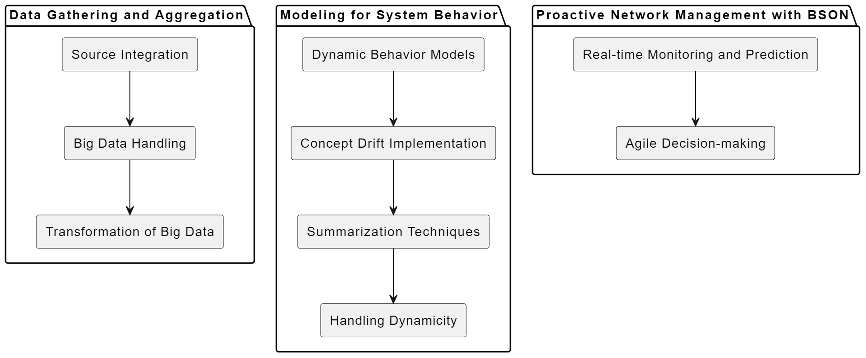
Block Diagram

Slide 10
Tools Identified
5G-EmPOWER is the best tool for putting the Big Data Empowered SON concept into practice. Because of its SDN/NFV architecture base, BSON can integrate and deploy a wide range of network operations with ease, which is essential given its dynamic nature
With realistic network simulation, strong support for network slicing, and open-source adaptability, 5G-EmPOWER provides a complete environment for exhaustive validation and ongoing BSON enhancement. Amidst the dynamic terrain of evolving 5G networks, the active community backing guarantees consistent updates and bug corrections, creating a perfect venue for the framework's validation and refinement.

Slide 11
Conclusion and Future works
By utilising big data and machine learning to anticipate and resolve network issues, the BSON architecture presents a paradigm leap in 5G network management.
BSON makes proactive network management, behaviour prediction, and performance optimisation possible by converting unprocessed data into actionable insights.
This methodology represents a crucial advancement, enabling networks to effectively and dynamically adjust to the intricacies of the 5G terrain.
BSON sets the stage for network operations that are ready for the future, guaranteeing resilience, efficiency, and agility in the face of the 5G era's swift changes.
By implementing proactive tactics instead of reactive ones, increasing productivity, and satisfying the needs of next-generation networks, BSON changes network management.

Slide 12
PROBLEM-2

Slide 13
Introduction
The introduction of 5G technology has brought revolutionary possibilities to the field of vehicular ad hoc networks (VANETs), especially in terms of guaranteeing efficient and safe communication.
Ensuring strong security measures has become crucial with the integration of Smart Grid (SG) technology into Vehicular Ad hoc Networks (VANETs).
Resilient security frameworks are necessary because of the urgency and significance of timely, secure video reporting services within VANETs, particularly during accidents or for traffic monitoring.
Using cloud platforms in conjunction with heterogeneous networks may provide benefits like lower latency and increased availability for urgent video reporting services in VANETs.
The vulnerabilities that have been identified draw attention to the security gaps that currently exist in VANET infrastructures. These vulnerabilities include the vulnerability to replay attacks, message fabrication, and potential Denial-of-Service (DoS) threats.

Slide 14
Related Work
WORK | ADVANTAGES | DISADVANTAGES | GAP ADDRESSED
Efficient Cloud-Assisted Message Dissemination by Wang et al. (2016) | Fast video delivery by cloud platform | Lacks user anonymity and traceability | Conditional privacy and user traceability with PASS scheme
 | Secure and privacy-aware cloud-assisted reporting | - Vulnerable to replay, message fabrication, and DoS attacks | - Replay attack resistance with random nonces
Lightweight and secure video streaming in 5G by Liu et al. (2018) | - Efficient for mobile users | - High computation cost for encryption/decryption | - Reduced computation cost with ABE scheme
Blockchain-based secure data sharing in VANETs by Li et al. (2019) | - Tamper-proof data storage and verification | - High overhead and scalability issues | - Improved system availability with 5G and heterogeneous networks
Privacy-preserving video sharing in VANETs by Zhang et al. (2020) | - Pseudonymous authentication for privacy | - Vulnerable to man-in-the-middle attacks | - Resistance to man-in-the-middle attack with digital signatures

Slide 15
Problem Definition
Eiza et al.'s secure and privacy-aware scheme for video reporting in SG-enabled VANETs, while promising for availability and low latency, is vulnerable to security attacks. These attacks include:
Replay attacks: Malicious actors can replay captured messages to disrupt communication or spread misinformation.
Message fabrication attacks: Attackers can forge messages to impersonate legitimate users and inject false information into the network.
DoS (Denial-of-Service) attacks: Attackers can flood the network with fake messages to overwhelm resources and render the service unusable.
These security vulnerabilities raise concerns about the privacy, confidentiality, and reliability of the video reporting service, potentially hindering its effectiveness in VANETs.

Slide 16
Previously existing work
The participant vehicle Cv encrypts the video using symmetric encryption key
Cv creates a searchable encryption using recipient’s public key and a set of keywords
Now Cv encrypts the symmetric encryption key so that only an intended recipient with a specific private key can decrypt it
Cv now signs the message which consists of encrypted video, searchable keyword etc..) with a pseudonym certificate
Cv uploads the message including the encrypted content to cloud platform
Upon the video upload, the cloud platform verifies the integrity of identifier h(U) and notifies the nearest designated vehicle (Dvi)
Dv verifies the validity of the pseudonym certificate and signature
If its valid, Dv extracts the symmetric encryption key
Then, Dv decrypts the received video

Slide 17
Previously existing work(contd)
LEA(Law enforcement agencies) private key, generates a searchable trapdoor for retrieving a specific video from cloud based on a keyword
LEA sends the trapdoor to the cloud platform
Cloud platform checks the received trapdoor against the ciphertext stored messages(already encrypted video)
If the match is found, then the cloud platform sends the corresponding video content to LEA

Slide 18
Proposed Methodology
Cv initiates the registration process by sending a registration request
DMV(department of motor vehicles) verifies the registration request and forwards the users request to TA(trusted authority)
TA generates the pseudonymous certificates to be used within the system containing the private key, public key for ABE(attribute-based encryption), set of random numbers
Random numbers prevent replay attacks because it changes for each certificate
DMV delivers pseudonym certificate of Cv
Now Dv also sends a registration request and a certificate will be issued by TA. Dv registers for the cloud platform as well

Slide 19
Proposed Methodology(contd)
Using Cv’s private key, it generates a signature for message content. The content signed includes concatenated hash of several components. The message uploaded to the cloud includes
Encrypted content of the video
Searchable keyword
Random number of the pseudonym certificate
H(U)-hashed tag ‘U’
H(*)U-Hmac function applied to all message content using U as a secret key
Hmac function verifies that the received message remains unchanged and unaltered during transmission
Now Cv uploads the message to cloud platform containing all the above

Slide 20
Proposed Methodology(contd)
Cloud platform verifies the integrity and authenticity of h(U) and H(*)U, ensuring the validity of these components within uploaded messages
The cloud checks if the recorded index (random number) already exists. If its not a re-upload, then notification will be sent to the nearest official vehicle Dv
Dv verifies the received video similar to the previous method. If the validity of the report ids compromised at any step, Dv reports to nearest LEA.
The video will then be retrieved similar to previous method

Slide 21
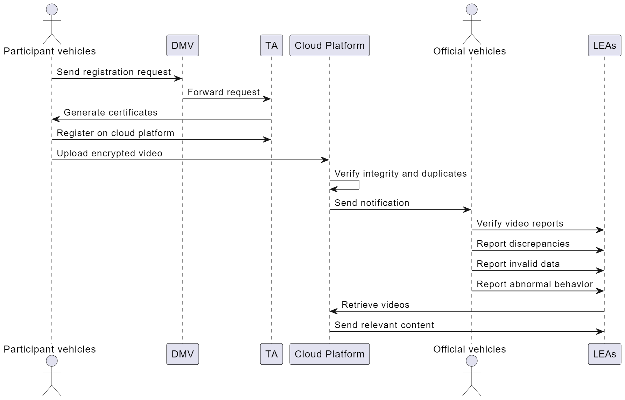
Block Diagram

Slide 22
Tools Identified
VanetSim: An open-source VANET simulator that can be used to model the proposed protocol and evaluate its performance in terms of communication overhead, latency, and security against attacks like replay, message fabrication, and DoS.

Slide 23
Conclusion and Future Works
Finally, the protocol that has been suggested is meant to strengthen the security of the video reporting scheme developed by Eiza et al. in SG-enabled VANETs.
In order to mitigate weaknesses such as replay attacks, message fabrication, and denial-of-service threats, the protocol makes use of a combination of cryptographic algorithms, pseudonymous certificates, and secure communication channels.
The implementation of techniques like cloud-based validation and random number distribution is done to improve the dependability and integrity of video reporting services.
Future work:Implementing AI-powered anomaly detection systems within vehicular networks to enhance security and mitigate potential threats or abnormal behaviors.

Slide 24
PROBLEM-3

Slide 25
Introduction
Service types and network configurations are exposed, leaving user data vulnerable to unauthorized access.
User identities and usage patterns can be revealed during authentication and service access.
Lack of security and privacy discourages the adoption of IoT services in 5G networks.
We have tried to implement a solution to overcome the above challenges which consists of the following
Network slicing with hidden details: Physical network resources are divided into slices with specific features, but details are hidden using protected identifiers.
Partial service tickets and key negotiation: Access control is delegated through partial tickets, concealing sensitive information. Secure session keys are established for communication without revealing identities.
Anonymous authentication with hidden network choices: Users present authenticated messages with hidden allowed network slice options. Service providers can route messages without knowing the specific service type, protecting user privacy.

Slide 26
Related Work
WORK | ADVANTAGE | DISADVANTAGE | GAP ADDRESSED
Eiza et al. (2018): Anonymity for real-time video reporting in VANETs | Protects vehicle identity, enables misbehavior traceability | Limited to specific application (VANETs) | N/A
Duan and Wang (2019): Efficient authentication for fast handovers in 5G hetnets | Reduces handover delay, simplifies authentication procedure | Ignores network slicing and fog computing | Lacks service-oriented approach
Rost et al. (2019): Scalability and flexibility of network slicing in 5G | Highlights potential security vulnerabilities in sliced networks | Doesn't propose solutions for secure service authentication | Gaps in slice selection and service access privacy
Yan et al. (2020): Security and trust framework for 5G networks | Adaptive trust evaluation and sustainable security technologies | Focuses on overall network security, not service-specific authentication | Lacks delegation and key agreement for specific services
Liang et al. (2021): Information-centric wireless network virtualization for resource balancing | Optimizes resource allocation based on user and service provider needs | Doesn't address user privacy and secure communication channels | Lacks identity verification and key management for service access

Slide 27
Problem Definition
Existing methods for accessing IoT services in 5G networks lack sufficient security and privacy guarantees.
Security concerns: Service providers and network operators can potentially access sensitive user data or track user activity due to the exposure of service types and network slice configurations.
RRH(remote radio head) and BBU(Baseband unit) which are the intermediate nodes capture the authentication messages and service data about local users which can be used to predict mobility patterns and extract sensitive information about users

Slide 28
Proposed Methodology
System Initialization:
The 5G operator sets up the network parameters and generates secret/public key pairs for itself, the IoT server (ISV), and the local controller.
Network Slicing:
The physical network is divided into slices with specific features and service types.
The core network hides these details by generating protected network slice/service type identifiers (PSi) and protected feature values (ACFi).
The controller maintains these identifiers to select appropriate slices for service packages.
5G Network Access:
The user generates its secret/public key pair and performs standard 3GPP registration and authentication procedures to access the 5G network.
This process grants the user network access credentials and subscription information, including allowed network slice selections.

Slide 29
3GPP (3rd generation partnership project):
3GPP registration Process: 1) Attach procedure
2) Identity exchange
3) Authentication
4) Location update
5) assigning temporary identity
6) Netwok access credentials

Slide 30
Proposed Methodology(contd)
Service Delegation:
To access an IoT service, the user sends a request to the 5G network.
The network identifies eligible network slices and generates a partial service ticket (PSTi) for the user.
The PSTi is forwarded to the ISV, which creates a full service ticket (STi) containing session information, service credentials, and a key negotiation tag.
Service Authentication:
The user presents the STi and an authenticated key agreement message (AKAi) to the service provider.
The AKAi includes hidden allowed network slice identifiers (PAS) which enable the controller to route the message without knowing the specific service type.
The ISV verifies the AKAi and service credentials to grant access to the service while maintaining user anonymity.
A new key negotiation tag is generated for secure communication with the service.

Slide 31
Proposed Methodology(contd)
Key Negotiation:
The controller and the ISV exchange key negotiation tags with the user to establish a secure session key (ski) for encrypted communication and service access.

Slide 32
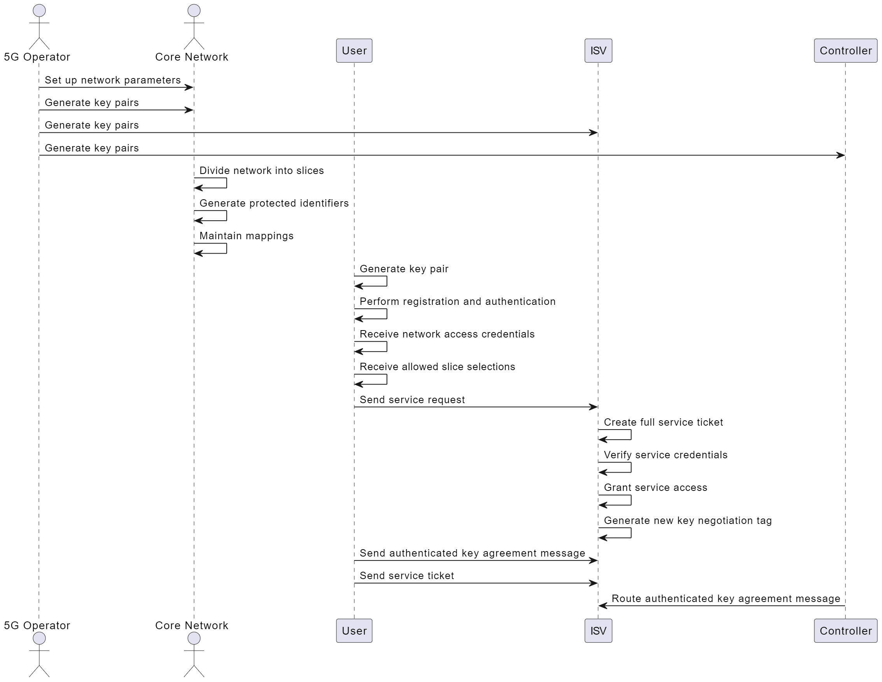
Block diagram

Slide 33
Tools Identified
NS-3, a powerful network simulation tool, enables the evaluation of advanced security protocols like network slicing and partial service tickets to enhance privacy and thwart unauthorized access in 5G IoT networks.

Slide 34
Conclusion
Overall the method proposed addresses critical security and privacy concerns by employing:
Privacy-preserving slice selection: This mechanism hides the specific service types accessed by users, protecting their privacy.
Service-oriented anonymous authentication: Users can authenticate to IoT servers anonymously through delegation, ensuring anonymity while verifying their legitimacy.
Confidentiality of service data: Secure data channels are established for accessing service data stored on local fogs and remote servers.

Slide 35
Future works
Network slicing-based privacy-preserving authentication for roaming: We will design authenticated key agreement protocols for roaming scenarios, enabling users to access services across different network slices while preserving privacy.

Slide 36
PROBLEM-4

Slide 37
Introduction
Use cases of 5G such as
Enhanced mobile broadband – focusses on delivering higher data rates, increased network capacity and improve user experience
Ultra reliable low latency – applications such as autonomous driving, machine type of communication requires low latency and higher reliability due to immediate decision making need
Massive machine type communications – MMTC uses enhanced mobile broadband and ultra reliable lower latency technology for IOT applications

Slide 38
Problem Statement
PROBLEM STATEMENT:
To optimize resource allocation and improve system performance in terms of connectivity preservation, rate control, offloading, and meeting quality of service (QoS) requirements for different types of services. -- using deep reinforcement learning

Slide 39
Related work
WORK | DESCRIPTION | ADVANTAGE | DISADVANTAGE | GAP ADDRESSED
ORAN Alliance | Non-proprietary RAN architecture with interoperable components | Standardized, open-source | Lacks real-world implementation, limited research on AI integration | Need for specific use cases and AI algorithms tailored to ORAN architecture
Parallel DNN for User Association (e.g., [12]) | Improves decision-making for user-base station association | Faster learning, diverse exploration strategy | Complex architecture, high computation cost | Need for scalable and lightweight solutions for near-real-time resource allocation

Slide 40
Proposed Methodology
Architecture:
Non-real time RAN intelligent controller handles non real time functions; like network planning
Near real time RAN intelligent controller is responsible for dynamic changes in resource allocation
Network Slicing in ORAN architecture provides isolated resources for different slice category
Each slice consist of intelligent agent that takes care of optimizing KPI(key performance indicators)
Intelligent agents operate at the near real time RAN intelligent controller
Takes care of URLLC, MMTC, EMB services for 5G users

Slide 41
Proposed Methodology(contd)
System Model
Users can request for:
URLLC
eMBB
Each type of slice requested has their own QoS requirements.
Users can request different slice like URLLC, Embb and MMTC
Users are associated with ORAN radio unit, ORAN centralized unit, ORAN distributed unit
ORU acts as a transceiver with antennas whereas ODU and OCU are at higher level protocol layers
Algorithms such as IQRA and LIQRA focusses on improving the following metrics
SINR – signal to noise ratio
Physical Resource Blocks – efficient allocation of PBR to each slice
Capabilities of Radio units – optimization of ORU capacity
QOS – includes throughput and latency thresholds and overall enhances user experience

Slide 42
Proposed Methodology(contd)
IQRA:
IQRA is described as Intelligent agent based approach
Parameters considered- SINR, ORU, QOS
Intelligent agents : Agents analyze the wireless environment and customize decision-making parameters
Decision making is done by weighted values for the parameters that are learned from intelligent agents
Generates a database of user with ORU associations
The algorithm focusses on evaluating weighted values of parameters and estimates required parameters using the database
The estimation is taken care by Intelligent agents

Slide 43
Proposed Methodology(contd)
LIQRA (Low Complexity Intelligent Qos aware Resource Allocation)
Designed for intra slice radio resource management and reduced computational complexity
Makes decision based on snr and ORU metrics
Parameters Considered:
Considers SNR, which is the ratio of the power of the received signal to the background noise.
Introduces a global ORU metric (τg) that likely represents the overall suitability or performance of ORUs across the network.
Algorithm Steps:
Calculates SNR for each user with each available ORU using a specific formula.
Calculates the global ORU metric (τg).
Evaluates the combination of SNR and τg for each user-ORU pair.
Makes optimal association decisions based on the combined metric.

Slide 44
Proposed Methodology(contd)
The Agents:
The agents use a combination o deep Q learning and other DRL algorithms to make optimal decisions
The agents learn from their observations from the wireless communication environment
The agents are specifically designed to optimize resource allocation and management of radio access networks
Factors Considered:
Traffic Uncertainty: Accounting for uncertainties in network traffic patterns.
Connectivity Preservation: Ensuring the preservation of connectivity in the network.
Rate Control: Managing data rates efficiently based on network conditions.
Offloading: Considering the offloading of tasks or data to optimize network performance.

Slide 45
Objective: The primary goal of the agents is to maximize user-perceived throughput, enhancing the overall quality of experience for users in the wireless network.
The agents aim to minimize packet delay violations to ensure low-latency communication.
Reward Function:
The reward function plays a crucial role in guiding the decision-making process of the agents.
Rewards and Penalties: The agent is rewarded if QOS metrics are met if not it is penalized
Normalization: The reward is normalized by the threshold values themselves, ensuring that the reward reflects the relative success in meeting QoS requirements.
By optimizing the reward function, the intelligent agents aim to achieve optimal system performance.

Slide 46
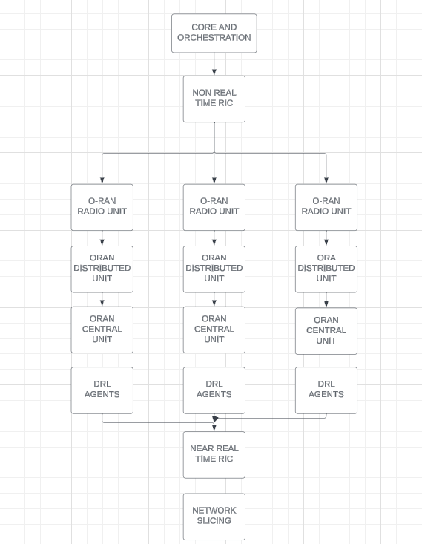
Block Diagram

Slide 47
TOOLS IDENTIFIED
Python (OpenAI-gym, Keras, Tensorflow): to simulate the DQN agents that learn to allocate the resources according to the slice requested by the user.
SyntheticNET: a 3GPP-standard compliant for wireless communication models

Slide 48
Conclusion
According to the results presented in the paper, the IQRA algorithm provides 11.5% and 7.42% improvement in throughput for eMBB slices compared to the baseline and state-of-the-art (SOTA) techniques, respectively.
On the other hand, the LIQRA algorithm improves latency by achieving a minimum latency value that is 45.5% less than the baseline approach. It also improves system throughput for eMBB slices by 6.7%. Overall, both IQRA and LIQRA algorithms outperform the baseline and SOTA approaches in terms of performance improvements

Slide 49
References
Problem-1:
https://r.search.yahoo.com/_ylt=AwrKB0RwcoBlne8aBle7HAx.;_ylu=Y29sbwNzZzMEcG9zAzEEdnRpZAMEc2VjA3Ny/RV=2/RE=1702945520/RO=10/RU=https%3a%2f%2fieeexplore.ieee.org%2fdocument%2f9322479/RK=2/RS=iMEoeWaWFCPcz3T7muRgySkuqNE-
https://r.search.yahoo.com/_ylt=Awrx._vAcoBlu5gc4.a7HAx.;_ylu=Y29sbwNzZzMEcG9zAzEEdnRpZAMEc2VjA3Ny/RV=2/RE=1702945601/RO=10/RU=https%3a%2f%2fwww.hindawi.com%2fjournals%2fwcmc%2f2022%2f7357820%2f/RK=2/RS=hJp_dXbZCbc2MDSKogPZNpBpoew-
https://r.search.yahoo.com/_ylt=AwrKDqPscoBl8Asf17K7HAx.;_ylu=Y29sbwNzZzMEcG9zAzEEdnRpZAMEc2VjA3Ny/RV=2/RE=1702945644/RO=10/RU=https%3a%2f%2ftechhq.com%2f2022%2f11%2fedge-computing-trends-in-2023%2f/RK=2/RS=971SDonu3GpOgl.Bni6L73plG7Y-
Problem 2:
https://r.search.yahoo.com/_ylt=Awr1TXljb4Bl9vkgvFC7HAx.;_ylu=Y29sbwNzZzMEcG9zAzEEdnRpZAMEc2VjA3Ny/RV=2/RE=1702944740/RO=10/RU=https%3a%2f%2feprints.whiterose.ac.uk%2f88240%2f1%2fcloud-vanet-b_4.pdf/RK=2/RS=OB1ghMcT7vjMGi2mun8UE.NcnU4-
https://r.search.yahoo.com/_ylt=AwrKEiKQcYBlQsUt24.7HAx.;_ylu=Y29sbwNzZzMEcG9zAzEEdnRpZAMEc2VjA3Ny/RV=2/RE=1702945297/RO=10/RU=https%3a%2f%2flink.springer.com%2fchapter%2f10.1007%2f978-981-19-7753-4_36/RK=2/RS=R50cKJft1ym1.bMvaXDxwweOnFg-
https://r.search.yahoo.com/_ylt=AwrKBU.2cYBlt58g7267HAx.;_ylu=Y29sbwNzZzMEcG9zAzEEdnRpZAMEc2VjA3Ny/RV=2/RE=1702945335/RO=10/RU=https%3a%2f%2flink.springer.com%2farticle%2f10.1007%2fs12083-023-01532-7/RK=2/RS=VcQF5oiZ4wzMwvoO6fQfNxX2MsU-

Slide 50
References
Problem-3:
https://r.search.yahoo.com/_ylt=Awr1TXn2cYBlTvAf1Ei7HAx.;_ylu=Y29sbwNzZzMEcG9zAzEEdnRpZAMEc2VjA3Ny/RV=2/RE=1702945399/RO=10/RU=https%3a%2f%2fieeexplore.ieee.org%2fdocument%2f7081072/RK=2/RS=bY.8UhPoddD_DgpgCnJwcL0BeQA-
https://r.search.yahoo.com/_ylt=AwrKBU8ccoBlbBAiNWy7HAx.;_ylu=Y29sbwNzZzMEcG9zAzEEdnRpZAMEc2VjA3Ny/RV=2/RE=1702945436/RO=10/RU=https%3a%2f%2fieeexplore.ieee.org%2fdocument%2f7926920/RK=2/RS=HsnmrPUQJTKojsEL2pgHrDarn1Y-
https://r.search.yahoo.com/_ylt=AwrKB0Q8coBlJEEaGde7HAx.;_ylu=Y29sbwNzZzMEcG9zAzEEdnRpZAMEc2VjA3Ny/RV=2/RE=1702945468/RO=10/RU=https%3a%2f%2fonlinelibrary.wiley.com%2fdoi%2f10.1002%2fsec.1243/RK=2/RS=wSVTl3v1nqI0H9DYGz.HX32kQus-
Problem-4:
https://r.search.yahoo.com/_ylt=Awr1QPpVcYBlp1EhnRq7HAx.;_ylu=Y29sbwNzZzMEcG9zAzEEdnRpZAMEc2VjA3Ny/RV=2/RE=1702945237/RO=10/RU=https%3a%2f%2fwww.sciencedirect.com%2fscience%2farticle%2fpii%2fS1046202322002353/RK=2/RS=khPPq309ZZtYnmBHKuVKWH8YTuY-
https://www.sciencedirect.com/science/article/abs/pii/S1389128623003821
https://ieeexplore.ieee.org/abstract/document/9851417

Slide 51
THANK YOU!!

