Slide 1


NBA player’s score prediction – Team 02
Presented by:
Hima Sri Chunchu

Slide 2

Motivation
Like the Indian Premier League (IPL) captivates cricket enthusiasts with its dynamic gameplay and unexpected twists, the NBA mesmerizes fans worldwide with its blend of athleticism, strategy, and raw talent.
Join us as we dive into the world of NBA predictions, where every game becomes an opportunity to test our foresight, celebrate the sport's unpredictability, and revel in the sheer joy of basketball mastery

Slide 3
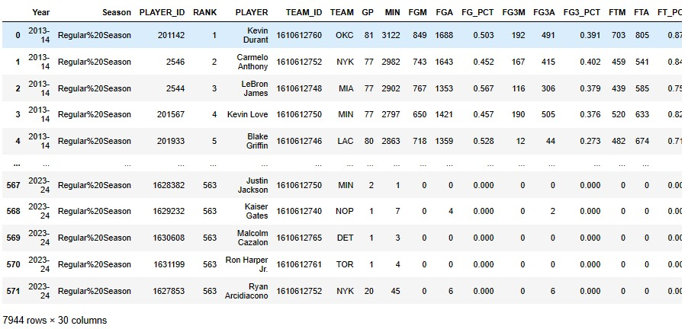
Web Scrapping (Extra Work)

Slide 4

Before Cleaning

Slide 5


FYI....

Slide 6
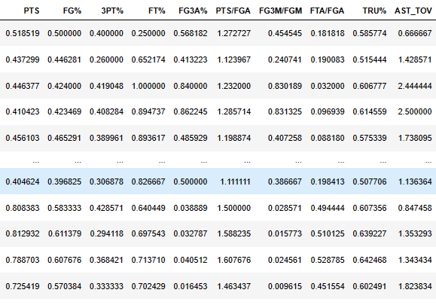
Feature Engineering:

Slide 7
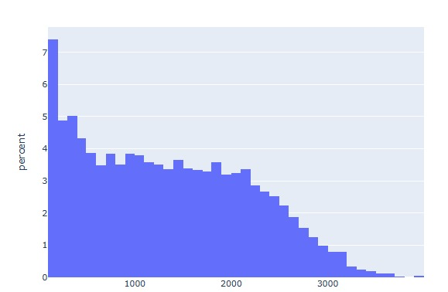
Distribution of players with minutes played

Slide 8

After Cleaning:

Slide 9
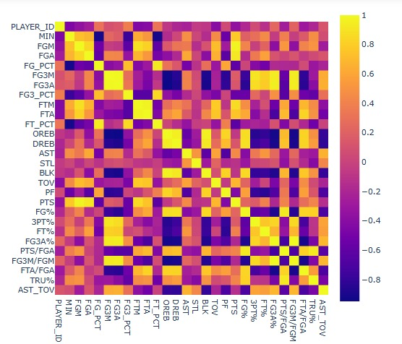
Correlation map

Slide 10
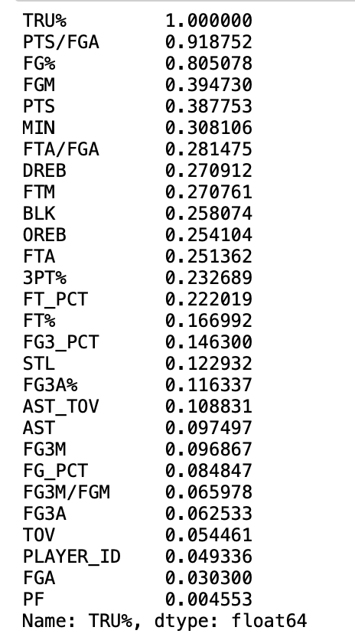

Results of Linear Regression:

Slide 11
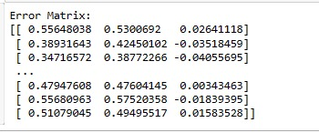
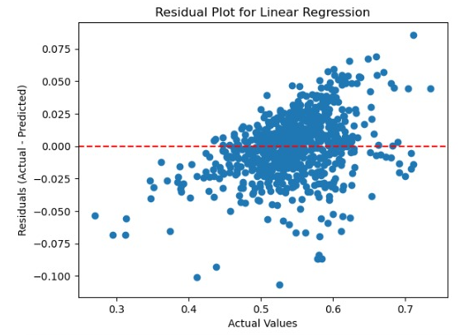
Error matrix and graph

Slide 12
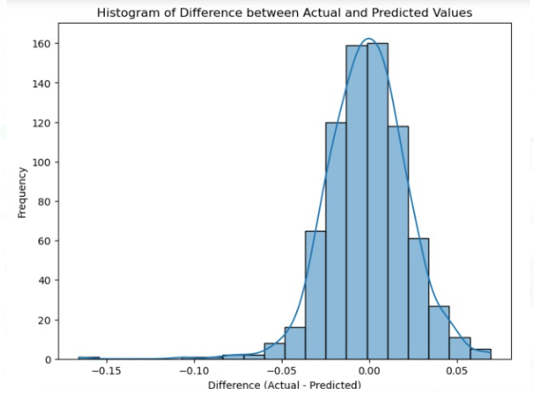
Histogram

Slide 13
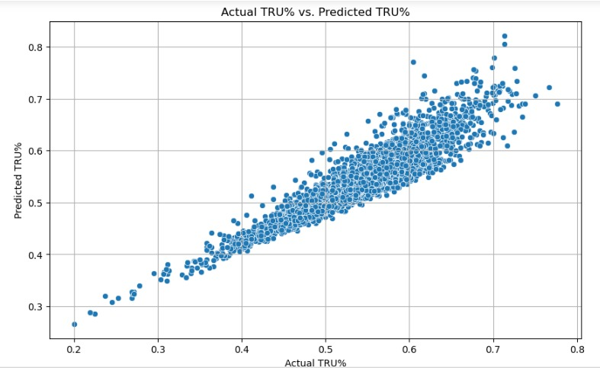
Actual TRU% VS Predicted TRU%

Slide 14
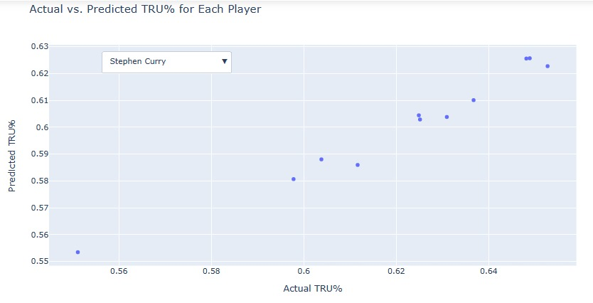
Actual TRU% VS Predicted TRU% (Individual)

Slide 15




Predicted TRU% For Next Year

Slide 16
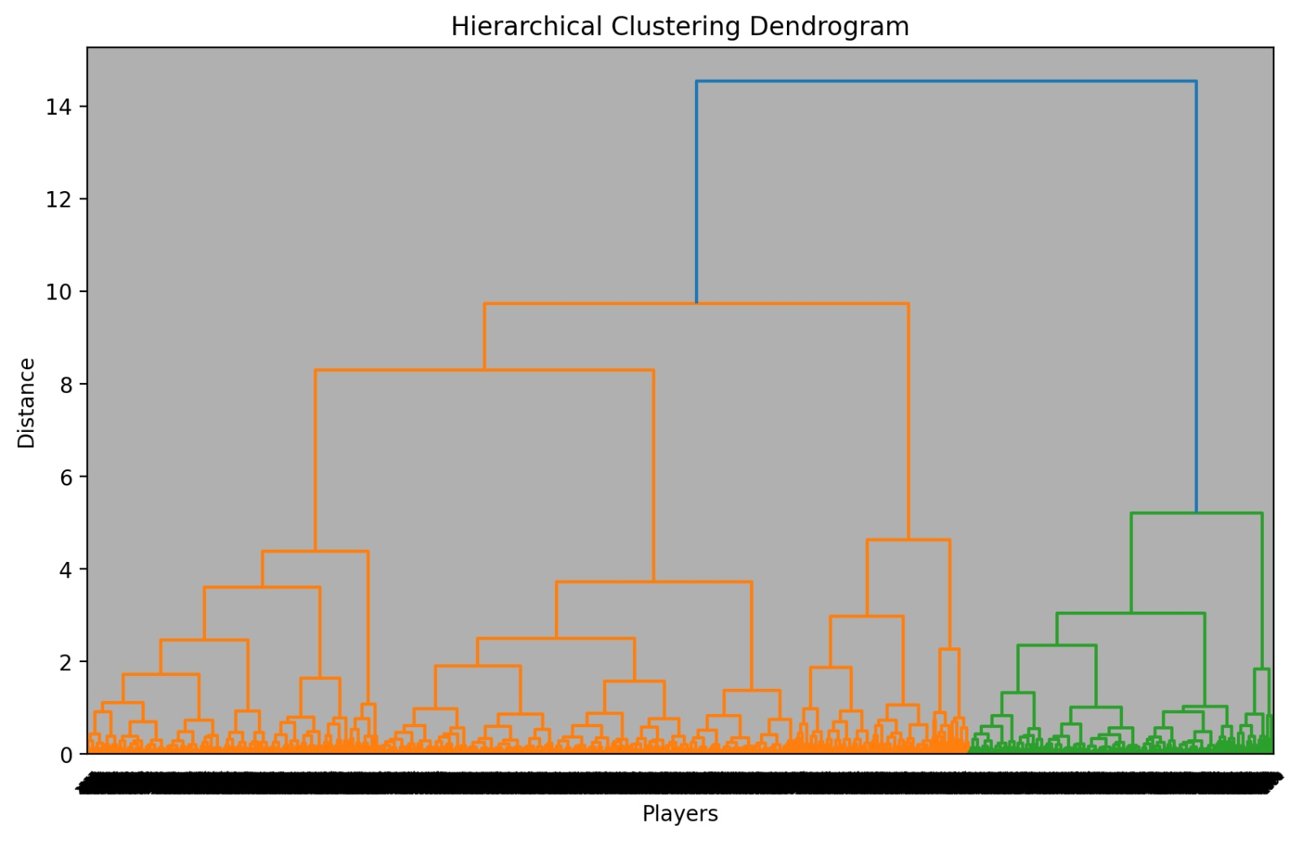
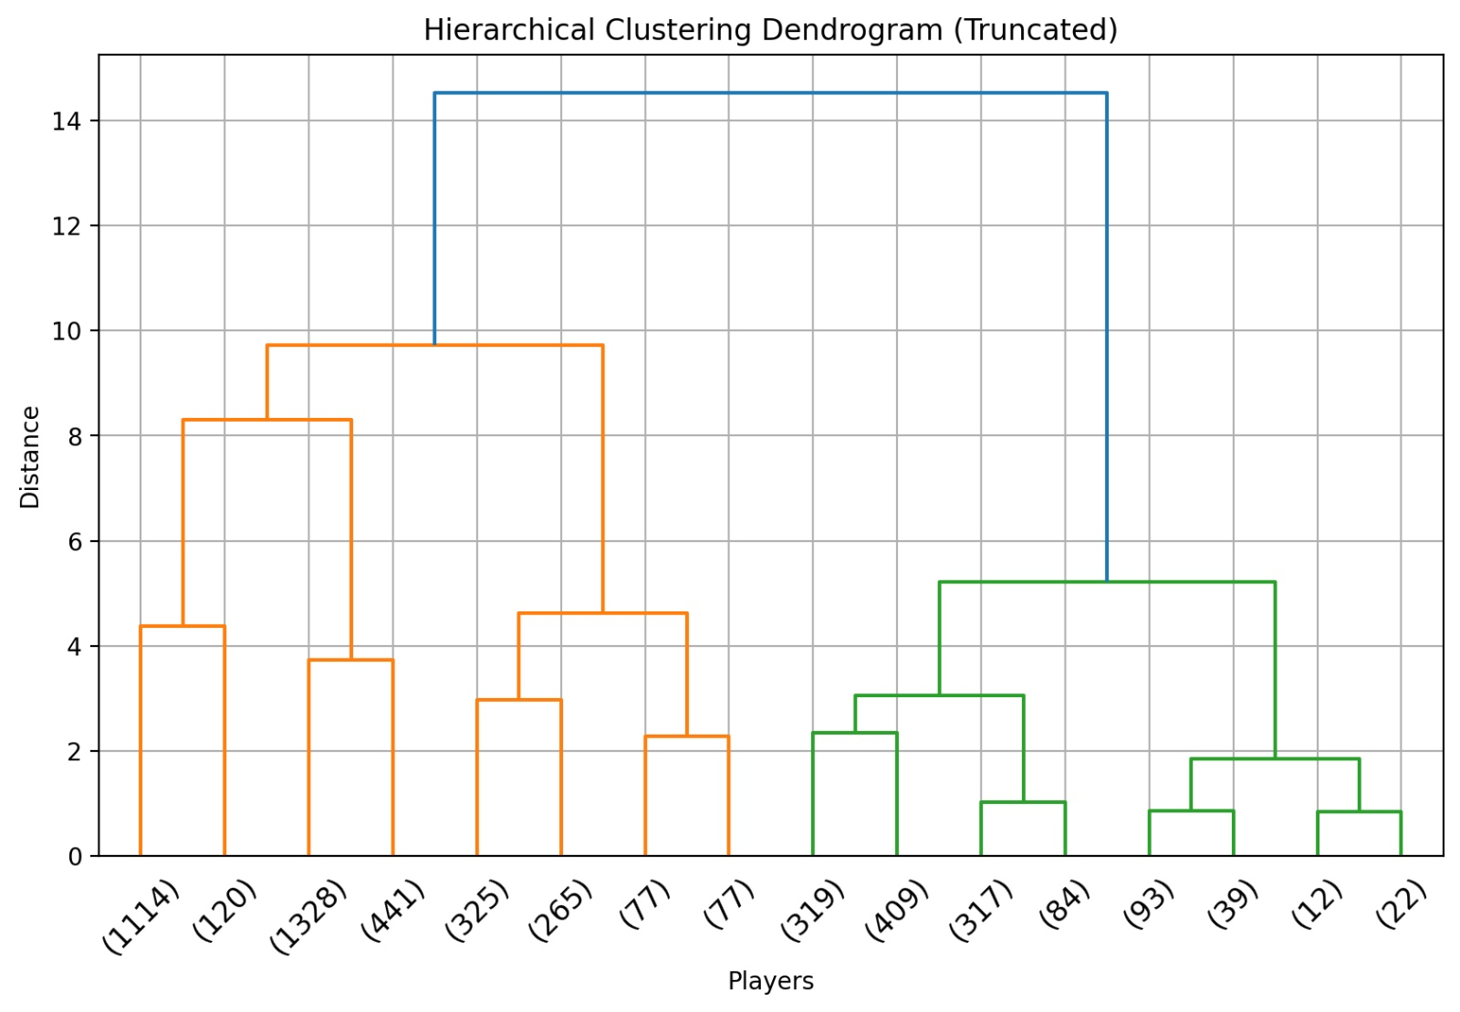
Hierarchal Clustering

Slide 17
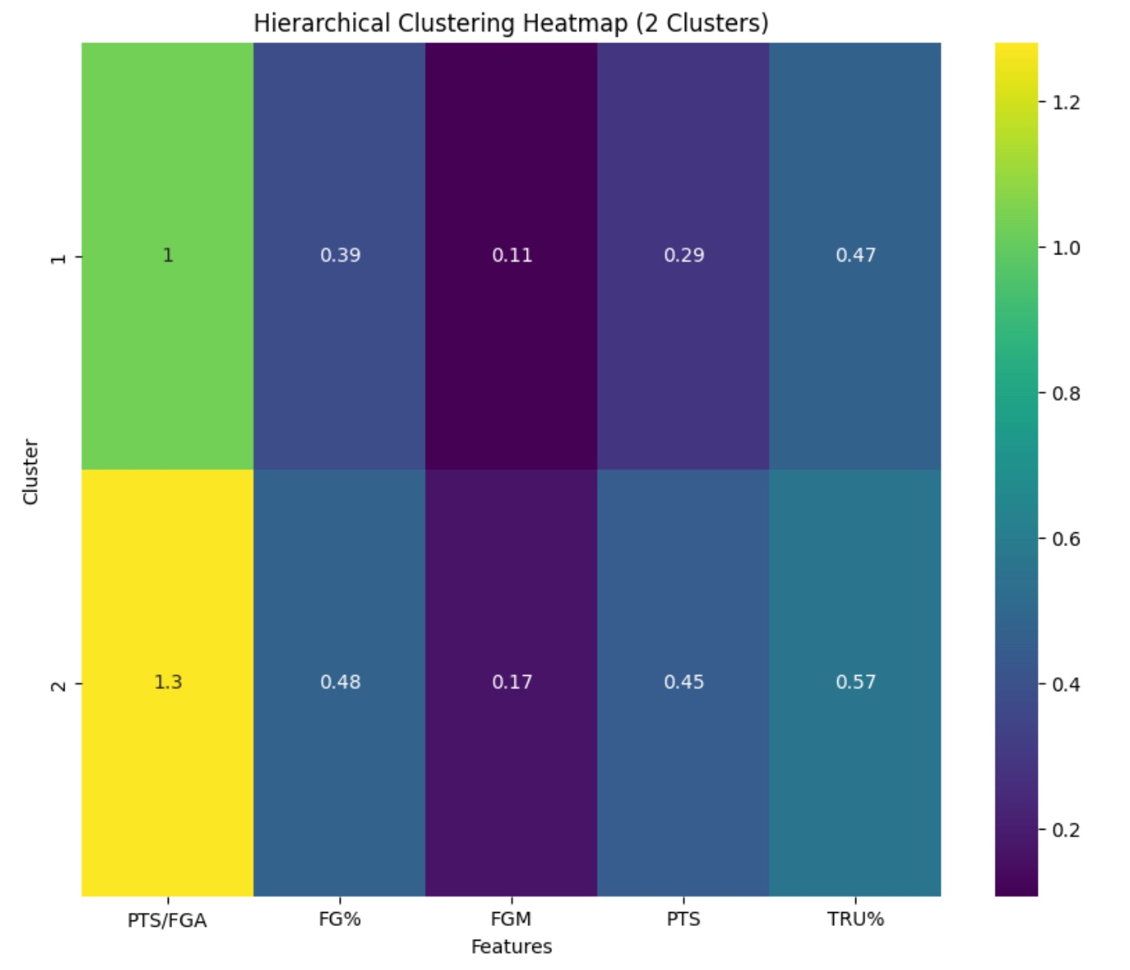
Hierarchal Clustering – Heat map

Slide 18
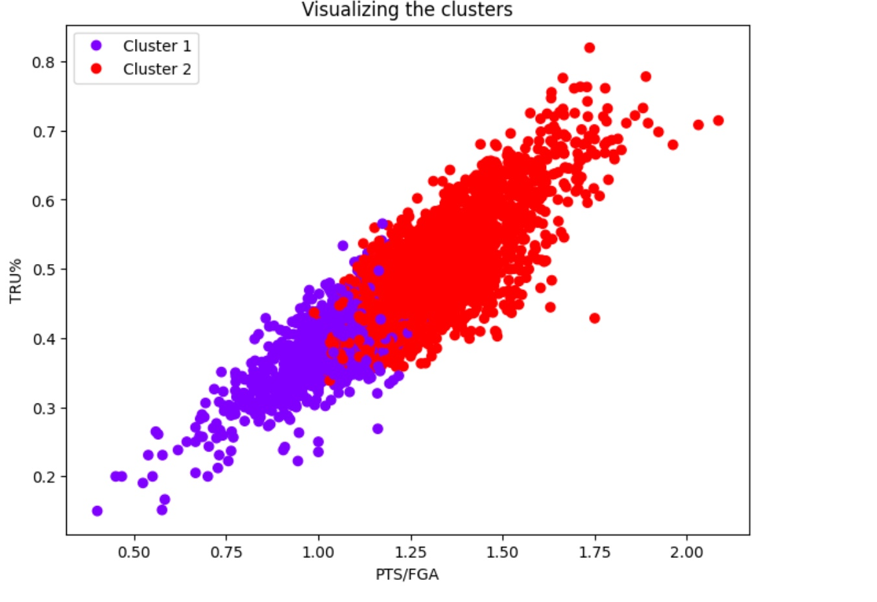
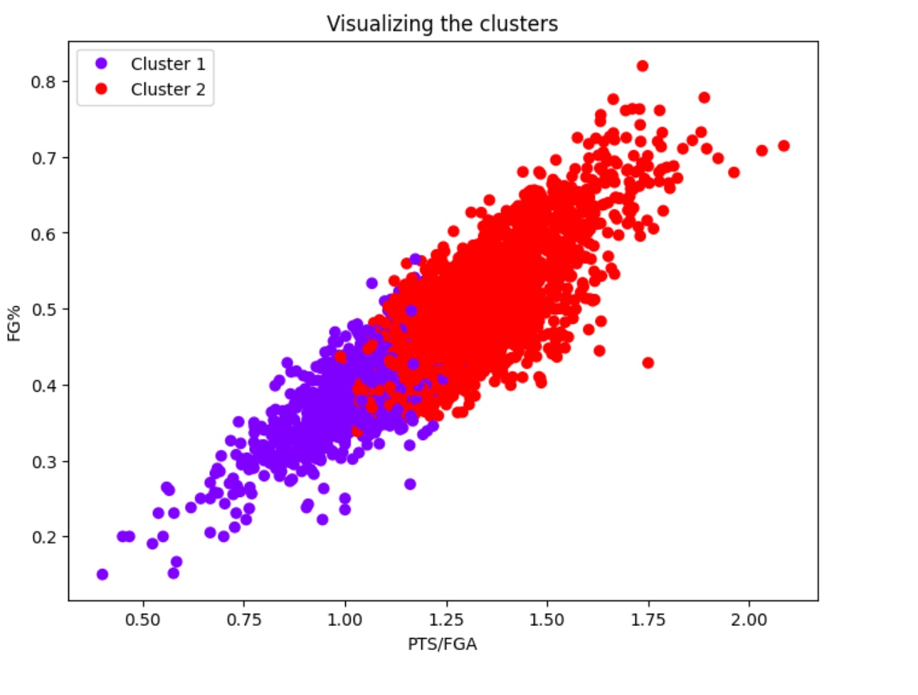
Hierarchal Clustering

Slide 19
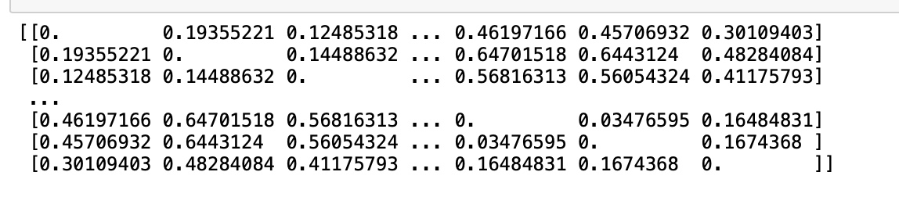
Distance Matrix

Slide 20
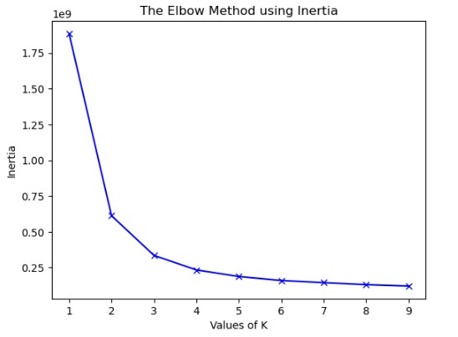
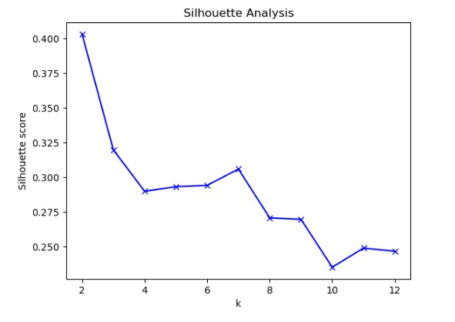
Elbow and Silhouette Analysis

Slide 21
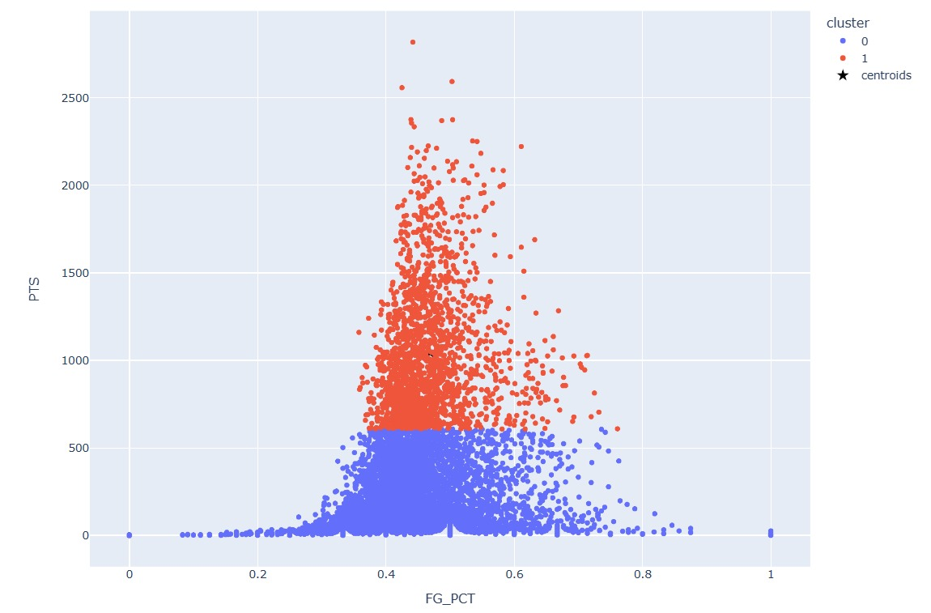
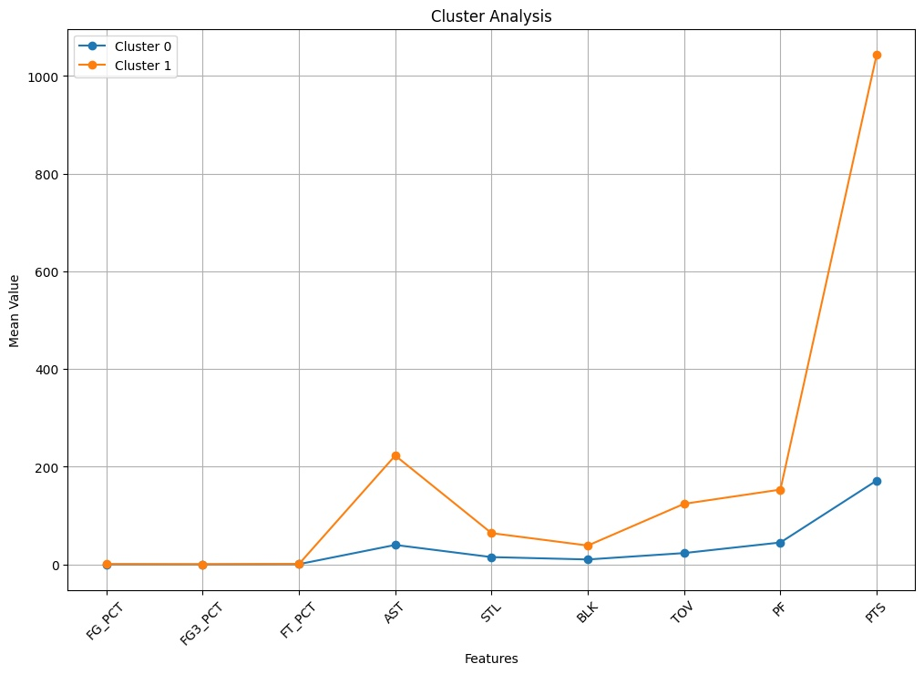
K-NN Clustering

Slide 22
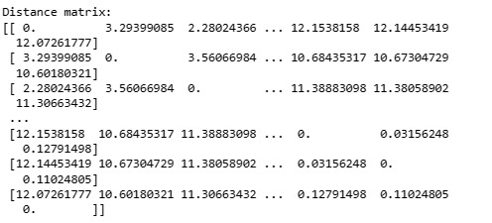
K-NN distance Matrix

Slide 23

Text Mining

Slide 24
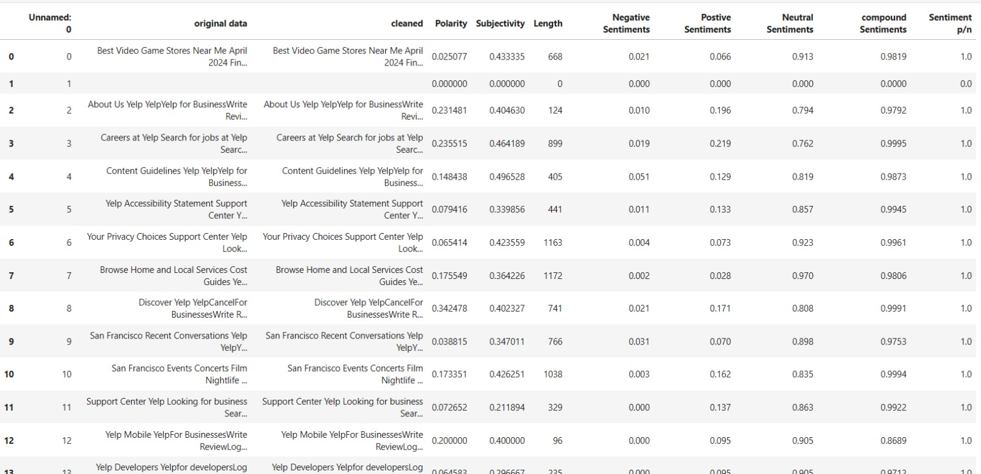
After Webscraping

Slide 25
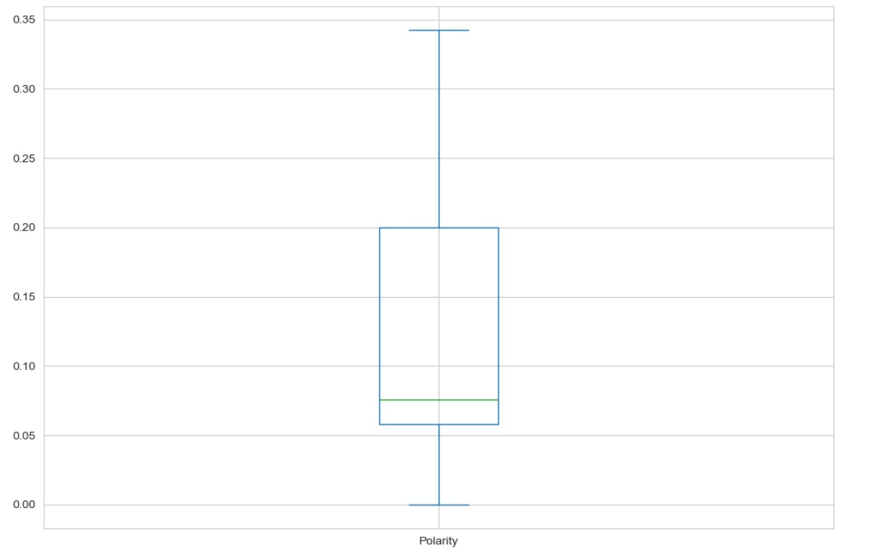
Polarity and Subjectivity

Slide 26
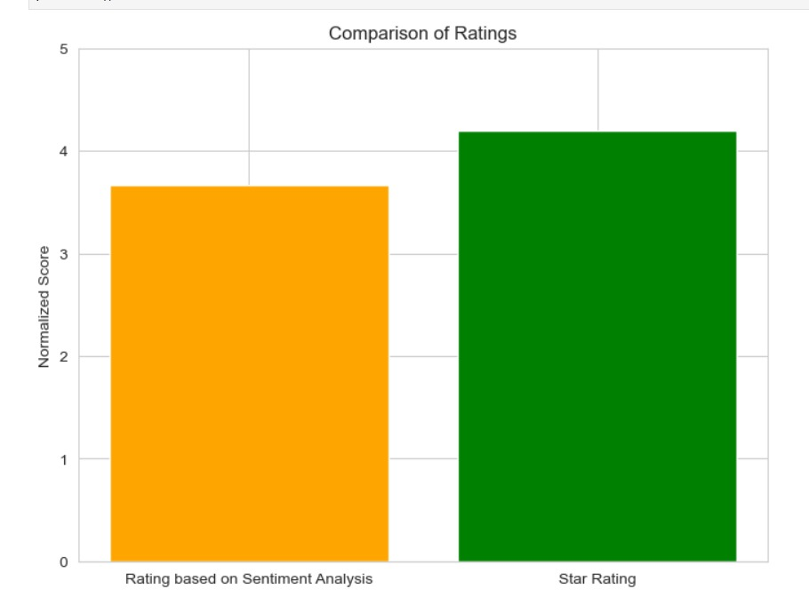

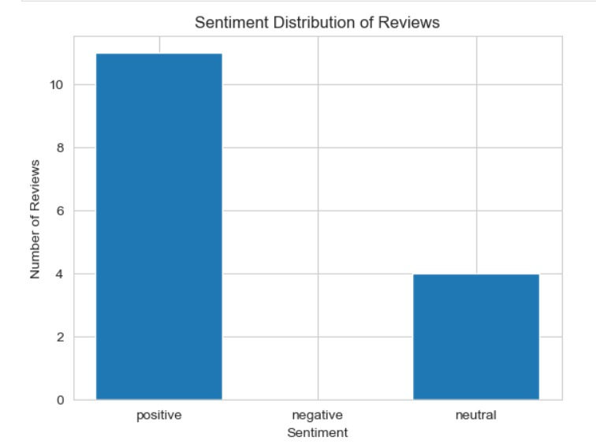
Sentiment Score

Slide 27

Thank You

