Slide 1


Accident Detection
Using YOLOV8 and two-stream CNN

Slide 2
Abstract
Road accidents are a major problem in Bangladesh, with thousands of people losing their lives and many more suffering serious injuries every year. road accidents caused over 105,000 deaths and 149,000 injuries from 2014 to 2024, with women and children notably affected. For solving this issue have existing some features. Traditional methods of accident detection in real-time are slow and often inaccurate, which delays responses and exacerbates the impact of accidents. This research Proposed Accident detection using YOLOV8 and Two-stream CNN algorithms to mitigate
the gap.
To solve this problem, I proposed and approach of this paper:
To develop an efficient system for detecting accidents in real-time using
YOLOv8 and Two-Stream CNN
Applies Biliterial filtering for noise removal
25-02-2025

Slide 3
Content Overview
Introduction
Background Study
Literary Review
Methodology
Outcomes and Contribution
References
25-02-2025

Slide 4



Introduction
Research Topic :
Detect the probability of a scenario which occurs accident or not
Significance :
Provide a scalable solution for real world development sector
The study offers potential applications in smart cities, highway surveillance, and autonomous vehicles.
Research Question
1.Can YOLOv8 detect accidents in real-time with sufficient accuracy?
2.How can noise removal techniques, like bilateral filtering, improve model performance?
3.How do alternative models, like the two-stream CNN, compare to YOLOv8?
.
Research Problem:
The challenge is detecting accidents accurately in diverse, real-time environments.
25-02-2025

Slide 5

Background Study
Context of research
A custom dataset of 1500 videos was transformed into images and filter with bilateral filtering. Two models, YOLOv8 for real-time object detection and a Two-Stream CNN for feature extraction, were trained, enhancing accident detection performance.
Key Concepts and Theories
YOLOv8 (You Only Look Once): A state-of-the-art object detection algorithm that provides real-time object detection.
Two-Stream CNN: A model that processes two input streams for multi-viewpoint learning, often used in dynamic scene analysis like accident detection.
Bilateral Filtering: A noise reduction technique that smoothens images while preserving edges.
25-02-2025

Slide 6
Literary Review(Paper 1)
Paper & Publication Year | Methodology | Datasets | Accuracy | Limitations
Title: Comparison of YOLO Algorithms for Vehicle Accident Detection and Classification Authors: Ahmed N. Nusari, Abdulfattah E. Ba Alawi, Ferhat Bozkurt, İbrahim Yücel Özbek Publication Year: 2024 | Dataset Collection: 12,122 labeled images of vehicles and accidents from real and simulated scenarios. Data Preprocessing: Images resized to 640x640px with augmentations like noise, brightness adjustment, grayscale conversion, and blur to improve model robustness. Model Training: Fine-tuned multiple YOLO models (YOLOv6, YOLOv7, YOLOv8, YOLOv9) with adjusted hyperparameters like learning rate, batch size, and anchor boxes. Model Evaluation: Used Precision, Recall, mAP50, and mAP50-95 to assess each model's effectiveness in detecting vehicle accidents. Comparison of Models: Compared the YOLO models based on precision, recall, and mAP for both moderate and severe accidents. | 12,122 labeled images of vehicles and accidents, including both moderate and severe accidents, sourced from real-world and simulated scenarios. | YOLOv8 precision (0.979) and recall (0.927). YOLOv9c mAP50 with a score of 0.977. YOLOv9e achieved the best mAP50-95 score of 0.941, | Computational Complexity: High-precision models like YOLOv9 may require powerful hardware for real-time deployment. Data Quality: The system's performance can be affected by low-quality or noisy images in the dataset. Edge Conditions: The model may struggle with poor lighting or adverse weather conditions, reducing detection accuracy.
25-02-2025

Slide 7
Literary Review(Paper 2)
Paper & Publication Year | Methodology | Datasets | Accuracy | Limitations
Title: Accident Detection System Using YOLOv8 and CNN Algorithm Authors: Aadarsh Darokar, Akanksha Talware, Amit Jadhav, Darshana Guntiwar, Swati Dandhare, Devendra Dandekar Publication Year: 2023 | Data Collection: Gather video from road cameras at highways and intersections. Preprocessing: Resize, normalize, and augment frames for model input. YOLOv8 Configuration: Use CSPDarknet53 for feature extraction and fine-tune with labeled accident data. Model Training: Train YOLOv8 by adjusting hyperparameters to optimize accuracy. Real-time Detection: YOLOv8 detects accidents in real-time by drawing bounding boxes. Alert Generation: Send immediate alerts to authorities when accidents are detected. Performance Evaluation: Evaluate the model’s accuracy, speed, and resource efficiency. | The system is trained using a custom dataset of road accident images collected from public and private sources. These images are annotated with bounding boxes to indicate the location of accidents and non-accidents. | perform real-time accident detection with high accuracy and minimal latency. | Generalization: Model may not perform well in different traffic patterns or environments. Complex Scenarios: Struggles with accidents involving overlapping objects in high-density areas. Real-time Constraints: Computational demand may limit performance in low-resource environments. Lighting & Weather: Accuracy may drop under poor lighting or adverse weather conditions.
25-02-2025

Slide 8
Literary Review(Paper 3)
Paper & Publication Year | Methodology | Datasets | Accuracy | Limitations
Title: A Deep Learning based Accident Detection System Authors: Gokul Rajesh, Amitha Rossy Benny, Harikrishnan A, James Jacob Abraham and Nithin Prince John Publication Year: 2020 | Custom dataset of 5,000 images focusing on accidents in India. CNN model trained for 30 epochs using 4,000 images, with dropout and data augmentation to prevent overfitting. CNN uses convolutional layers, max-pooling, batch normalization, and ReLU activation. Video classification using frame averaging and rolling predictions with deque. Alert system sends camera location alerts to control rooms via the GSM module upon accident detection. | Custom Dataset: 5,000 images were created with 2,500 accident images and 2,500 non-accident images, focusing on road accidents in India. These images were collected from Google Images and converted to a consistent size for training. | CNN : Accuracy 85% | Lack of Existing Mechanism: No current real-time accident detection system with similar efficiency. High Costs: Sensor-based systems (e.g., GSM, GPS) are expensive and hard to install. Infrastructure Dependency: Relies on existing camera networks and location data, limiting use in areas without infrastructure. Dynamic Environments: Performance may drop in poor camera quality conditions (e.g., low light, bad weather). Scalability: Expanding the system requires addressing network delays and data integration.
25-02-2025

Slide 9
Literary Review(Paper 4)
Paper & Publication Year | Methodology | Datasets | Accuracy | Limitations
Title:Accident Detection Using Convolutional Neural Networks Authors: Sreyan Ghosh, Sherwin Joseph Sunny, Rohan Roney Publication Year: 2019 | Data Collection: Created a custom dataset of 20,000 accident and non-accident frames from video footage. Preprocessing: Resized and preprocessed frames for CNN input. Model Training: Trained Inception v3 model using labeled frames. Model Implementation: Deployed on Raspberry Pi 3 Model B+ with TensorFlow and OpenCV for real-time video processing. Alert System: Sends SMS alerts with location and timestamp to emergency services upon detecting an accident frame. Evaluation: Trained and tested the model on accident and non-accident frames to measure accuracy. | 20,000 images (10,000 accident frames and 10,000 non-accident frames) used to train the CNN. | Training Accuracy: 95% Validation Accuracy: 85% Overall Accuracy: The model achieved up to 98.76% accuracy in accident detection. | Real-World Application: Model performance may be impacted by varied traffic conditions not included in the training data. Video Quality: Detection accuracy drops if video quality is poor or if the accident isn’t clearly visible. Overfitting: The model may overfit to the dataset if not properly tuned, leading to poor performance on new data.
25-02-2025

Slide 10
Literary Review(Paper 5)
Paper & Publication Year | Methodology | Datasets | Accuracy | Limitations
Title: Noisy Values Detection and Correction of Traffic Accident Data Authors: Rupam Deb, Alan Wee-Chung Liew Publication Year: 2019 | Data Collection : - Paper uses four publicly available datasets - Datasets are from Queensland, Australia, and New York, USA - Datasets: RCL, RC, MCI, MII Noise Detection - Introduces the NoiseCleaner algorithm - Purpose: Detect and correct noisy values in categorical data Noise Identification - Algorithm flags attributes with low occurrence frequency - Example: Values occurring once or twice Correction Process - Uses Levenshtein distance - Focuses on simple typographical error corrections Similarity Measures - Implements P-measure: probability of correctness - Implements S-measure: similarity between values - Aims to identify and correct noisy values in categorical data Algorithm Testing - Evaluated NoiseCleaner algorithm's performance - Used synthetic noisy patterns: simple, medium, complex, blended | RCL (Road Crash Locations): 251,705 records from Queensland, Australia RC (Road Casualties): 15,744 records from Queensland, Australia MCI (Motor Vehicle Crash-Case Information: 2011): 13,889 records from New York, USA MII (Motor Vehicle Crash-Individual Information: 2011): 17,858 records from New York, USA | In all noisy conditions (e.g., 2%, 4%, 6%, 8% noise ratios), NoiseCleaner outperformed other algorithms . | Real-World Application: Assumes low noise volume, which may not be the case for all datasets. Noise Type: May not perform well on correlated noisy data, as it focuses on random, independent noise. Model Dependency: Effectiveness varies depending on the dataset, and customization might be needed for different types. Computational Cost: High computational complexity could be a limitation for working with very large datasets.
25-02-2025

Slide 11

Methodology
Dataset Creation
Data annotation
Noise Removal
Dataset Preparation
Trained YOLOv8 for real-time object detection; if effectiveness is low, used Two-Stream CNN for comparison in accident detection.
Model training
25-02- 2025

Slide 12
Methodology
Compared the performance of YOLOv8 and Two-Stream CNN based on Precision, Recalll and mAP
Evalution
25-02-2025

Slide 13
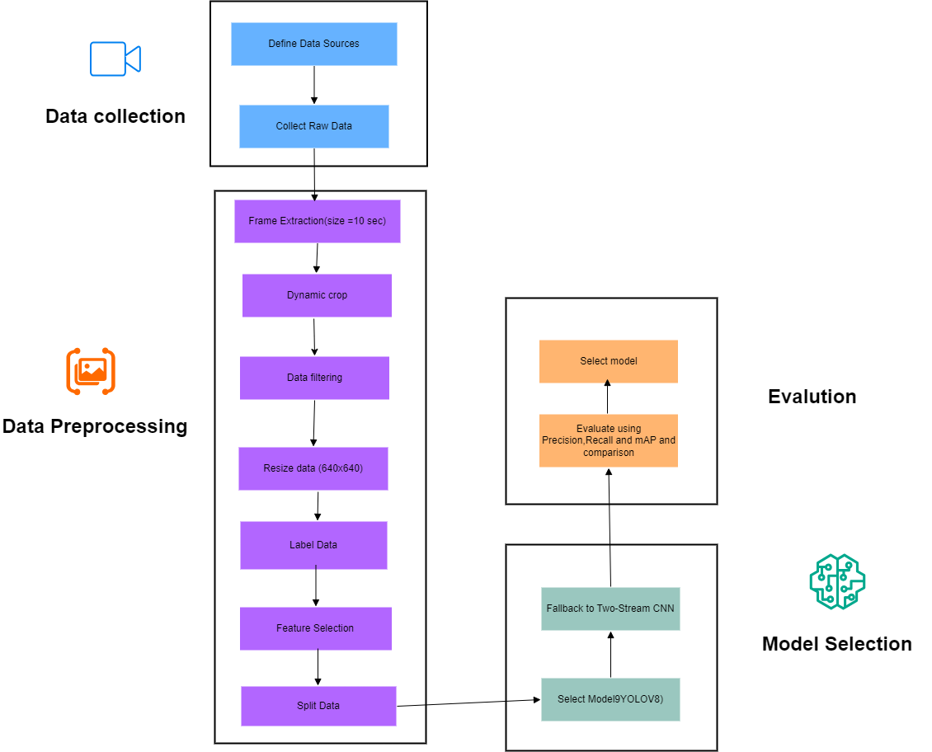
Methodology
Diagram

Slide 14


Outcomes and Contribution
Comparison of YOLOv8 and Two-Stream CNN for real-time accident detection.
Expected Outcome: Identification of the most effective model based on accuracy and detection speed.
Bilateral Filtering applied to improve image quality and optimize model performance.
25-02-2025

Slide 15
References
1.
Nusari, A. N., Ba Alawi, A. E., Bozkurt, F., & Özbek, İ. Y. (2024). Comparison of YOLO Algorithms for Vehicle Accident Detection and Classification. International Conference on Emerging Smart Technologies and Applications.
2.
Darokar, A., Talware, A., Jadhav, A., Guntiwar, D., Dandhare, S., & Dandekar, D. (2023). Accident Detection System Using YOLOv8 and CNN Algorithms. International Research Journal of Modernization in Engineering Technology and Science.
3.
Rajesh, G., Benny, A. R., Abraham, H. A., & John, N. P. (2020). A Deep Learning Based Accident Detection System. IEEE International Conference on Communication and Signal Processing.
4.
Ghosh, S., Sunny, S. J., & Roney, R. (2019). Accident Detection Using Convolutional Neural Networks. IEEE.
5
Deb, R., & Liew, A. W.-C. (2019). Noisy Values Detection and Correction of Traffic Accident Data. Information Sciences.
25-02-2025

Slide 16
Thank You
For Your Attention
25-02-2025

