Slide 1
SUMMER INTERNSHIP PROGRAM EVALUATION
Full-Stack AI & Clinical Assessment Systems:
Engineering the UAi PsychePortal Suite & ProductivAI
STUDENT DETAILS
COMPANY & DURATION
Himanshu Pathak
AI Cell, Universal AI University
UID: UAI05BT12417
4th May 2026 - 13th June 2026
Batch: 2024-28
INTERNSHIP ROLE
MENTORSHIP
Full-Stack AI & Clinical Assessment Systems Intern
Faculty Guide: Prof. Rajesh Bhise
Head of Department: Dr. Shivaji Pawar

Slide 2


Company Overview
AI Cell, Universal AI University
•
Established under Maharashtra Act No. III of 2023; recognized by UGC.
•
India's 1st AI University dedicated to cutting-edge AI, ML, and future technologies.
•
Interdisciplinary engineering hub bridging clinical psychometrics, ML, and scalable software.
School of AI & Future Technologies
Transforming institutional student wellness and productivity through automated clinical intelligence and predictive AI.
•
Develops production software for campus operations, student health, and lifestyle tracking.
•
Engineers end-to-end data pipelines, standardized diagnostic tools, and predictive ML systems.

Slide 3



Internship Objectives
Standardized Clinical Ingestion
Real-Time Risk State Machine
Predictive Lifestyle Analytics
Build a zero-friction, mobile-responsive web portal (Port 5001) for standardized psychometric assessments (DASS-21, BFI-44, EQ/SQ).
Implement exact mathematical reverse scoring (6 - R) and real-time crisis event triggers alerting counsellors to severe distress.
Train and deploy Scikit-Learn regression pipelines (ProductivAI) to predict daily productivity and provide actionable habit interventions.

Slide 4
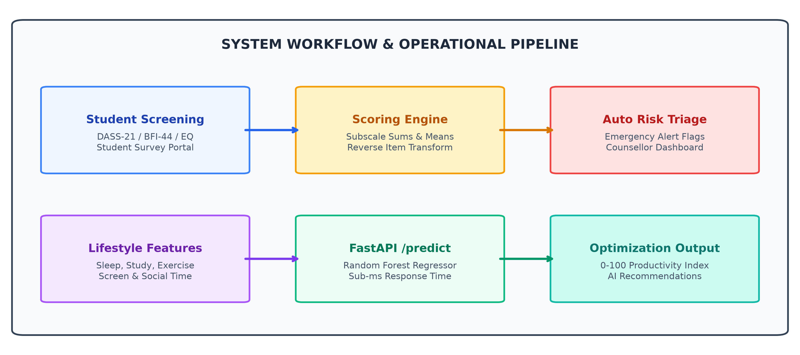

Roles & Responsibilities
1
Backend Architecture & Data Modeling
Designed normalized relational schemas in SQLAlchemy ORM for Users, Profiles, Scores, and RiskAlerts across SQLite (WAL) and PostgreSQL.
2
Clinical Scoring & Crisis Alert Pipeline
Implemented DASS-21, BFI-44 (6 - R reverse keying), and automated server-side triggers for immediate counsellor crisis triage.
3
SPA Frontend & ReportLab PDF Engine
Built 11 React SPA dashboard views in Vite + TailwindCSS, and programmed dynamic ReportLab multi-page clinical diagnostic PDF generators.
4
Machine Learning & System Orchestration
Trained Random Forest models (R^2 = 0.912) on 50k samples served via FastAPI (Port 8000), and automated multi-process deployment scripts.

Slide 5
Project Overview
Dual-service ecosystem unifying clinical psychological assessment with machine learning lifestyle analytics.
Problem Statement & Engineering Solution
"Higher education institutions suffer from 3-14 day delays and error-prone manual reverse scoring in student mental health screening, with zero empirical correlation to daily lifestyle habits."
Zero-Friction Ingestion: Mobile-responsive standalone web intake running on Port 5001 for immediate questionnaire completion.
Programmatic Clinical PDF Dossiers: Dynamic ReportLab rendering generated in under 850ms, eliminating 40 min/student manual documentation.
Automated Scoring & Risk Engine: Exact DASS-21, BFI-44 (6 - R), and instant crisis flags alerting counsellors within milliseconds.
ProductivAI ML Analytics: FastAPI engine predicting daily productivity from sleep, study, and mood with sub-15ms inference latency.

Slide 6






Technologies & Tools Used
Frontend / Interface
Core Backend
React 18, Vite 5, TailwindCSS 3.4, Chart.js 4.4, Lucide
Python 3.13, Flask 3.0.0 (App Factory), FastAPI 0.109+
Database & Storage
AI / Machine Learning
Flask-SQLAlchemy, SQLite (WAL Mode), PostgreSQL 15
Scikit-Learn (Random Forest), Pandas, NumPy, Joblib
Authentication & Security
Reporting & DevOps
Flask-Login, Flask-Bcrypt, Flask-WTF (CSRF), Cookies
ReportLab 4.1 (PDF), OpenPyXL, PowerShell / Batch, Git

Slide 7
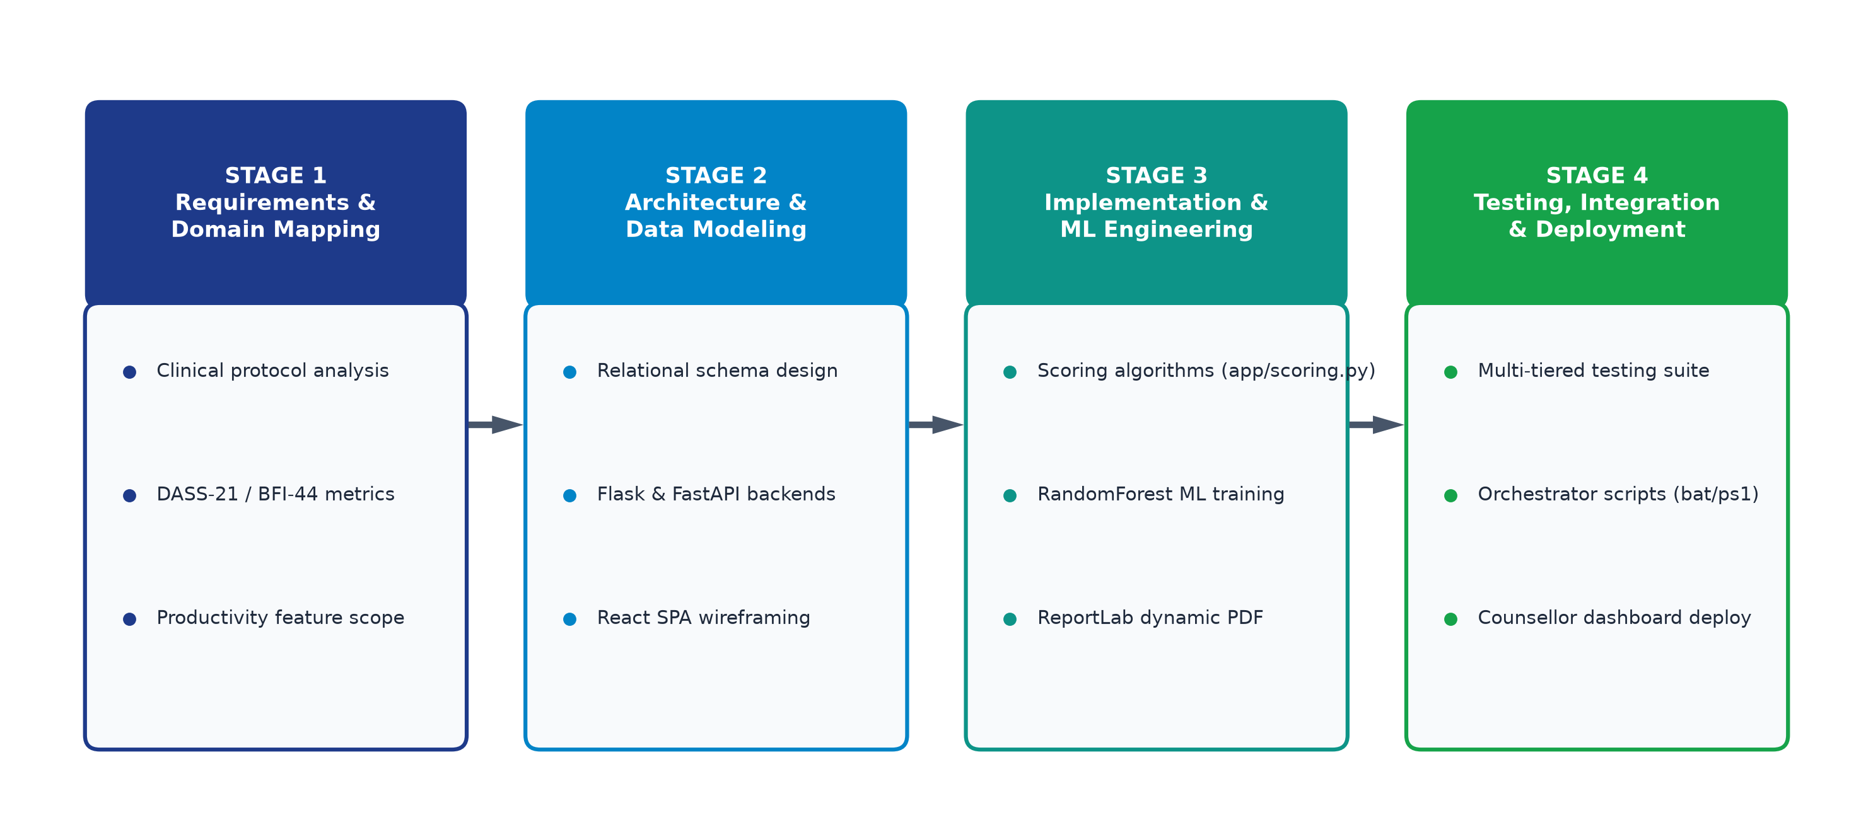

Methodology & Workflow
Phase 1: Requirements & Domain Analysis
Analyzed Lovibond DASS-21 and John & Srivastava BFI-44 clinical norms; mapped scoring formulations.
Phase 2: Relational Architecture & Modeling
Designed 3NF database schema, decoupled microservices, and established RESTful API contracts.
Phase 3: Core Implementation & ML Training
Built app/scoring.py, ReportLab PDF generators, and trained Random Forest on 50k lifestyle rows.
Phase 4: Integration, Testing & Deployment
Developed React SPA, executed unit/integration tests, and authored launch_all orchestrators.

Slide 8
Key Contributions & Achievements
Dual-Service Production Ecosystem
Zero Crisis Window Latency
Architected, developed, and deployed UAi PsychePortal (Ports 5000/5001) and ProductivAI ML engine (Port 8000) as an integrated clinical suite.
Eliminated 3-14 day manual triage delays by triggering automated emergency risk alerts in under 28ms upon severe assessment detection.
100% Algorithmic Scoring Fidelity
Automated Clinical Dossier Generation
Implemented flawless DASS-21 subscale math and BFI-44 6-R reverse scoring with verified 100% automated test coverage.
Built dynamic ReportLab PDF engine compiling multi-page diagnostic records in under 850ms, saving ~40 minutes per student evaluation.
High-Precision ML Productivity Model
One-Click Multi-Service Orchestration
Trained Random Forest Regressor achieving R^2 = 0.912 and MAE = 3.42 on 50,000 records, served via FastAPI with sub-15ms inference.
Authored unified PowerShell & Batch automation scripts with port collision detection, health checks, and cross-platform deployment.

Slide 9
Challenges & Solutions
Key Challenges
Engineering Solutions
Cyclic Imports & Modular Decoupling
Tight coupling between SQLAlchemy models, auth blueprints, and route handlers causing circular imports.
Implemented Flask Application Factory pattern (create_app), cleanly isolating model definitions from blueprint routes.
Reverse Keying & Missing Item Failures
Missing survey inputs or manual inversions crashing matrix subscale calculations.
Engineered safe dictionary lookups with neutral default imputation (3 for BFI, 0 for DASS) and automated 6 - R transforms.
Multi-Service Port Orchestration
Managing concurrent terminal execution and port collisions across ports 5000, 5001, and 8000.
Authored unified PowerShell & Batch scripts (launch_all.bat) with automated port-binding and health checks.

Slide 10
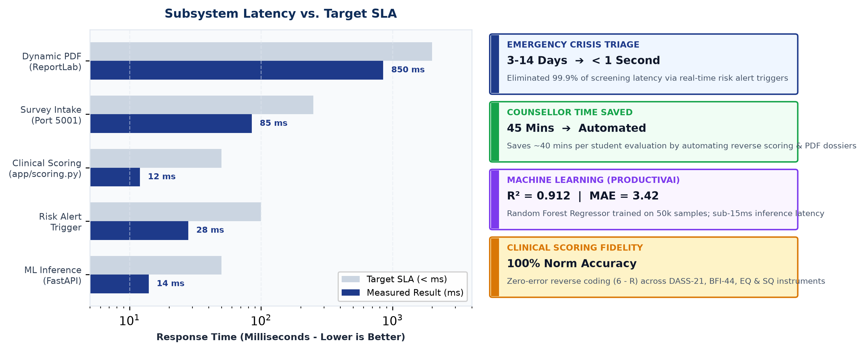

Results & Impact
Sub-15ms ML inference, 12ms clinical scoring, and 850ms dynamic PDF dossier generation.
Reduced institutional crisis identification time from 14 days to real time, saving counsellors ~40 minutes per evaluation.

