Slide 1
PW1100G-JM, GTFA
Bolt protrusion at flange#2 interface
Stack-up
JAEC Design Team
Date: 02nd Dec. 2025

Slide 2
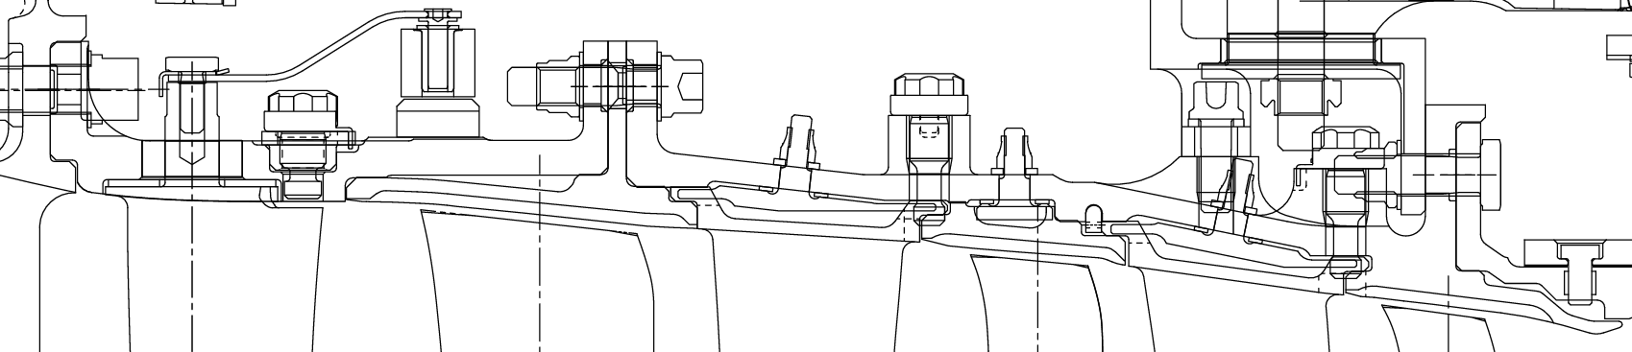
Bolt protrusion at Flange#2 interface
Bolt protrusion
Washer
Bolt
Rearcase
Nut
Front case
R1OAS
X-sect at the Flange-2 interface
Units: mm

Slide 3
Back-up slides

Slide 4
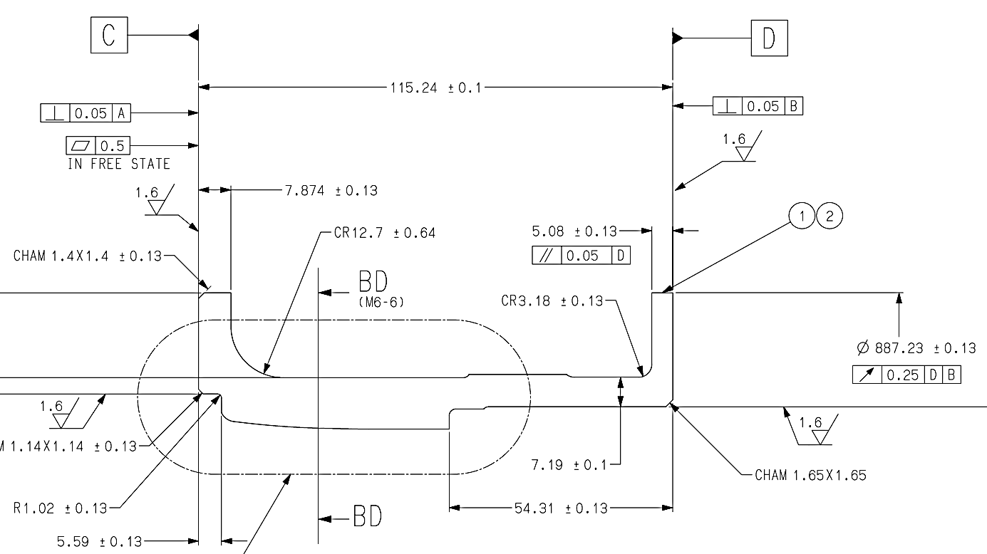
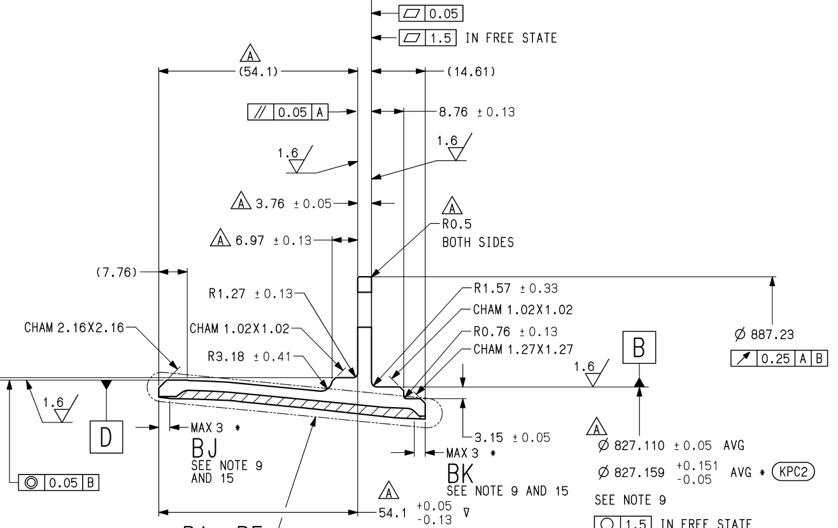
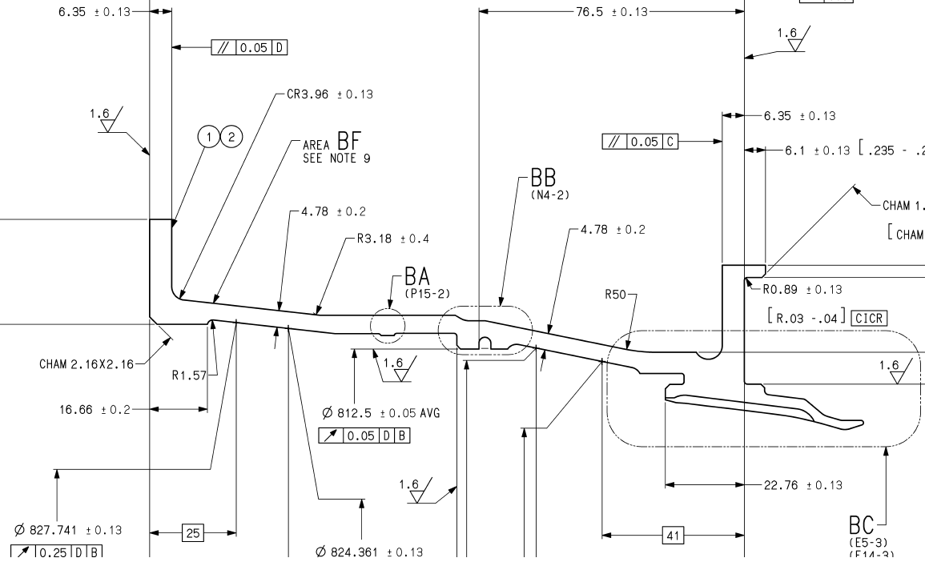
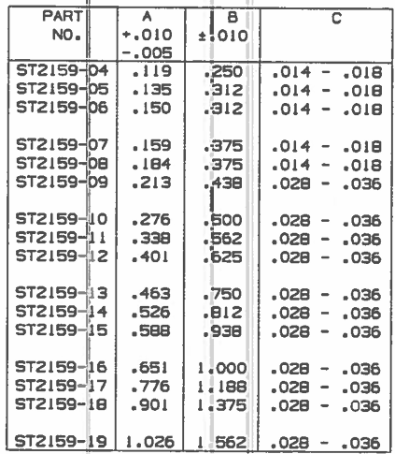
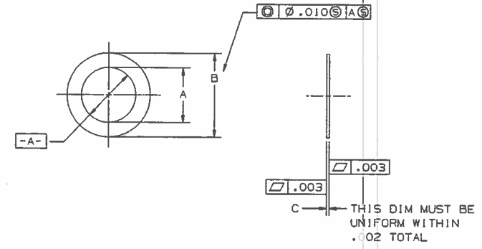
Drawing dimensions
1
2
5377630-01
5377632
3
4&5
5377631-01
AS2159
Units: mm

Slide 5
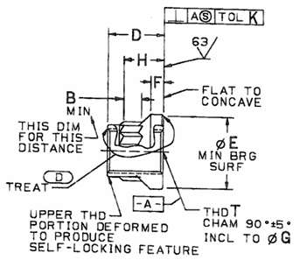
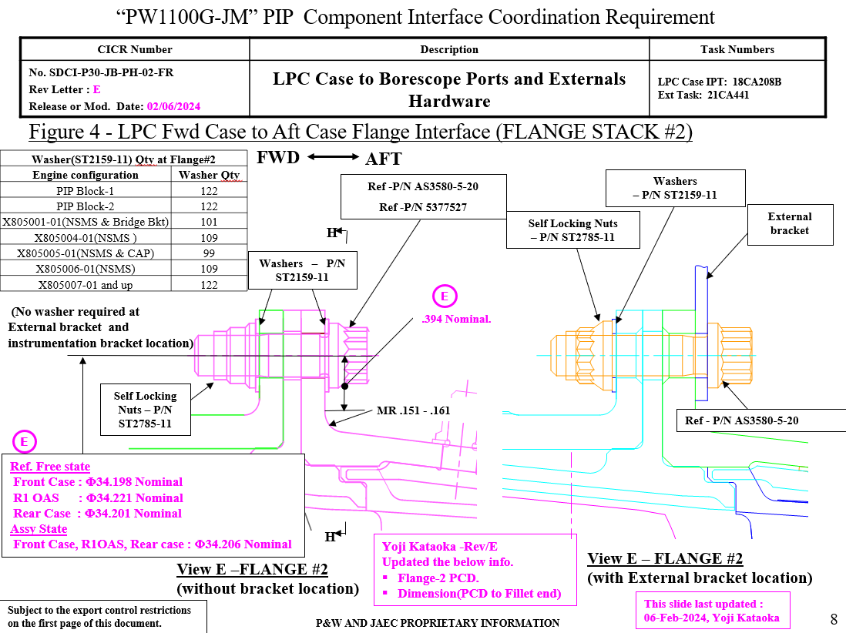
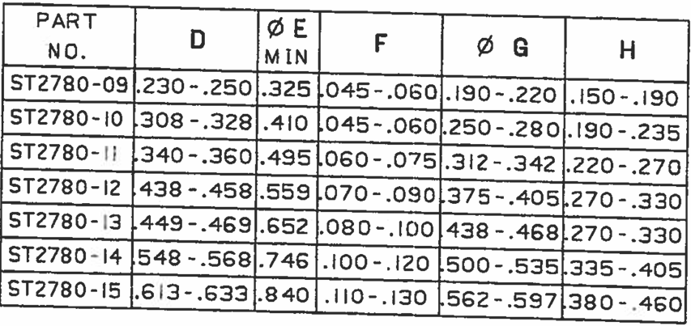
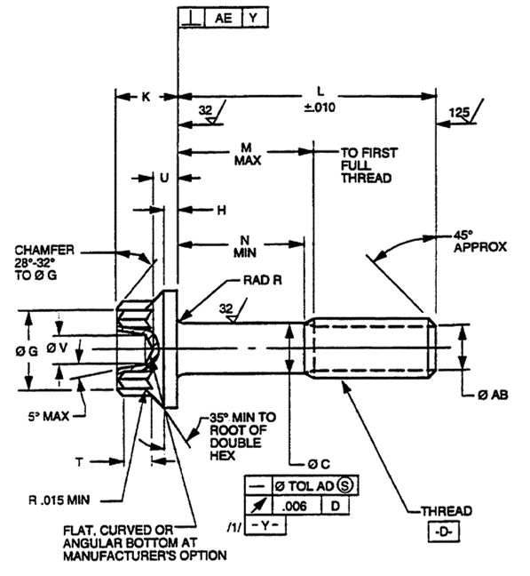
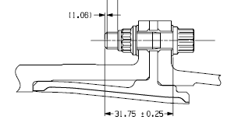
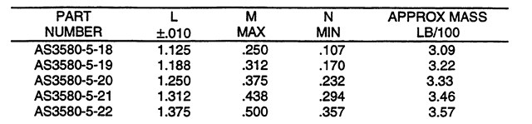
Drawing dimensions
7
ST2785/ST2780(optional)
CICR_CI-CICR-SDCI-P30-JB-PH-02-FR-E
8
6
Chamfer length measured from UG
AS3580
Units: mm

