Slide 1

Gokaraju Rangaraju Institute of Engineering and Technology
(Autonomous)
Department of Artificial Intelligence and Machine Learning Engineering
MINI PROJECT(Review-3&4)
Clustering of Research Paper Abstracts using BERT and LDA
Under the Guidance of
Mr. K Mallikarjun Raju
Assistant Professor, AIML Department
Presented by:
1. Mr. Nikhil Garimella (21241A6623)
2. Mr. A. Karthikeya (21241A6602)
3. Mr. Akhilesh Varma (21241A6603)

Slide 2
Abstract
In this project, we propose to leverage unsupervised machine learning techniques, including Latent Dirichlet Allocation (LDA) for topic modeling, to cluster scientific papers based on their abstracts. The primary objective is to discover underlying themes and structures within the extensive body of scientific literature, facilitating enhanced organization and comprehension of research topics. Alongside traditional clustering algorithms such as K-Means, DBSCAN, and hierarchical clustering, LDA will be employed to extract latent topics from the abstracts, allowing for a deeper understanding of the content. By integrating LDA-based topic modeling into the clustering process, we aim to uncover nuanced relationships between papers and identify cohesive clusters of documents sharing similar thematic content. This holistic approach promises to provide researchers with a comprehensive tool for navigating and exploring related work, fostering interdisciplinary collaboration and advancing knowledge discovery in scientific domains.

Slide 3
Problem Statement
The abundance of scientific literature across various disciplines poses a significant challenge for researchers to efficiently navigate and explore relevant literature. Existing methods for organizing and accessing scientific papers often rely on manual categorization or keyword-based search, which may overlook nuanced relationships and interdisciplinary connections present in the content. This lack of effective tools hampers researchers' ability to stay abreast of the latest developments and identify emerging trends within their fields of interest. Therefore, the problem at hand is to develop an automated solution that utilizes unsupervised machine learning techniques, including clustering and topic modeling, to group scientific papers based on their abstracts. By doing so, we aim to provide researchers with a more intuitive and comprehensive approach to accessing and exploring related literature, thereby facilitating knowledge discovery and fostering interdisciplinary collaboration.

Slide 4
Objectives of the Project
Develop an unsupervised machine learning framework for clustering scientific papers based on abstracts.
Utilize Latent Dirichlet Allocation (LDA) for topic modeling to extract underlying themes.
Evaluate clustering algorithms and combinations to optimize organization of literature.
Create a user-friendly interface for interactive exploration of clustered papers.
Assess the impact of the system on researchers' efficiency in accessing and comprehending literature.

Slide 5
Existing Approaches (Literature Survey)
Reference Number | Title | Objective | Methodology | Accuracy | Pros | Research Gap
An integrated clustering and BERT framework for improved
topic modeling.
To integrate clustering algorithms with BERT embeddings to enhance topic modelling.
It integrates BERT by preprocessing texts, generate BERT embeddings, cluster documents using algorithms like K-Means.
Enhanced topic coherence, Improved Interpretability, Increased robustness, Efficient Computation.
Limited Integration of BERT with clustering, Lack of Comprehensive evaluation.
Precision : 91.35%
Accuracy : 93.50%.
1.
Topic Modeling Techniques for Document Clustering and Analysis of Judicial Judgements.
Develop topic modeling techniques for clustering and analyzing judicial judgments to enhance legal document organization, retrieval, and understanding.
Preprocess Judgements, Apply LDA for topic extraction, Cluster Documents, Evaluate clustering, Analyse clusters for legal insights.
Accuracy of LDA : 75.50%.
Accuracy of BERT : 84.5
Enhances legal document organization, provides insights into legal concepts, improves understanding of legal trends
Sparse use of topic modelling, limited exploration of topic modelling for judicial judgements, need for tailored topic modelling.
2.

Slide 6
Reference Number | Title | Objective | Methodology | Accuracy | Pros | Research Gap
Develop accurate Arabic text classification for legal documents, Enhance accuracy in categorizing texts, utilize domain specific features. Create scalable classification for diverse legal actions.
We build four models which are naïve bayes, K-Nearest Neighbours, Support Vector machine and decision tree to classify documents.
Facilitates efficient organization of legal documents. Supports streamlined legal research processes.
Limited research on Arabic text classification in law, Lack of comprehensive Evaluation, Lack of scalable frameworks.
Arabic Text Classification in the Legal Domain
Accuracy : 83.62%.
3.
An Approach for Analyzing Unstructured Text Data Using Topic Modeling Techniques for Efficient Information Extraction.
Develop text analysis approach using topic modelling, uncover latent patters in unstructured text, create scalable framework for diverse text analysis
Preprocess text data, apply topic modelling techniques, evaluate topic coherence and relevance, analyse resulting topics for insights.
Enables efficient analysis of unstructured text data, provides scalable framework for diverse text analysis
Neglection of real world challenges in text analysis, need for integrated text analysis methods.
Accuracy is measured using coherence score.
Good score : 1
4.

Slide 7
Reference Number | Title | Objective | Methodology | Accuracy | Pros | Research Gap
MTEB spans 8 embedding tasks covering a total of 58 datasets and 112 languages. Through the benchmarking of 33 models on MTEB, we establish the most comprehensive benchmark of text embeddings to date.
Collect diverse text datasets, preprocess data for consistency, generate embeddings using top models, design benchmark tasks and metrics, evaluate model performance on tasks.
Standardizes text embedding model evaluation, Enables cross-task and cross-dataset comparison, enhances text analysis
Limited benchmarking for text embeddings, sparse cross task comparison, need for embedding research advancement.
MTEB: Massive Text Embedding Benchmark
Not pre trained.
5.
Enhance summary coherence and informativeness, address redundancy and improve summary quality, explore benefits, and apps of clustering.
Collect multi document datasets, extract propositions using NLP, cluster propositions, generate summaries from clusters.
Enhance coherence and informativeness, offers structured summarizations, provides potential for diverse apps.
Sparse effectiveness comparison, Lack of comprehensive evaluation.
Proposition-Level Clustering
for Multi-Document Summarization
Accuracy : 95.00%.
6.

Slide 8
Reference Number | Title | Objective | Methodology | Accuracy | Pros | Research Gap
Use BERT embeddings to convert text data into meaningful vector representations and apply probabilistic topic modeling to identify and cluster underlying topics, enhancing the organization and understanding of large text corpora.
Preprocess the text data by tokenizing and removing stop words. Convert the text into embeddings using a pre-trained BERT model. Cluster these embeddings using an algorithm like K-means, and then apply probabilistic topic modeling (e.g., LDA) to the clusters for identifying underlying topics.
This paper innovatively combines BERT and probabilistic topic modeling for more accurate and scalable text clustering, improving topic coherence and applicability across diverse datasets and domains.
This paper fills a research gap by combining BERT's contextual embeddings with probabilistic topic modeling for improved text clustering, addressing challenges of scalability and interpretability in diverse datasets.
TEXT MINING: CLUSTERING USING BERT AND PROBABILISTIC TOPIC MODELING
Uses Coherence scores
7.
The performance of BERT as data representation of text clustering. explain objectives, short
Assessing BERT's effectiveness in representing text for clustering purposes, aiming to improve accuracy and semantic coherence compared to traditional methods.
BERT's contextual embeddings are used for clustering, evaluating their impact on accuracy and coherence.
Using BERT's contextual embeddings for clustering offers higher accuracy and improved semantic coherence in topic clusters. It effectively handles diverse datasets by leveraging advanced deep learning techniques, enhancing the robustness and interpretability of text mining tasks.
Integration of BERT's embeddings with clustering methods addresses a research gap in leveraging deep contextual understanding for improved text analysis.
Accuracy : 95.30%.
8.

Slide 9
Reference Number | Title | Objective | Methodology | Accuracy | Pros | Research Gap
Topic Modeling Using LDA and BERT Techniques: Teknofest Example
The objective is to compare and evaluate topic modeling techniques—specifically Latent Dirichlet Allocation (LDA) and BERT—using Teknofest data as a case study.
The methodology involves applying Latent Dirichlet Allocation (LDA) and BERT techniques to analyse and compare topics extracted from Teknofest data. LDA is used for probabilistic topic modelling, while BERT provides contextual embeddings for more nuanced understanding and clustering of topics.
LDA : Established probabilistic modelling for topic coherence. BERT : Enhanced semantic understanding with contextual embeddings.
Gap in comparing LDA's probabilistic modeling with BERT's contextual embeddings for topic modeling in specific datasets like Teknofest.
Accuracy :
94.00%
9.
To enhance topic detection accuracy by combining BERT’s contextual embeddings with a seed LDA clustering model.
Apply BERT's contextual embeddings and seed LDA clustering for topic detection.
Topic detection based on BERT and seed LDA clustering model
Integrates BERT and seed LDA for precise topic detection.
Integration gap between BERT embeddings and seed LDA for efficient topic detection.
Accuracy : 96.00%.
10.

Slide 10
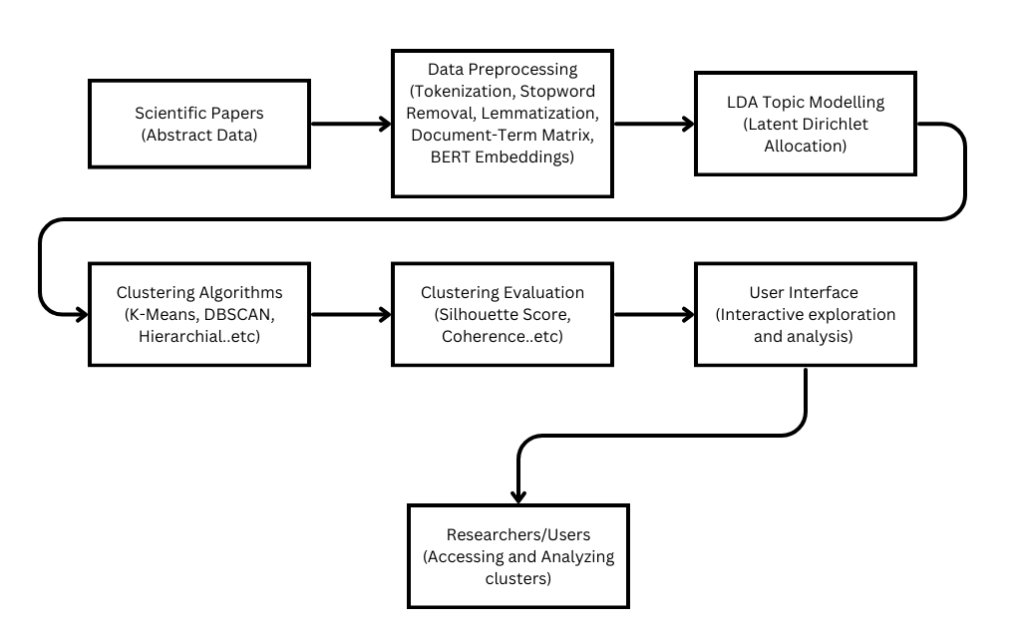
Architecture Diagram

Slide 11
Description of Architecture Diagram
This architecture diagram represents a comprehensive pipeline for analyzing scientific papers using text mining techniques. It begins with abstract data as input and proceeds through several stages:
1. Data Preprocessing: Abstract data undergoes preprocessing, including tokenization, stop word removal, lemmatization, and BERT embeddings generation.
2. LDA Topic Modeling: The preprocessed data is fed into Latent Dirichlet Allocation (LDA) to uncover latent topics within the scientific papers.
3. Clustering Algorithms: Identified topics are clustered using algorithms like K-Means, DBSCAN, and hierarchical clustering to group similar topics.
4. Clustering Evaluation: The quality of clusters is evaluated using metrics like silhouette score and coherence to ensure effectiveness.
5. User Interface: An interactive interface allows researchers and users to explore and analyze clusters, providing insights into the content and themes within the papers.

Slide 12
Dataset Details
This dataset contains a collection of research papers along with various attributes and metadata. It is a comprehensive and diverse dataset that can be used for a wide range of research and analysis tasks. The dataset encompasses papers from different fields of study, including computer science, mathematics, physics, and more.
Fields in the Dataset :
1. Id : A unique identifier for each paper.
2. Title : The title of the research paper.
3. Authors : The list of authors involved in the paper.
4. Venue : The journal or venue where the paper was published.
5. Year : The year when the paper was published.
6. n_citation : The number of citations received by the paper.
7. References : A list of paper IDs that are cited by the current paper.
8. Abstract : The abstract of the paper.

Slide 13
Software & Hardware Requirements
Hardware Requirements:
Software Requirements:
Multi-core processor and minimum 8GB RAM.
Sufficient disk space for dataset and files, preferably with SSD Storage.
Optional : Graphics for faster and better performance.
Python Programming Language with libraries such as Scikit-Learn, Gensim, NTLK, Pandas, Matplotlib/Seaborn and Streamlit for interface.
Anaconda for Python Environment.
Text Editor or IDE like VS Code, PyCharm or Jupyter Notebook for coding.

Slide 14
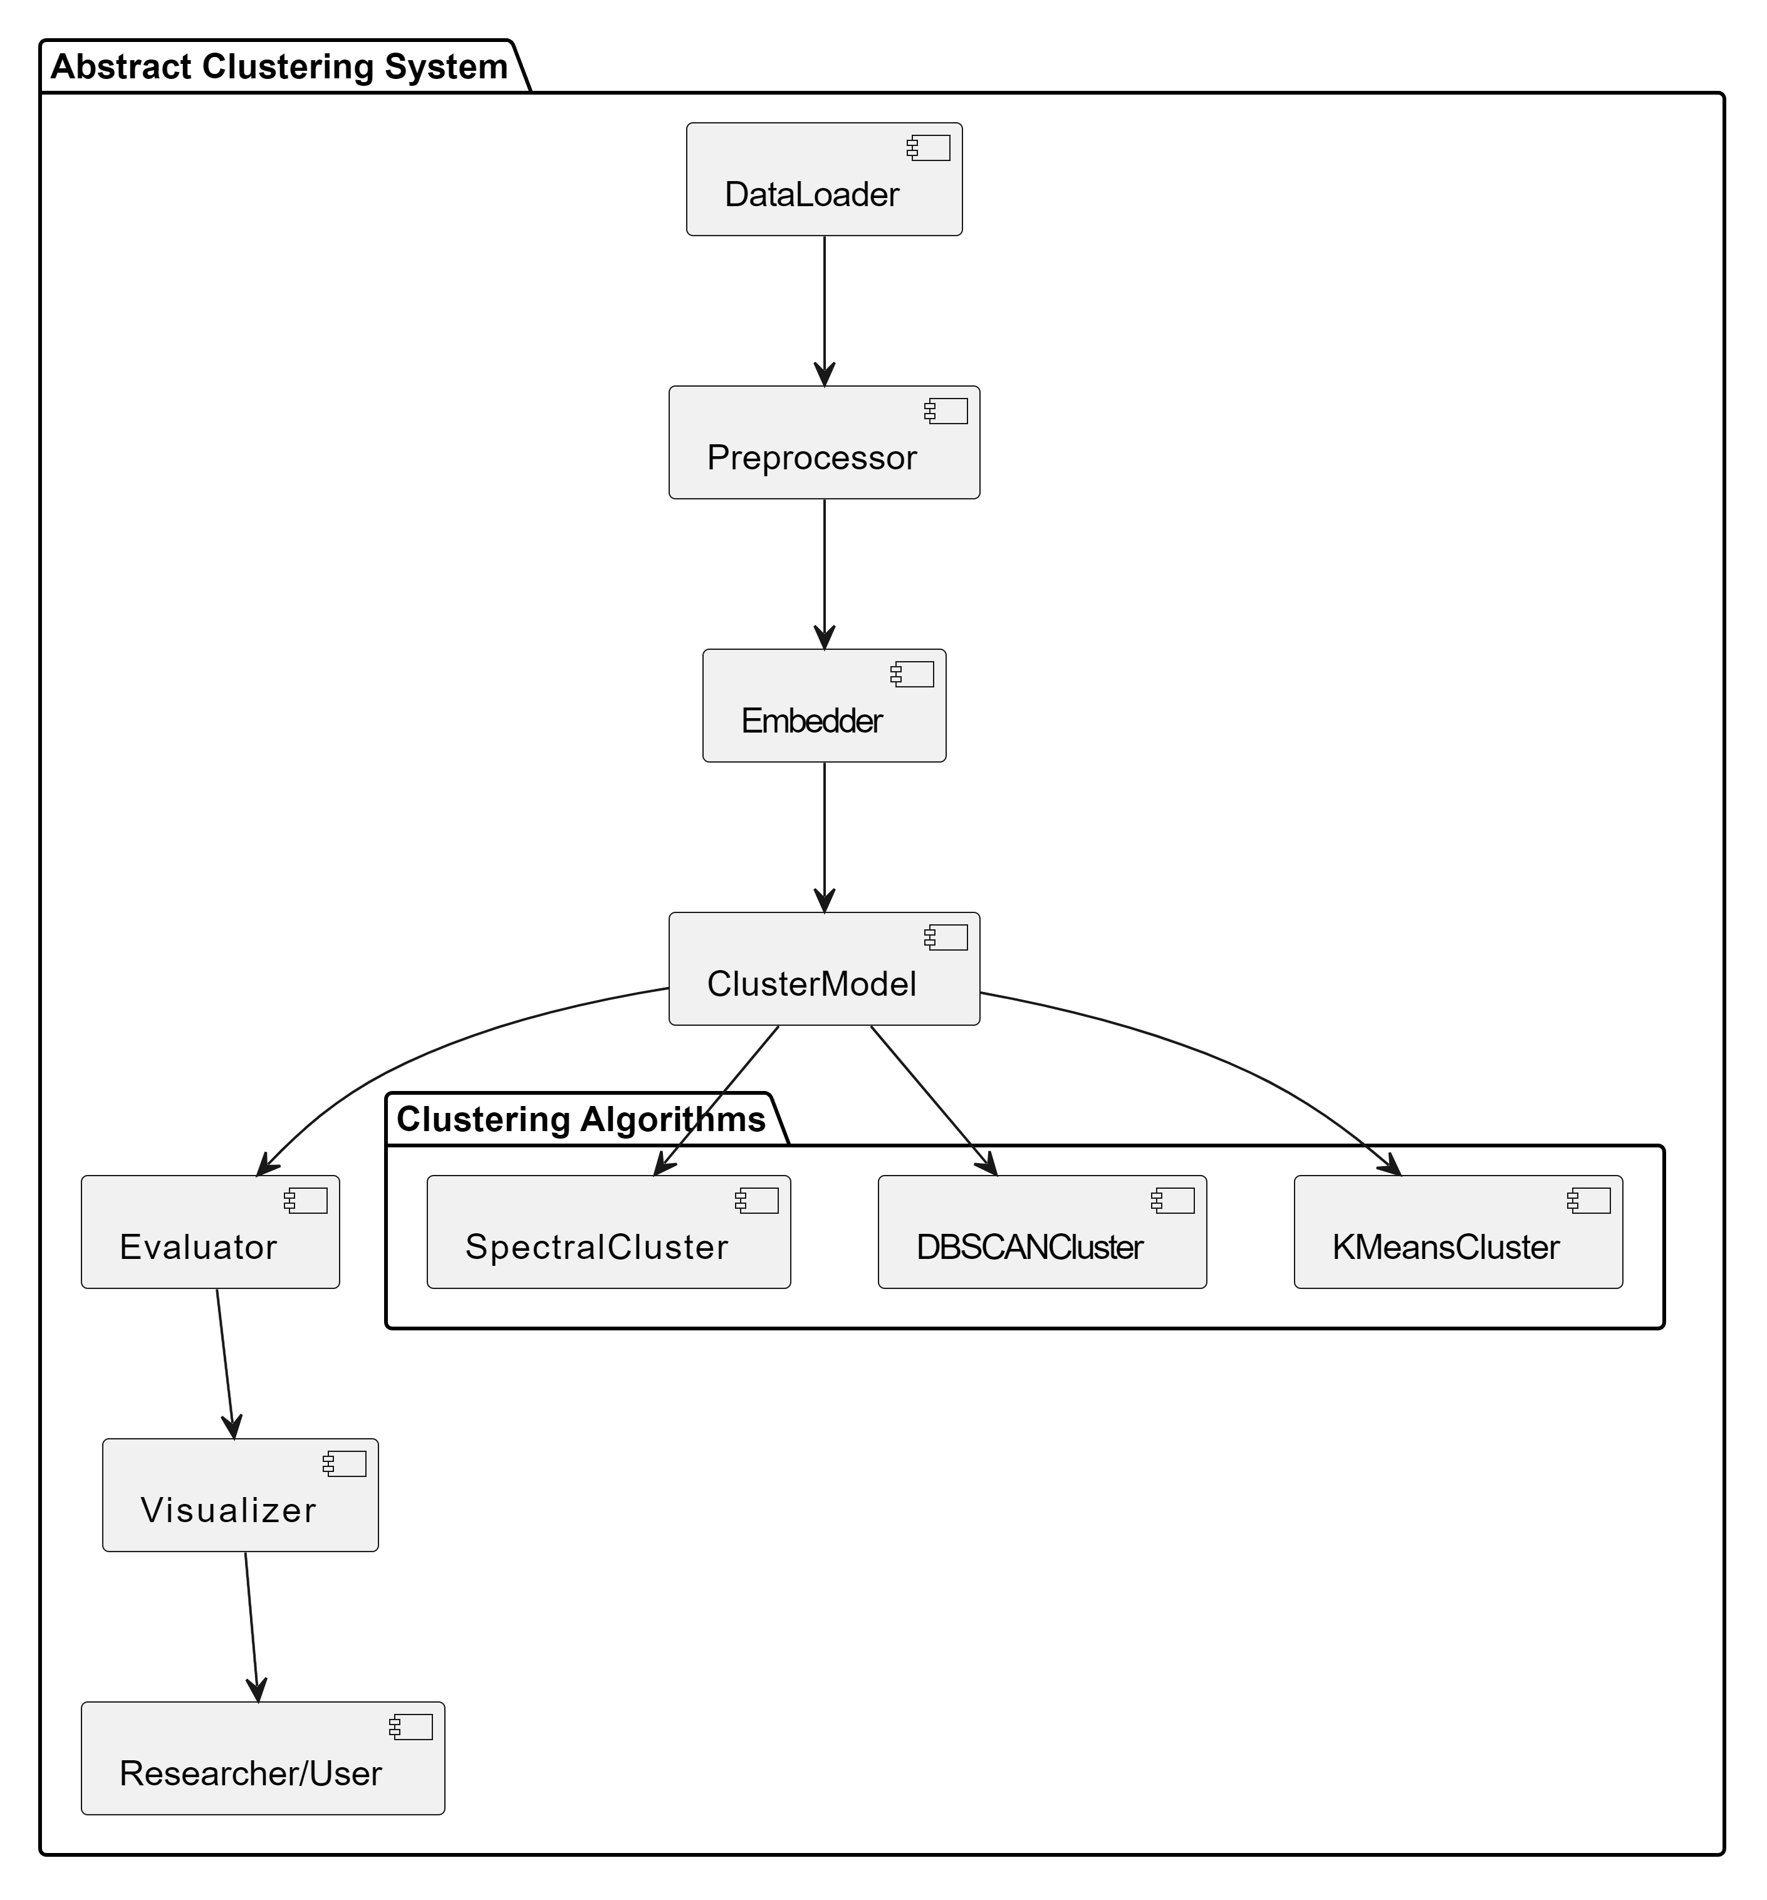
Modules Connectivity Diagram

Slide 15
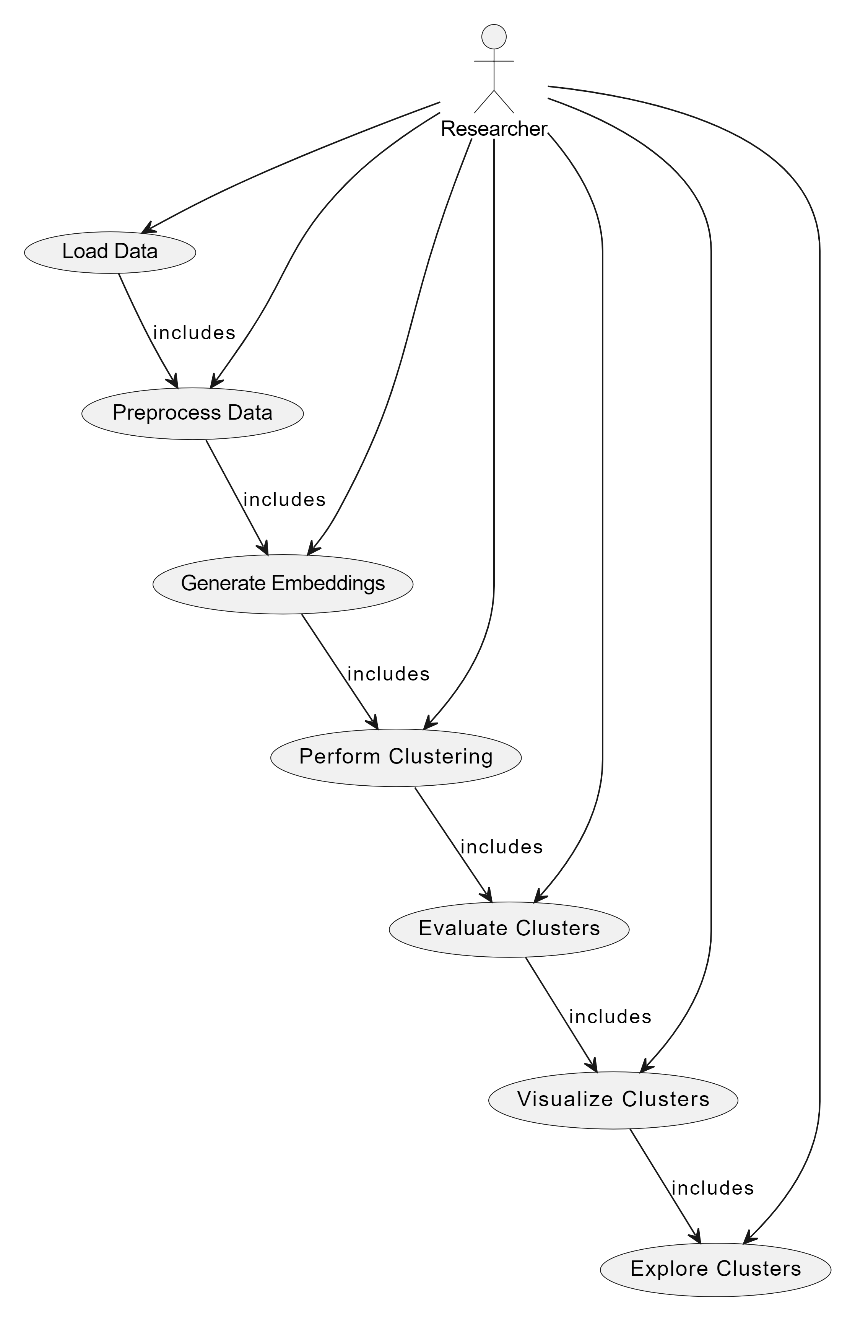
Use Case Diagram

Slide 16
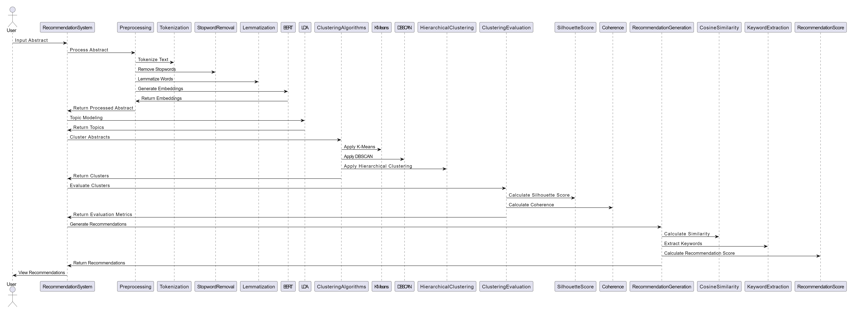
Sequence Diagram

Slide 17
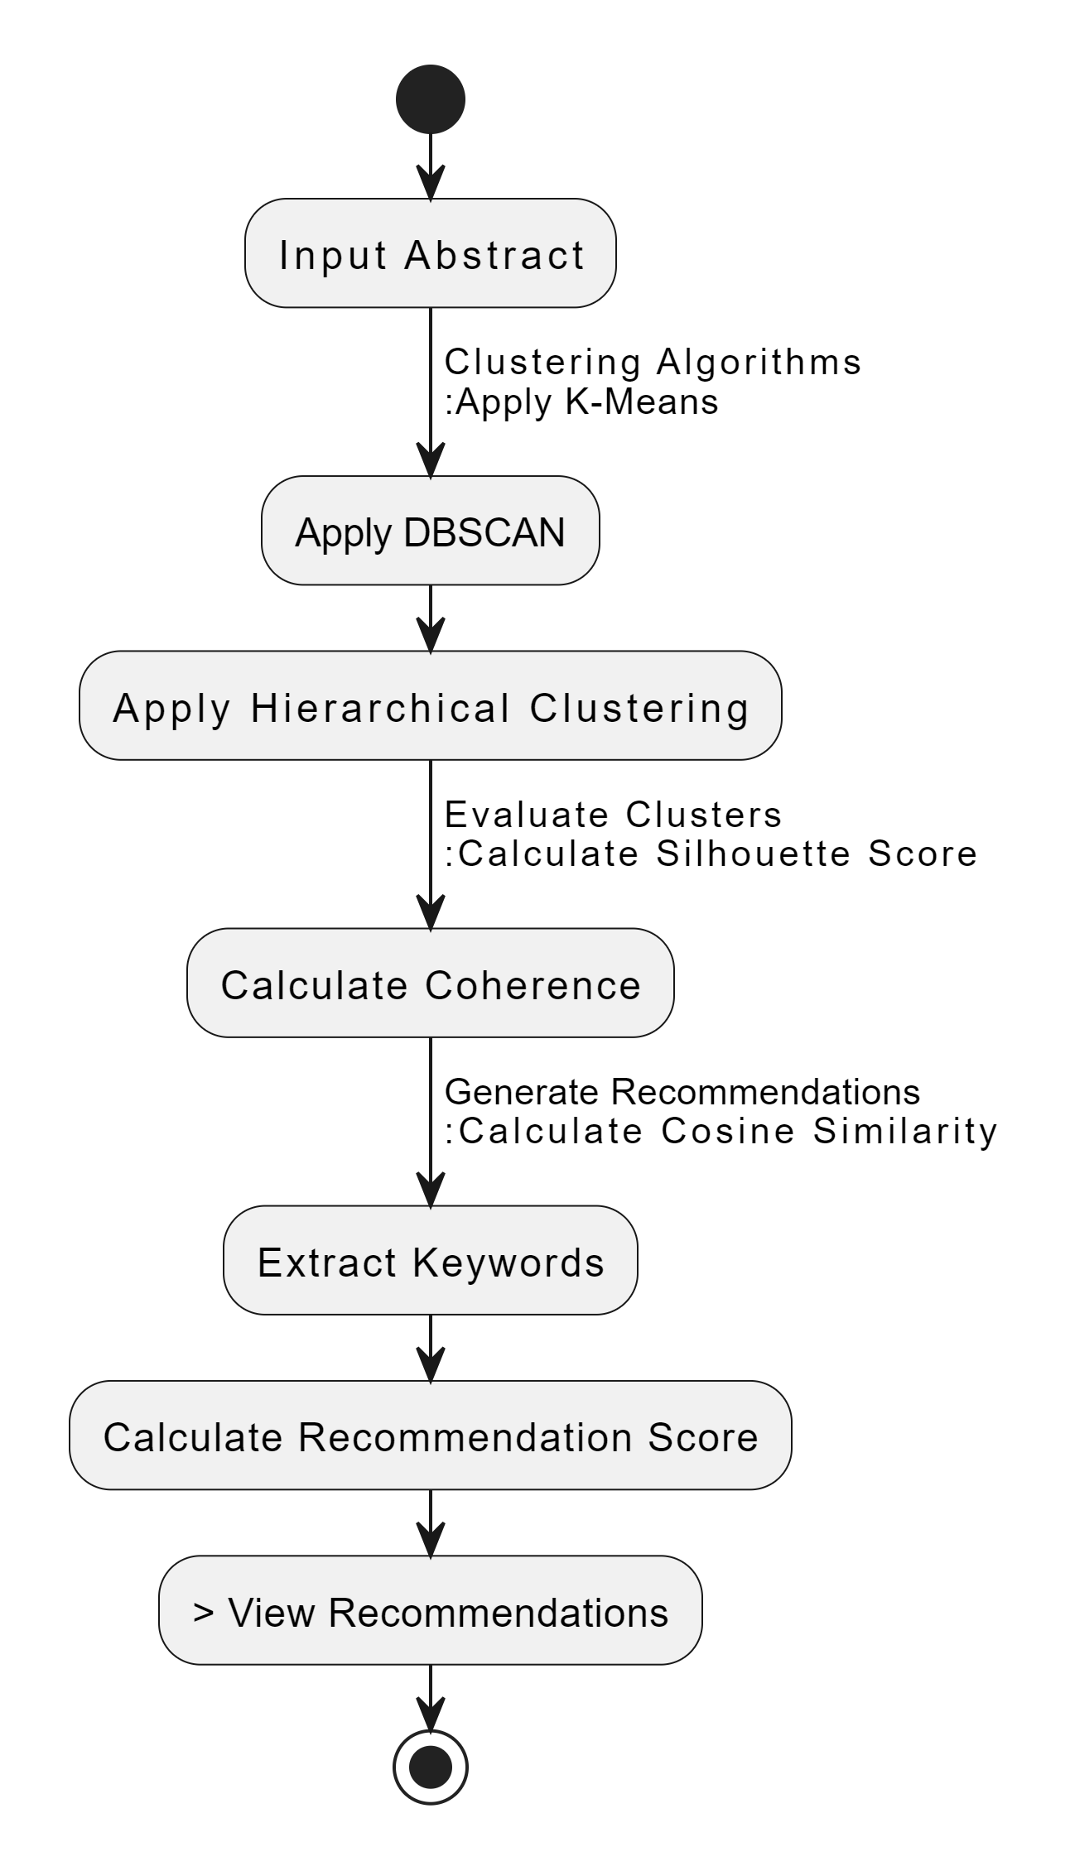
Activity Diagram

Slide 18
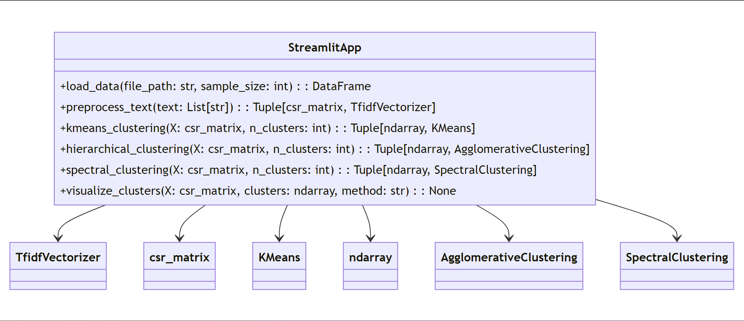
Class Diagram

Slide 19
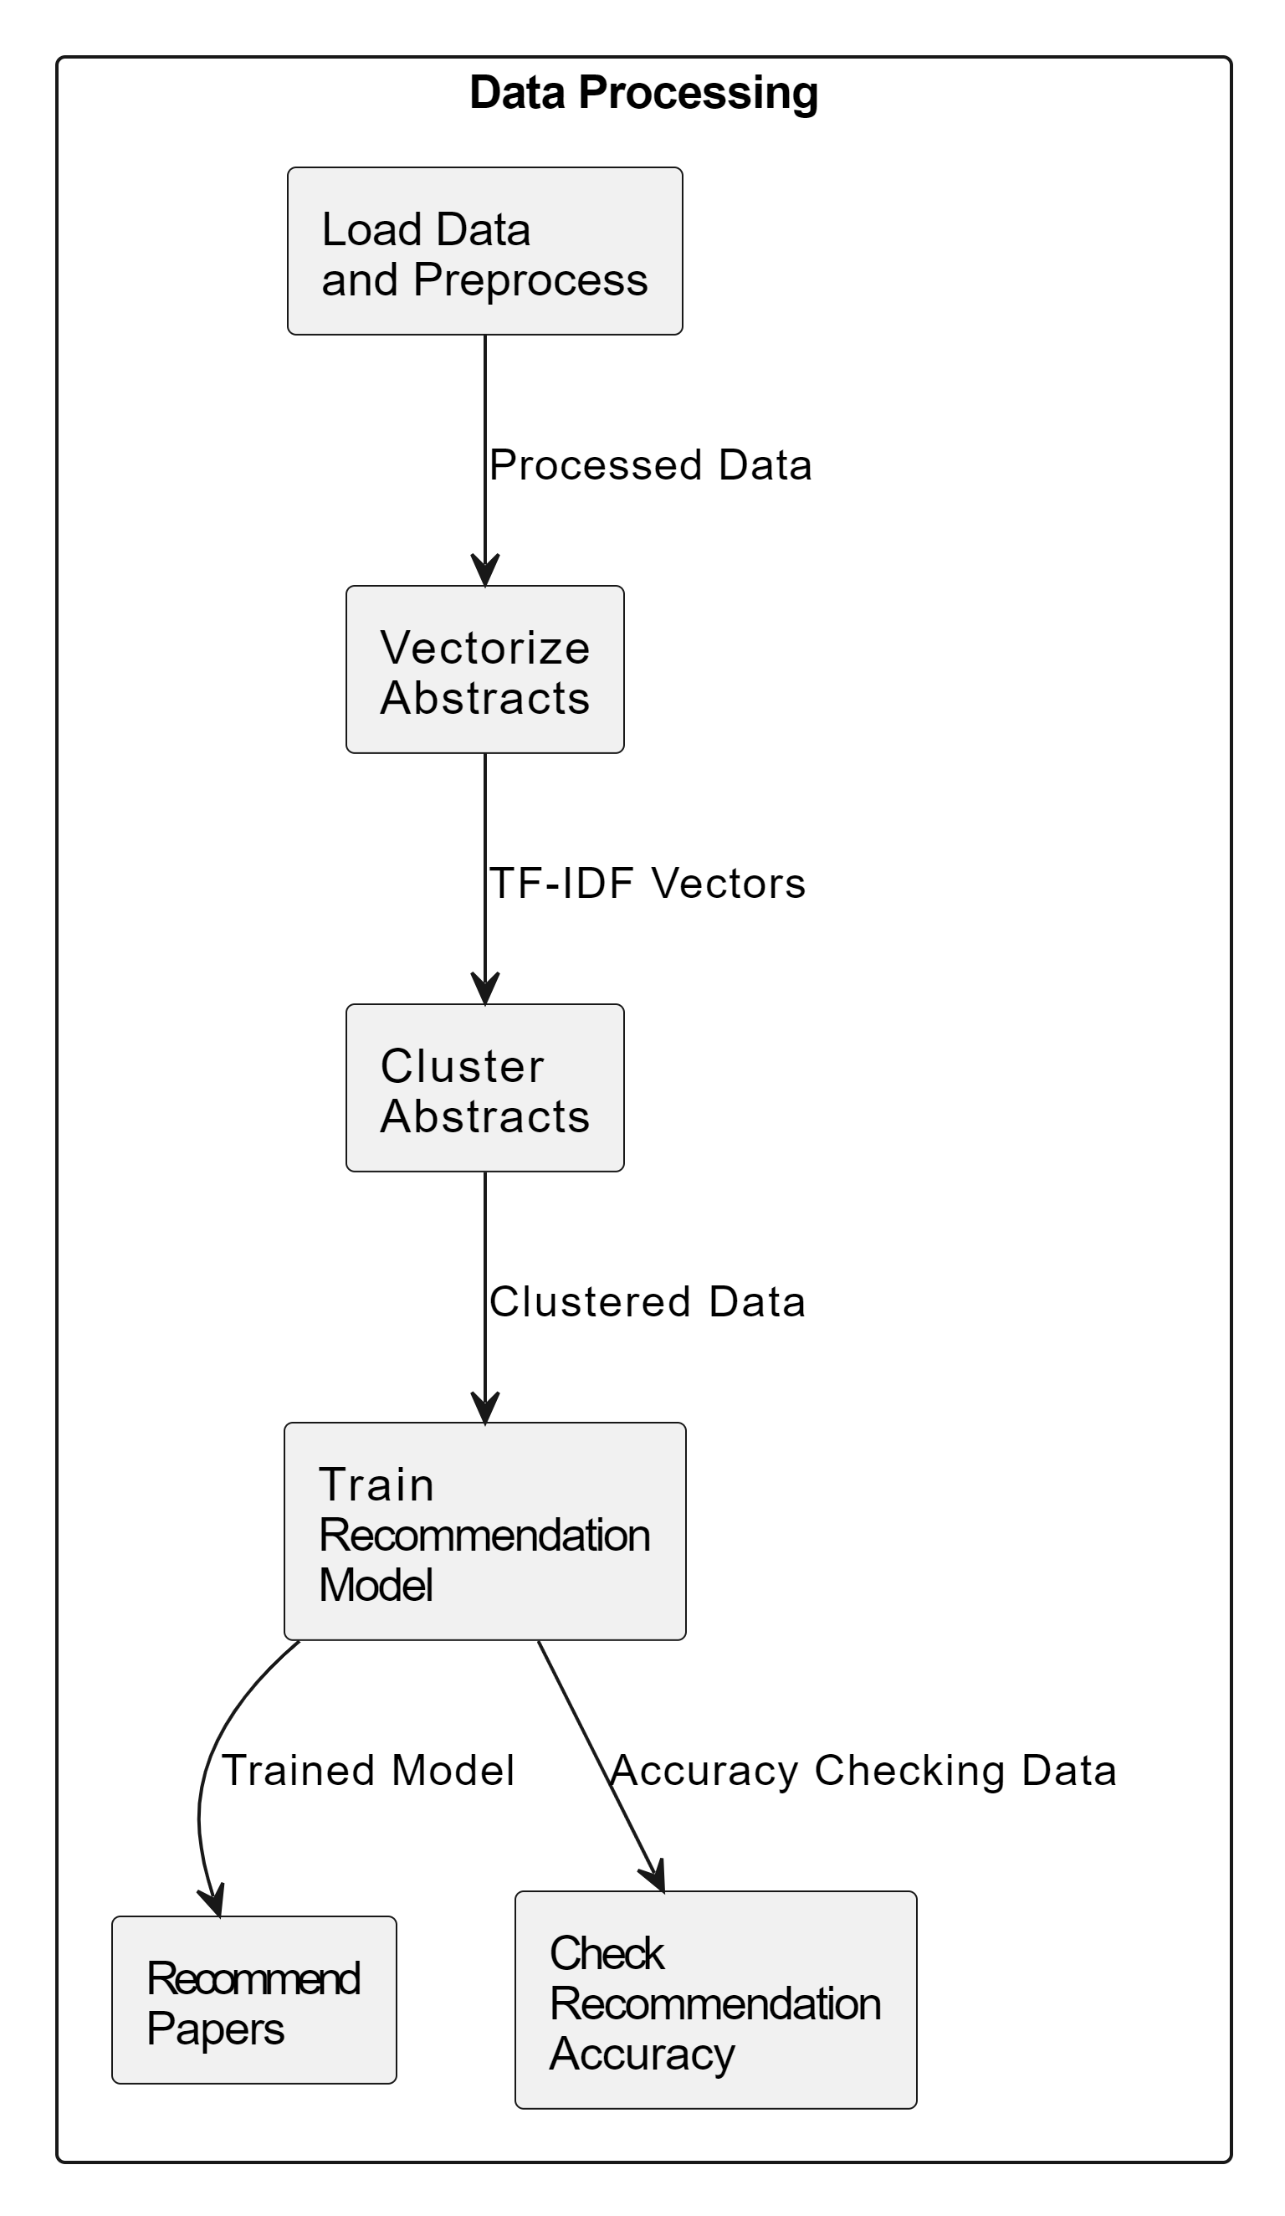
Data Flow Diagram

Slide 20
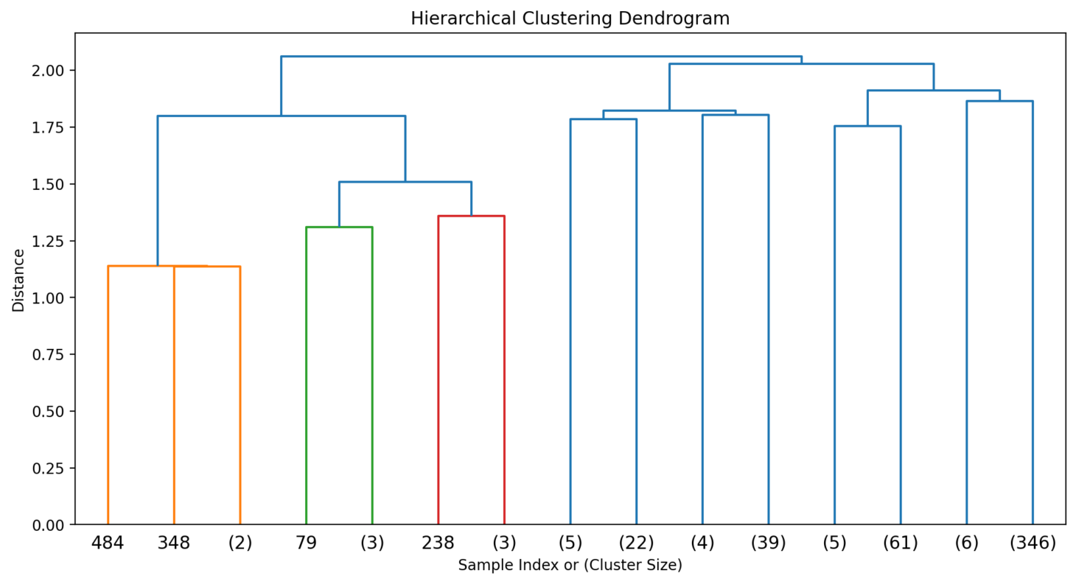
Experimental Results

Slide 21
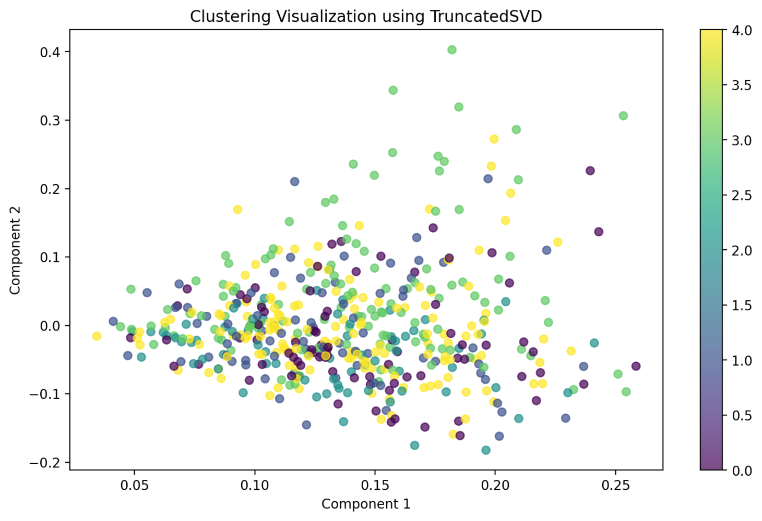
Experimental Results

Slide 22
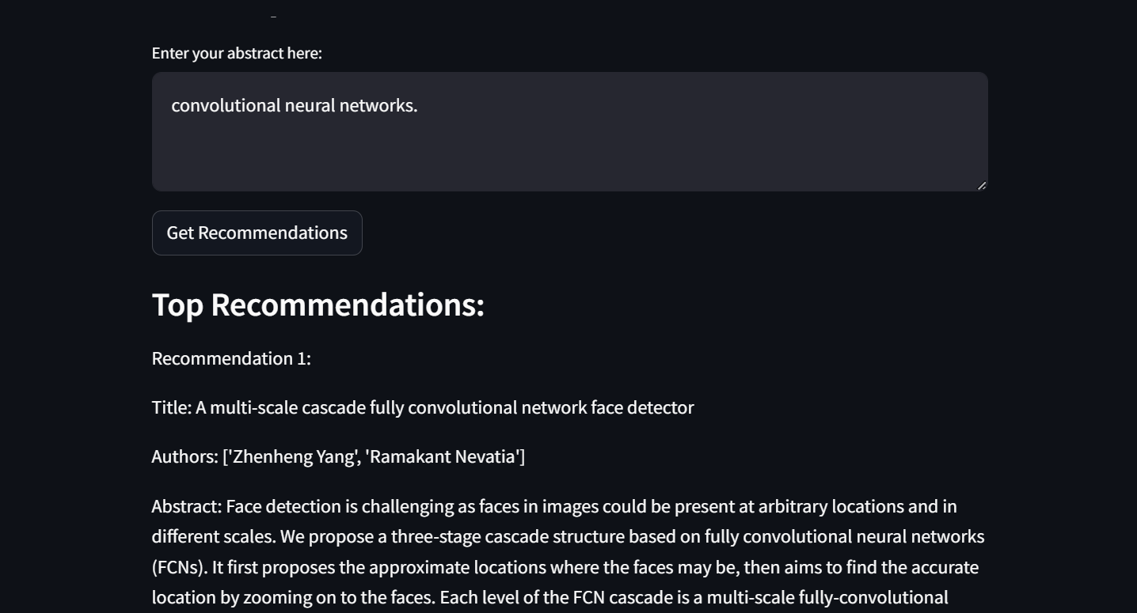
Screenshots of Results

Slide 23
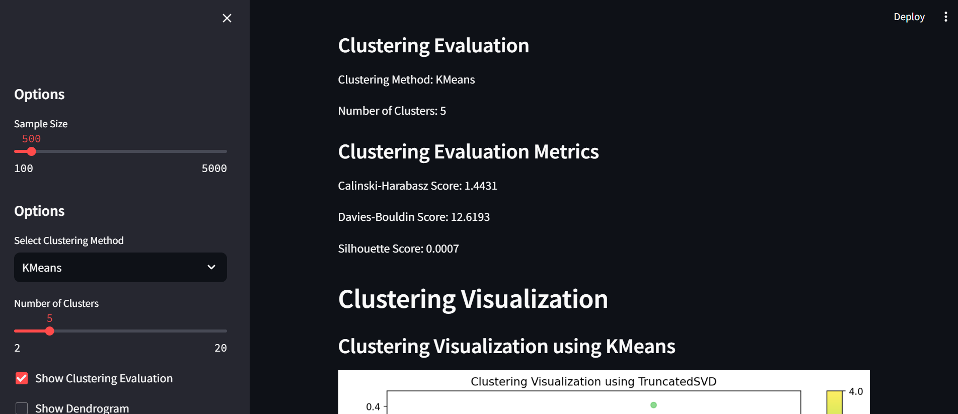
Screenshots of Results

Slide 24
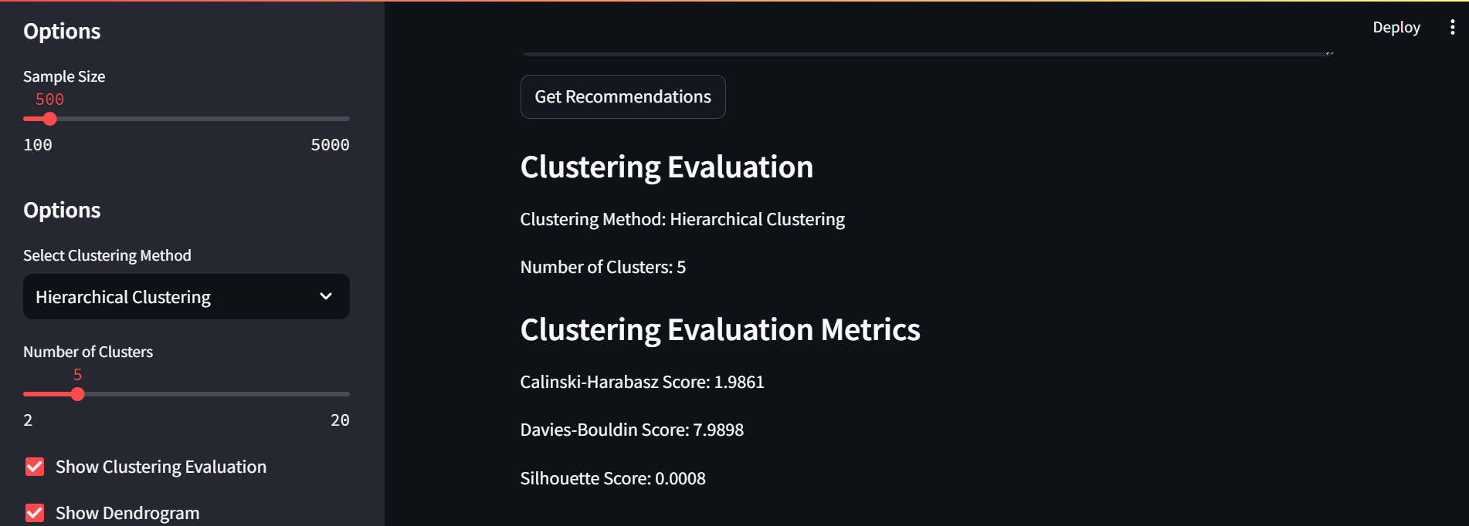
Screenshots of Results

Slide 25
Significance of Proposed Work
Improved Information Retrieval: Clustering abstracts helps researchers quickly find relevant literature, streamlining the review process.
Enhanced Knowledge Discovery: Reveals hidden patterns and relationships between research topics, fostering new insights and innovation.
Scalability and Efficiency: Utilizes BERT embeddings and LDA topic modeling to handle large datasets efficiently.
Interdisciplinary Research Support: Identifies connections between different fields, promoting collaborative research.
User-friendly Interface : Provides an interactive interface for exploring and analyzing clusters, accessible to users of all expertise levels.
Advanced Analytical Techniques : Combines BERT and various clustering algorithms for precise and relevant results.
Objective Evaluation : Uses metrics like silhouette and coherence scores to ensure high-quality clustering.

Slide 26
Conclusion
This project demonstrates the application of advanced unsupervised machine learning techniques to cluster scientific papers based on their abstracts. By leveraging BERT embeddings for rich text representations and employing LDA for topic modelling, the proposed system effectively organizes large datasets of scientific literature. The integration of various clustering algorithms, such as K-Means, DBSCAN, and Spectral Clustering, ensures robust and precise clustering results. Additionally, the inclusion of a user-friendly interface facilitates easy exploration and analysis of the clusters, making the system accessible to researchers across disciplines. This approach not only improves information retrieval and knowledge discovery but also supports interdisciplinary research and collaboration. Overall, the project provides a scalable and efficient solution for managing and analysing scientific papers, enhancing research productivity and innovation.

Slide 27
Future Enhancements
Integration with more advanced NLP models : Incorporate newer NLP models like GPT-4 to improve the quality and accuracy of the text embeddings.
Real-Time data processing : Implement real-time processing capabilities to handle continuously growing datasets and provide up-to-date clustering results.
Support for Multilingual Abstracts : Add support for clustering abstracts in multiple languages, broadening the system's applicability to a global research community.
Incorporation of Citation Analysis : Integrate citation analysis to enhance clustering by considering the citation networks and relationships between papers.
Collaboration Features : Add features that enable collaborative work, such as shared clustering projects, annotations, and discussion threads among researchers.

Slide 28
References
[1] George, L., Sumathy, P. An integrated clustering and BERT framework for improved topic modeling. Int. j. inf. tecnol. 15, 2187–2195 (2023). https://doi.org/10.1007/s41870-023-01268-w
[2] Amar Jeet Rawat, Sunil Ghildiyal, Anil Kumar Dixit, "Topic Modeling Techniques for Document Clustering and Analysis of Judicial Judgements," International Journal of Engineering Trends and Technology, vol. 70, no. 11, pp. 163-169, 2022. Crossref,
https://doi.org/10.14445/22315381/IJETT-V70I11P217

Slide 29
[3] A. Y. Ikram and L. Chakir, "Arabic Text Classification in the Legal Domain," 2019 Third International Conference on Intelligent Computing in Data Sciences (ICDS), Marrakech, Morocco, 2019, pp. 1-6,
doi: 10.1109/ICDS47004.2019.8942343.
[4] Zadgaonkar, Ashwini & Agrawal, Avinash. (2023). An Approach for Analyzing Unstructured Text Data Using Topic Modeling Techniques for Efficient Information Extraction. New Generation Computing. 42. 10.1007/s00354-023-00230-5.

Slide 30
[5] Niklas Muennighoff, Nouamane Tazi, Loic Magne, and Nils Reimers. 2023. MTEB: Massive Text Embedding Benchmark. In Proceedings of the 17th Conference of the European Chapter of the Association for Computational Linguistics, pages 2014–2037, Dubrovnik, Croatia. Association for Computational Linguistics.
[6] Ori Ernst, Avi Caciularu, Ori Shapira, Ramakanth Pasunuru, Mohit Bansal, Jacob Goldberger, and Ido Dagan. 2022. Proposition-Level Clustering for Multi-Document Summarization. In Proceedings of the 2022 Conference of the North American Chapter of the Association for Computational Linguistics: Human Language Technologies, pages 1765–1779, Seattle, United States. Association for Computational Linguistics.

Slide 31
[7] Datchanamoorthy, Kavitha & S, Anandha & Padmavathi, B.. (2023). TEXT MINING: CLUSTERING USING BERT AND PROBABILISTIC TOPIC MODELING. Social Informatics Journal. 2. 1-13. 10.58898/sij.v2i2.01-13.
[8] Subakti, A., Murfi, H. & Hariadi, N. The performance of BERT as data representation of text clustering. J Big Data 9, 15 (2022) .
https://doi.org/10.1186/s40537-022-00564-9

Slide 32
[9] E. Atagün, B. Hartoka and A. Albayrak, "Topic Modeling Using LDA and BERT Techniques: Teknofest Example," 2021 6th International Conference on Computer Science and Engineering (UBMK), Ankara, Turkey, 2021, pp. 660-664, doi: 10.1109/UBMK52708.2021.9558988.
[10] Jing Wu, Bicheng Li, and Qilong Liu. 2023. Topic detection based on BERT and seed LDA clustering model. In Proceedings of the 2023 7th International Conference on Innovation in Artificial Intelligence (ICIAI '23). Association for Computing Machinery, New York, NY, USA, 72–78. https://doi.org/10.1145/3594409.3594418

