Slide 1

Gokaraju Rangaraju Institute of Engineering and Technology (Autonomous) Department of Artificial Intelligence and Machine Learning Engineering
Intelligent Police Sketch System using VAE
Under the Guidance of:
Ms. P. Sirisha,
Assistant Professor,
Department of CSE (AI & ML)
Presented by:
1. Mr. Nikhil Garimella (21241A6623)
2. Mr. G. Sai Prakash Reddy (21241A6622)
3. Mr. Ch. Shanmukh (21241A6616)
4. Mr. J. Yuva Teja (21241A6629)

Slide 2
Abstract
Sketch Generation in law enforcement involves of generating a visual representation of the suspect based on witness description as they aid to speed up investigation. The key objectives of the project are to develop an image that can be matched with the criminal database to speed up the investigation procedure, it also seeks to improve efficiency and accuracy of sketching by using interactive slider features. The methodology follows three phases, Train a Variational Auto Encoder (VAE) model on a large facial dataset to generate realistic sketches, Utilize Facenet-512 to match the generated sketch with the dataset and filter the top n (depends on number of matches) matches using Decision tree algorithm, Implement a User Interface with sliders to change facial features to get much accurate outputs. The novelty lies in combining VAE driven sketch generator with Facenet based matching for precise identification of suspect from rough sketch. Additionally, the interactive slider interface allows for more accurate results and those outputs can be added back to dataset for more training data.

Slide 3
Objectives
To generate suspect sketches based on witness descriptions using a Variational Autoencoder (VAE) model.
To match generated sketches with the database using Facenet-512 with which law enforcements can identify the suspects quickly.
To provide slider based interface so that features can be adjusted and fine tuned for better results.
To improve the model by adding unidentified images to the database.
To reduce manual sketching and improving overall efficiency.

Slide 4
Literature Survey
Ref. No. | Methodology | Dataset Name | Advantage | Drawbacks | Results
[1] | GAN inversion for multi-class sketch-based image generation (MC-SBIG). | Synthetic dataset(Self-Made) | Utilizes pretrained generator and focuses on low dimension latent code mapping. | Scarcity of public paired sketch-photo data. | Produces sketch-faithful and photo realistic image and outperforms baselines.
[2] | 3D CAD model retrieval using sketches and unsupervised learning. | Approximately 2,000 3D CAD models. | Considers speed, accuracy, and ease of use simultaneously it constructs attributed loop relation tree. | Not faster than encoders. | Validated feasibility and effectiveness through experiments.

Slide 5
Literature Survey(Cont..)
Ref. No. | Methodology | Dataset Name | Advantage | Drawbacks | Results
[3] | Hierarchical variational autoencoders (VAEs) in a two-stage setup | ImageNet-256 | Focuses on learning structural components and avoids fine-grained detail modeling. | Slower convergence compared to FaceNet. Limited capability in adapting to new data | Achieved a FID of 9.34, comparable to BigGAN.
[4] | Art Model for generating coloured sketches | CWGAN - Deep Dive | Automates sketch creation. Improves quality compared to existing methods and saves time for artists. | Limited adaptability to different styles of art. | Good image quality. Improved sketch to image conversion.

Slide 6
Literature Survey(Cont..)
Ref. No. | Methodology | Dataset Name | Advantage | Drawbacks | Results
[5] | Conditional variational autoencoder for generating gamma event images | Monte Carlo Simulations | Reduces computational cost compared to Monte Carlo. Produces images similar to real data. | Dependent on Monte Carlo data for training. | Classifier neural network assigns average gamma score of 0.984
[6] | Bidirectional collaborative synthesis network with StyleGAN-like architecture | Public composite face sketch database | Effectively aligns photo and sketch distributions in latent space. | Relies heavily on latent space alignment, which is less interpretable than decision tree approaches. | Good performance compared to state-of-the-art methods.

Slide 7
Literature Survey(Cont..)
Ref. No. | Methodology | Dataset Name | Advantage | Drawbacks | Results
[7] | VDVAE-SR, a VDVAE-based model for image super-resolution | Kaggle Image Dataset | Leverages transfer learning on pretrained VDVAE and is competitive with state-of-the-art models. | Lacks interpretability compared to decision tree approaches | Comparable results on image quality metrics with state-of-the-art models.
[8] | Cascaded diffusion models with conditioning augmentation | ImageNet | Generates high fidelity images without any classifiers | More computationally intensive compared to simpler models like FaceNet. | FID scores: 1.48 (64x64), 3.52 (128x128), 4.88 (256x256); top-1 accuracy: 63.02%, top-5: 84.06%.

Slide 8
Literature Survey(Cont..)
Ref. No. | Methodology | Dataset Name | Advantage | Drawbacks | Results
[9] | Lightweight deep learning model for face recognition, inspired by FaceNet | Public face recognition datasets | Memory-efficient (3.5 MB). Useful for real-time performance. | Interpretability is harder. | State-of-the-art accuracy, suitable for resource-constrained devices, real-time performance.
[10] | Deep Neural Networks for binarizing facial biometric data | MOBIO, Labelled Faces in the Wild, MS-Celeb-1M | High-entropy binary representation, customizable length, supports crypto-biometric systems. | Relies heavily on latent space alignment, which is less interpretable than decision tree approaches. | 4096-bit binary embeddings with 3300 bits of entropy.

Slide 9
Literature Survey(Cont..)
Ref. No. | Methodology | Dataset Name | Advantage | Drawbacks | Results
[11] | Large-scale synthetic dataset using computer graphics for face recognition | LFW, SynFace, synthetic dataset | Addresses label noise and bias in real data. Improves augmentation. | Requires fine tuning. | 52.5% error reduction on LFW, accuracy improves from 91.93% to 96.17%.
[12] | Lightweight CNN architecture for real-time face detection | WIDER Face Dataset | Reduces computational cost | Low accuracy in high dimensional images. | Increased accuracy with reduced computation. Implemented on low-end systems.

Slide 10
Literature Survey(Cont..)
Ref. No. | Methodology | Dataset Name | Advantage | Drawbacks | Results
[13] | Deep cascaded multi-task framework for face detection. | WIDER Face Dataset | Handles challenging conditions like varying poses, improves accuracy using online hard sample mining. | Struggles with extremer light variations. | Achieves 94% accuracy which is more than ArcFace.
[14] | Deep learning models for facial feature recognition in forensic investigations | Face-Detection Dataset (14000 images) | Accurate facial recognition and is useful in identifying suspects or missing persons. | Doesn’t include important attributes like skin tone and appearance. | Effective use of deep learning in law enforcement.

Slide 11
Literature Survey(Cont..)
Ref. No. | Methodology | Dataset Name | Advantage | Drawbacks | Results
[15] | Computer vision algorithms and deep learning models for face sketch creation and recognition | LFW-People(Face Recognition) | Useful in forensic investigations and law enforcement. | Excludes features like skin tone and texture. | Advances in creating and identifying face sketches.
[16] | GAN-based bidirectional style transfer network for cross-modal facial image synthesis. | Sketch segmentation dataset. | Retains shape content and transfers style details effectively. | Large modality gap leads to challenges. | Effective for synthezing facial photos, sketches and semantic segmentation.

Slide 12
Literature Survey
This paper introduces the first GAN inversion-based method for multi-class sketch-based image generation (MCSBIG), tackling the significant domain gap between sketches and natural images [1]. The objective is to utilize a pretrained generator for image generation from sketches and simplify mapping to a low-dimensional latent code. The methodology involves leveraging GAN inversion and introducing a novel shape loss for improved quality. The model focuses on learning sketch-to-latent code mapping, bypassing the complexity of direct image mapping. Results show sketch-faithful, photo-realistic images that outperform baseline methods.

Slide 13
Literature Survey(Cont..)
The paper addresses the challenge of retrieving 3D CAD models that align with design intentions, as existing methods lack speed, accuracy, or ease of use [2]. The objective is to develop a system that combines speed, accuracy, and usability using sketches and unsupervised learning. The approach utilizes loops as key sketch elements, constructing loop relation trees, and deep variational autoencoders to generate fixed-length descriptors for matching models using -nearest neighbors. Experiments on a dataset of 2,000 CAD models show the feasibility and effectiveness of this retrieval system.

Slide 14
Literature Survey(Cont..)
This paper introduces a fast, realistic image generation method using hierarchical variational autoencoders (VAEs) on high-resolution, multimodal datasets[3]. The objective is to model structural image components by leveraging a two-stage setup where a deterministic autoencoder compresses images into semantic features, and the VAE handles structural modeling. The method achieves a FID score of 9.34 on ImageNet-256, comparable to BigGAN. The results highlight the VAE's ability to generate high-quality images without modeling fine-grained details, making the process faster. Compared to your approach, this method may lack direct integration of face-specific models like FaceNet.

Slide 15
Literature Survey(Cont..)
This paper presents a method for generating colorful sketches to express human emotions, utilizing three stages: data preprocessing, art generation, and color generation[4]. The Art Model enables machines to create high-quality sketches suitable for media use, thereby saving time for artists. The methodology's effectiveness is evaluated using a popularity index metric, demonstrating superior sketch-to-image conversion quality compared to existing methods. Overall, the approach highlights the potential of technology in enhancing artistic expression.

Slide 16
Literature Survey(Cont..)
This study addresses the challenge of detecting gamma-ray events from imaging atmospheric Cherenkov telescopes, traditionally reliant on computationally intensive Monte Carlo simulations[5]. By employing a conditional variational autoencoder, the researchers generate images of gamma events, utilizing the size of the images as a conditional parameter. The generated images closely resemble Monte Carlo outputs, achieving an average gamma score of 0.984. However, the sizes of the generated images exhibit a minor error, suggesting room for improvement in aligning generated outputs with conditional parameters.

Slide 17
Literature Survey(Cont..)
This paper presents a deep learning framework for matching face sketches with photo databases, addressing challenges like the large modality gap and limited paired data[6]. The proposed method utilizes a bidirectional collaborative synthesis network within an intermediate latent space to align the distributions of sketches and photos. Employing a StyleGAN-like architecture, it enhances representation power and introduces a three-step training scheme to mitigate data scarcity. Extensive evaluations demonstrate its superior performance over existing methods, with potential applications for other modality pairs.

Slide 18
Literature Survey(Cont..)
This paper introduces VDVAE-SR, a novel model for image super-resolution that leverages advancements in deep Variational Autoencoders (VAEs)[7]. While traditional models like GANs have excelled in high-resolution image generation, VDVAE-SR employs transfer learning on pretrained VAEs to enhance generative performance. The model demonstrates competitive results against state-of-the-art techniques in image quality metrics, highlighting the potential of deep VAEs in surpassing previous limitations associated with VAE-based approaches.

Slide 19
Literature Survey(Cont..)
This paper presents a cascaded diffusion model for generating high-fidelity images without relying on auxiliary classifiers[8]. The model uses multiple diffusion stages to progressively increase image resolution, with a novel conditioning augmentation method enhancing sample quality. Experimental results show that this approach achieves impressive FID scores (1.48 at 64x64, 3.52 at 128x128, and 4.88 at 256x256) and outperforms existing methods like BigGAN-deep and VQ-VAE-2 in classification accuracy on the ImageNet benchmark.

Slide 20
Literature Survey(Cont..)
This paper introduces a lightweight deep learning model for face recognition optimized for resource constrained devices like embedded systems[9]. The model uses one- or few-shot learning to generate feature embeddings and incorporates refinements to FaceNet, achieving a compact 3.5 MB size 30 times smaller than FaceNet while maintaining high accuracy. The study evaluates the model on public datasets, showing its effectiveness in recognizing occluded faces in uncontrolled environments. With fewer FLOPs (0.06G) and fewer parameters (1.2M), it is well-suited for real-time applications like security and attendance systems.

Slide 21
Literature Survey(Cont..)
This paper presents a novel approach for binarizing facial biometric data using deep neural networks for use in crypto-biometric schemes like fuzzy commitment[10]. The method achieves state-of-the-art performance with minimal degradation on the MOBIO and Labelled Faces in the Wild datasets. Binary embeddings of 4096 bits and 3300 bits of entropy were obtained using a pretrained convolutional neural network trained on the MS-celeb-1M database. These high-entropy binary representations are suitable for clustering, similarity searches, and the creation of a cancellable system with a shuffling transformation for security.

Slide 22
Literature Survey(Cont..)
State-of-the-art face recognition models achieve over 99.8% accuracy on the Labeled Faces in the Wild (LFW) dataset, but often rely on biased, web-crawled images with label noise and ethical concerns around consent[11]. To address this, a large-scale synthetic dataset was created using computer graphics rendering, reducing the error rate on LFW by 52.5% compared to GAN-generated synthetic faces. Data augmentation narrows the synthetic-to-real gap, and fine-tuning on fewer real, consent-obtained images yields performance comparable to models trained on millions of real faces.

Slide 23
Literature Survey(Cont..)
Real-time face detection faces challenges like occlusions, varying backgrounds, and poses. Convolutional Neural Networks (CNNs) improve detection accuracy but are computationally intensive, requiring high-end hardware[12]. This paper proposes a lightweight CNN-based architecture that reduces computation while maintaining accuracy. It uses two modules: a backbone for feature extraction and a detection module for identifying faces at different scales. Mini-inception blocks reduce costs, allowing the model to run on low-end systems. Trained on the WIDER Face dataset, the proposed model shows improved accuracy and reduced computation compared to state-of-the-art methods.

Slide 24
Literature Survey(Cont..)
The paper evaluates a Pareto-optimized FaceNet model enhanced with data preprocessing to improve face recognition accuracy amid mask-wearing challenges due to COVID-19[13]. The model optimizes both accuracy and computation time using Pareto optimization and addresses masked faces through preprocessing. Results show improved accuracy over 94%, surpassing both the original FaceNet and ArcFace models. The model is also smaller and more efficient, reducing inference time, making it practical for real-world, mask-inclusive applications.

Slide 25
Literature Survey(Cont..)
Facial imaging and recognition play a key role in computer vision and biometrics, particularly in forensic investigations and law enforcement, by focusing on facial features alone[14]. Advanced techniques using deep learning models help accurately capture and compare these features against known databases. This review explores recent advancements in generating and recognizing facial images, highlighting their applications, challenges, and future developments. Key areas include diagram creation for identifying individuals and the evolving role of deep learning in improving accuracy and scalability of facial recognition systems.

Slide 26
Literature Survey(Cont..)
This paper proposes a user-friendly application to streamline the process of creating and matching composite face sketches in forensic science[15]. Utilizing deep learning and cloud infrastructure, the application allows users to generate sketches through a drag-and-drop feature, reducing reliance on forensic artists and speeding up the identification process by matching sketches with police databases. This innovation offers a more efficient solution for criminal identification, enhancing the use of technology in law enforcement while addressing the time limitations of traditional hand-drawn sketches.

Slide 27
Literature Survey(Cont..)
This paper explores the use of adversarial networks to convert offender sketches into color photographs, addressing discrepancies in traditional manual sketching processes[16]. Using a novel sketch generator based on gamma adjustment, the study improves photogeneration accuracy. Pre-trained transfer learning models are then employed for classification, achieving a lowest similarity score of 91% and an average identification accuracy of over 70% across datasets. The research concludes that the proposed method outperforms existing state-of-the-art techniques, offering more reliable tools for law enforcement and offender recognition.

Slide 28
Limitations of Existing Approaches
GAN Inversion: Generates realistic images from sketches by mapping to a low-dimensional latent space.
Sketch-Based 3D CAD Retrieval: Uses loop relation trees and VAEs to retrieve 3D models from sketches.
Art Model for Sketches: Creates expressive sketches using a three-stage pipeline of preprocessing, art generation, and colorization.
Collaborative Synthesis Networks: Aligns sketches and photos in latent space using a StyleGAN-like architecture for face recognition.
Cascaded Diffusion Models: Enhances image resolution through a multi-stage diffusion approach.
Lightweight CNN for Detection: Reduces computational load while maintaining accurate face detection.

Slide 29
Software & Hardware Requirements
Minimum Software Requirements
Python 3.8 or above with following libraries:
Numpy
Tensorflow
Pillow
Minimum Hardware Requirements
Intel i5 or above
Nvidia rtx 2050 GPU or above
16GB DDR4 3200MHz RAM
500GB PCIe Gen3(or above) NVMe M.2 SSD

Slide 30
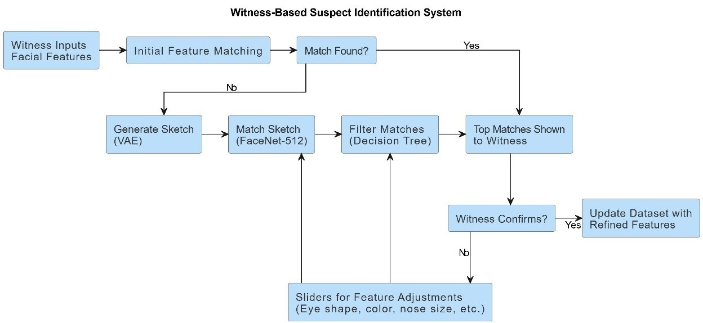
Proposed Method: Architecture Diagram

Slide 31
Description of Architecture Diagram
This is a flowchart depicting a definite pattern of developing and enhancing facial images from the description made by the witnesses. First, the witness gives the facial features and the system searches among the dataset for a match. In case, no such image exists, then the application generates a sketch using unique models such as FaceNet-512. This sketch then undergoes a filtering process through a decision tree to reach to some other option of possible matches. The best matches are presented to the witness who chooses and delineates the portrait using controls for variation such as eye type, and the size and position of the nose. If a match is confirmed, the system updates its dataset for better features where witness feedback would help in improving the future matches. This repeated cycle improves both the levels of precision as well as integration of the facial recognition system.

Slide 32
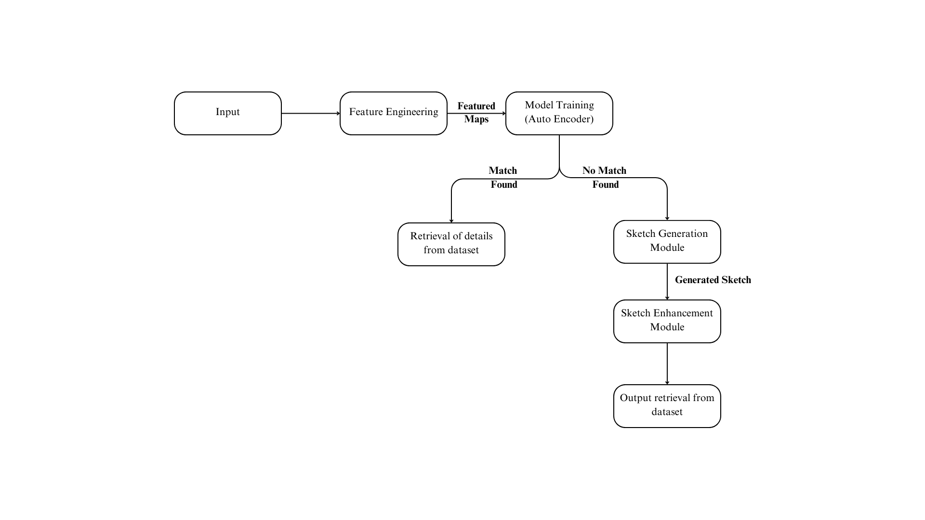
Proposed Method: Module Connectivity Diagram

Slide 33
Description of Module Connectivity Diagram
The provided module connectivity diagram illustrates the workflow of a system for processing and handling input data through various interconnected stages. Here's a brief description:
Input Stage: The process begins with the raw input data, which serves as the starting point for the system.
Feature Engineering: The input data undergoes feature extraction to generate feature maps, which capture key characteristics essential for further processing.
Model Training (Autoencoder): The feature maps are fed into an autoencoder-based model, which determines whether a match is found within a dataset or not.

Slide 34
Description of Module Connectivity Diagram
If a Match is Found: The system retrieves corresponding details from the dataset based on the identified match.
If No Match is Found: The system proceeds to a sketch generation module.
Sketch Generation Module: In cases of no match, this module creates a sketch representation based on the processed input data.
Sketch Enhancement Module: The generated sketch undergoes refinement to improve its quality and ensure it is detailed enough for further use.
Output Retrieval: The enhanced sketch is used to query the dataset and retrieve relevant output information, ensuring a seamless integration between the sketch generation and data retrieval processes.

Slide 35
Dataset Details
The dataset comprises records from the Illinois Department of Corrections (DOC) and includes images and detailed information about 68,149 inmates.
Attributes of the Dataset:
ID: Every inmate has a unique ID.
Name: The first and last name of the inmates.
Hair: The hair colour of the inmates.
Sex: The gender of the inmates.
Eyes: The eye colour of the inmates.
Race: The race of the inmates.
Height: The height of the inmates.
Location: The inmates last found location.

Slide 36
Advantages and Limitations
Advantages
Dual Functionality
High Accuracy
Scalability
Efficient Integration
Limitations
Processing Time
User Responsiveness
Flexibility Challenges
Generative Model Constraints

Slide 37
Experimental Results
The VAE is used to learn the mapping of facial images into a lower dimensional space and reconstruct images from it. The training process is evaluated using two loss functions: reconstruction loss which preferably calculated with Mean Squared Error and KL divergence loss to balance the regulator of the latent space. We assume that the total loss and therefore the reconstruction capability as well as the quality of the feature encoding in more than 20 epochs decreases for the VAE. For additional improvement in performance, intermediate checkpoints are stored and the learning rate is controlled with a scheduler. These results show the VAE ability to generalize over different facial features, which are necessary to the downstream tasks.

Slide 38
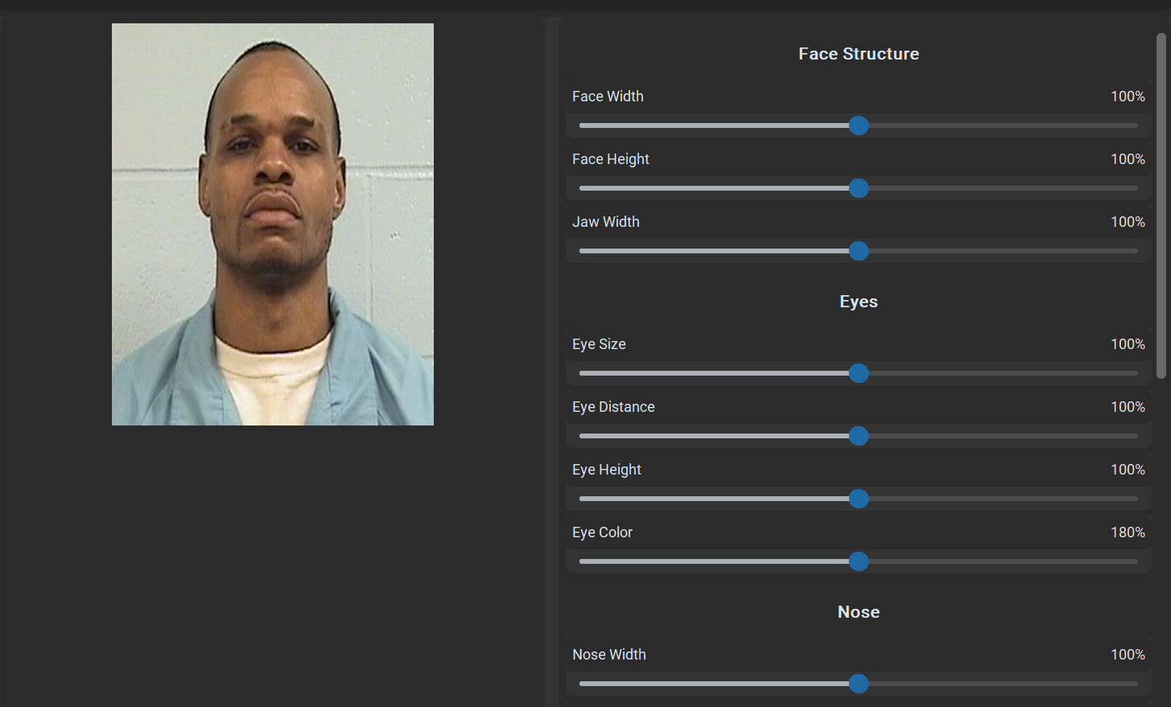
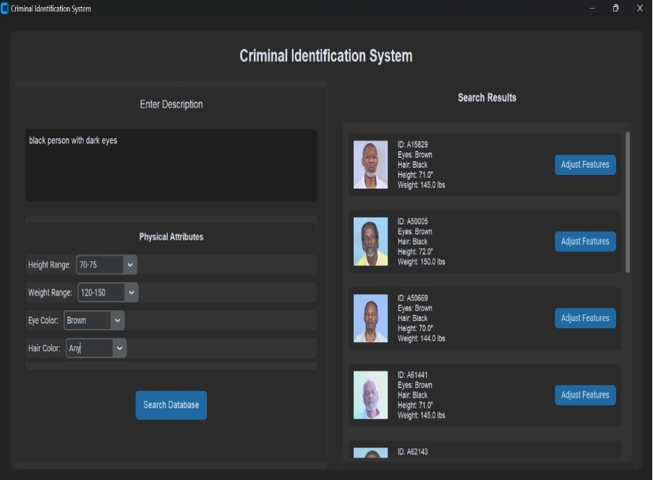
Representation of the Slider
Results of given inputs

Slide 39
Conclusions and Future Enhancements
The proposed face-sketch generation and matching system represents a significant advance in combining generative modeling with feature-based analysis. By leveraging Variational Autoencoders, it excels in generating photo-realistic sketches and effectively matches facial features, particularly valuable in domains like forensics and creative industries. The system strikes a balance between precision and adaptability, ensuring applicability across diverse scenarios. Looking ahead, future enhancements focus on improving realism, complexity, and user responsiveness. Integrating advanced generative models such as GANs and diffusion models could significantly elevate the detail and accuracy of generated sketches. This would enable better handling of complex datasets and further refine the system's ability to reconstruct intricate facial structures. Enhanced user interaction, faster performance, and increased flexibility will solidify its utility in high-stakes applications.

Slide 40
References
[1]Zirui An, Jingbo Yu, Runtao Liu, Chuang Wang, Qian Yu, “SketchInverter: Multi-Class Sketch-Based Image Generation via GAN Inversion”, IEEE/CVF Winter Conference on Applications of Computer Vision (WACV), Waikoloa, HI, USA, pp.4308-4318, 2023, doi:10.1109/WACV56688.2023.00430
[2]Feiwei Qin, Shi Qiu, Shuming Gao, Jing Bai, “3D CAD model retrieval based on sketch and unsupervised variational autoencoder” Advanced Engineering Informatics, China, pp. 101427 , 2023, doi: 10.1016/j.aei.2021.101427
[3]Troy Luhman, Eric Luhman, “High Fidelity Image Synthesis With Deep VAEs In Latent Space”, published at arXiv:2303.13714 ,2023 doi: 10.48550/arXiv.2303.13714
[4]Y. Liu, H. Zhao, X. Wu, “cGAN-based Sketched Image Art Generator Using Deep Learning” IEEE Transactions on Computational Imaging, 2023, doi: 10.1109/ACCESS.10170433.

Slide 41
References (Cont..)
[5]Stanislav Polyakov , Alexander Kryukov, Andrey Demichev, Julia Dubenskaya , Elizaveta Gres , Anna Vlaskina , “ Using conditional variational autoencoders to generate images from atmospheric Cherenkov telescopes”, pushlished at arXiv:2211.12553 ,2023, doi: 10.48550/arXiv.2211.12553
[6]Seho Bae, Nizam Ud Din, Hyunkyu Park, Juneho Yi, “Face Photo-Sketch Recognition Using Bidirectional Collaborative Synthesis Network” 16th International Conference on Ubiquitous Information Management and Communication (IMCOM) , Seoul, Korea, Republic of ,2022, pp. 1-8 ,doi: 10.1109/IMCOM53663.2022.9721719
[7]Chira, D., Haralampiev, I., Winther, O., Dittadi, A., Liévin, V. (2023), “Image Super-Resolution with Deep Variational Autoencoders.” In: Karlinsky, L., Michaeli, T., Nishino, K. (eds) Computer Vision – ECCV 2022 Workshops. ECCV 2022. Lecture Notes in Computer Science, vol 13802. Springer, Cham, doi:10.1007/978-3-031-25063-7_24

Slide 42
References (Cont..)
[8]Jonathan Ho, Chitwan Saharia, William Chan, David J. Fleet, Mohammad Norouzi, Tim Salimans, “Cascaded Diffusion Models for High Fidelity Image Generation”, The Journal of Machine Learning Research, Volume 23, Issue 1,2022, doi:10.5555/3586589.3586636
[9]Zong-Yue Deng, Hsin-Han Chiang, Li-Wei Kang, Hsiao-Chi Li, “A lightweight deep learning model for real-time face recognition” , published at sensors ,2020,doi: 10.3390/s20216114
[10]Mohamed Amine Hmani, Dijana Petrovska-Delacrétaz, Bernadette Dorizzi, “Locality preserving binary face representations using auto-encoders” Publication: IET Biometrics Volume 11, Issue 5,pp 445-458, 2022, doi: 10.1049/bme2.12096
[11]B. Bae, J. Chong, and M. Cho, “DigiFace-1M: 1 Million Digital Face Images for Face Recognition” Proceedings of the IEEE/CVF Winter Conference on Applications of Computer Vision (WACV), 2023, doi: 10.1109/WACV56688.2023.00129.

Slide 43
References (Cont..)
[12]Akingbesote, Damilola ; Zhan, Ying ; Maskeliūnas, Rytis ; Damaševičius, Robertas, “A novel deep facenet framework for real-time face detection based on deep learning model” published at Algorithms.. Basel : MDPI. 2023, vol. 16, iss. 6, art. no. 292, p. 1-24, 2023, doi: 10.3390/a16060292
[13]Pawan Kumar, Nihal Manzoor, Chhavi Dhiman, “Masked-face recognition using deep metric learning and FaceMaskNet-21”, 8th International Conference on Signal Processing and Integrated Networks
(SPIN), Noida, India, pp. 569 – 573, 2021, doi: 10.1109/SPIN52536.2021.9566002 .
[14]B. Sharma, S. Kaur, "Enhancing Suspect Identification: Automated Composite Sketch Generation and Recognition" Applied Intelligence, vol. 51, no. 10, pp. 7112–7123, 2021, doi: 10.1007/s10489-021-03150-3.
[15]A. Kumar, V. K. Jain, "Face Sketch Recognition" Lecture Notes in Networks and Systems, Springer, 2023, doi: 10.1007/978-981-97-6036-7_9.

Slide 44
References (Cont..)
[16]S. P. Singh, R. C. Gupta, "Performance enhancement of generative adversarial network for photograph–sketch identification" International Journal for Research Trends and Innovation, vol. 8, no. 1, pp. 25-30, 2024, doi: 10.52792/IJRTI2401045.

