Slide 1
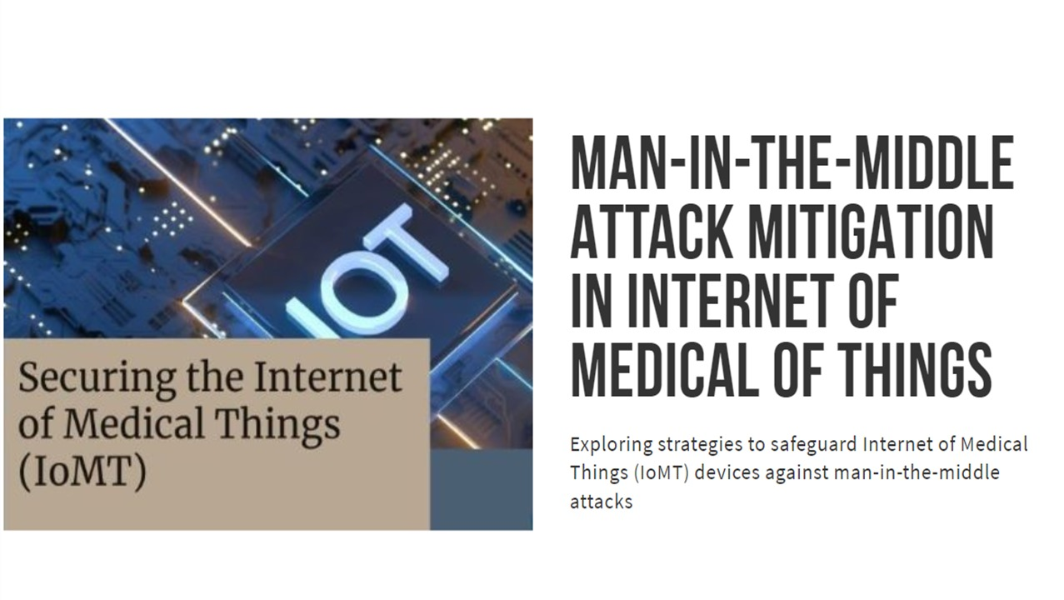

Slide 2

CONTEXT
Introduction to IoMT and MitM Attacks
Problem Overview
Proposed Framework
Components of frameworks
Approach
Security Mechanisms
Conclusion

Slide 3
What is Man-in-the-Middle Attack? A Man-in-the-Middle (MitM) attack intercepts and alters communication between two parties without their knowledge. What is Internet of Medical Things? IoMT (Internet of Medical Things) refers to the network of connected medical devices, sensors, and systems that collect, transmit, and analyze healthcare data over the internet. Remote patient monitoring, Medical image analysis and Drug discovery – Applications of IoMT

Slide 4
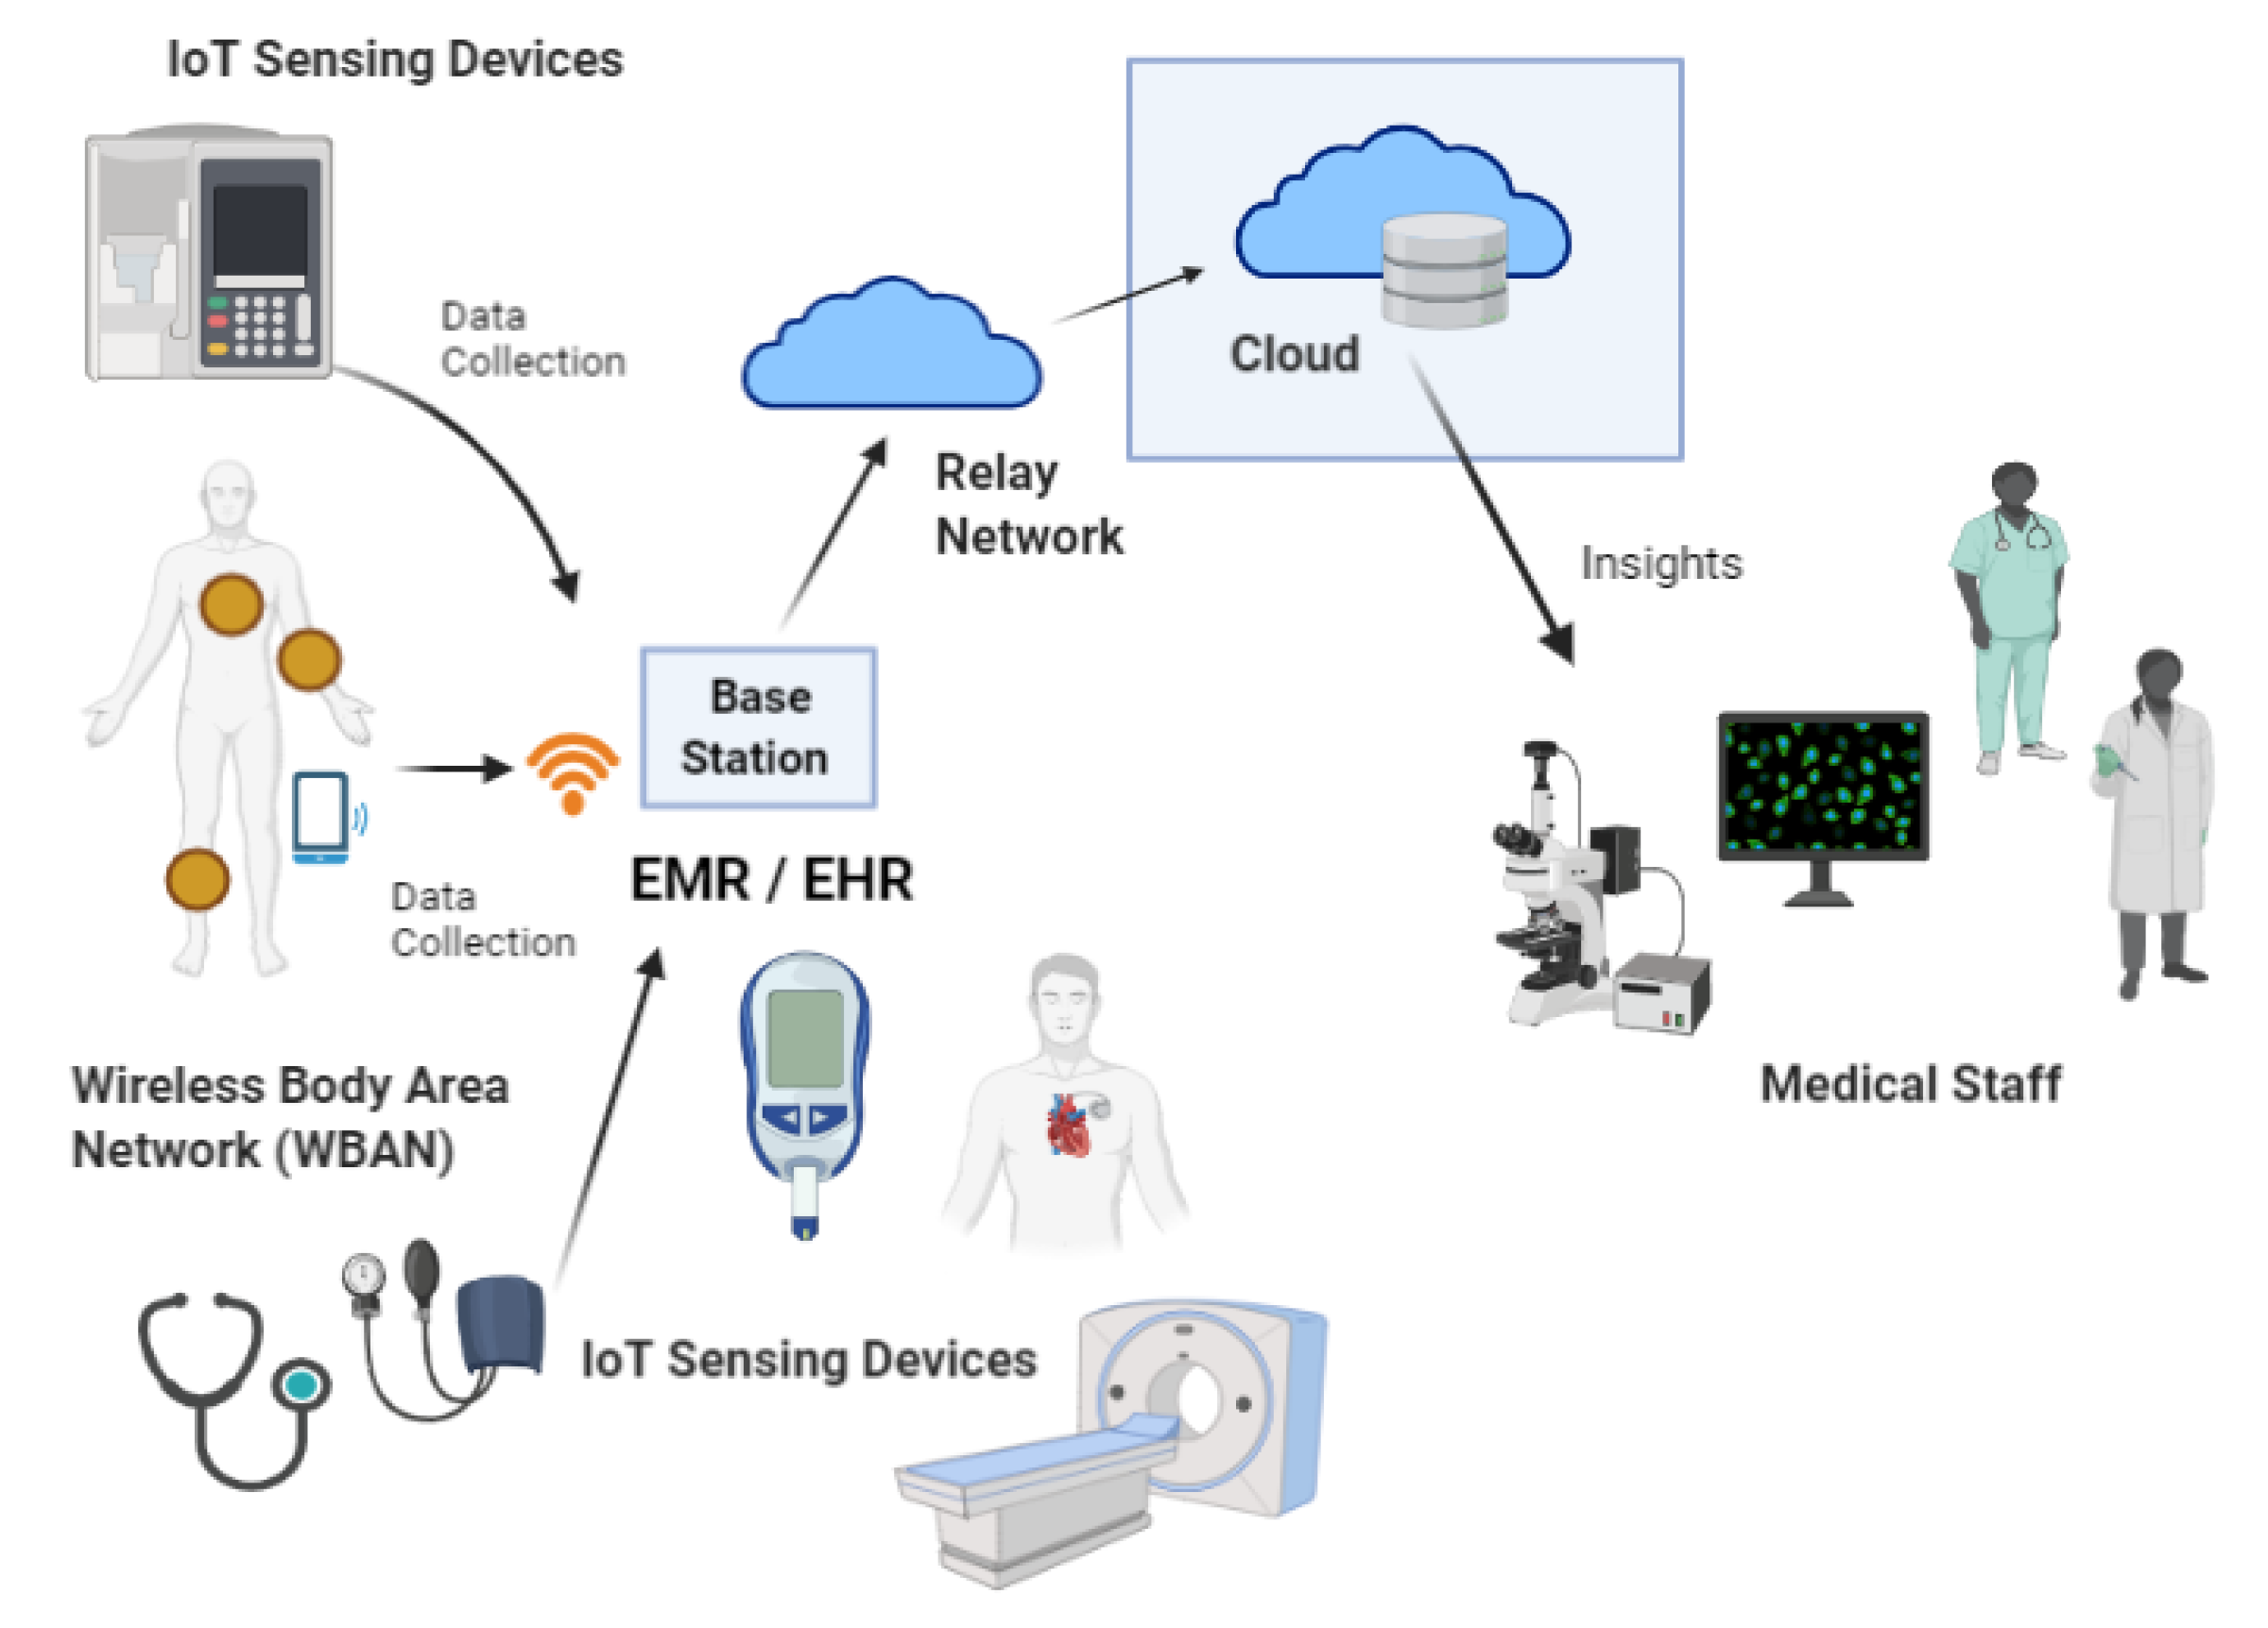
Main Motive
Identifies healthcare conditions of patients and replay physiological data to prevent system from raising false alarms.
Researchers proposed a framework to prevent MitM from disrupting operations and prohibiting raise of alarms by remote healthcare monitoring systems.
This framework transmits smaller size signature derived from MAC where the key is derived from received signal strength.

Slide 5
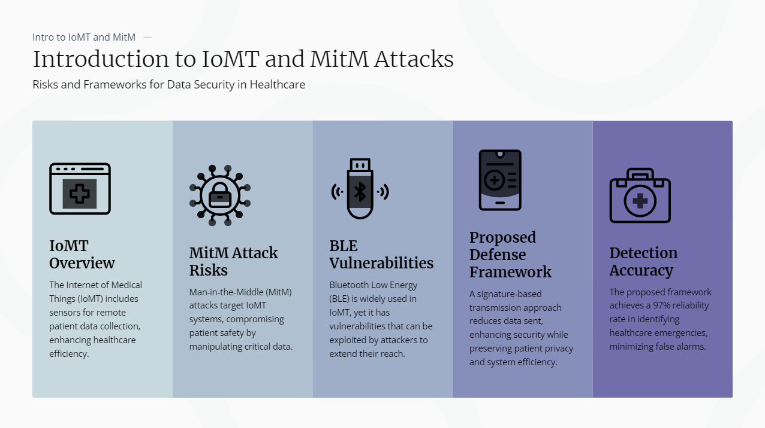

Slide 6
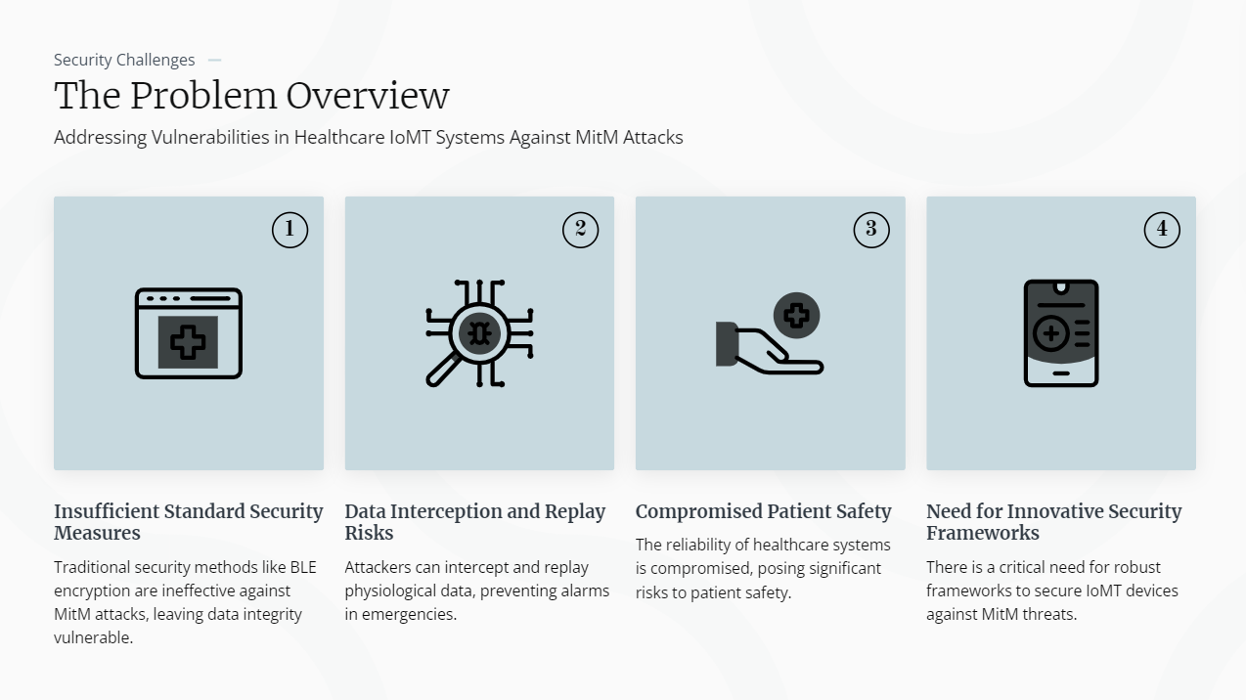

Slide 7

Physiological Signature-Based Authentication Framework
This framework focuses on transmitting signatures derived from physiological data instead of raw data
These signatures are irreversible, meaning even if intercepted, they cannot be converted back to the original measurements.
Key Mechanism:
The sensor data is hashed using cryptographic algorithm (HMAC) to generate a unique signature.
Only the signature is transmitted over the network and the receiver verifies the data's integrity by comparing the received signature with the computed one.
MitM Prevention:
In the event of a successful MitM attack, the attacker can only access the irreversible signature, making it impossible to decipher the actual data or alter it meaningfully.

Slide 8
Components of Proposed Framework: Essential Elements for Securing IoMT Against MitM Attacks
Data Acquisition - Sensors gather vital physiological metrics like heart rate and blood pressure.
Data Preprocessing - Cleansing and filtering data ensures accuracy and reliability before transmission.
LSH Signature - Locality Sensitive Hashing creates irreversible signatures for enhanced security.
- These signatures are typically represented as bitmaps.
HMAC Transmission - Utilizes a keyed Hash Message Authentication Code to ensure data integrity.
RSSI-based Key Derivation - Key for HMAC is determined by the received signal strength, enhancing authentication.
Anomaly Detection - Validates signatures and detects healthcare emergencies using pre-defined thresholds.

Slide 9
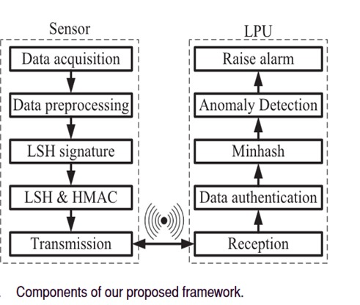
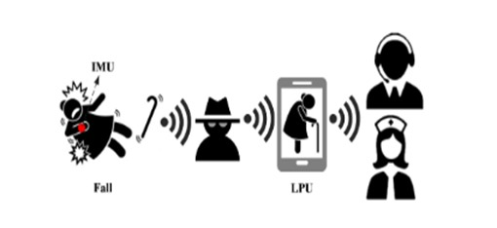
Approach
Framework proposes a system to mitigate man-in-the-middle attacks in IoT medical devices.
The system collects physiological data from sensors, preprocesses it, and calculates LSH signatures and HMACs.
These signatures and HMACs are transmitted to a remote LPU.
The LPU verifies the signatures and detects anomalies to identify healthcare emergencies.
The system provides confidentiality by transmitting LSH signatures and authentication and integrity using HMACs.
In the reception block on the LPU, the authenticity of received signature is verified before conducting anomaly detection to identify healthcare emergency and raise an alarm.

Slide 10
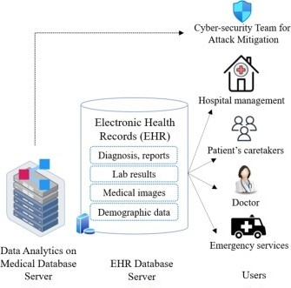
Solutions for Mitigating MitM attacks in IoMT
Improved Security - HMAC derived from RSSI ensures data integrity and prevents data manipulation, securing the transmission
High Detection Accuracy - Assuming that this framework achieves a low false alarm rate of 3%, ensuring reliable detection of healthcare emergencies
Reduced Energy Efficiency - Transmitting smaller signatures instead of full data reduces energy use, extending device life.
Signatures for Securing Data - Irreversible signatures protect sensitive health data from unauthorized access.
Data integrity - Utilizes HMAC for ensuring the authenticity and integrity of transmitted data.

Slide 11


Slide 12
Conclusion
Discussed about secure IoT medical devices from man-in-the-middle attacks.
LSH signatures and HMACs to protect data privacy and integrity.
The approach is efficient and does not require labeled training data.
Experimental results show high detection accuracy with low false alarms.
We can assume that this experiment results may achieve high detection accuracy with low false alarm rate of 3%.

Slide 13
Acknowledgments Gratitude for Contributions to IoMT Security Enhancement
Appreciation for Researchers
Authors: Osman Salem , Khalid Alsubhi, Aymen Shaafi, Mostafa Gheryani, Ahmed Mehaoua ,and Raouf Boutaba
Thanks to researchers whose work fosters innovation in IoMT security, enabling safer healthcare environments.
Enhancing Patient Privacy
Efforts contribute to robust mechanisms that protect patient data from unauthorized access and manipulation.
Advancing Security Frameworks
Collaboration with experts has led to the development of frameworks that mitigate MitM attacks effectively.

Slide 14


References
Research on IoMT Security Measures
Previous studies outline various strategies to enhance IoMT security, highlighting vulnerabilities and protective measures.
IEEE Transactions on Industrial Informatics
This journal article provides insights into the latest IoMT technologies and security measures, published in March 2022.

Slide 15
THANK YOU
Presented By Group 9
Jyothirmayee(CY24)
P Hima Bindu(CY62)
Mounika(CY60)
Nandini(CY38)

