Slide 1





INVENTORY MANAGEMENT AND FORECASTING SYSTEM USING ML
Business Data Management Capstone Project
By- Himanshu Savargaonkar (22ds3000140)

Slide 2


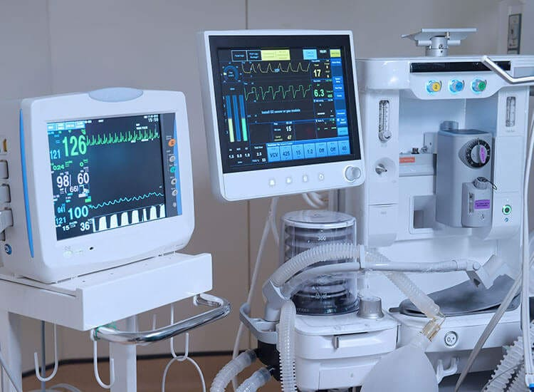




Medical Electronics Pvt. Ltd.
Problem Statement:
To perform statistical analysis on the inventory data; to observe patterns and trends present. Using the trends, use machine learning to project ideal inventory values for the stock items.

Slide 3
Raw Data and Pre-Processing
Item ID and Date | TXN ID | Item name | Incoming QTY | Price | Outgoing QTY | Price | InStock Qty | Total Price
100101001 |  | alluminium clip for to-220 pack. |  |  | UOM | NO | 269 | 707.47
30-Aug-2019 | TOR20001329 |  | 0 | 0 | 1 | 2.63 | 268 | 704.84
16-Sep-2019 | TOW20001636 |  | 0 | 0 | 6 | 15.78 | 262 | 689.06
24-Dec-2019 | TOW20002513 |  | 21 | 55.23 | 0 | 0 | 283 | 744.29
24-Dec-2019 | TOW20002512 |  | 0 | 0 | 21 | 55.23 | 262 | 689.06
24-Dec-2019 | TOW20002514 |  | 0 | 0 | 20 | 52.6 | 242 | 636.46
16-Mar-2020 | TOW20003391 |  | 0 | 0 | 15 | 39.45 | 227 | 597.01
Item ID | Item Name | No. of Transactions | Last Transaction Date | Final Qty | Final Price
100101001 | alluminium clip for to-220 pack. | 51 | 28-Jun-2023 | 453 | 1,116.19
101701002 | connector 10 pin relimate female with wire 2.54 pitch | 2 | 02-Jan-2021 | 0 | 0
101201090 | smd cap 0.1uf /50v 0805 x7r | 361 | 30-Jun-2023 | 21 | 17.26
Number of Transactions |  | Final Stock Quantity:
Very Low (0-5) | 982 items | Very Low (0-5) | 1320 items
Low (6-100) | 1608 items | Low (6-100) | 894 items
Medium (101-500) | 488 items | Medium (101-500) | 486 items
High (501-1000) | 34 items | High (501-1000) | 125 items
Very High (>1000) | 7 items | Very High (>1000) | 294 items

Slide 4
Dead and Zero Inventory
Dead Inventory Report | Total Dead Inventory: | 720
Item ID | Name | Quantity | Price | Last Transaction Date
100101011 | aluminium plate for printer mounting for lifeguard b | 10 | 50 | 15-Feb-2021
100301003 | antistatic bag 250*350 | 500 | 4 | 30-Jan-2021
100401002 | base plastic | 108 | 2 | 02-Jan-2021
100401003 | Side plate for C monitor | 96 | 0 | NAN
Zero Inventory Report | Total Zero Inventory: | 201
Item ID | Name | Last Transaction Date
101001128 | cable for output of adaptor 17v for small defib / Cardiomax | 13-Jan-2020
101001141 | POWER CORD ASSEMBLY-SS-NTM-10-00 | 03-Dec-2019
101201207 | capacitor 120uf/2300vdc, part no-SP25ME / G1200 / G | 25-Jul-2019
101201208 | smd Capacitor 1.5nf 1206 | 23-Apr-2019

Slide 5

Analysis and Implementation
Time Series Problem
Linear Regression
Lasso Regression
Ridge Regression
Implementation Steps
Data Pre-processing
Remove Zero and Dead Inventory.
Remove Data with low and very low number of transactions.
Train Test Split
First 70% of data -> Training Data
Last 30% of data -> Testing Data
Naïve Implementation
Algorithm Selection
Choosing the best algorithm based on scoring metrics.
Parameter Tuning
Final Result
Validation and Scoring
R-Squared Score
Root Mean Squared Error
Mean Absolute Error

Slide 6
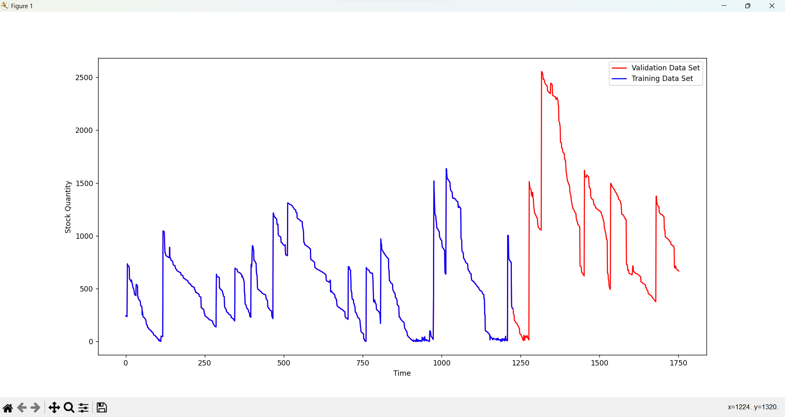
Results

Slide 7
Results

Slide 8
Recommendations and Conclusion
Inventory Categorization and Inventory System Optimization
Splitting the Inventory into different categories
Dead Inventory and Zero Inventory
Remove Dead & Zero Inventory
Maintain offline Dead Inventory Log.
Maintain offline Zero Inventory Log.
Using the Prediction model during Inventory planning
Identify potential demand increase
Phase out items with decreasing demand
Identify over-stocked/under-stocked items
Be more Data Aware

Slide 9
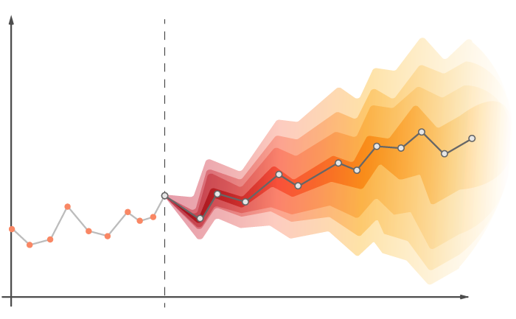
Future Scope
ARIMA Model
Auto-Regressive Integrated Moving Average
time series forecasting model
TimeNet - April 2023 link
TimeGPT-1 - Oct 2023 link

Slide 10





Thank You
Q & A

