Slide 1

TEMPERATURE SENSING USING RFID FOR VACCINE DELIVERY
BY
A. HIMA VARSHA
N. KAAVIA
B. SHRIRAM

Slide 2
MOTIVATION
Vaccines play a critical role in preventing and eradicating diseases, but their efficacy can be compromised by changes in temperature during transportation and storage.
The World Health Organization estimates that up to 50% of vaccines are wasted each year due to improper storage and handling, which can result in reduced effectiveness and increased costs.
Traditional methods of temperature monitoring, such as manual checks, are time-consuming, prone to error, and can be difficult to implement at large scale.

Slide 3
INTRODUCTION
As efforts get underway to vaccinate people around the world. So, pharmaceutical companies and national health authorities are looking for ways to ensure that delicate vaccines remain safe while in transit and are ready to use when they arrive at their intended destination.
Accurate and immediate alerts if temperatures deviate from the safe range is what our project aims to develop, a cost-effective and scalable solution for vaccine temperature monitoring using RFID technology. By ensuring the safe storage and transportation of vaccines, we can help prevent the spread of diseases and protect public health.

Slide 4
Vaccine Box
Infrared thermometer MLX90614
Temperature information
BLYNK(Cloud):
Real time data(Tag and temp information)
Internet
Node MCU
Transmission of Unique ID
BLYNK server
RFID energy activates card
RFID tag
EM-18 Reader with antenna
BLYNK mobile App
(Notifications)
Range 10 cm
Chip information transmission

Slide 5
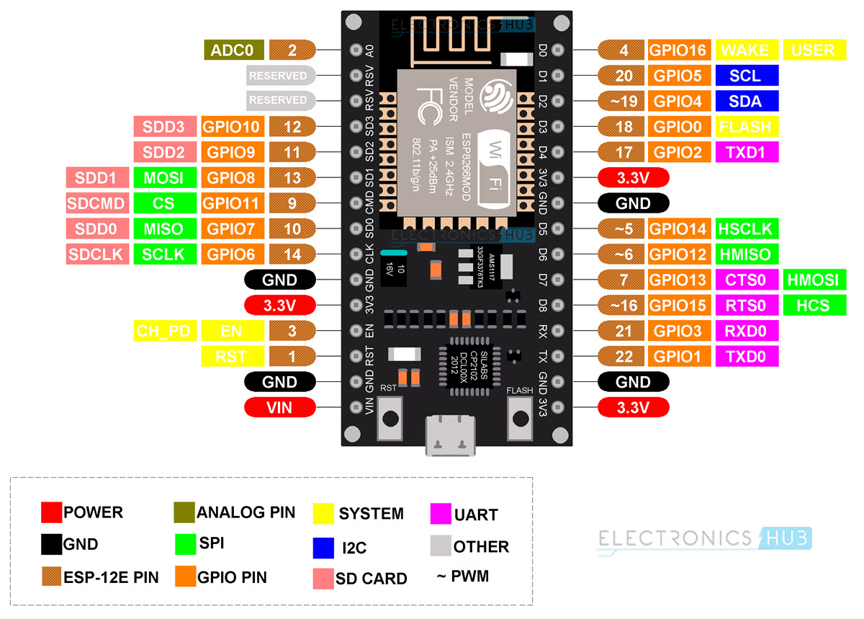
COMPONENETS DESCRIPTION
NODE MCU ESP8266
NodeMCU is an open source platform based on ESP8266 which can connect things and allows data transfer via Wi-Fi.
In addition, by providing some of the most important features of microcontraollers such as GPIO, PWM, ADC and etc.
Contains 13 GPIO pins , 10 PWM channels, I2C, SPI, ADC, UART.

Slide 6
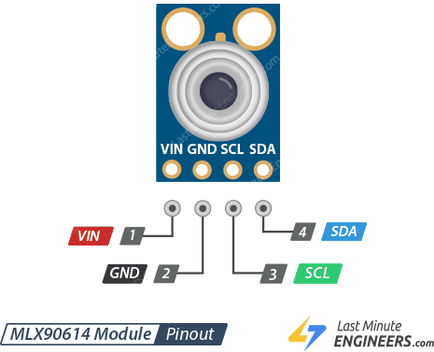
MLX90614:
MLX90614 is an infrared thermometer for non-contact temperature measurements.
It can measure temperature in the range of -20 to 120 ℃, with an output resolution of 0.14℃
This sensor can feel the temperature of an object without touching the object.

Slide 7
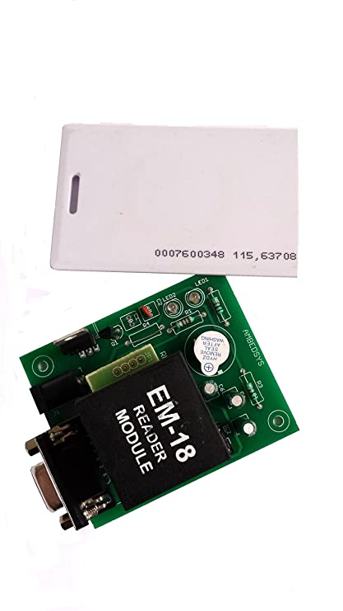
EM-18 RFID Module
The EM18 RFID reader is a low-cost, high-performance RFID reader module
Operates at a frequency of 125kHz
Capable of reading both passive and active RFID tags.

Slide 8
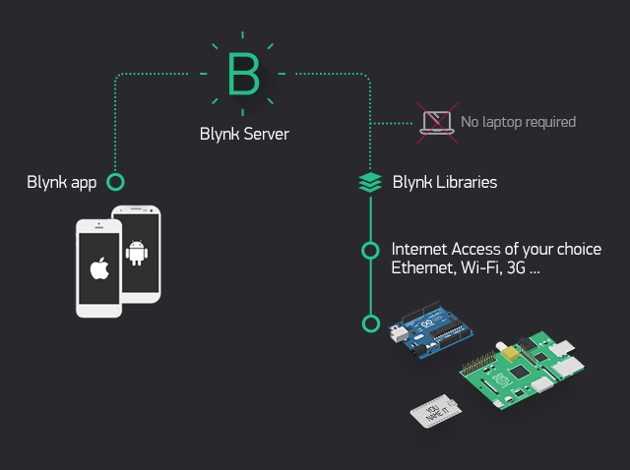
Blynk
To remotely control connected devices and visualize data from them.
To send push notifications by using available widgets and appropriate address.
This application is used to create a graphical interface or human machine interface (HMI)

Slide 9
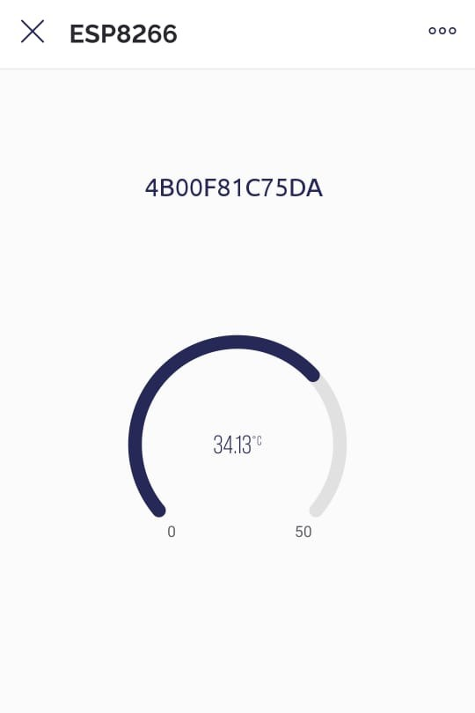
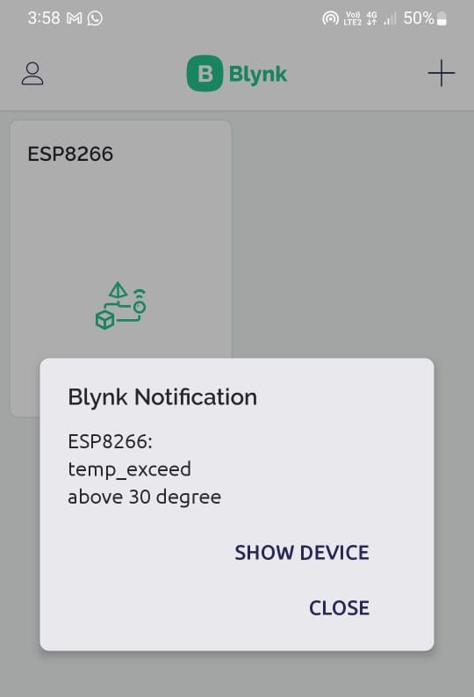
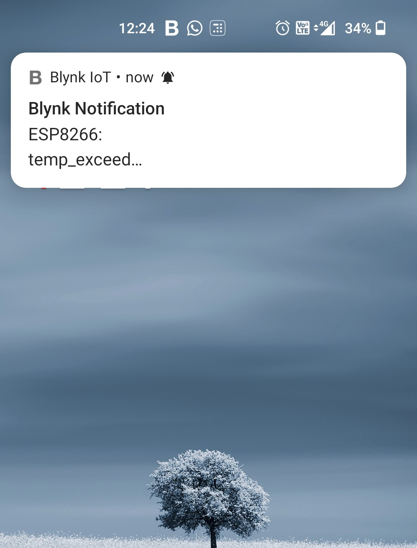
BLYNK OUTPUT

Slide 10
REFERENCES
https://www.nxp.com/company/blog/nfc-and-hf-rfid-technologies-can-help-protect-vaccine-deliveries-and-enable-verifiable-vaccination-certificates:BL-NFC-HF-RFID-TECHNOLOGIES
https://iopscience.iop.org/article/10.1088/1742-6596/1881/3/032002/pdf
https://apps.who.int/iris/bitstream/handle/10665/183583/WHO_IVB_15.04_eng.pdf;jsessionid=7E03EE55FF228B15FDC37EEC38F60A45?sequence=1

Slide 11
Thankyou :)

