Slide 1
SMART
EDUCATION
Development of gamified
platform on
Children’s Rights
to Increase Legal
Literacy and awareness among children in India
Problem Statement ID 1281

Slide 2
Basic Details of the Team and Problem Statement
Ministry
Ministry Of Education
Team Name
Code Crafters
Team Leader Name
Himanshu SIngh
Institute Code
U-0522
Institute Name
Jaypee Institute of Information Technology
Theme Name
Smart Education

Slide 3

As we all know, children are one of the best visual learner and which kid does not like to play games right?
So our team decided to combine visual learning with games for the awareness of children’s right among them.
Our main focus is story game where on the kid’s choice he can have multiple outcome but the catch is that in every scenario he will be learning something.
Our main focus is to educate and help children through things like:
Child Labour
Lack of Money for Education
Sexual Harassment
Child Abuse
Not only learning we also aim that someday our website will contribute in helping real victims suffering these insufferable crimes.
For making this project interactive with kids we also created our very own mascot named…. .MR. LEO
Interactivity among kids
Child-restricted content
Legal correctness and associated challenges
These dependencies have been resolved through extensive research and consultations with legal experts. The
introduction of Mighty Leo, a mascot, which has sparked interest among children

Slide 4
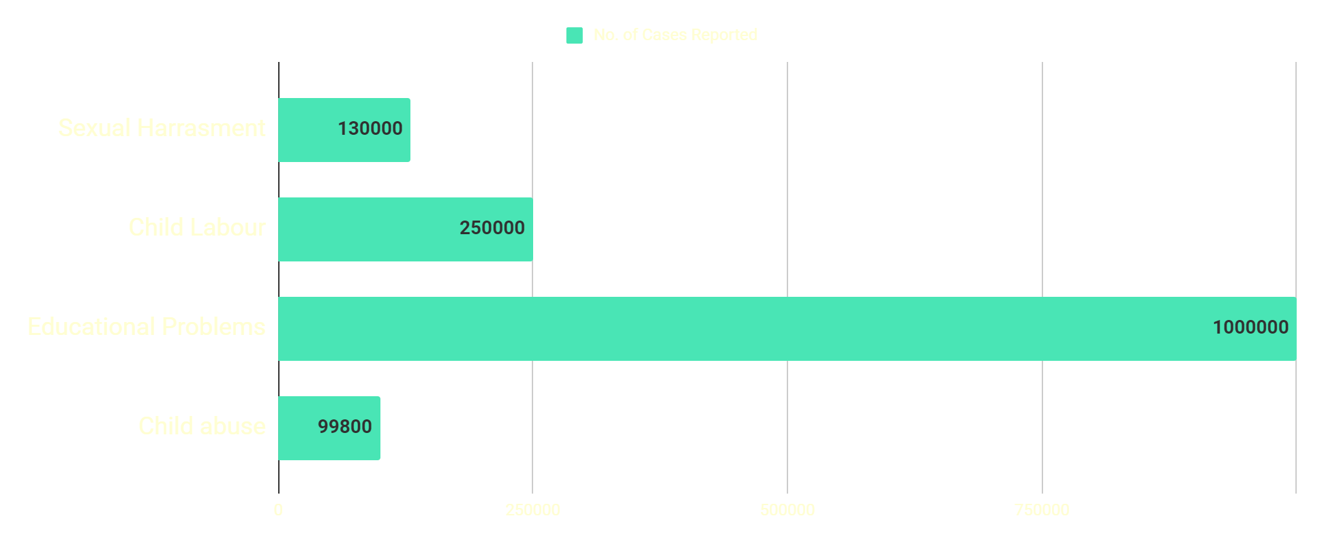
Problems Being Faced By Children
01
02
Whole Indian reach
03
Sexual Harassment
Educational Problems
04
Child Labour
Child Abuse
*The data is derived from a survey conducted by different States. Team Code Crafters disclaim any responsibility for discrepancies in the data.

Slide 5
SAMPLE SOLUTION
Mail sent to Department with urgent subject with IP address
Describe
Are you feeling safe
NO
User
Yes
Yes
Conclusion
Awareness
What right do you want to learn about?
Push to educate and aware other children
Interesting Educational Story
Do you face this situation
NO

Slide 6
Team Details
Team Leader Name
Himanshu Singh
Btech-CSE Year:1
Team Member 1
Yasharth Singh
Btech-CSE Year:1
Team Member 2
Divyansh Singh
Btech-CSE Year:1
Team Member 3
Yash Aggarwal
Btech-ECS Year:1
Team Member 4
Reet Kapoor
Btech-ECS Year:1
Team Member 5
Mohammed Ali
Btech-ECS Year:1

Slide 7

THANKS
Do you have any questions?
himan0411singh@gmail.com
+91 9818377959
https://yasharthsingh0910.wixsite.com/personalsite01
https://github.com/Himaanshuuuu04/
https://www.linkedin.com/in/divyansh-singh-61aa02284

