Slide 1
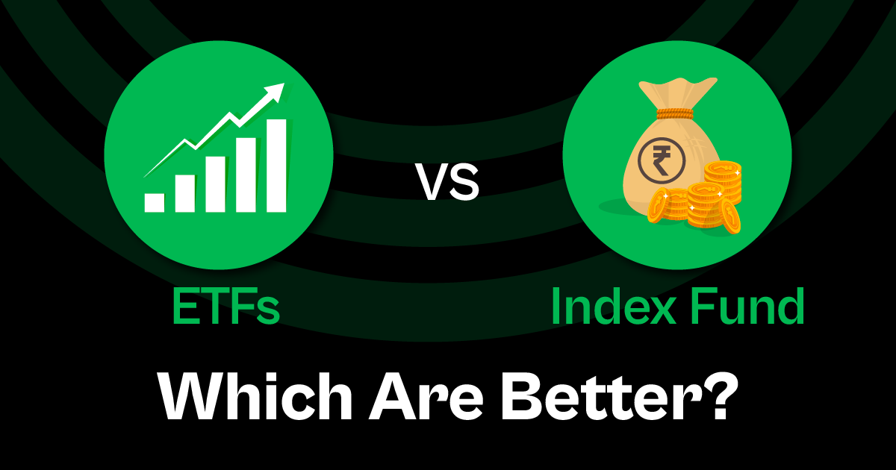
ETFs Vs MutualFunds
PRESENTED BY-
•HIMANSHI

Slide 2

INTRODUCTION
Welcome to our presentation, which compares mutual funds and exchange-traded funds (ETFs), two well-liked financial vehicles, using data analytics.
Using Power BI and SQL, we have carefully evaluated mutual fund and ETF data to uncover valuable insights that can help shape strategic decision-making in the investment industry.
In this presentation, we will take you on a journey around the aromatic world of investments, examining market patterns, accessibility, and liquidity across a range of fund families, categories, and time periods.
Come learn about the hidden potential in your exchange-traded fund (ETF) and mutual fund (MF) data, and acquire useful advice to help you succeed in the competitive world of investing.
Mutual funds are investment vehicles that combine the capital of several individuals.
ETFs provide investors with a convenient and efficient way to gain exposure to various asset classes and investment strategies.

Slide 3
Project Overview
:
This presentation aims to show how Power BI and SQL were used to analyze mutual fund and exchange-traded fund (ETF) data in great detail. We hope to accomplish the following by fusing SQL's reliable querying strength with strength BI's analytical capabilities.
Discover important insights: Examine the details of mutual fund and exchange-traded fund (ETF) data to find patterns, trends, and outliers that offer insightful information on risk, efficiency, liquidity, and the investing market.
To improve decision-making in the investment business, provide relevant and useful information to stakeholders so they may formulate and implement effective marketing plans, product offers, and operational efficiency
Effectively visualize data by presenting complex investment data in an understandable and straightforward manner using the interactive visualizations and dashboards built with Power BI. This will allow stakeholders to quickly discover more information.
Data Cleaning and Preprocessing Steps :
Handling null values
Removing duplicates
Delete irrelevant features
Checking Data types
Add some new features
Making new tables according to my needs
Background Design in Power Point
Generate KPI’s
Importing images
Dashboard Building
Make buttons for page Navigation
Uncover insights

Slide 4
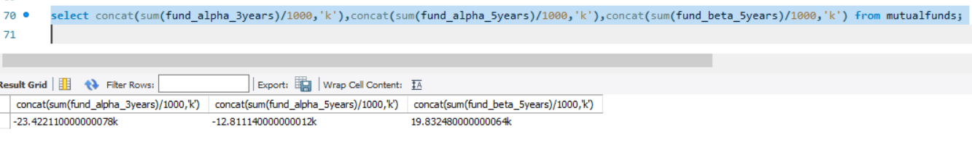
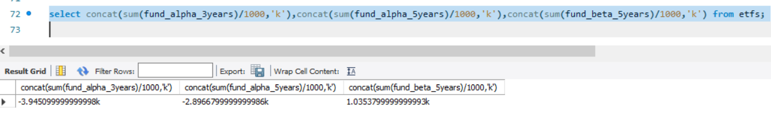
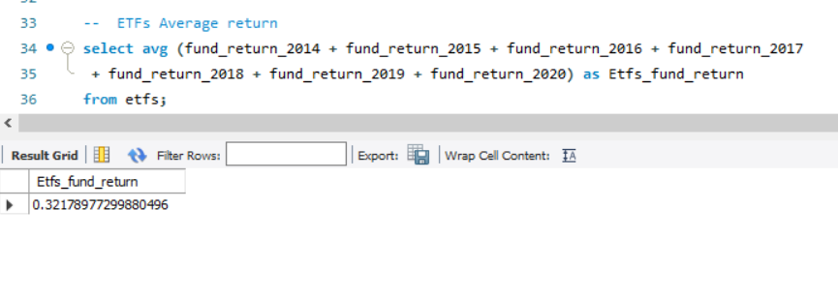
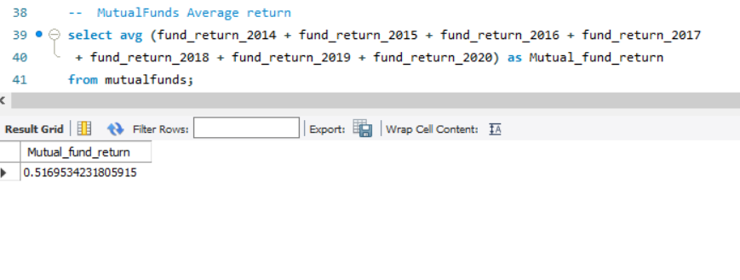
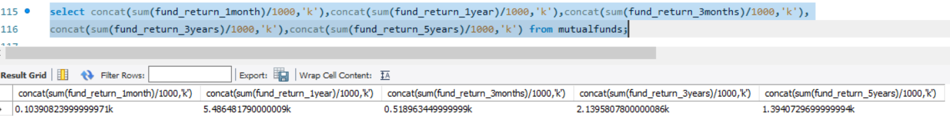
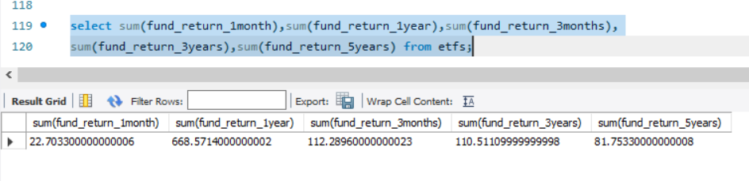
KPI’s
We can compare the differences in return between mutual funds and exchange-traded funds (ETFs)
by obtaining the KPI of our data from the SQL query.

Slide 5
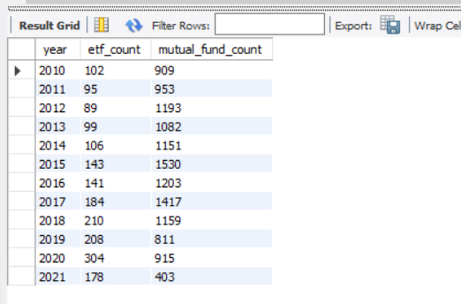
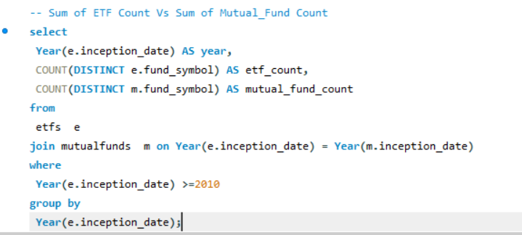
INSIGHTS
This is one of the most significant measures of our dataset since it allows us to identify the fund investment in both categories after 2010.

Slide 6
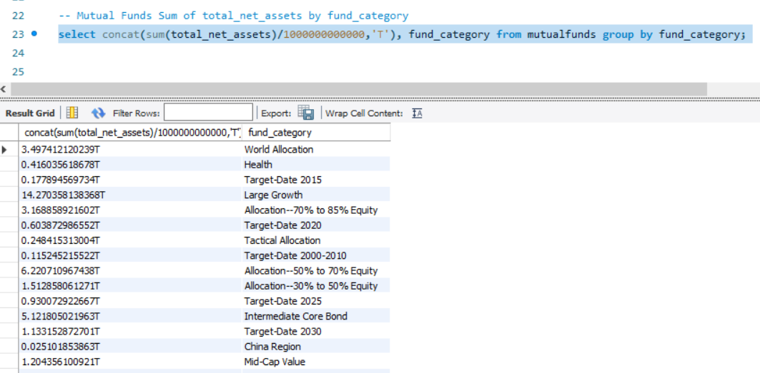
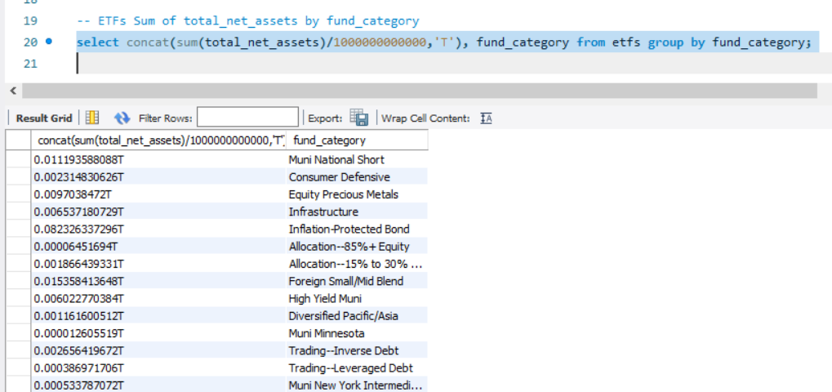
INSIGHTS
This query allows us to see the total net assets in trillion for each fund category of individuals for both investment kinds.

Slide 7
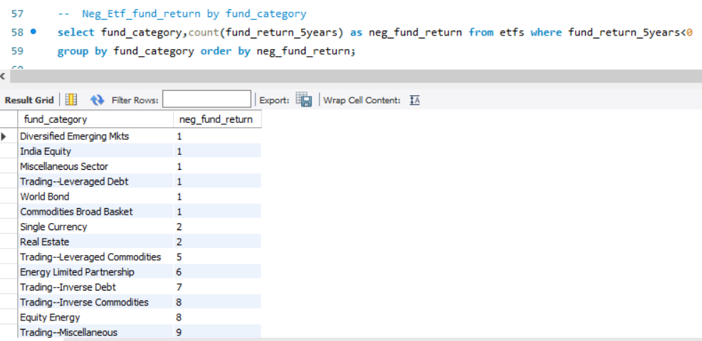
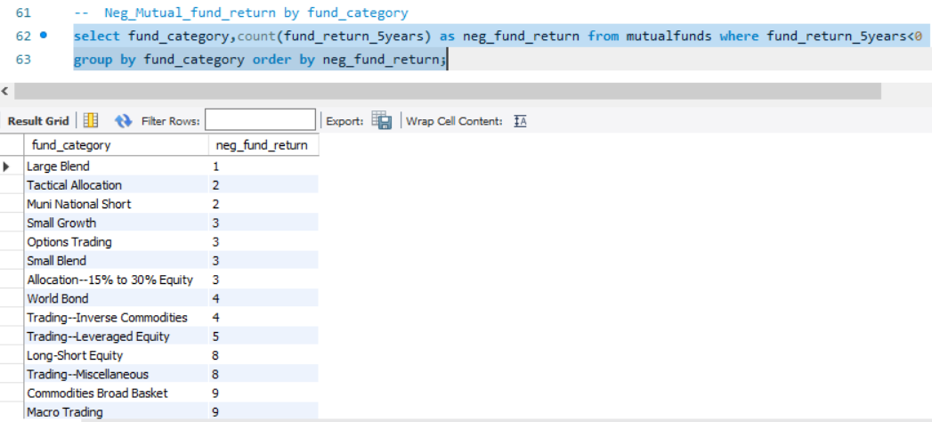
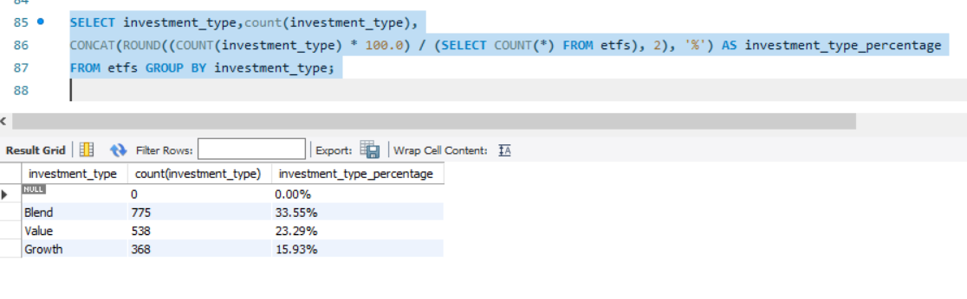
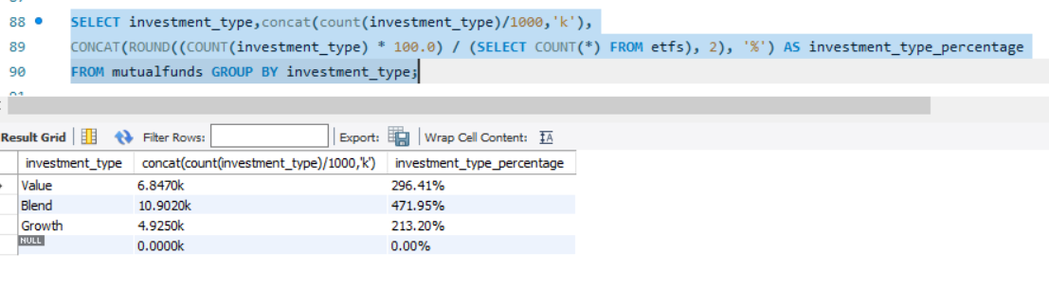
.
INSIGHTS
The purpose of this query is to obtain the count of negative fund returns for each fund category in both the mutual fund and exchange-traded fund separately
one of the important questions that aids in determining the kind of investment and how much of it to put into each investment

Slide 8
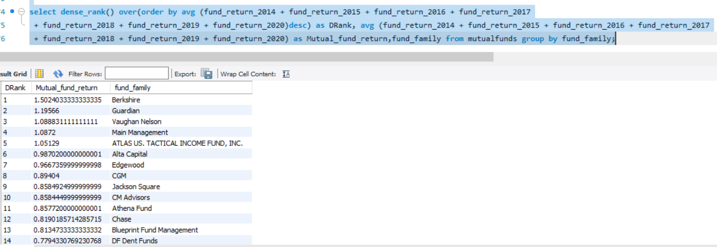
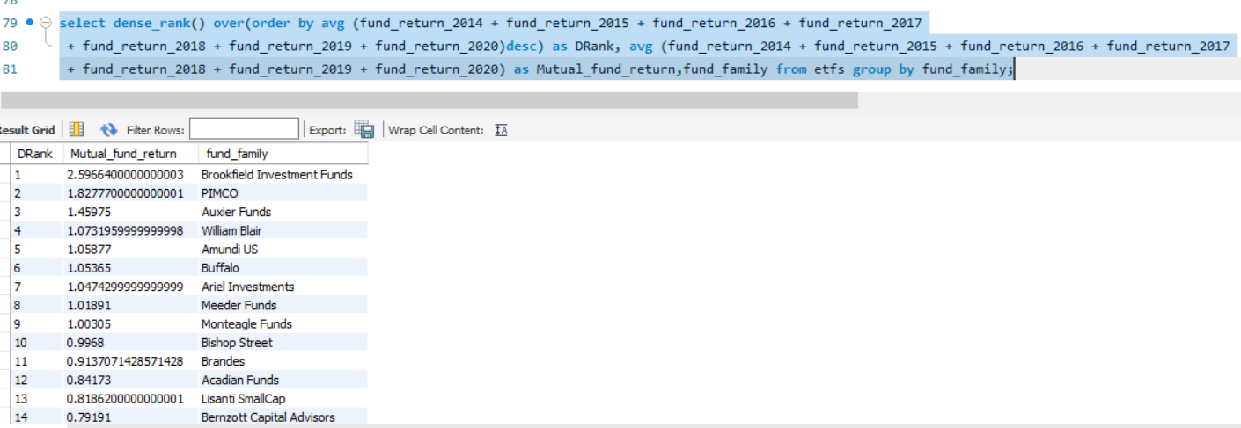
The Rankwise fund return for each fund family can be obtained with the aid of this SQL query.

Slide 9


