Slide 1
AMAZON
Module :Order Management System

Slide 2
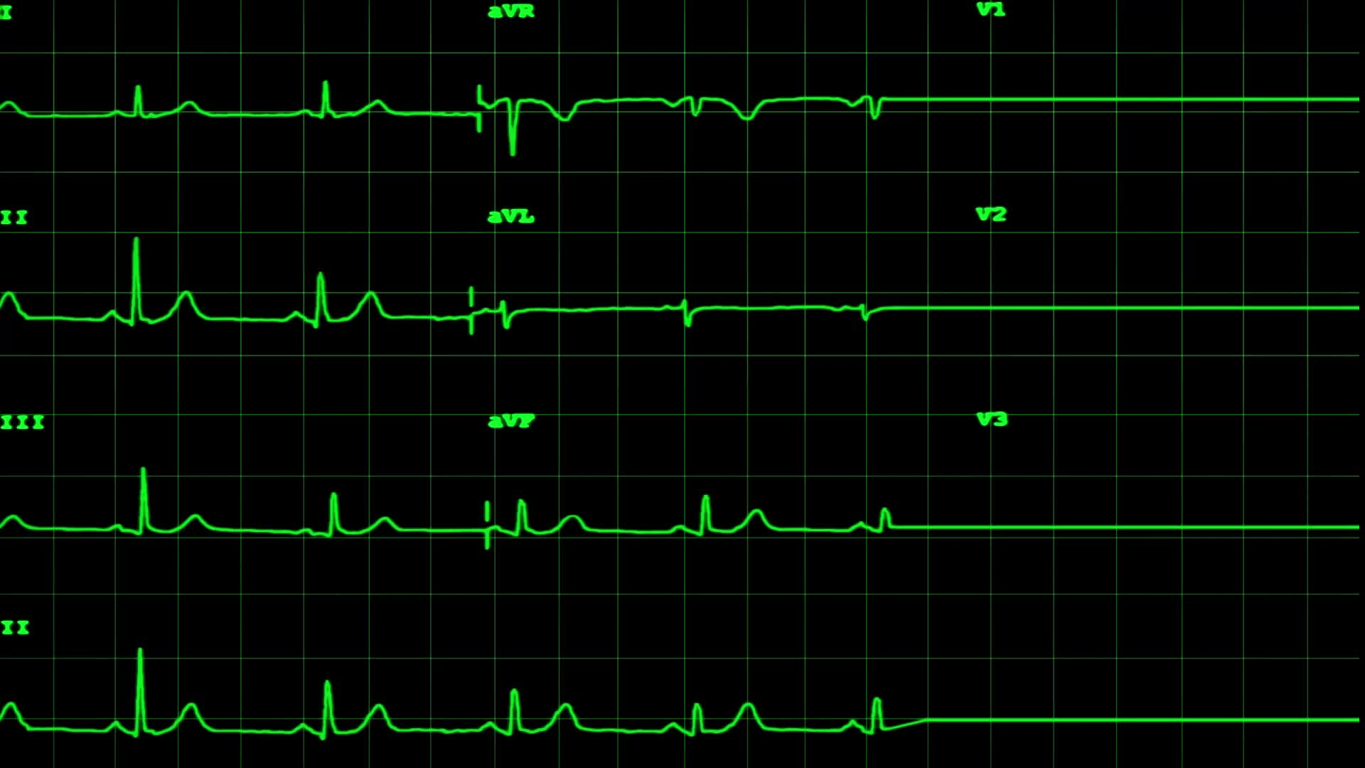
BPMN diagram Presentation
Presented by
Anuron Maitro (2105037)
Group-2 (A2)
Other members of the group :
Md. Asif Ali (2105038)
Md. Maruf Hasan Rubab (2105042)
Himadri Gobinda Biswas (2105047)
Md. Mehedi Hasan (2105052)
Md. Rafat Kabir (2105054)

Slide 3
Features
Our Order Management Module includes 6 core features:
1 )Show Product Cards
2 )Search Items by Category and Name
3 )Add/Remove Items from Cart
4 )Place Order
5 )Order Review and Checkout
6 )Cancel Order

Slide 4
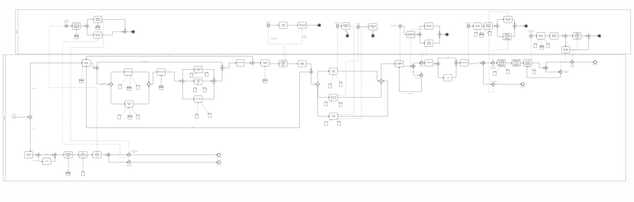
Entire BPMN diagram :

Slide 5
Pools :
Customer (User)
Server (Amazon Order Management System)

Slide 6
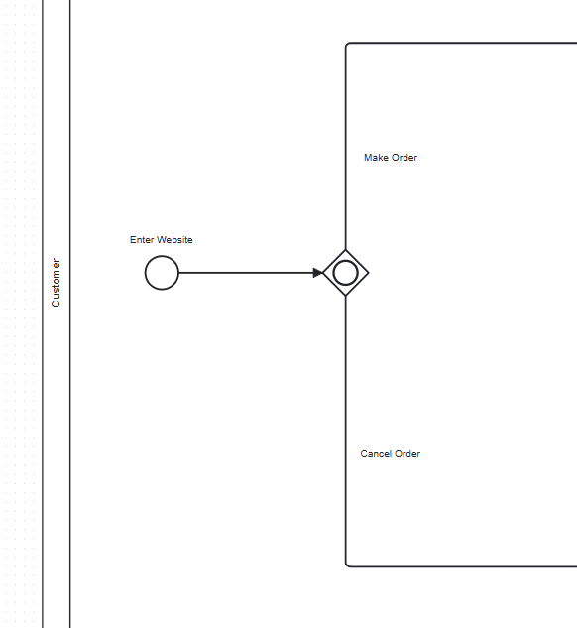
Customer Pool: Starting the process

Slide 7
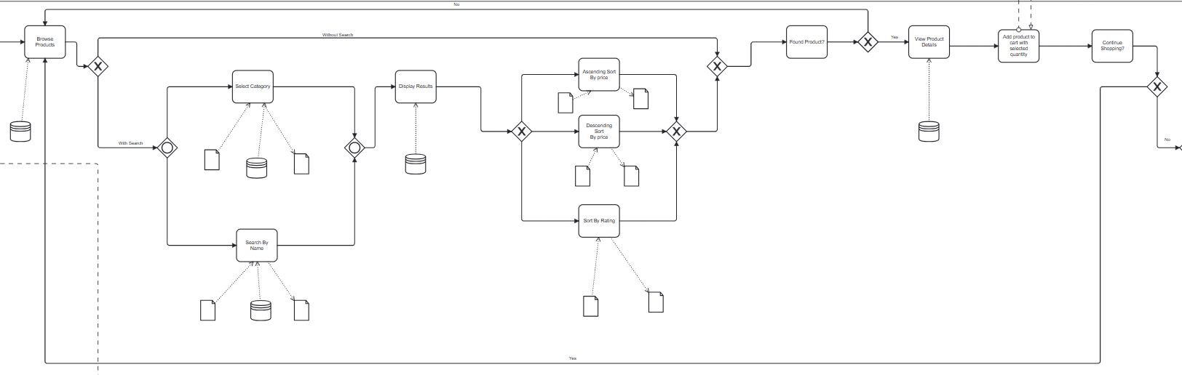
Customer Pool: Find the desired Product

Slide 8
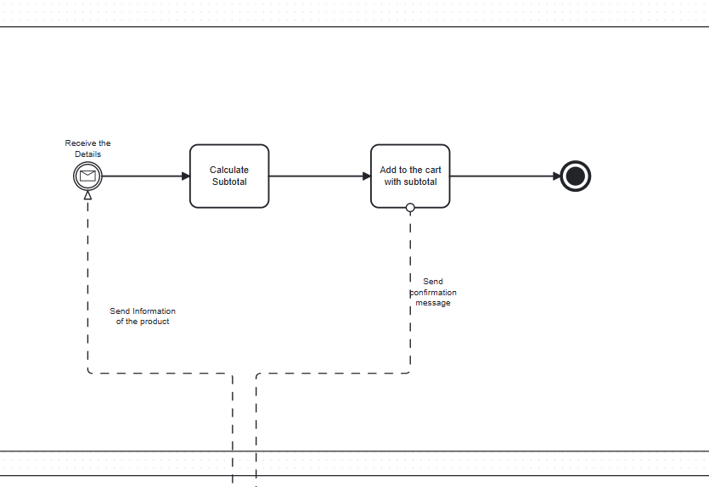
Server Pool: Handling calculation of product cost

Slide 9
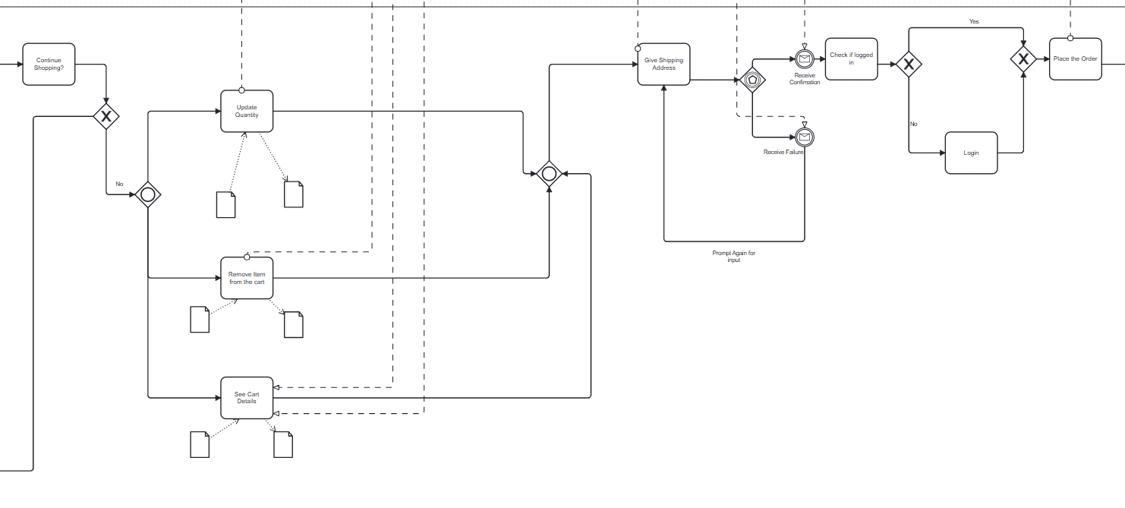
Customer Pool: Managing Cart and Order Placement

Slide 10
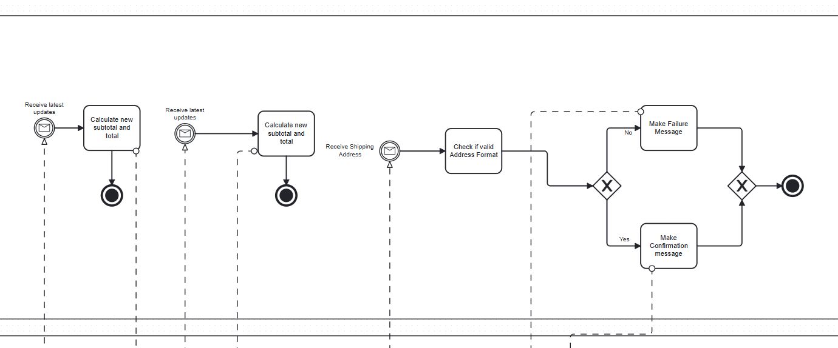
Server Pool: Cost Update and address validation

Slide 11
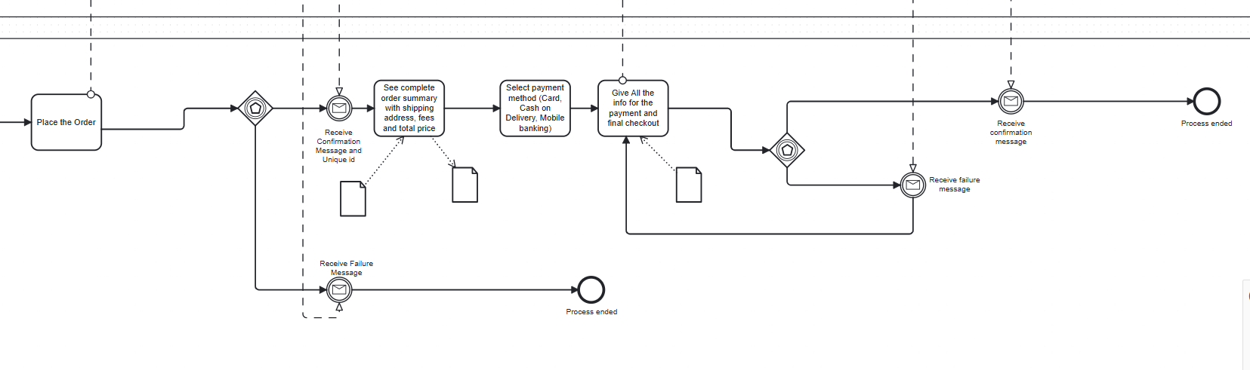
Customer Pool : Payment Processing and Order Completion Workflow

Slide 12
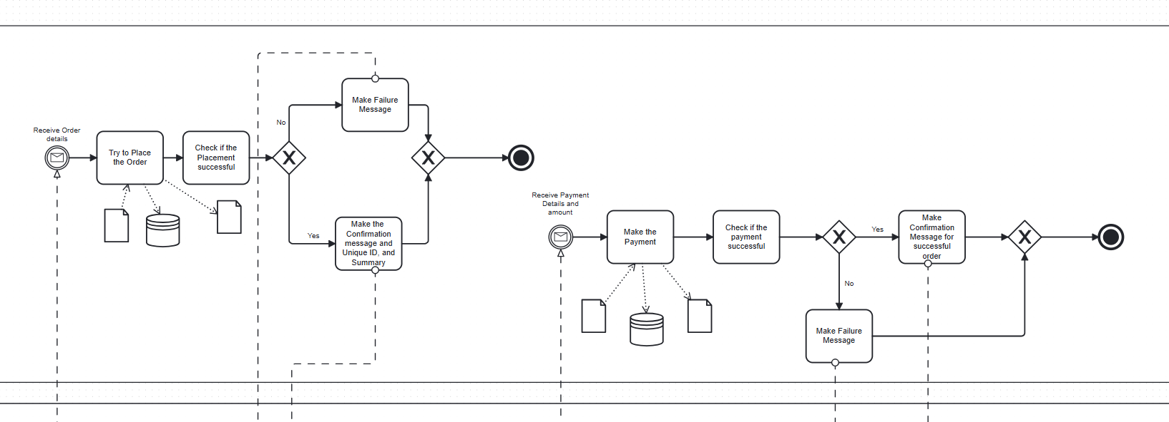
Server Pool: Handling Order Placement and payment validation

Slide 13
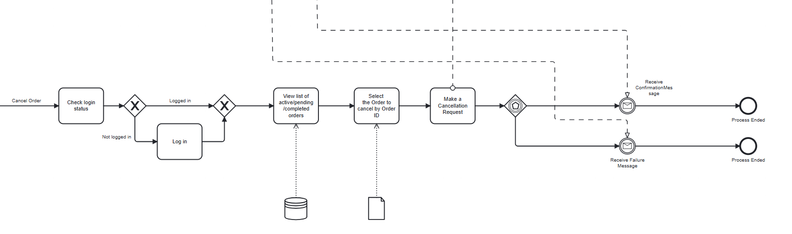
Customer Pool: Order Cancellation Workflow

Slide 14
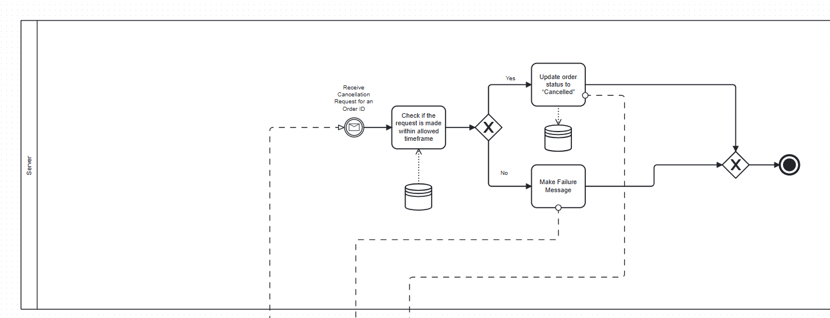
Sever Pool: Order Cancellation handling

Slide 15
Thank You!

