Slide 1
R Project
Predictive Analysis of Anime Data
(Movie/Web series)
Submitted By
Himadri Pan

Slide 2
Aims and Objectives
we need to predict the conditions affecting the “Rating” of Anime movie or web series for “Anime” dataset.
The main objective of this project is to create a Linear Regression Business model by the help this dataset in R-Studio and predict the “Rating”. Also Find the significant variables, Interpretations and giving useful business recommendations. It help us to release our next anime movie/web series which will become most popular.

Slide 3
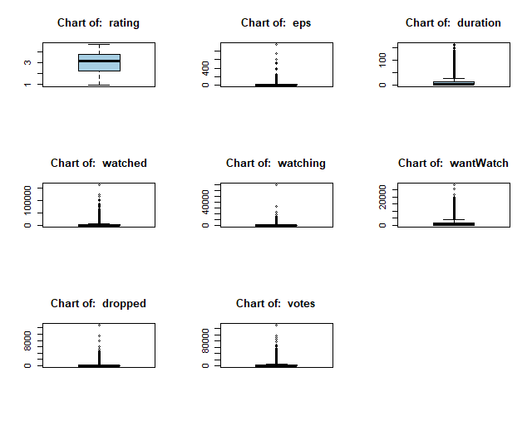
Univariate Analysis
We need outlier treatment for each continuous columns except the target column. The data under those columns are not normally distributed which is viewed from above boxplot.

Slide 4
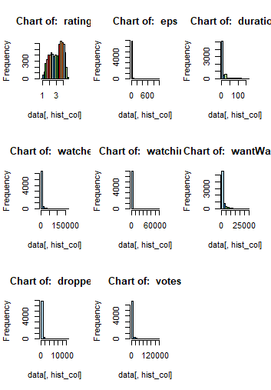
As we can see from above histogram plot that each and every continuous columns are highly positively skewed except “Rating” column. So, we need log transform to make those data normally distributed which will help us to increase the accuracy of the model.

Slide 5
Bivariate Analysis
Correlation Test:- After log transformation we have found---- "watched" ,"watching" ,"wantWatch“,"dropped" ,"votes" columns are strongly correlated with the target variable column.
Annova Test:- “MediaType” & “ongoing” categorical columns are strongly correlated with “Rating” column.(cause, p-Vaue<0.05)

Slide 6
Significant Variables
Among the 15 Independent variables, the variables which were found to be most significant in final model are as follows:-
Votes: -The number of votes that contribute to the ratings received by different anime.
MediaType:-Format of publication of the anime releases (Web/DVD special/Movie/TV special/TV).

Slide 7
Interpretations of the variables
The variables which are found to be significant are discussed one by one as follows:-

Slide 8
Votes
It has been observed from the above curve that “Votes” is increasing with increase of “Rating”. So , these two columns are positively correlated. Increasing rate of votes help to increase the rating of the anime series which makes it more popular than others.

Slide 9
MediaType
Movie, Music video, ova, Tv ,Tv Special genre type under mediaType category are most popular according to our final model. Those type have more rating value and popularity than others which has been observed from above chart.

Slide 10
Results Obtained
It was found from MAPE (Mean and Median error percentage) that our regression model is predicting the outcome 81.14%(Mean) & 87.55%(Median) accurately and error percentage is varying from 13% to 18% which is pretty good for prediction model.
The R-square value is found to be 0.553 and adjusted R-square value is 0.5525. As these values are between 0.5 to 0.95, so this is good predictive model.

Slide 11
Business Recommendations
For better rating, it is required to focused on movie type –Movie , ova, Tv ,Tv Special, as this categories are famous to maximum audience.
Over the past few years audience change there way of watching movie. Now peoples are mostly interested to watch movie in Multiplex Theater also they like to web series as a platform to release Animation type of movie.

Slide 12
Thank You

