Slide 1



COMPETITIVE ANALYSIS OF BI TOOLS
By- Srijita Chakraborty, Sayali Nitin and
Himadri Neogi

Slide 2


INTRODUCTION
The objective of this project is to evaluate the efficiency and capabilities of various Business Intelligence (BI) tools, including Tableau, Qlik Sense, Zoho Analytics, and BYOD, to determine which is best suited for different business analytical needs. Choosing the right BI tool is crucial as it directly impacts data-driven decision-making, operational efficiency, and overall competitiveness. This analysis focuses on evaluating these tools based on several criteria, including performance, visualization quality, data handling capacity, customization options, and cost-effectiveness.

Slide 3
METHODOLOGY
Data Collection: Selected datasets reflecting real-world business metrics (e.g., sales, profit, and regional performance data from “Superstore Sales”).
Performance Metrics: Defined performance metrics for evaluation, including response time, visualization flexibility, customization options, and user satisfaction.

Slide 4
METHODOLOGY
Tool Evaluation Process: Used sample data to simulate dashboard creation, report generation, and user interaction with each BI tool.
Comparative Analysis: Quantitative scoring based on tool effectiveness across the selected criteria, including processing of large datasets, dynamic dashboard creation, and ease of integration

Slide 5
METHODOLOGY
An example of how we created data analysis items from the tools we evaluated is captured in the following video. It shows how to create a trend chart and stylize it by conventional BI methods, i.e. by selecting dimensions, measures and filters as well as by querying the AI engine of the BI tool in natural language. To access the video click on tutorial: Tutorial .

Slide 6




SUMMARY
HIGHLIGHTS
Visualization Sample: “Superstore Sales Report” dashboard example
Dashboard Features:
Sales by Segment: Segment-specific sales data. Yearly and Monthly Sales Trends: Clear, detailed trend analysis.
Profit Insights: Visualizations to support deeper profitability analysis.
Observation: Tableau’s flexibility enables users to create engaging and customizable visuals.
User Experience: Intuitive interface with high
interactivity.

Slide 7
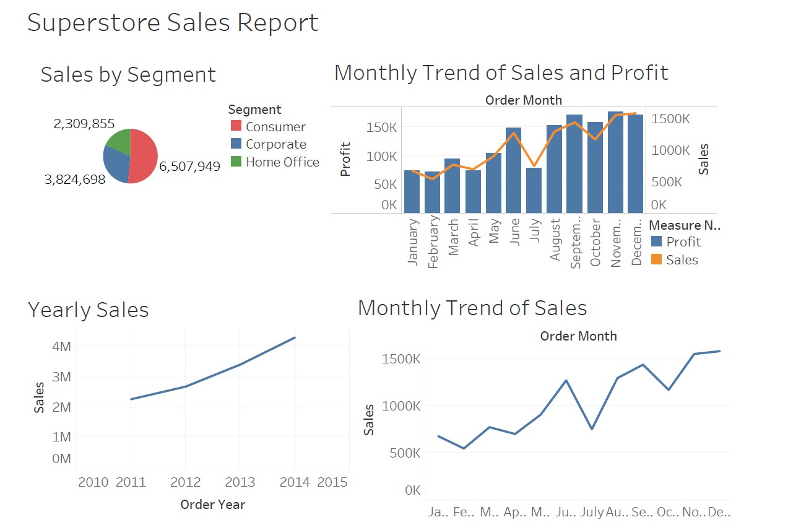
TABLEAU

Slide 8
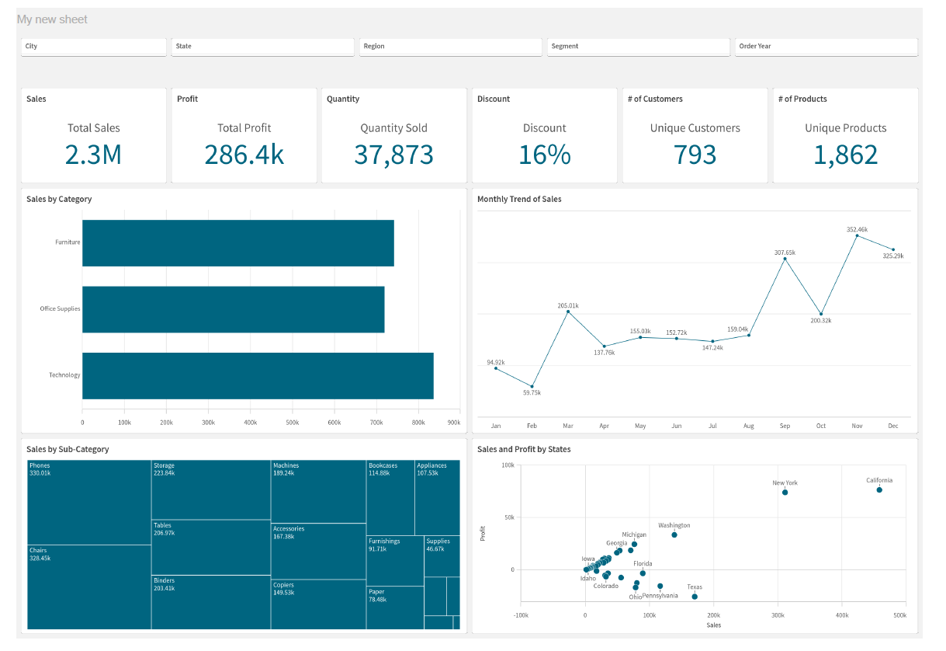
QLIKSENSE

Slide 9
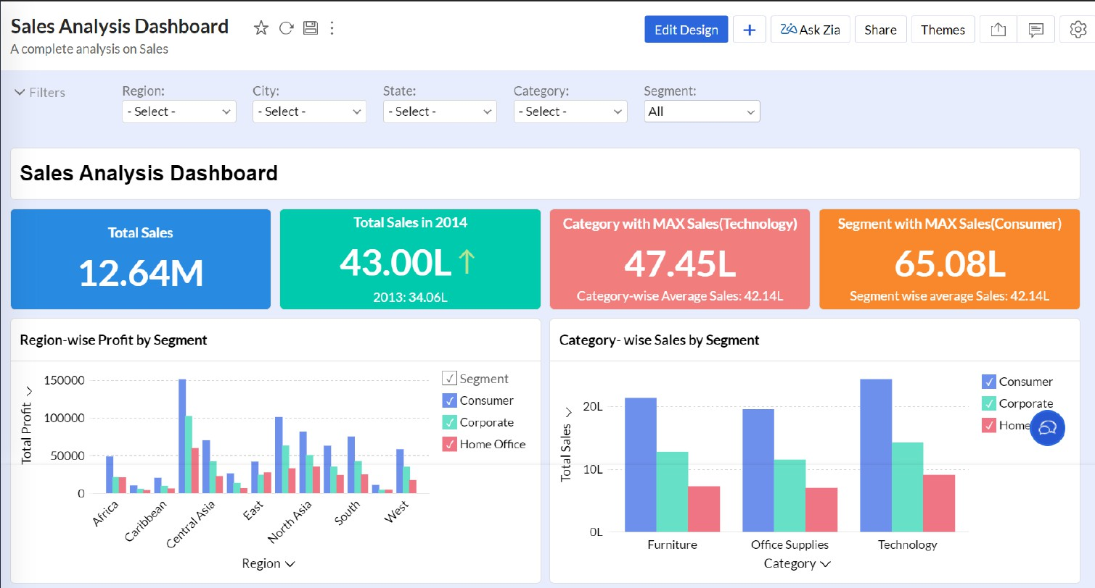
ZOHO ANALYTICS

Slide 10
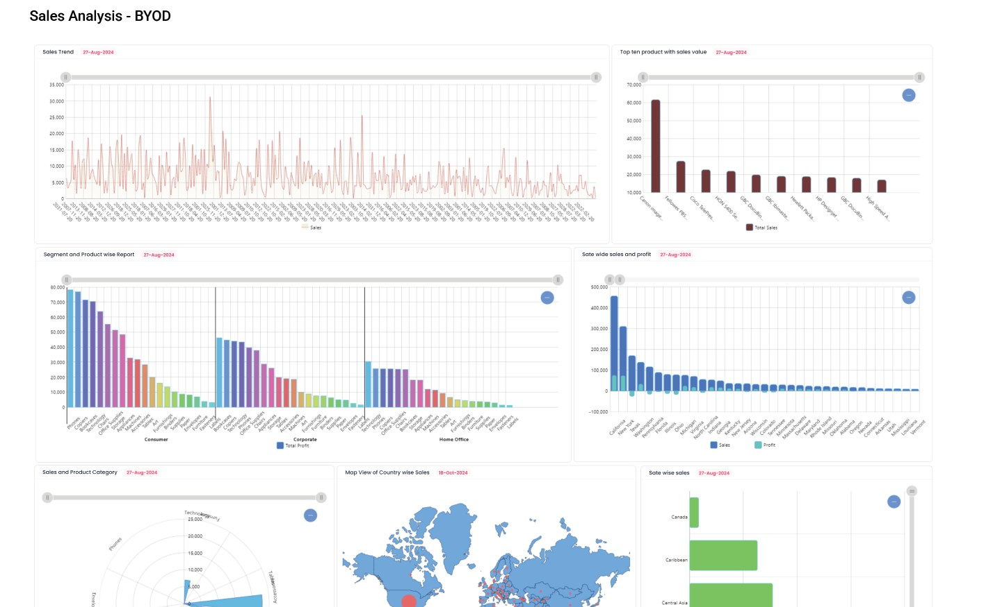
BYOD

Slide 11
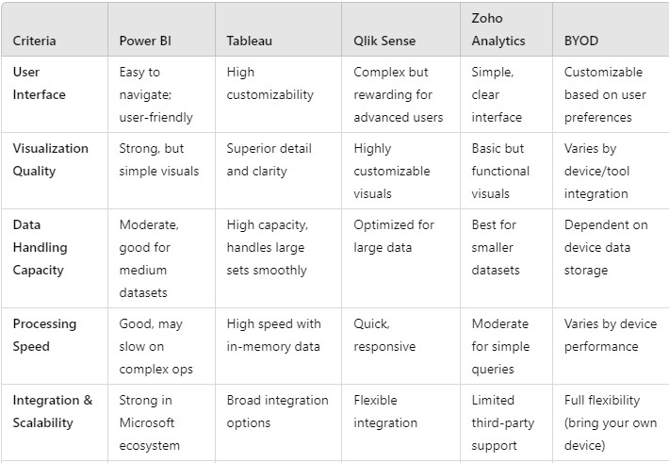
ANALYSIS

Slide 12




PERFORMANCE
ANALYSIS
Data Visualization Quality:
Tableau: High-quality, interactive visuals ideal for storytelling.
Qlik Sense: Highly customizable visuals,
preferred for detailed data exploration. Zoho Analytics: Straightforward visuals; best suited for smaller-scale insights.
BYOD: Offers flexibility, visuals vary based on device capabilities.
Processing Speed:
Tableau: Rapid processing with large datasets using in-memory capabilities.
Qlik Sense: Very fast, performs well even with
extensive data.
Zoho Analytics: Moderate, handles small to medium datasets efficiently.
BYOD: Speed varies by device hardware and
software specifications.

Slide 13
PERFORMANCE
ANALYSIS
User Accessibility and Customization:
Tableau: Broad appeal, adaptable to varying user levels.
Qlik Sense: Advanced customization for
experienced users.
Zoho Analytics: Simple, easy for non- technical users.
BYOD: Highly adaptable based on device
capabilities.

Slide 14




CONCLUSION
SUMMARY OF KEY FINDINGS
Key Findings:
Tableau is best for high-quality visualization and in-depth data analysis.
Power BI excels in cost- effectiveness and user accessibility.
Qlik Sense is optimal for advanced data handling with customizable options.
Zoho Analytics is suited for smaller datasets and cost-conscious users
.
BYOD provides flexible analysis on user-owned devices
Recommendations: Select based on specific requirements—data size, visualization depth, and user needs
.
Future Exploration: Explore potential for real-time data and AI-driven insights.

Slide 15


THANK YOU !
Please feel free to ask any questions or provide feedback

