Slide 1

FINAL REVIEW
Explainable Dual-feature Fusion Framework for Early Identification of Neonatal Sleep Apnea Diagnosis using Overnight Physiological Time-Series
BATCH-8
AUTHORS:
GUIDE:
: 22X41A4409
: 22X41A4451
: 22X41A4405
: 22X41A4404
: 22X41A4403
Gopalam.Himaja
SK.Mabunnisa
Ch.Vamsi Narendra
CH.Tarun Sai
Ch.Monish Vamsi
Ch. Sai Siva Durga
(Assistant Professor)

Slide 2
CONTENTS
Abstract
Introduction
Literature study
Existing Problem
Research Objective
Proposed Methodology
Results
Discussions
Conclusion
References
Paper Publication

Slide 3
ABSTRACT
Sleep apnea (SA) is the most predominant breathing sleep issue caused by immature control of breathing of neonates. Polysomnography (PSG) approach is the best practical way to diagnose SA and numerous researchers have been developed machine learning (ML) based apnea detection frameworks. However, those studies failed to detect apnea in an effective way due to architectural constraints. Although, deep learning (DL) based neural networks have been used to capture efficient Electrocardiogram (ECG) related features, it offered high complexity in detection. To address the issues of high complexity, poor feature representation, inaccurate detection this proposed model developed a novel explainable dual-feature fusion assisted transformer model. This study initialized with preterm infant cardio respiratory signals database collection and are pre-processed for enhancing data quality. Further, ECG and respiratory signal features are extracted using dual-feature fusion temporal convolutional network with Bi-directional GRU (ADTCN-Bi-GRU) model which effectively improve the representation of features.

Slide 4
Further, DL based optimized residual dilated depth-wise squeeze absolute transformer (ORD²S-ATrans) model is proposed to classify the apnea in neonates. Moreover, to reduce the complexity and tune the parameters of transformer model, an improved sinusoidal whale optimization (ISWOA) is developed that significantly intended for faster convergence. In order to enhance interpretability, Shapely Additive Explanations (SHAP) is employed which offer significant improvement in detection. Experimental findings demonstrate the effectiveness of proposed approach by attaining 98.63% of accuracy, precision of 98.35%, sensitivity of 98.47%, specificity of 98.56% and F1-score of 98.46% accordingly. Moreover, optimization’s fitness value analysis shown faster convergence which reduces model’s complexity.
Keywords: Sleep apnea diagnosis, absolute transformer, sinusoidal whale optimization, Electrocardiogram, Polysomnography.

Slide 5
Introduction
Sleep apnea is a common and serious sleep disorder that causes repeated interruptions in breathing during sleep.
It can lead to severe health issues such as heart problems, fatigue, poor concentration, and reduced quality of life.
Early detection of sleep apnea is essential to prevent long-term health complications.
Detecting sleep apnea in pre-term infants is particularly challenging due to their delicate health and irregular breathing patterns.
Traditional diagnostic methods rely on Polysomnography (PSG), which monitors multiple physiological signals.
PSG-based diagnosis is often time-consuming, expensive, and requires expert supervision.
Manual analysis of PSG signals may sometimes result in inaccurate or inconsistent outcomes.
With advancements in Artificial Intelligence, automated detection systems are becoming more efficient and reliable.

Slide 6
Deep learning techniques have shown strong performance in analyzing complex biomedical data.
Neural networks can automatically extract meaningful features from raw signals, reducing the need for manual feature engineering.
This project proposes a transformer-based deep learning model for sleep apnea detection.
The model uses a dual-branch fusion approach to capture both temporal and contextual features.
Instead of processing full-length signals, the system focuses on extracting rich and relevant feature representations.
This approach improves detection accuracy while also reducing computational complexity.
The proposed system aims to provide a scalable, efficient, and reliable solution for real-time sleep apnea detection in healthcare applications.

Slide 7
Literature study
Several studies have explored sleep apnea detection using machine learning and deep learning techniques, focusing on ECG and related physiological signals. Neural networks, CNNs, hybrid transformer models, and feature-based ML classifiers have shown promising results in improving detection accuracy. However, many approaches suffer from limitations such as small dataset sizes, insufficient feature extraction, lack of scalability, limited generalization, and reduced clinical reliability, highlighting the need for more robust and explainable models.
Varisco et al. used neural networks for central sleep apnea detection in preterm infants. Abasi et al. applied a CNN with honey badger optimization on ECG data. Hu et al. proposed a hybrid transformer with attention for apnea detection. Padovano et al. used HRV-based machine learning methods, while Chen et al. introduced an attention-based fusion network for ECG-based sleep apnea detection.

Slide 8
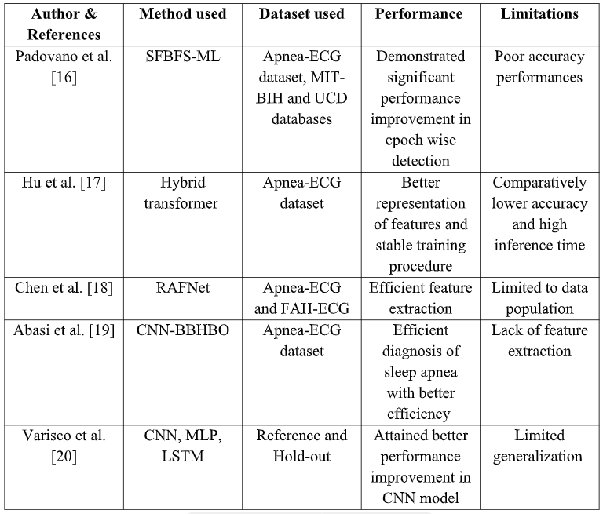
Prior research analysis

Slide 9
Existing Problem
Sleep apnea detection in neonates is clinically critical, but current diagnostic and AI-based approaches face several limitations. Traditional diagnosis using polysomnography (PSG) is expensive, time-consuming, computationally complex, and unsuitable for continuous monitoring in NICUs. Although machine learning and deep learning models have improved detection performance, they still lack reliability, scalability, and clinical trust.
PSG-based diagnosis is costly, slow, and resource-intensive.
ML methods depend on handcrafted features, leading to poor accuracy and weak generalization.
DL models (CNN, RNN) require large datasets and suffer from high complexity and training instability.
Transformer models improve temporal learning but are computationally expensive.
Poor fusion of multimodal signals (ECG, respiration, SpO₂) limits diagnostic performance.
Lack of interpretability reduces clinician trust and real-world adoption.

Slide 10
Research Objective
The main objective of this research is to develop an automated and reliable system for sleep apnea detection using advanced deep learning techniques. The study focuses on designing a transformer-based model with a dual-branch fusion approach to effectively capture both temporal and contextual features from physiological signals. It aims to improve detection accuracy, robustness, and consistency while reducing dependence on manual analysis of Polysomnography (PSG) data. Additionally, the research emphasizes efficient feature extraction by focusing on relevant signal segments, thereby reducing computational complexity and processing time. The model is evaluated using standard performance metrics to ensure its effectiveness and generalization across different datasets. Ultimately, the proposed system seeks to provide a scalable, cost-effective, and real-time solution that can support early diagnosis and enhance decision-making in healthcare applications.

Slide 11
Proposed Methodology
This research proposes an explainable multi-feature fusion transformer-based framework for early detection of neonatal sleep apnea using overnight physiological time-series signals. The model integrates multimodal signal processing, advanced deep learning architectures, optimization techniques, and explainable AI to achieve accurate, efficient, and clinically reliable diagnosis.
Methodology Workflow
Data Collection: Multimodal PSG signals (ECG + respiratory signals)
Pre-processing: Resampling, normalization, noise removal, missing value handling
Feature Extraction: Attention-assisted dual-feature fusion using TCN + Bi-GRU
Feature Fusion: Cross-attention based multimodal fusion
Detection Model: Optimized residual dilated depth-wise squeeze absolute transformer
Optimization: Improved sinusoidal whale optimization for hyperparameter tuning
Interpretability: SHAP-based Explainable AI for transparent predictions

Slide 12
Architecture Model
The proposed system employs a deep learning-based architecture for the effective detection of Sleep Apnea from physiological time-series data. Initially, the input data undergoes preprocessing and normalization to ensure consistency and improve model performance. The processed data is then passed through multiple convolutional layers, which are responsible for automatically extracting significant features such as irregular breathing patterns and variations in heart rate. Activation functions like ReLU are applied to introduce non-linearity, while pooling layers are utilized to reduce dimensionality and computational complexity. The resulting feature maps are subsequently flattened and provided as input to fully connected dense layers, which learn the complex relationships among the extracted features. Finally, the output layer, using an appropriate activation function such as sigmoid or softmax, performs the classification of the input into apnea or normal categories. This architecture enhances detection accuracy by enabling automatic feature learning and minimizing the dependency on manual feature extraction techniques.

Slide 13
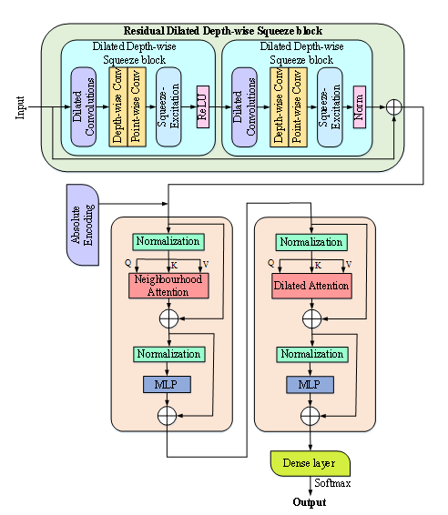

Slide 14
Results
The experimental results demonstrate that the proposed deep learning model achieves effective performance in detecting Sleep Apnea from the given dataset. The model was evaluated using standard performance metrics such as accuracy, precision, recall, and F1-score, which indicate its capability to correctly classify apnea and normal cases. The results show that the model is able to learn meaningful patterns from physiological signals, leading to improved prediction accuracy. Additionally, the confusion matrix analysis reveals a balanced classification performance with minimal false positives and false negatives. The model’s performance highlights its robustness and generalization ability when applied to unseen data. However, minor misclassifications may occur due to noise in the input data or overlapping patterns between classes. Overall, the findings suggest that the proposed approach is reliable and can be effectively utilized for automated Sleep Apnea detection, with potential for further improvement through larger datasets and advanced model tuning.

Slide 15
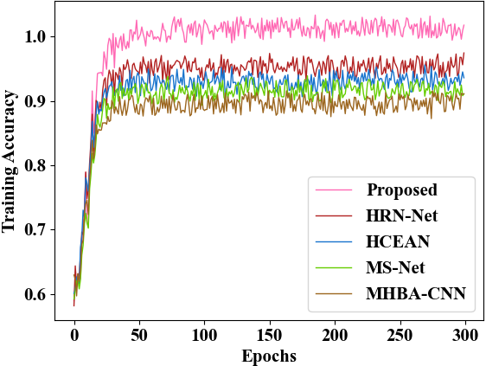
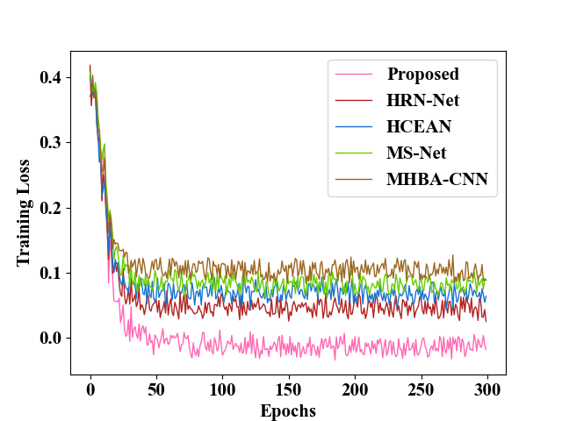
a) Training accuracy
b) Training loss

Slide 16
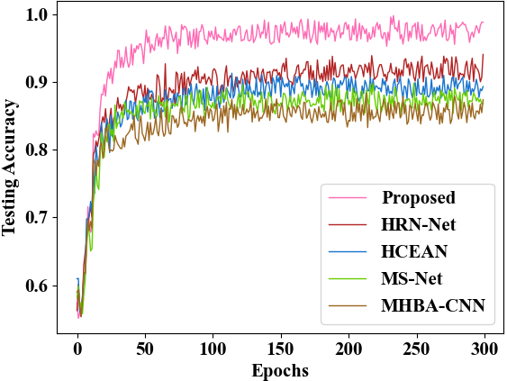
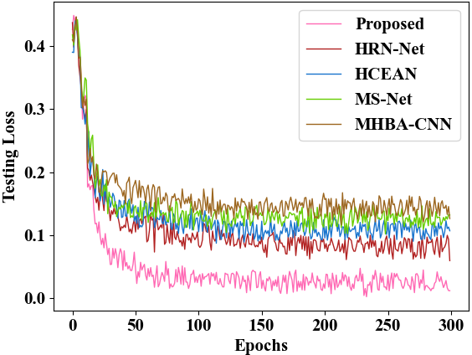
c) Testing accuracy
d) Testing loss

Slide 17
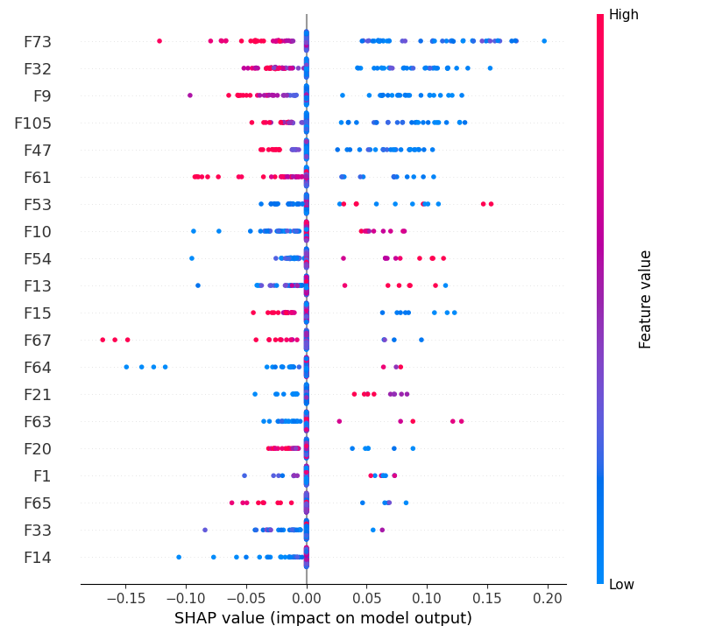
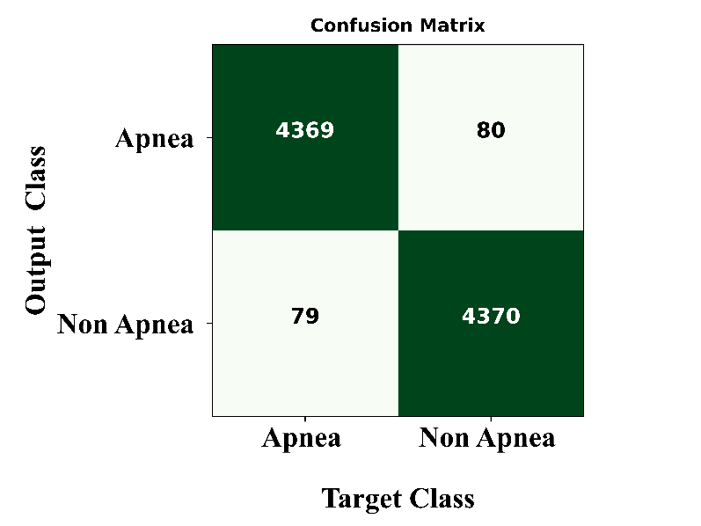

Slide 18
Discussions
The proposed transformer-based sleep apnea detection framework demonstrates significant improvement over existing approaches, particularly in handling pre-term infant physiological signals. By integrating a dual-branch fusion Temporal Convolutional Network (TCN) with Bi-GRU and cross-attention mechanisms, the model effectively captures both local and temporal dependencies from ECG and respiratory signals, resulting in richer feature representation and more stable processing. The inclusion of a transformer with dilated attention further enhances detection accuracy while minimizing information loss through residual connections. Experimental results show that the proposed model achieves a high accuracy of 98.63%, outperforming existing methods such as SFBFS-ML (85.46%), Hybrid Transformer (94.21%), RAFNet (91.4%), and CNN-BBHBO (90.92%). Unlike traditional machine learning and some deep learning approaches that suffer from lower accuracy or generalizability issues, the proposed framework ensures better reliability through comprehensive stages including preprocessing, feature extraction, detection, parameter tuning, and explainable AI interpretation. Overall, the model provides a robust, scalable, and clinically relevant solution for sleep apnea detection with improved generalization and performance.

Slide 19
Conclusion
The proposed transformer-based sleep apnea detection framework provides an accurate and reliable solution for identifying apnea in pre-term infants. By combining dual-branch TCN, Bi-GRU, and attention mechanisms, the model effectively captures complex physiological patterns from ECG and respiratory signals. The system achieves high accuracy and improved generalizability compared to existing methods, demonstrating its robustness in real-world scenarios. Overall, this approach enhances automated diagnosis and has strong potential for clinical application, with future scope for further optimization and deployment on larger datasets.

Slide 20
References
Padovano, Daniele, Arturo Martinez-Rodrigo, Jose M. Pastor, Jose J. Rieta, and Raul Alcaraz. “the generalization of sleep apnea detection methods based on heart rate variability and machine learning:”IEEE Access 10 (2022): 92710-92725.
[17] Hu, Shuaicong, Wenjie Cai, Tijie Gao, and Mingjie Wang. “A hybrid transformer modelfor obstructive sleep apnea detection based on self-attention mechanism using single-leadECG”IEEE Transactions on Instrumentation and Measurement 71 (2022): 1-11.
Chen, Ying, Huijun Yue, Ruifeng Zou, Wenbin Lei, Wenjun Ma, and XiaomaoFan.“RAFNet Restricted attention fusion network for sleep apnea detection”NeuralNetworks 162 (2023): 571-580.
Abasi, Ammar Kamal, Moayad Aloqaily, and Mohsen Guizani. “Bare-bones basedhoney badger algorithm of CNN for Sleep Apnea detection”Cluster Computing 27, no. 5(2024): 6145-6165.
Varisco, Gabriele, Zheng Peng, Hendrik Niemarkt, Peter Andriessen, Carola van Pul,and Xi Long’Improving central apnea detection in preterm infants: Neural network strategies and clinical impact.”Computer Methods and Programs in Biomedicine (2025):109038.

Slide 21
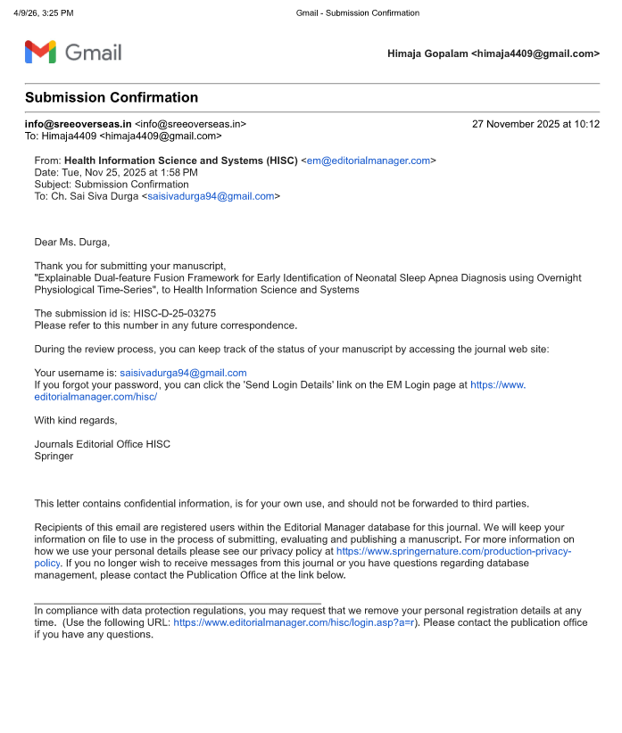
PAPER PUBLICATION

Slide 22
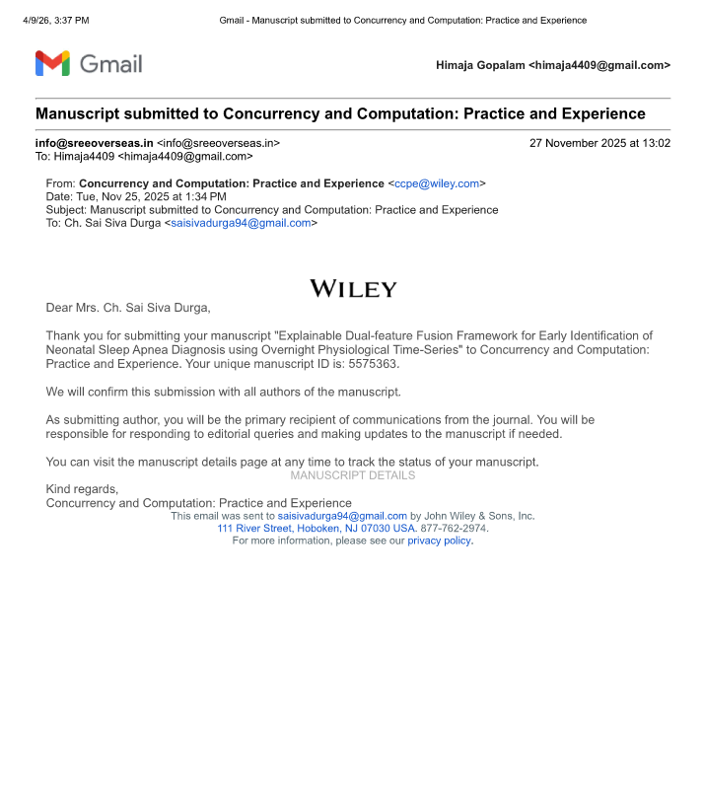

Slide 23
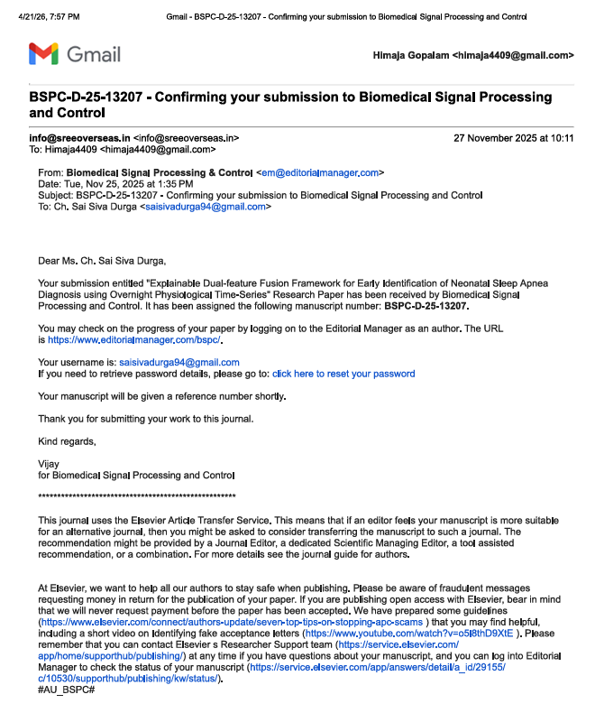

Slide 24
THANK YOU

