Slide 1





HARRINGTON SQUAD PRESENTS
Cura-AI
DATA
↓
Sorting out drugs using the power of Big Data
LEARNING
One workspace for drug data and student learning
↓
DISCOVERY
Presented by Sanjeevi and Himaja
Team: Mariappan • Harris Winfred • Sanjeevi • Himaja

Slide 2
01 • TEAM
The team behind Cura-AI
Harrington Squad is building a concept that makes drug information easier to find, compare and learn from.
M
HW
S
H
MARIAPPAN
HARRIS WINFRED
SANJEEVI
HIMAJA
Team leader
Core founding member
Presenter
Co-presenter
Shared mission: connect trustworthy drug data with clear, accessible educational resources.

Slide 3
02 • PROBLEM
The problem: drug information is fragmented
1
FOR RESEARCHERS
2
FOR STUDENTS
Drug structures, properties, targets and interactions may be spread across different databases. Finding, comparing and cleaning data can delay the actual research.
Research databases often present raw technical data, while learning resources are scattered across textbooks, videos and notes with different levels of depth.
The gap: one accessible workspace that combines organized drug information with understandable learning materials.
Example from the source brief: during COVID-19 drug-repurposing work, researchers needed to integrate drug–target data from multiple sources. Licensing terms also vary by database.
Evidence to verify before public launch: source-specific licenses, dataset permissions and current database terms.

Slide 4
03 • PRODUCT OVERVIEW
Proposed solution: one place to search, study and compare
Cura-AI is a proposed web platform combining a searchable drug-data workspace with student-focused learning resources.
01
SEARCH
02
EXPLORE
Find drug records, structures, properties, known targets and interactions.
View and compare information in a consistent layout, with 2D/3D structure viewing as a planned feature.
03
LEARN
04
ACCESS
Use reviewed notes, diagrams, videos and frequently asked questions alongside technical data.
Offer a free public preview and institution-funded premium access for students and faculty.
Differentiator: drug-data discovery and learning support are designed together, rather than as separate experiences.

Slide 5
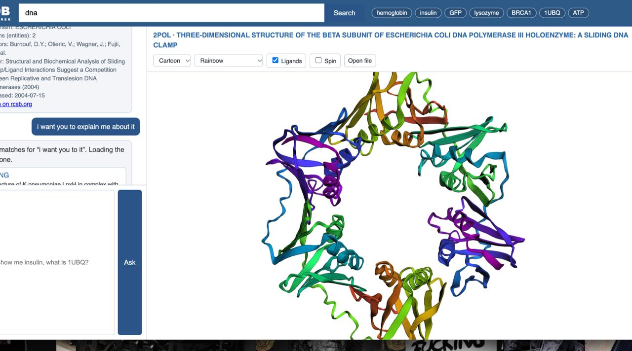
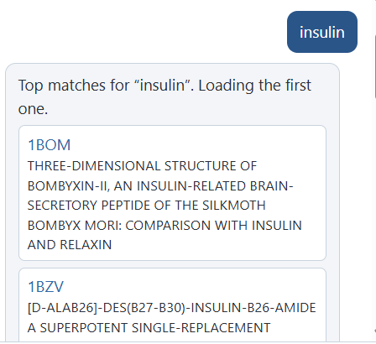
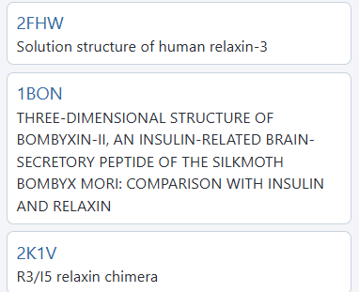
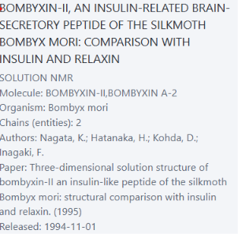
04 • PRODUCT VISUAL
Product visuals: drug search and molecular data examples
MOLECULAR STRUCTURE VIEW
DRUG SEARCH RESULTS: INSULIN
RELATED STRUCTURE RESULTS
MOLECULAR RECORD DETAILS

Slide 6
05 • COMPETITION
Competitive landscape: combining data with learning
Capability | Textbooks / notes | Video platforms | Drug databases | Cura-AI concept
Drug data in one place | Limited | No | Often yes | Planned
Student-friendly explanations | Yes, varies | Yes, varies | Often technical | Core focus
FAQs, diagrams and videos | Partial | Video-led | Limited / varies | Planned bundle
Structured search / comparison | Limited | No | Yes | Planned
University-wide access model | Not typical | Varies | License-dependent | Proposed
USP: one workspace for organized drug data plus student-friendly notes, diagrams, FAQs and videos.
Important: comparison is qualitative; feature availability and licensing must be checked product by product.

Slide 7
06 • MARKET
Market opportunity: start with university departments
1
PRIMARY BUYER
2
PRIMARY USERS
Universities and colleges with pharmacy, pharmacology, medicine, biotechnology, chemistry and life-science departments.
Undergraduate and postgraduate students, research scholars and faculty who need both drug information and learning support.
A bottom-up illustration—not a market forecast
100
300
30,000
institutions reached
relevant students each
potential student seats
Early outreach target
Illustrative average audience
100 × 300; not confirmed demand
Market logic: one institutional agreement can serve many learners. Validate willingness to pay, student usage and procurement timelines through pilot interviews before relying on market-size estimates.

Slide 8
07 • TECHNOLOGY
Technology and innovation: build in stages
1. CURATE
Collect permitted public drug records and learning references; record provenance and license conditions.
2. STANDARDIZE
Normalize names, identifiers, units and fields; flag missing or conflicting records.
3. SEARCH & DISPLAY
Store records in a searchable database and present structures, properties, targets and interactions.
4. LEARN & IMPROVE
Add reviewed study content, usage analytics and later recommendation/NLP features.
IPR: protect original notes, diagrams, videos, curated arrangements and brand; assess patents only for genuinely novel technical methods.
TRL: concept / early planning stage. A working MVP and benchmarked AI capabilities are future milestones, not current claims.

Slide 9
08 • BUSINESS MODEL
Business model: institutions pay, students learn
1
PRIMARY: INSTITUTIONAL LICENSE
2
SECONDARY: INDIVIDUAL PREMIUM
Universities pay annually for full student/faculty access, reviewed resources and optional usage analytics.
Students without a campus subscription may buy personal access. A free public layer builds awareness and lets users evaluate value.
Indicative starting prices from the project brief (to be tested with buyers)
Universities / colleges | ₹1.5–4 lakh / year | Full access for students and faculty
Large medical / pharmacy colleges | ₹4–8 lakh / year | Site-wide license + optional analytics
Individual students | ₹999–₹2,499 / year | Premium access if institution is not subscribed
Sales channels: faculty demos, department pilots, incubators, student ambassadors and direct university outreach.

Slide 10
09 • GTM
Go-to-market: prove value with a small pilot
MONTH 3
MONTH 6
MONTH 12
VALIDATE
MONETIZE
SCALE
Interview 30–50 students/faculty; publish 20–30 reviewed resources; pilot with 1–2 departments; aim for 100–200 registrations.
Target 500–1,000 registrations; expand to 3–5 departments; test first paid student or institutional plan.
Target 2,000–5,000 registrations; work with 5–10 colleges; maintain 150–250 reviewed resources and seek renewals.
Success metric: repeat use + credible learning feedback + at least one institution willing to run or fund a pilot.

Slide 11
10 • TIMELINE
Duration and resource allocation
FOUNDATION
Searchable drug-data and resource catalogue; core website; 20–30 reviewed learning resources.
MONTHS 0–3
INTELLIGENCE
Feedback analytics; better search; recommendations prototype; NLP exploration for reviewed content.
MONTHS 4–6
RESEARCH & SCALE
Integrate additional permitted datasets; test drug-target analysis prototype against held-out benchmark data; seek university validation.
MONTHS 7–12
MVP estimate in the brief: 6–12 months with a small core team; 3–6 months may be possible if suitable open-source tools and infrastructure are reused.

Slide 12
11 • BUDGET
Financial overview: a ₹1 lakh initial plan
Initial funding required: ₹1,00,000 | Proposed funding sources—not confirmed
Website development & hosting | ₹25,000
Big data & AI research | ₹20,000
Educational content & scientific review | ₹15,000
Marketing & college outreach | ₹15,000
Operations & administration | ₹10,000
Emergency reserve | ₹15,000
TOTAL | ₹1,00,000
PROPOSED SOURCES
Founder contributions: ₹25,000
Incubators / competitions: ₹50,000
Grants / external funding: ₹25,000
3-MONTH OUTCOME
Aim for a working website, 20–30 reviewed resources, 100–200 registered users and a basic AI research prototype.
A detailed 3-year revenue/expense forecast is not supplied in the project brief. Build it after validating pricing, institutional conversion, hosting costs and development needs.

