Slide 1

Detecting Phishing Attacks Using Deep Neural Networks
Himaja Yerra

Slide 2
Team Information
Himaja Yerra - #7007388410
HXY88410@ucmo.edu

Slide 3
Roles & Responsibilities
Conducted background research in phishing detection techniques.
Looked at various Machine learning and Deep neural network models and choose LSTM & Bi-LSTM for this project to study and compare in detail.
Built model and trained on dataset chosen, to evaluate results.

Slide 4
Motivation
Phishing attacks are very dynamic, so should be the AI models.
To be able to fully use the neural network capabilities in detecting the phishing attacks on internet.
To better understand the working of LSTM & Bi-LSTM layers.

Slide 5
Objectives
Do background research work in estimating the various studies conducted and their performance.
Explore all possible datasets available for phishing detection training models to choose the widely accepted data.
Develop a deep neural network model for detecting phishing websites with significant accuracy.
Compare and analyze different models developed and understand the internal architecture of layers used.
Evaluate the results and identify the future areas of research in further optimizing the models.

Slide 6
Related Work
Garera et al. used the Logistic Regression algorithm and 18 manually crafted features, achieving an accuracy of 97.3%.
Verma et al. used statistical lexical features of URLs based on metrics like Kolmogorov-Smirnov Distance and Kullback-Leibler Divergence and achieved a 99.3% detection accuracy on one dataset and a 93.17% on the other.
The traditional machine learning approach for URL-based phishing detection requires manual feature extraction, while the deep learning approach does not.
Bahnsen et al. have conducted one related study on using deep learning for URL-based phishing detection, achieving a detection accuracy of 98.7% using a forward direction LSTM network.

Slide 7
The Problem Statement
There are many ML models that are available for detecting the phishing attacks and very few Neural Network models are in-place. We are trying to develop RNN based LSTM & Bi-LSTM models to improve accuracy rate.

Slide 8
Proposed Solution
Using RNN based architectures that can process sequential data, and LSTM layers that help reduce the vanishing gradient problem in RNN’s combined together will help in achieving better performance for our model.

Slide 9
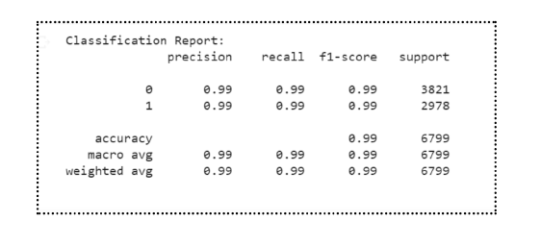
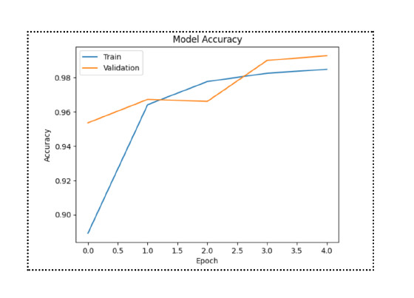
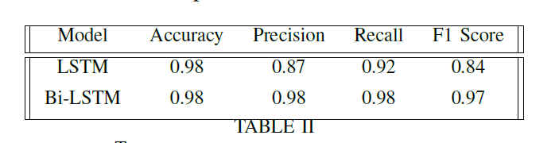
Results
Accuracy curve for train and validation set
We have compared the LSTM & Bi-LSTM models in our project. These are the metrics for 3 epochs.
Notes:
𝐴𝑐𝑐𝑢𝑟𝑎𝑐𝑦 = (𝑇 𝑃 + 𝑇 𝑁) (𝑇 𝑃 + 𝑇 𝑁 + 𝐹𝑃 + 𝐹𝑁) ∗ 100
Precision = TruePositives / (TruePositives + FalsePositives)
Recall = TruePositives / (TruePositives + FalseNegatives)
F1 = 2*((precision*recall)/(precision+recall))

Slide 10
References
[1] S. Ariyadasa, S. Fernando and S. Fernando, "Combining Long-Term Recurrent Convolutional and Graph Convolutional Networks to Detect Phishing Sites Using URL and HTML," in IEEE Access, vol. 10, pp. 82355-82375, 2022, doi: 10.1109/ACCESS.2022.3196018.
[2] C. Opara and Y. Chen, "Look before you leap: Detecting phishing web pages by exploiting raw URL and HTML characteristics", arXiv:2011.04412, 2020.
[3] J. Feng, L. Zou, O. Ye and J. Han, "Web2Vec: Phishing Webpage Detection Method Based on Multidimensional Features Driven by Deep Learning," in IEEE Access, vol. 8, pp. 221214-221224, 2020, doi: 10.1109/ACCESS.2020.3043188.
[4] PHISHTANK: Free community site for anti-phishing service. http://www.phishtank.com/

Slide 11
Thank You

