Slide 1


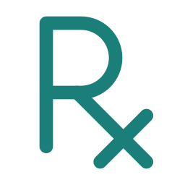


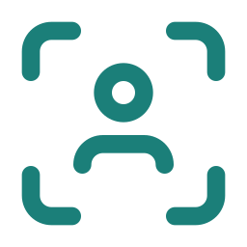



SOLUTION
Diagnosia
2
AI that gives doctors back their time
and patients their independence
Four AI tools. One principle: doctors stay in control, AI removes the repetitive work.
We don't replace doctors. We remove the repetitive and slow parts of their work so each doctor can see more patients properly, and we help patients understand and act on the care they receive.
1 · WAITING ROOM
History taken by voice; a ready report
2 · DOCTOR'S CABIN
Reads the report; lesion? Quick second opinion
3 · AFTER THE VISIT
Medicines, diet, exercise, next visit explained
DiagnoFast
Skin Cancer Detection
Prescription Analyzer
OptiKinesis · Runs alongside every stage: for patients who cannot use their hands. Hands-free computer use at home or in hospital.
FOR DOCTORS
FOR DOCTORS
FOR PATIENTS
FOR PATIENTS
DiagnoFast
Skin Cancer Detection
OptiKinesis
Prescription Analyzer
The patient's history is ready before they walk in.
An objective second opinion before costly tests.
Full computer control by head and blink, with any webcam.
A prescription the patient can actually understand.
PROBLEM
Same questions, every visit
PROBLEM
Costly biopsy; judgement varies
PROBLEM
Locked out; trackers cost lakhs
PROBLEM
Can't read the prescription
HOW IT WORKS
HOW IT WORKS
HOW IT WORKS
HOW IT WORKS
Asks aloud in the patient's language
Patient answers by voice note
AI fills doctor's form + follow-ups
Adds ABHA history (with consent)
Snap lesion: phone or dermatoscope
Model 1: healthy or suspicious?
EfficientNet-B0 ranks 7 lesion types
Scores, heatmap, suggested priority
478 face points steer the cursor
5-point calibration fits each user
A deliberate blink clicks
Keyboard + word suggestions, SOS
Photograph the prescription
Reads medicines, doses, timing, dates
Decodes 1-0-1, BD, TDS, SOS, HS
Explains in own language, text + voice
WHAT YOU GET
WHAT YOU GET
WHAT YOU GET
WHAT YOU GET
Chief complaint in one line
History + doctor's own questions
Meds, allergies, urgent flags
Ranked conditions with confidence
Heatmap + triage hint, not a verdict
Final call stays with the doctor
Any app, no special hardware
Find answers + Read this page
MotionGlass (planned): precision add-on
What each medicine is for, and when
Daily timetable; foods to eat/avoid
Yoga, exercise + next-visit reminder
Custom form per doctor's diagnosis style. Readable in under a minute; doctor still asks in the cabin.
Validation pending: trained on HAM10000; Indian skin-tone and biopsy-confirmed testing before any clinical claim.
Windows. Software-only, ~₹[FILL: price] vs ₹50,000‑60,000 for dedicated eye-trackers.
Explains only: never changes a dose or medicine. If unreadable, it says so and refers to the doctor or pharmacist.
IN DESIGN
WORKING PROTOTYPE
WORKING PROTOTYPE
IN DESIGN
TIME: doctors drown, patients wait
→ DiagnoFast
COST & ACCESS: diagnosis is a luxury
→ Skin Cancer Detection
INCLUSION: sharp minds, locked-out bodies
→ OptiKinesis
UNDERSTANDING: unreadable prescriptions
→ Prescription Analyzer
TRUST BY DESIGN
WHO IT'S FOR
HOW WE EARN
Doctors stay in charge · minimum data collected
Consent first: ABHA only with explicit consent
Aligned with India's DPDP Act
Encrypted storage + transfer; honest confidence + limits
Doctors & clinics: DiagnoFast, Skin Cancer Detection
Hospitals: organisation plan, Institutional Bundle
Patients: Prescription Analyzer, voice intake
Motor disability, families, NGOs: OptiKinesis, MotionGlass
DiagnoFast: individual membership or organisation plan
OptiKinesis: Access (one-time) · MotionGlass Kit · Care subscription · Institutional Bundle
WORKING PROTOTYPE
IN DESIGN
PLANNED
Tech: TensorFlow/Keras, EfficientNet-B0, OpenCV, MediaPipe, speech-to-text for Indian languages, LLM agent, ABHA/ABDM integration
Notes:
Solution slide. Teal = solved. Status badges are exact: only Skin Cancer Detection and OptiKinesis are working prototypes. Replace the highlighted [FILL] before presenting.

