Slide 1
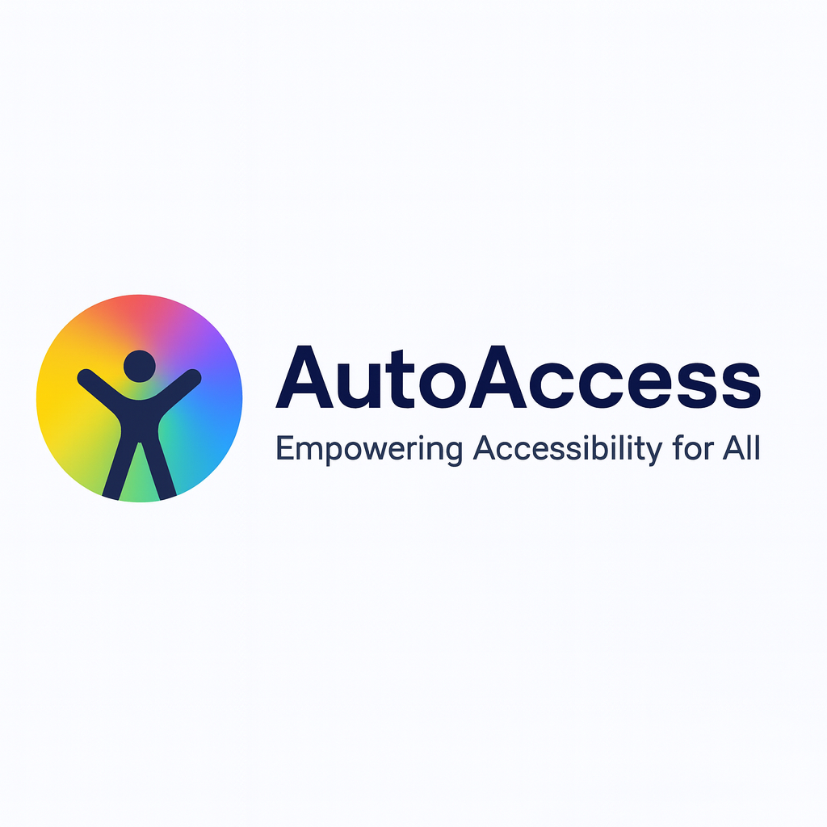

AutoAccess - AI-Powered Web Accessibility Extension
Team: NEXORA
Lead Developer & AI Integration Specialist: [ Himanshu Bali] Frontend Developer & UX Designer Backend Developer & Security Specialist [ Priya Gupta ] AI Integration Specialist:

Slide 2
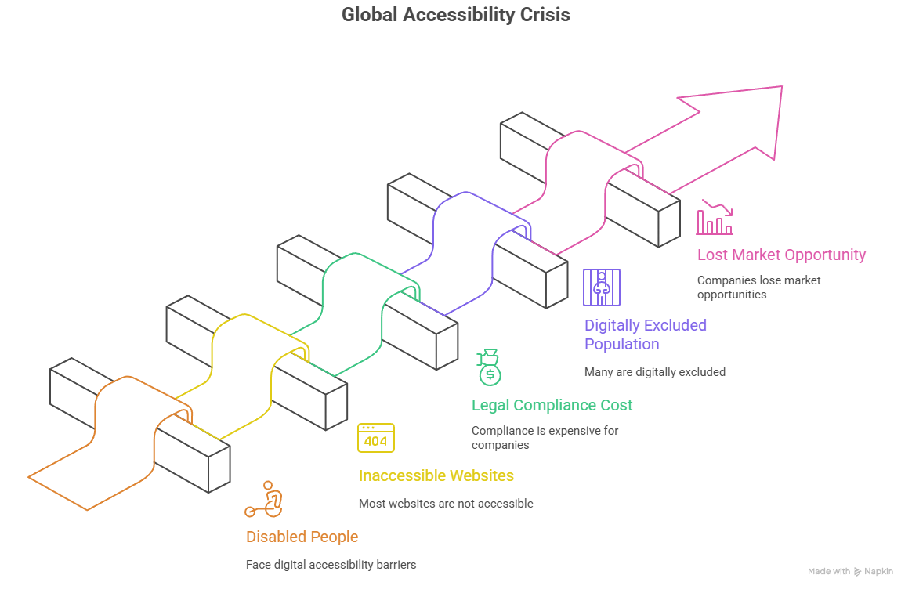
Problem Statement
Real-world Challenge:
1.3 billion people globally live with disabilities
97% of websites fail basic accessibility standards
Current solutions are fragmented and expensive
Manual accessibility testing is time-consuming and inconsistent
Significance:
Digital exclusion affects 15% of global population
Legal compliance costs companies $50K+ per lawsuit
Lost market opportunity of $6.9 trillion annually

Slide 3
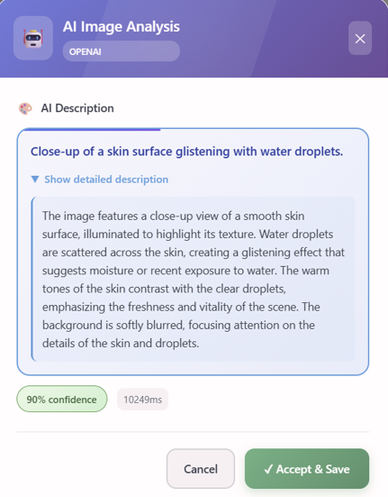
Proposed Solution
Clear Description:
AutoAccess is a revolutionary Chrome extension which uses AI to make any website instantly accessible through:
Real-time image captioning and OCR
Voice-to-text and text-to-speech conversion
Dynamic accessibility profile switching
Automated compliance auditing
Key Innovation:
One-click accessibility - transforms any website in seconds
AI-powered descriptions - understands context, not just text
Adaptive profiles - learns and improves user experience

Slide 4
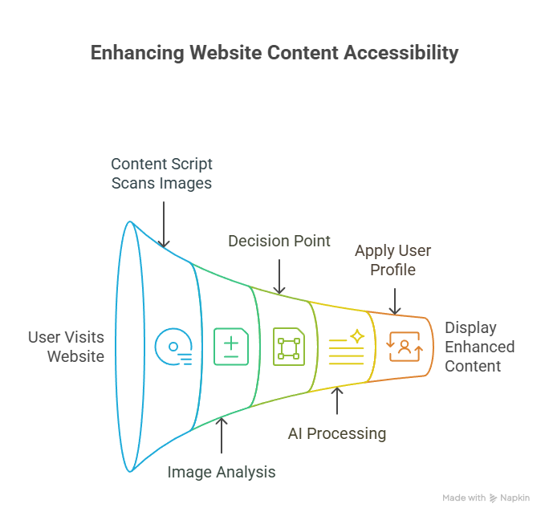
Objectives & Goals
Primary Objectives:
Make 1 million websites accessible by 2028
Reduce accessibility testing time by 90%
Achieve 99.9% accuracy in AI-generated descriptions
Support 10+ accessibility profiles
Expected Outcomes:
50,000+ active users within 6 months
95% user satisfaction rating
Integration with 100+ popular websites
Recognition as industry standard

Slide 5

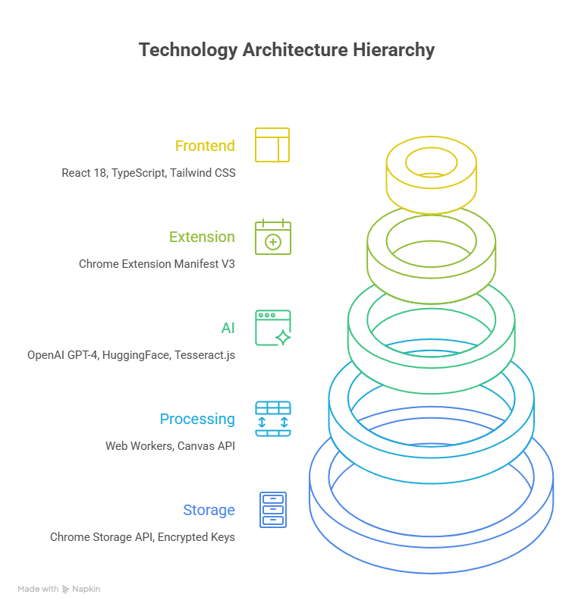
Technology Stack
Core Technologies:
Frontend: React 18, TypeScript, Tailwind CSS
Extension: Chrome Extension Manifest V3
AI Services: OpenAI GPT-4 , Hugging Face Transformers
OCR Engine: Tesseract.js
Voice Processing: Web Speech API, SpeechSynthesis
Advanced Features:
Canvas Processing: HTML5 Canvas API
Image Analysis: Computer Vision APIs
Real-time Processing: Web Workers
Security: Content Security Policy, Encrypted Storage

Slide 6
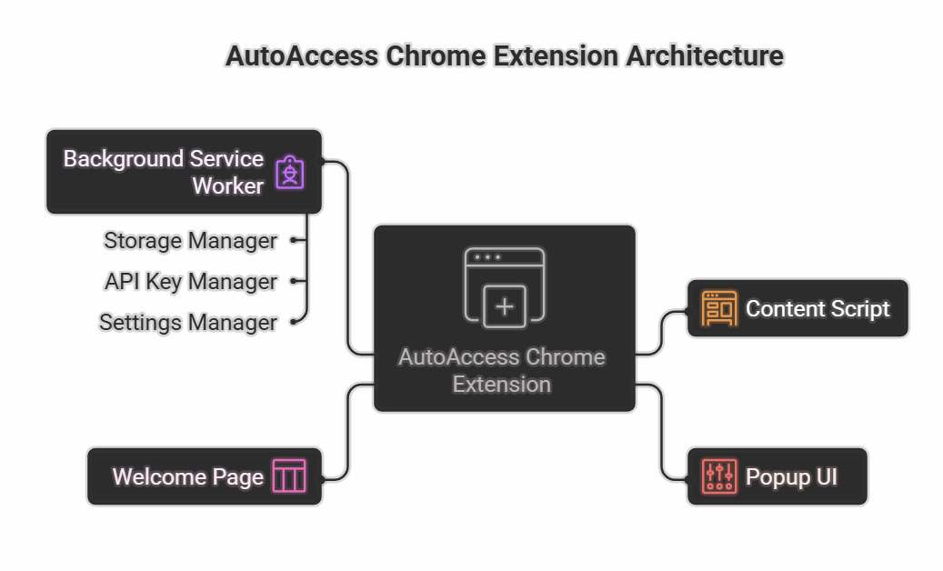
System Workflow/Architecture
User Interaction Flow:
Installation → One-click setup
Profile Selection → Choose accessibility needs
Automatic Processing → AI analyzes content
Real-time Enhancement → Voice + visual aids
Continuous Learning → Improves over time

Slide 7
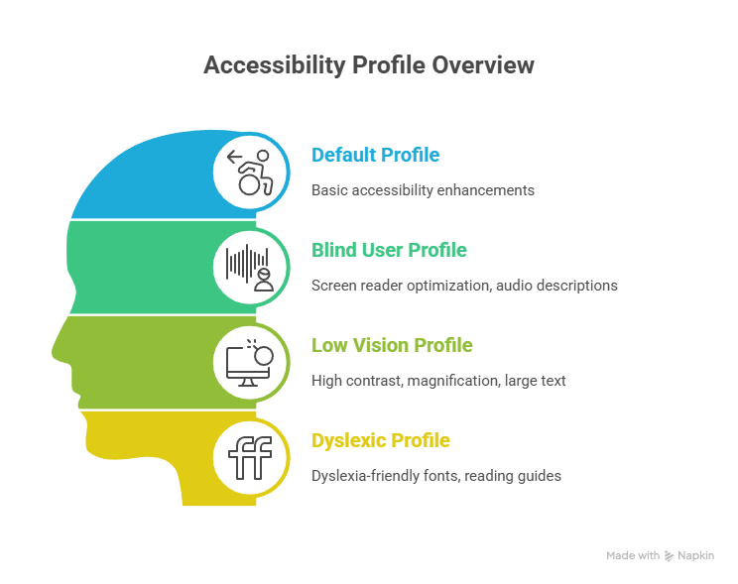
Key Features & Innovation
Unique Features:
AI-Powered Descriptions: Context-aware image understanding
Multi-Modal Accessibility: Visual + auditory + haptic feedback
Profile-Based Adaptation: 4 pre-configured + custom profiles
Real-time Processing: Sub-second response times
Privacy-First Design: Local processing by default
Differentiating Factors:
Only extension combining 3 AI services
First to solve cross-origin image processing
Most comprehensive accessibility feature set
Open-source with enterprise support

Slide 8
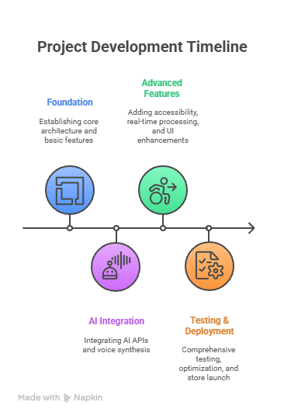
Implementation Plan
Development Phases:
Phase 1 - Foundation (Weeks 1-4):
Core extension architecture
Basic image scanning and OCR
Chrome API integration
MVP testing
Phase 2 - AI Integration (Weeks 5-8):
OpenAI API integration
HuggingFace model deployment
Voice synthesis implementation
Error handling and fallbacks

Slide 9
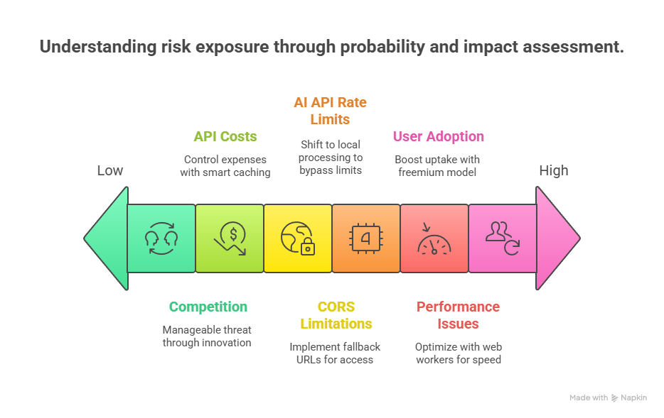

Challenges & Risk Management
Technical Challenges:
CORS Limitations: Mitigated with fallback data URLs
AI API Rate Limits: Implemented local processing fallbacks
Performance Issues: Optimized with Web Workers
Business Challenges:
User Adoption: Addressed with freemium model
API Costs: Managed with intelligent caching
Competition: Differentiated through innovation
Risk Mitigation Strategies:
Comprehensive testing, fallback systems
Freemium model, enterprise partnerships
User feedback loops, iterative development

Slide 10
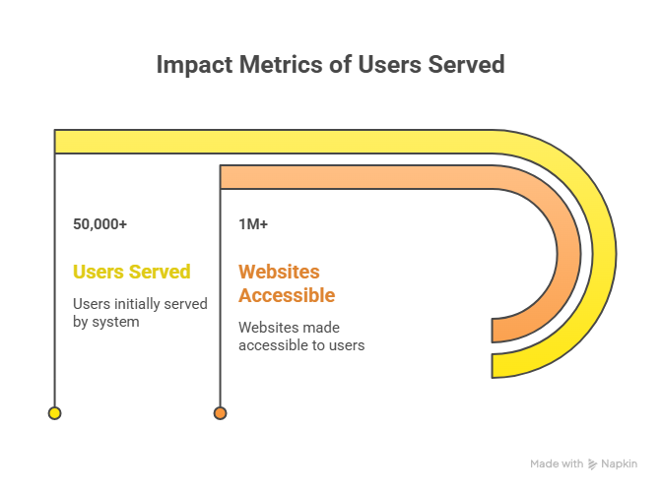
Impact & Conclusion
Immediate Benefits:
Users: Instant accessibility on any website
Developers: Automated compliance testing
Organizations: Reduced legal risk and costs
Society: Digital inclusion for all
Concluding Remarks:
Auto Access represents the future of web accessibility - where AI meets inclusion, technology serves humanity, and digital barriers become a thing of the past. We're not just building an extension; we're creating a movement toward universal digital access.
Call to Action:
Join us in making the web accessible for everyone. Together, we can build a more inclusive digital world.

