Slide 1

CS658 PROJECT : CIC-Evasive-PDFMal2022 (PDF Malware Detection)
Group 5
Himanshu Shekhar
Lokesh Yadav
Maj Kamal Kant Tripathi
CS658A: Topics in Malware Analysis and Intrusion Detection

Slide 2
GROUP 5
Group Members | Responsibilities
Himanshu Shekhar | Data Extraction, Coding, Training the Model, Creation of Reports and Submissions, Presentation Preparation
Lokesh Yadav | Data pre-processing and Cleaning, Coding, Data Analysis, Creation of Reports and Submissions, Presentation Preparation
Maj Kamal Kant Tripathi | Conceptualization, Data Analysis, Coding, Creation of Reports and Submissions, Presentation Preparation
CS658A: Topics in Malware Analysis and Intrusion Detection

Slide 3
PREVIEW
Background
A brief on existing work on the subject
Dataset and Feature Enhancement
Data Pre-Processing and Analysis
ML Model
Comparative Analysis and Results
Conclusion
CS658A: Topics in Malware Analysis and Intrusion Detection

Slide 4
BACKGROUND
Problem Statement
PDF is most popular content presenting format
Advanced features allows attackers to exploit it
Majority of PDF attacks target Adobe Reader
Vulnerabilities found in Adobe Reader, such as API overflow and memory corruption - Often exploited by attackers, mainly through using JavaScript
Traditional automated detection methods are inefficient - signature based
Impact on Cyber Security
CS658A: Topics in Malware Analysis and Intrusion Detection
Notes:
PDF has been the most widely used document format due to its portability and reliability. Unlike the rest of the document formats, such as doc files that may present the content differently on different platforms, PDF files are platform-independent. Despite the appearance, they have a very complex structure with a combination of binary and ASCII data, and they can be considered a whole programming language of their own, which gets executed upon being viewed.
PDF popularity and its advanced features, have allowed attackers to exploit them in numerous ways. As most users only associate danger with executable files
and do not think of files such as .doc and .pdf as being potentially malicious. Therefore, spreading malware through PDFs has become a common technique
in today’s online world.
It is worth mentioning that the majority of PDF attacks target Adobe Reader, one of the most popular PDF readers among users. Despite being a powerful PDF viewer, Adobe has many vulnerabilities, often the target for various PDF exploitation.
Traditional automated detection methods are inefficient for malicious PDF detection as they are mostly signature based, which allows the malware authors to evade them sometimes, even by applying a basic obfuscation. Therefore, PDF infection detection still requires a degree of manual analysis using different tools.

Slide 5
EXISTING WORK

Slide 6
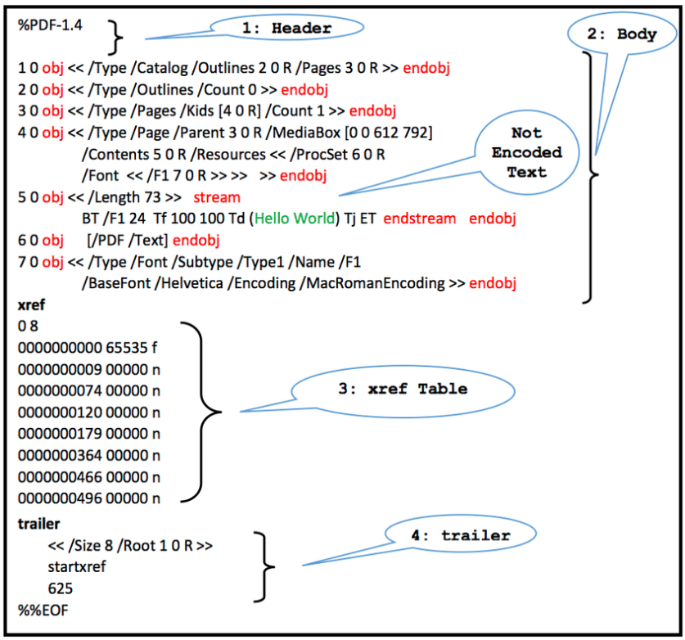
BRIEF ON EXISTING WORK
Proposed a novel evasive PDF malware detection approach based on Stacking Learning
Analyzed the shortcomings of the ”Contagio” PDF dataset
Internal structure of the PDF
CS658A: Topics in Malware Analysis and Intrusion Detection

Slide 7
BRIEF ON EXISTING WORK
Proposed Approach
Raw PDF Files
Feature Extraction
Detection Model
Prediction Results
CS658A: Topics in Malware Analysis and Intrusion Detection

Slide 8
BRIEF ON EXISTING WORK
Dataset
Available at https://www.unb.ca/cic/datasets/PDFMal-2022.html
Existing datasets for PDF Malware detection were analyzed
Improved the ”Contagio” dataset (11,173 malicious and 9,000 benign PDF files)
Issues Resolved with the Dataset
Duplicate Entries Extracted 28 out of 32 features from each file and found 44% duplicate entries in the Dataset
Lack of Coverage Low coefficient of variation indicating a low variation among malicious and benign PDF file classes in Contagio, 0.83 for Malware samples and 0.79 for benign
Data Bias More than 0.74 of the malicious data points have a value of more than 0 for the two features (“JavaScript“ and “OpenAction“), whereas only 0.0007 of the benign files have a value of more than 0 for both
Finally, after feature extraction and deduplication, following were left in Dataset
3,223 malicious files and 8,268 benign files from Contagio
4,868 malicious files from VirusTotal
A balanced Dataset
CS658A: Topics in Malware Analysis and Intrusion Detection

Slide 9
BRIEF ON EXISTING WORK
The Proposed Model – Stacking Learning
The best results were obtained by combining ’MLP’, ’Linear SVM’ and ’RF’ as base learners,
with using ’Logistic Regression’ as the meta learner
Base Learner | Accuracy (%) | Precision (%) | Recall (%) | F1-Score (%)
RF | 98.44 | 98.65 | 98.68 | 98.66
MLP | 98.33 | 98.55 | 98.53 | 98.52
SVM | 98.21 | 98.23 | 98.23 | 98.28
Adaboost | 97.32 | 97.75 | 97.73 | 97.75
Metric | Value (%)
Accuracy | 98.69
Precision | 98.88
Recall | 98.87
F1 Score | 98.77
CS658A: Topics in Malware Analysis and Intrusion Detection

Slide 10
DATASET AND FEATURE ENHANCEMENT

Slide 11
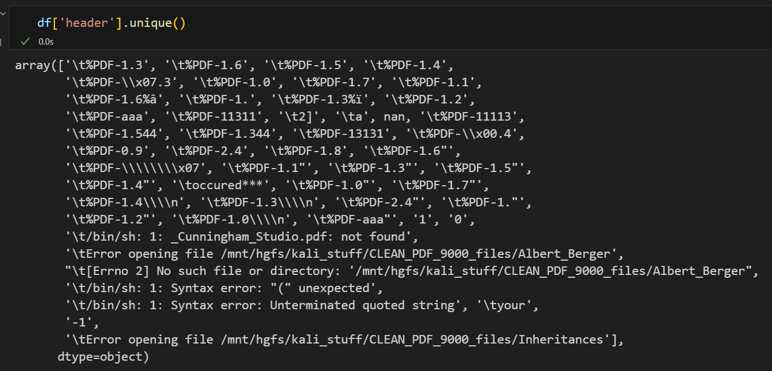
EVASIVE-PDFMal2022 DATASET
31 Features were used by the model in the paper
Data Distribution
5558 Malicious entries
4468 Benign entries
Source - here
Weird entries in the csv file used in the
paper
Feature extraction tool and data are
both outdated
CS658A: Topics in Malware Analysis and Intrusion Detection

Slide 12
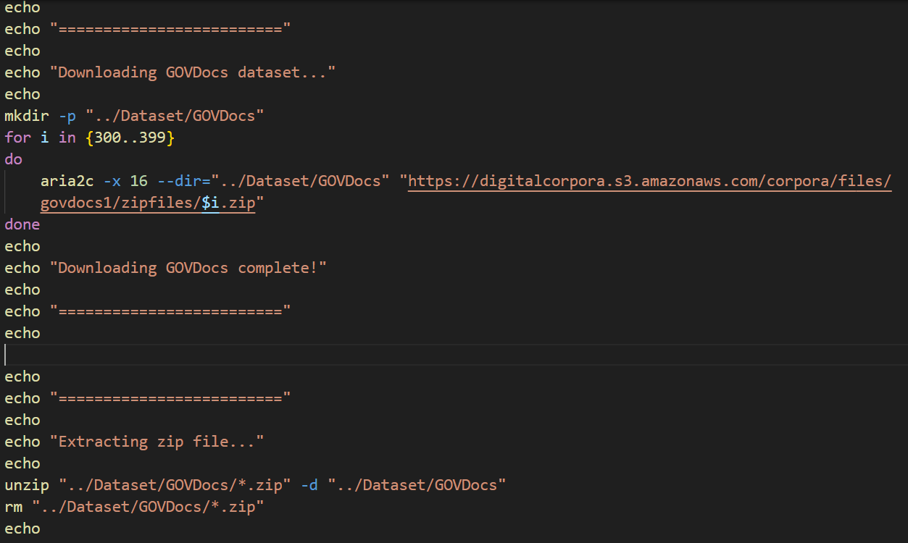
EXTENDED DATASET
A model trained on very little data is bound to be overfit. So, we decided to get some more!
(Our first novel idea)
Increased the dataset to more than 35k entries for both Malicious and Benign files
Sources used:
CIC-Dataset: here
GOVDocs: here
VirusShare: here
MalwareBazaar: here
Final Distribution
36862 Malicious entries
56149 Benign entries
CS658A: Topics in Malware Analysis and Intrusion Detection

Slide 13
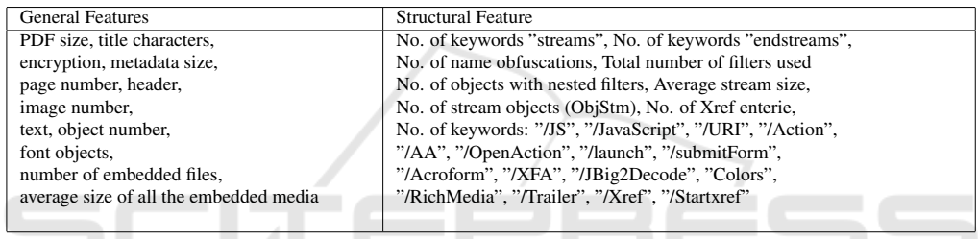
FEATURES
The paper used 31 features for training the model.
PDFMalLyzer was used to extract the features ( here ).
The features are of 2 types –
General Features
Structural Features
CS658A: Topics in Malware Analysis and Intrusion Detection

Slide 14
EXTENDED FEATURE SET
Updated the PDFMalLyzer tool to extract 60 features in total! (Our second novel idea)
Fixed bugs of the tool to handle errors gracefully
The features are of 3 types –
General Features
Structural Features
Custom Features
All features and their brief descriptions are written in the README in our GitHub repository
The updated tool has also been uploaded to GitHub
Libraries used by the tool – PyMuPDF, PyPDF2, Fitz
CS658A: Topics in Malware Analysis and Intrusion Detection

Slide 15
DATA PRE-PROCESSING AND ANALYSIS

Slide 16
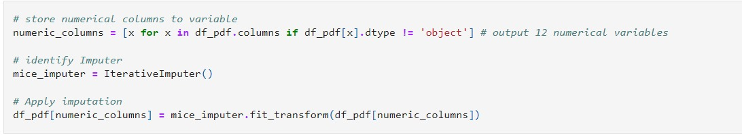
DATA PRE-PROCESSING AND CLEANING
Handled missing values row wise to ensure data consistency
Dropped the “file name” column and applied column wise imputation
Mapped text values in 'Class' and 'contains text' columns to numerical format
Applied Label Encoding to standardize header information
Converted all object-type values to numeric for ML compatibility
CS658A: Topics in Malware Analysis and Intrusion Detection

Slide 17
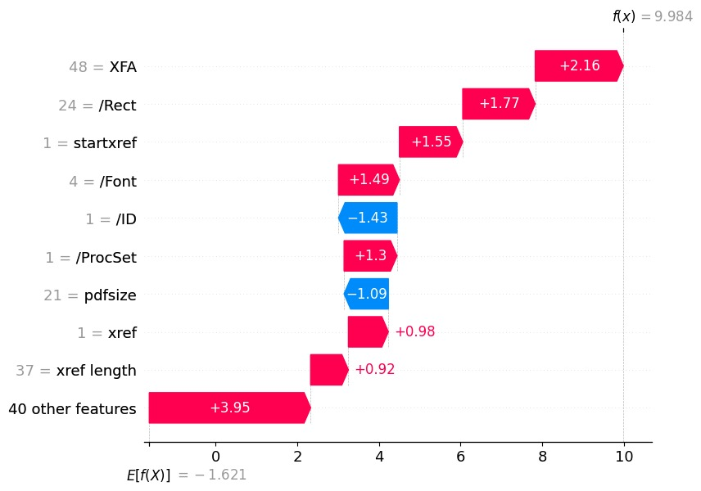
DATA ANALYSIS (SHAP)
Implementing SHAP (SHapley Additive exPlanations) - (Our third novel idea)
SHAP Waterfall Plot Overview
Visualizes feature contributions to a single prediction breaking down their impact
Shows how each feature’s impact accumulates from the base value to reach the final prediction
CS658A: Topics in Malware Analysis and Intrusion Detection
Notes:
SHAP (SHapley Additive exPlanations) is a popular method for explaining individual predictions of machine learning models. It’s based on Shapley values from cooperative game theory, where the idea is to fairly distribute the “payout” (in this case, the prediction) among features based on their contributions to the final prediction. Here’s a breakdown of how SHAP works and why it’s useful:
Key Concepts of SHAP:
Shapley Values: Shapley values assign a fair value to each feature based on its contribution to the model's output. They measure each feature’s contribution by considering all possible combinations of features, which leads to more robust and reliable explanations.
Additive Feature Attribution: SHAP operates under an additive feature attribution framework, meaning the sum of each feature’s contribution equals the model’s prediction. This makes SHAP particularly useful for feature importance explanations.
Model-Agnostic: SHAP can be used with any machine learning model (like decision trees, neural networks, etc.), though it may run more efficiently on some models (like tree-based models) due to optimizations.
Global and Local Explanations: SHAP can provide explanations both at the local level (specific to individual predictions) and the global level (explaining feature importance across the whole dataset).
How SHAP Works:
SHAP generates a baseline output (the average prediction if all features are missing) and then calculates how much each feature value changes the prediction relative to this baseline.
For each feature, SHAP computes its value by considering its contribution with and without other features, averaging across all combinations to ensure fair attribution

Slide 18
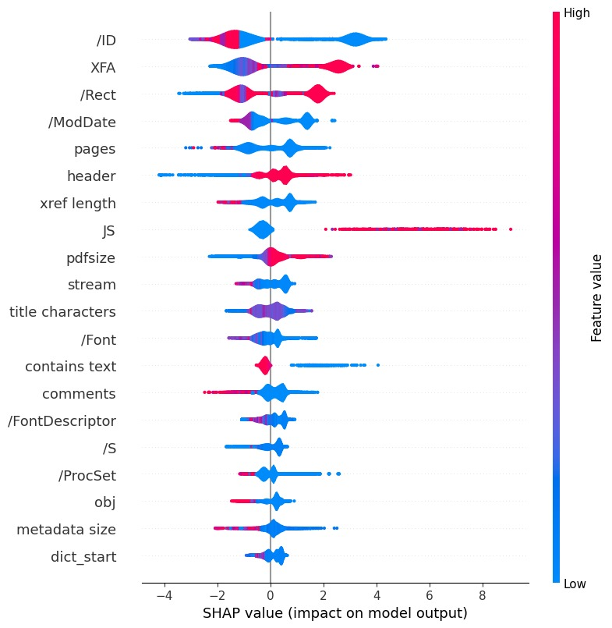
DATA ANALYSIS (SHAP)
The SHAP summary plot shows feature importance and impact on predictions across samples, with features ranked by influence
Wider point spreads indicate more variable impacts, highlighting which features are most significant and how their values affect predictions
CS658A: Topics in Malware Analysis and Intrusion Detection

Slide 19
ML MODEL

Slide 20
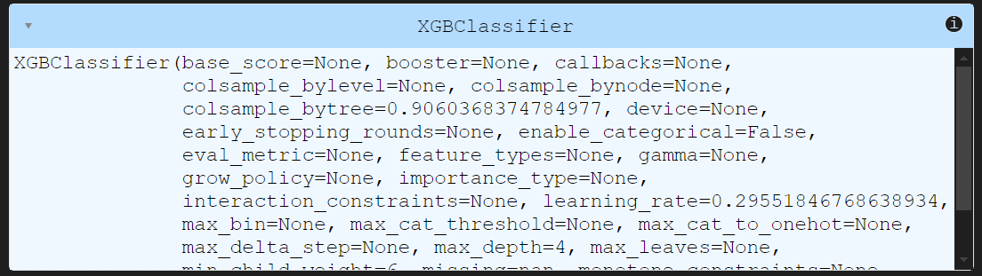
MODEL USED
Performed an exhaustive analysis for the model selection and the hyperparameters
Used XGBoost as our final model with hyperparameter optimization
XGBoost takes much lesser time for training and testing than the Stacking Model
Consistently gave better results during validation as well as on the MalwareBazaar dataset
For hyperparameter tuning, Optuna was used which is an open source tool
CS658A: Topics in Malware Analysis and Intrusion Detection

Slide 21
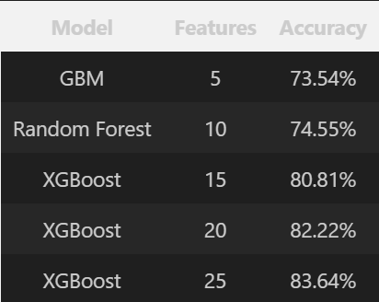
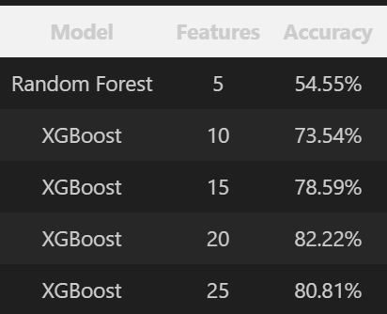
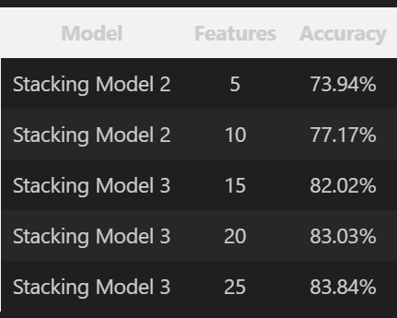
WHY XGBOOST?
Performance comparison showed that XGBoost performed better than other Classification algorithms on three different dataset splits and various combinations of features
XGBoost is around 15 times faster than the Stacking Model!
Testing on Balanced training data
Testing on Imbalanced training data
Testing on Balanced training data
CS658A: Topics in Malware Analysis and Intrusion Detection

Slide 22
COMPARATIVE ANALYSIS AND RESULTS

Slide 23
COMPARATIVE ANALYSIS AND RESULTS
Time taken on Enhanced and Diverse Dataset
Our model performed exceedingly well in terms of time than the existing model
The number of features used by us are less than that in the original paper and our model significantly outperforms their model even on live malware samples
Accuracy on most Updated Open Source Dataset
Our model has achieved better accuracy than the existing model when tested on most updated open source dataset from MalwareBazaar as well as the original dataset.
The accuracy of the paper’s model on the MalwareBazaar dataset was 83.03% and on the Validation dataset was 99.55%
The accuracy of our model on the MalwareBazaar dataset was 86.67% and on the Validation dataset was 99.89%
Model | Validation Dataset | MalwareBazaar | Execution Time
Stacking Model | 99.55 | 83.03 | 15x
Own Model | 99.57 | 86.67 | x
CS658A: Topics in Malware Analysis and Intrusion Detection

Slide 25
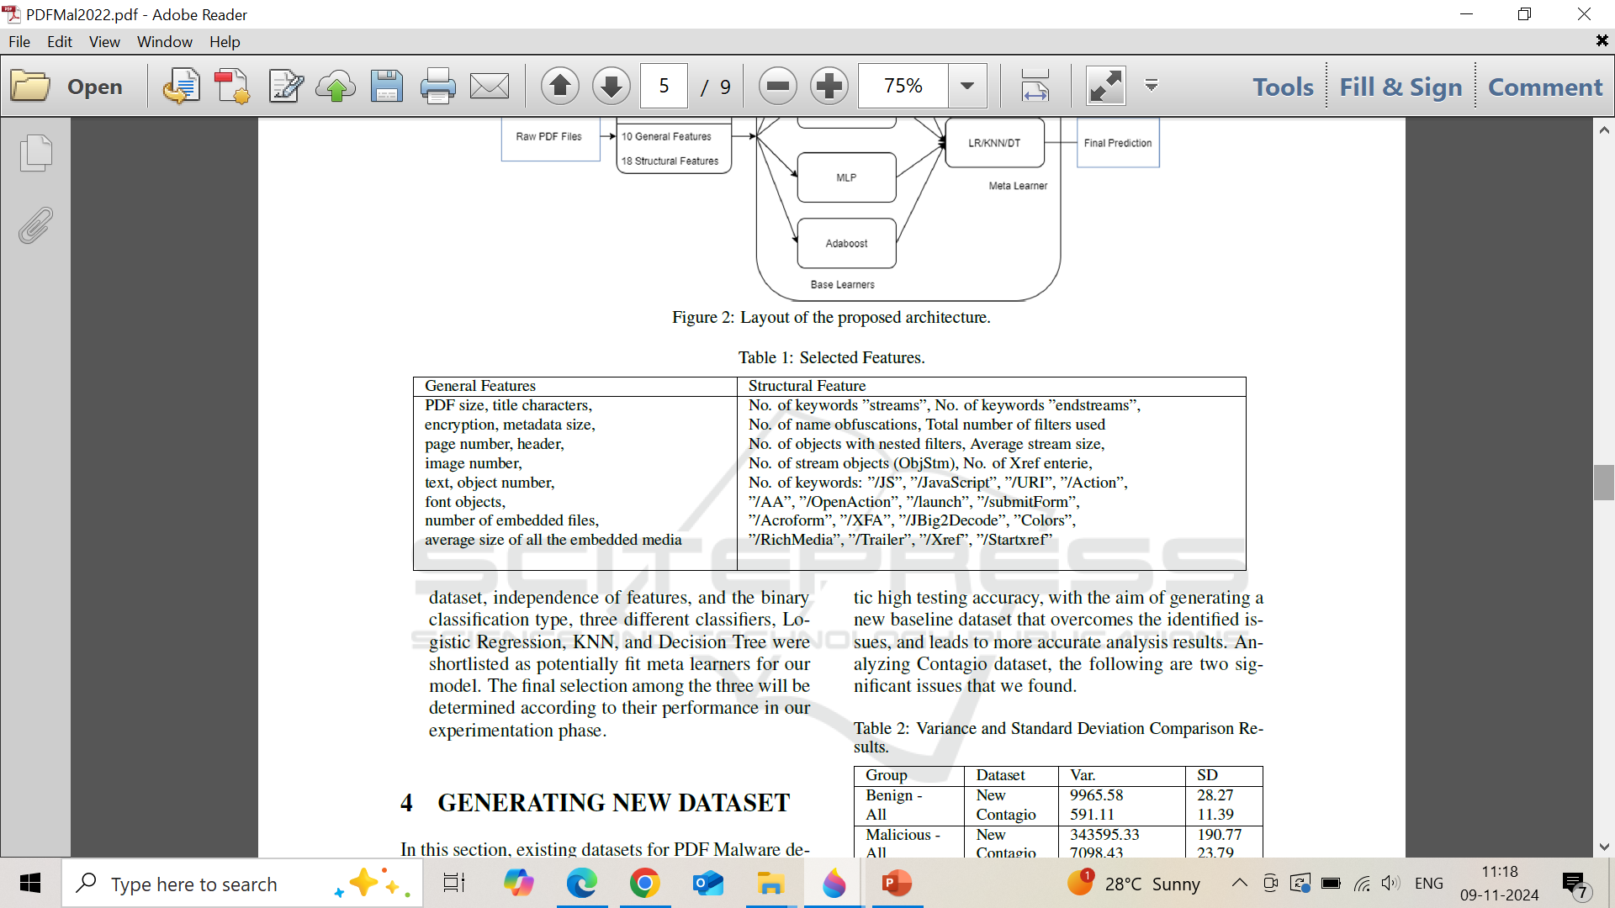
13 out of 25 are different than those used in the Paper

Slide 26
LIMITATIONS AND FUTURE SCOPE
Accuracy need to be increased on most updated dataset from MalwareBazaar, we believe that after adding the entire VirusShare and GOVDocs data we could have achieved a score of 90+% accuracy.
Dynamic Malware Analysis: We can also add features extracted from sandbox environments to further increase the feature set for analysis and model robustness and performance.
We did not try out Deep Learning methods due to lack of time and computational resources. Trying out such methods could have provided more insight of the data.
CS658A: Topics in Malware Analysis and Intrusion Detection

Slide 27
BIBLIOGRAPHY
PDF Malware Detection based on Stacking Learning
PDF Malware Detection: Toward Machine Learning Modeling with Explainability Analysis
XAI-PDF: A Robust Framework for Malicious PDF Detection Leveraging SHAP-Based Feature Engineering
https://github.com/Youssef-AK/PDF-Evasive-Detector
https://github.com/ahlashkari/PDFMalLyzer
https://github.com/thanlau/PdfRep?tab=readme-ov-file
MalwareBazaar
CS658A: Topics in Malware Analysis and Intrusion Detection

Slide 28

Questions?

