Slide 1
Automatic Naming TV serial
characters
Computer Vision Project - mideval

Slide 2
Members :
2019201012
2019201069
2019201071
2019201081

Slide 3
Objective of the project
The objective of this work is to label television or movie footage with the identity of the people present in each frame of the video.
The new technique used in this project is that we make the use of subtitles + script to know which speaker is speaking at a particular moment. Along with which speaker detection technique is used to remove ambiguity from the detected faces.

Slide 4
Methodology
Creating the CSV File for timestamp and respective names of actor speaking
Training
Prediction

Slide 5
Creating the CSV File
For each entry in srt file :
Create entry in csv file.
Get the start and end timestamp.
Map the dialogues using Dynamic Time Warping with the script file and extract the name of the person speaking.
Insert this into the new entry created

Slide 6
Training stage
Frame creation
Dataset creation
Training

Slide 7
Training stage contd...
1. Divide the video into frames so that we have a set of images now
2. The dataset is created using the images that have single person’s face detected in the image
where (1 bounding box detected) :
Face_recog.vector + csv-name
3. Train this data using the model (SVM classifier)
4. Save this model for later use for predicting

Slide 8
Final Predictions
Frame by frame run
For each frame :
For each bounding box:
name = model.predict
display name on the box

Slide 9
Video Processing
(Extracting Descriptors)
Aim is to extract descriptors out of the face tracks for matching.
Facial features:
Left Right corners of each eye
Two nostrils
Tip of nose
Left right corners of the mouth

Slide 10
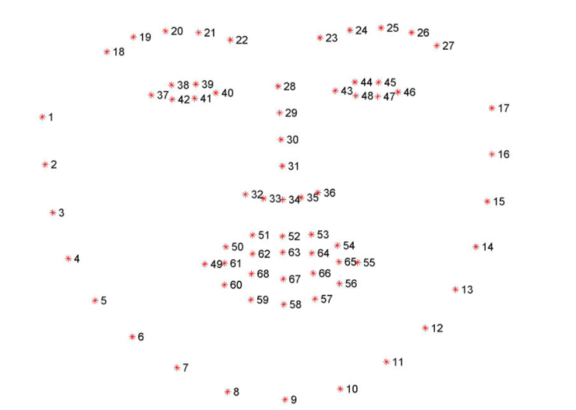
Additional approach for feature vector
Facial Landmarks detection -> 68 facial coordinates
The ratio between certain facial landmarks like:
the corners of eyes
Bridge of nose
Nose to chin
Jaw angle
Assuming that these remain same for a person
irrespective of the facial expressions.

Slide 11
Libraries and functions used
dlib.get_frontal_face_detector()
dlib.shape_predictor()
face_recognition.face_encodings()

Slide 12
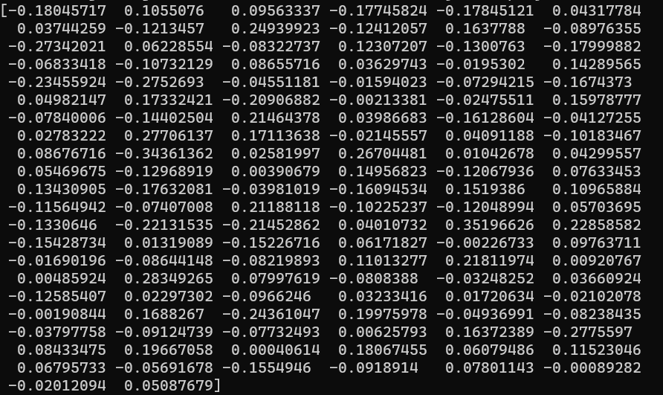
Image Feature Vector

Slide 13
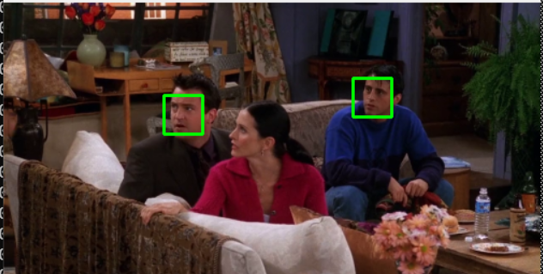
Face Detection

Slide 14
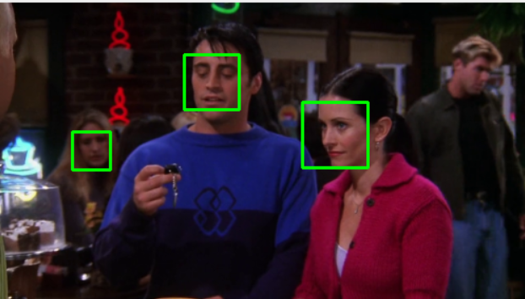

Slide 15
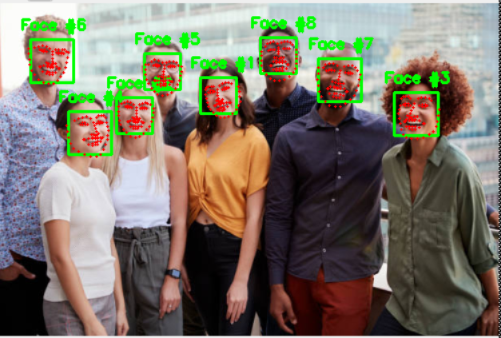
Facial Landmarks Detections

Slide 16
Thank you!

