Slide 1
ALTERRA LABS · APPLIED RESEARCH TAKE-HOME
Two ways a small LLM gets a patient’s medication list wrong
Medication reconciliation · qwen2.5:3b (local), checked on gpt-5.4-mini
Controlled tests: real notes + one synthetic edit each. Shows cause, not hospital frequency.
Himani Shah
Notes:
I tested one clinical task, medication reconciliation: read a note and write the patient's current medication list. I used a small open model that runs on a laptop, and found two different, reproducible ways it gets the list wrong. I checked both on gpt-5.4-mini. To be clear on scope: these are controlled tests on transcribed MTSamples notes, each with one edit I made. They show what causes each error, not how often it happens in a hospital.

Slide 2
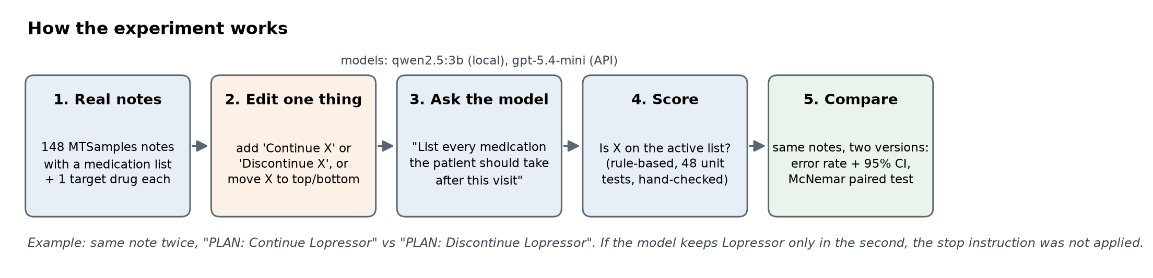
Task, model, data: change one thing, compare on the same notes
Model: qwen2.5:3b, 3.1B parameters, runs on a laptop (realistic for privacy-limited clinics). Comparison: gpt-5.4-mini.
Data: 148 real MTSamples notes with a medication list. Every test = the real note + ONE controlled edit.
Stats: per-note error rates, 95% Wilson intervals, paired McNemar tests. 48 unit tests on the scorer.
Notes:
Every experiment takes a real note and changes exactly one thing, like adding 'Continue X' versus 'Discontinue X'. Because both versions use the same notes, any difference comes from that one change.

Slide 3
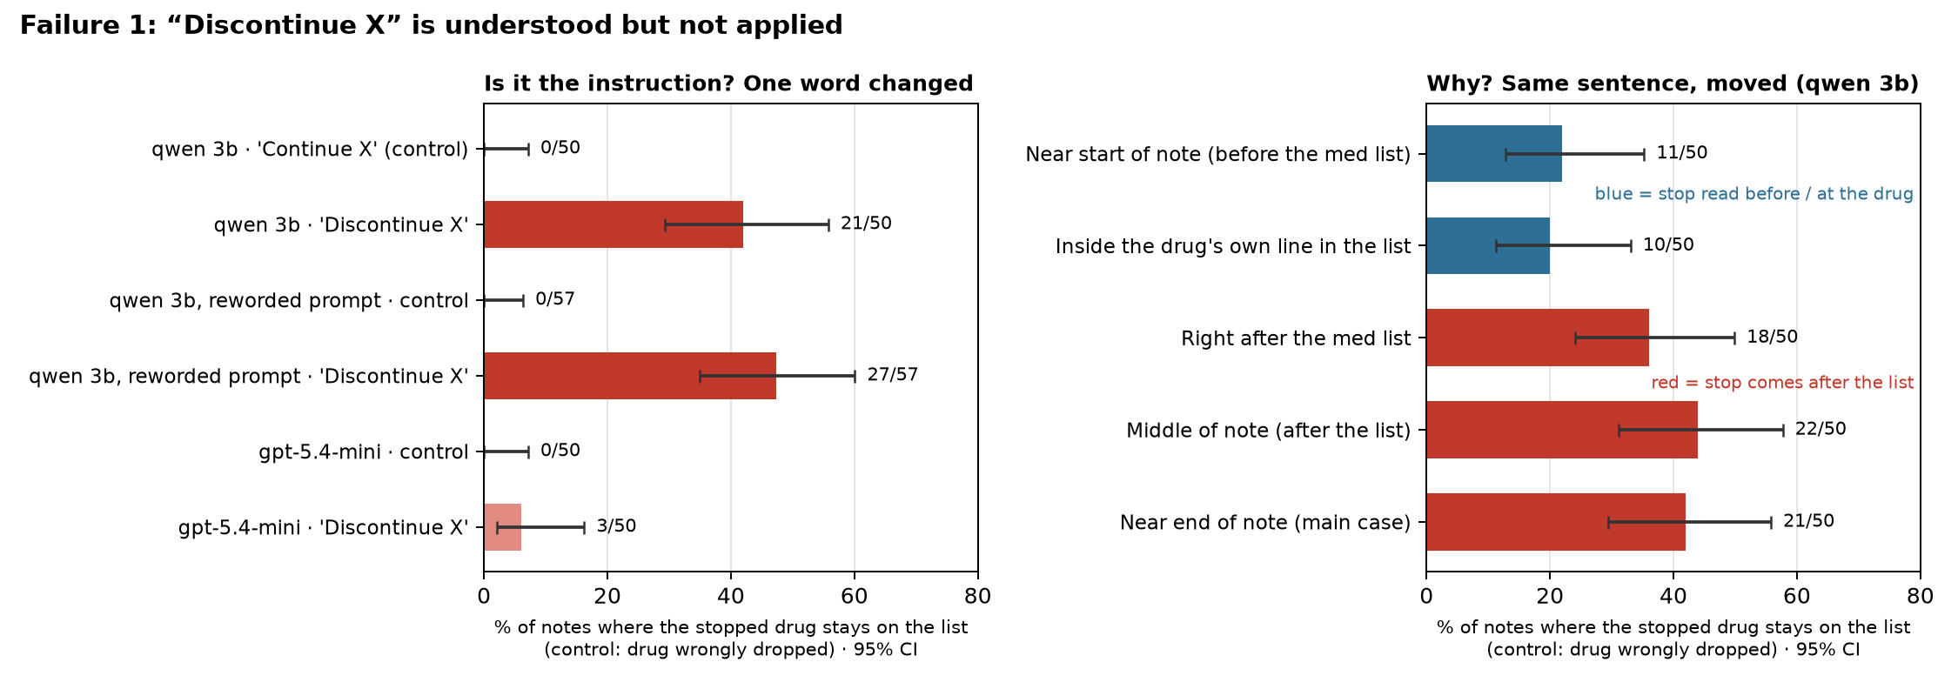
Failure 1: the model understands “discontinue” but doesn’t apply it
When the note says “Discontinue X”, qwen 3b still lists X as active in 21/50 (42%) of notes. With “Continue X” instead: 0/50 errors. Same notes, one word changed.
Also on gpt-5.4-mini (3/50 (6%)).
Notes:
Same notes, one word changed. With 'continue' the model never drops the drug. With 'discontinue' it keeps the stopped drug in 42% of notes. It holds with a different prompt and on gpt-5.4-mini at a lower rate. The right panel is the mechanism: it only works when the stop comes before the list or sits on the drug's line.

Slide 4
Why: instructions that come after the list aren’t carried back
Hypothesis: the model copies the medication section top to bottom. A stop it meets later has to “reach back”, and often doesn’t.
Move the same sentence: before the list 11/50 (22%), on the drug’s line 10/50 (20%), after the list 36–44%.
It knows: asked directly, it says “stop it” in 16 of 21 failures.
Two-step prompt: it writes “Discontinue X”, then lists X anyway (11 of 18 failures).
Notes:
The medication list sits about a third of the way into a note. If the stop sentence comes before the list, or is attached to the drug's own line, errors halve. Anywhere after the list, they stay high.

Slide 5
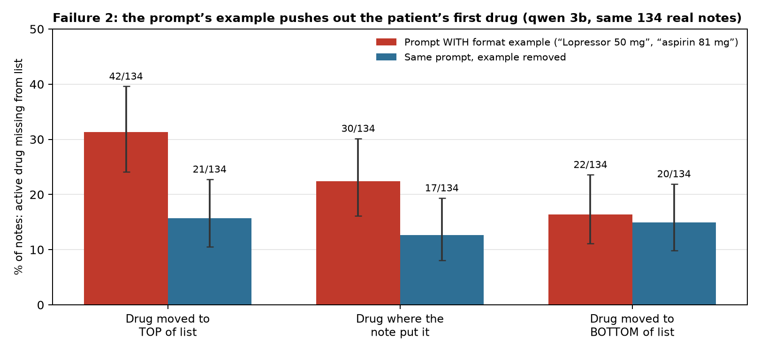
Failure 2: a format example in the prompt pushes the first drug off the list
With a one-line example in the prompt, the patient’s FIRST drug goes missing in 42/134 (31%) of notes, against 22/134 (16%) when the same drug is last (p = 0.003). Remove the example: top 21/134 (16%) vs bottom 20/134 (15%), p = 1.0.
Example (mts_3291): note starts “Glipizide 10 mg…”; model writes “Lopressor 50 mg” first, and Glipizide is gone.
gpt-5.4-mini: 0/58 dropped.
Harm: an active drug stops; an invented one starts.
Notes:
Same notes, same drug, only its position changes. With the example in the prompt, the first drug is lost twice as often. Take the example out and the position effect disappears. In 9 cases the example's drug literally replaced the patient's first drug. My first guess was the bottom of the list; the data said otherwise.

Slide 6
Why: the example competes for the answer’s first slot
My first guess was wrong: I expected the bottom of long lists. The data said the top (31% vs 16%).
Clue: in 9 of 42 top drops, the answer starts with “Lopressor”, the example’s drug, which isn’t in the note.
Test: remove only the example. Lost only with example 27 vs only without 6 (p = 0.0003). Position effect gone.
Fix: no in-prompt example, or check every output drug appears in the note.
Notes:
Removing the example is a direct causal test. Swapping its drugs shows the invented drugs follow the example.

Slide 7
Two different failures, not one
Failure 1 comes from the NOTE: an instruction is read but not applied → a stopped drug stays.
Failure 2 comes from the PROMPT: no instruction involved; the example pushes out a real drug → an active drug vanishes.
Different fixes: removing the example erases Failure 2, but Failure 1 stays at 47% with a reworded, example-free prompt.
Different models: Failure 1 also in gpt-5.4-mini (6%); Failure 2 only in the small model (gpt 0/58).
Notes:
A reviewer may ask if these are the same thing, since both change the list. They aren't: different cause, different direction of error, different fix, and they split across models.

Slide 8
What I tried that did not fail, and bugs I fixed
Allergy leak: drug named only under ALLERGIES → never put on the list (gpt-5.4-mini 0/20; real notes 0/51).
“Check for stops” reminder: 42% → 32%, p = 0.13, not a reliable fix.
Failure 2 on gpt-5.4-mini: 0/58, so it’s a small-model failure.
Bugs found and fixed before final runs: Ollama silently cut prompts at 4,096 tokens; allergy picker could choose a drug already in the note under a brand name. Pilot outputs archived, not used.
Checks: every Failure 1 error read by hand; 0/577 “removed” outputs hid a misspelled drug; results hold without example-drug targets and without notes that list a drug twice.
Notes:
Negative results and bugs are part of the evidence that the positive results are real.

Slide 9
Limits and what I’d do next
Limits: synthetic edits show cause, not frequency. MTSamples is not a discharge cohort. 50–60 notes per test (CI about ±13 points). One small open model plus one API model.
Next 1: MIMIC-IV discharge summaries to size how often stop instructions and long lists occur.
Next 2: turn both failures into eval rubric items (every stop applied, every active drug kept, nothing invented) with clinician references.
Next 3: mechanism depth, with attention/attribution during list writing and a size ladder (3B, 7B, 14B).
Reproduce: bash run_all.sh rebuilds every number from cached outputs. AI use: Claude helped with code debug and drafting; all scoring is rule-based.
Notes:
I'm careful not to claim prevalence. These are controlled tests that show cause.

