Slide 1
HR Analytics PROJECT Mentor :- Shruti Nigam

Slide 2
HR ATTRITION
Introduction
KPI’s
Dashboards
Conclusion

Slide 3
INTRODUCTION
Every organization wants its valuable employees to be a part of their organization for a long period. Still, when many employees start leaving the organization, it will be a concern for the organization. The organization should know the possible reasons why their employees are leaving.
In order to determine the potential causes of employee attrition and make the necessary modifications to the organization's rules and working environment, the company will compile data on all of the employees who have left and who are still employed there.
Attrition is the departure of employees from the organization for any reason (voluntary or involuntary), including resignation, termination, death or retirement.

Slide 4
DATA UNDERSTANDING
The data given in two parts HR 1 and HR 2 .
In HR 1 is dimension table in which all educational and professional details are included.
In HR 2 contains numerical data i.e., fact table.
Both sets have 50K observations and 18 variables in each set.
Merged the datasets with common column Employee number and Employee Id.

Slide 5
TOOLS
EXCEL
MY SQL
TABLEAU
POWER BI

Slide 6
KPI’s
AVERAGE ATTRITION FOR ALL DEPARTMENT
DEPARTMENT WISE WORK EXPERIENCE
AVERAGE HOURLY RATE OF MALE RESEARCH SCIENTIST
DEPARTMENT WISE PERCENT SALARY HIKE
MONTHLY INCOME VS JOB ROLE
JOB ROLE WISE ATTRITION RATE
DEPARTMENT WISE EXPERIENCE AND PROMOTION
JOB ROLE VS JOB SATISFACTION
AGE VS ATTRITION
NUMBER OF EMPLOYEES BY AGE

Slide 7
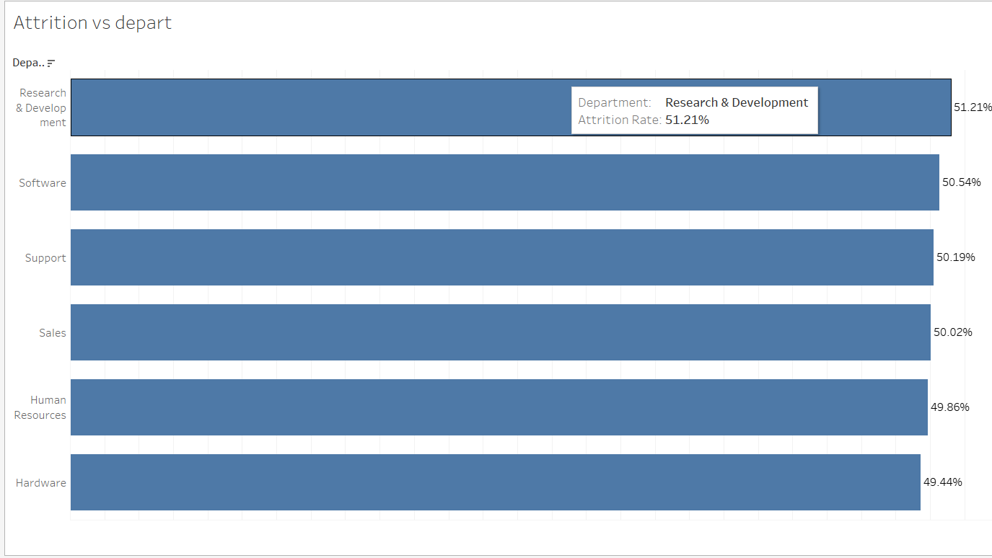
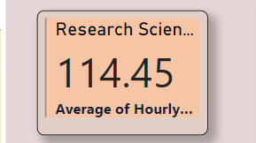
1. Average Attrition rate for all Departments
2.Average Hourly rate of Male Research Scientist
We calculated the average hourly rate of the research scientist job role and then by gender.
Compared to other departments, the research and development department has the highest attrition rates.

Slide 8
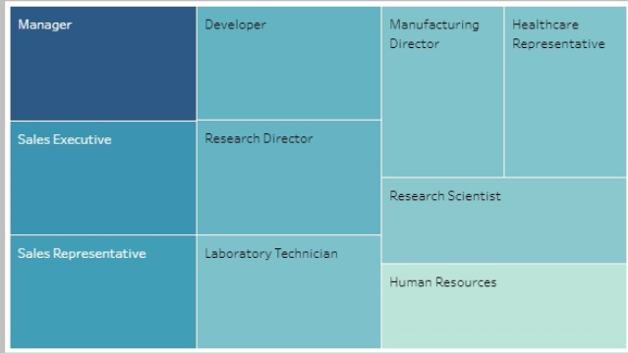
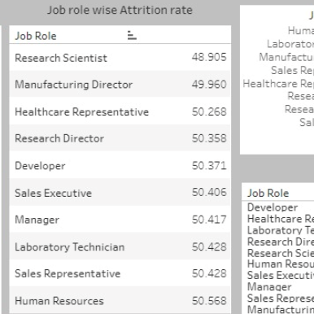
3. Monthly income vs job role
4. Job Role wise Attrition Rate
Tree Maps shows the monthly income high for Manager in dark blue colour.
Human resource has the lowest average monthly income because of which its attrition rate is very high.

Slide 9
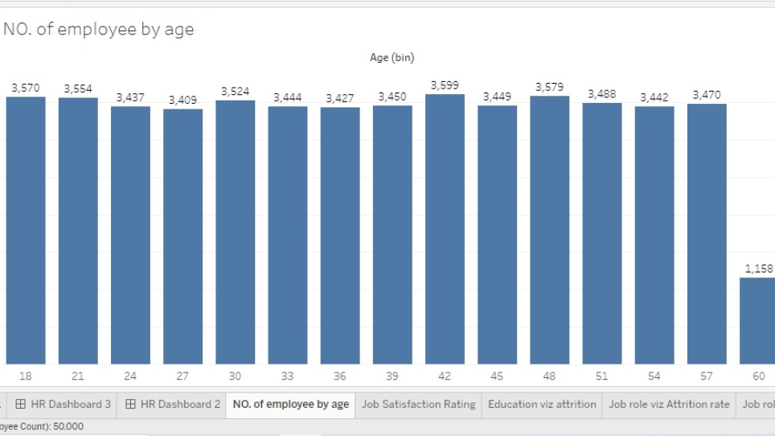
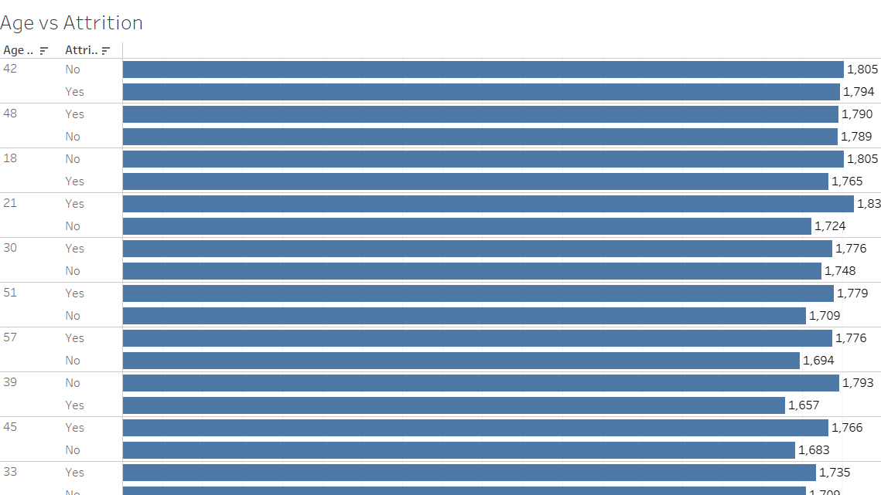
5. Number of Employees by Age
6. Age Vs Attrition
In this KPI we created the bins for Age.
Here, the age group of 42 has the highest
number of active Employees but the attrition
rate is low.
Since age group of 21 also have the highest active employees still the attrition for this group is largest among the all.

Slide 10
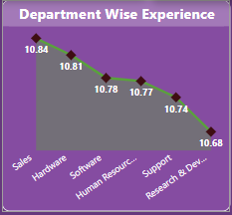
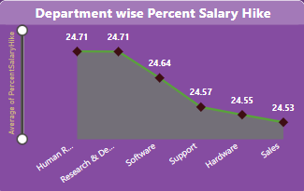
7. Department wise experience
8. Department wise Percent Salary Hike
Each Department have average 11 years of experience with the same company but percent salary hike in this 11 years is only 24 % .
Sales Department have highest experience but lowest salary hike.

Slide 11
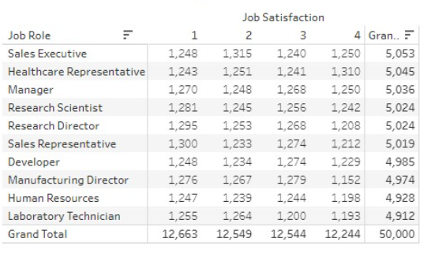
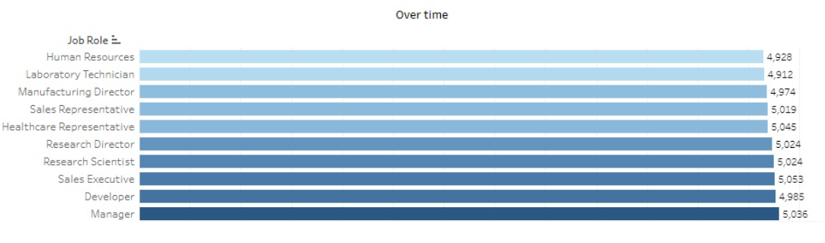
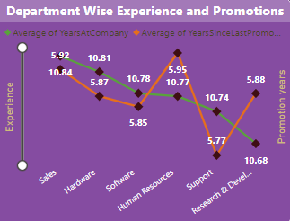
9. Job role vs Job satisfaction
10. Job role vs Overtime
11. Department wise experience and promotions
Almost 75% employees are not satisfied
More than 50% employee have to do overtime
AS they are involved in number of job works and doing overtime but not recognize with any rewards as its clearly visible, after10 to 11 years of experience not received promotion since last 5 to 6 year .

Slide 12
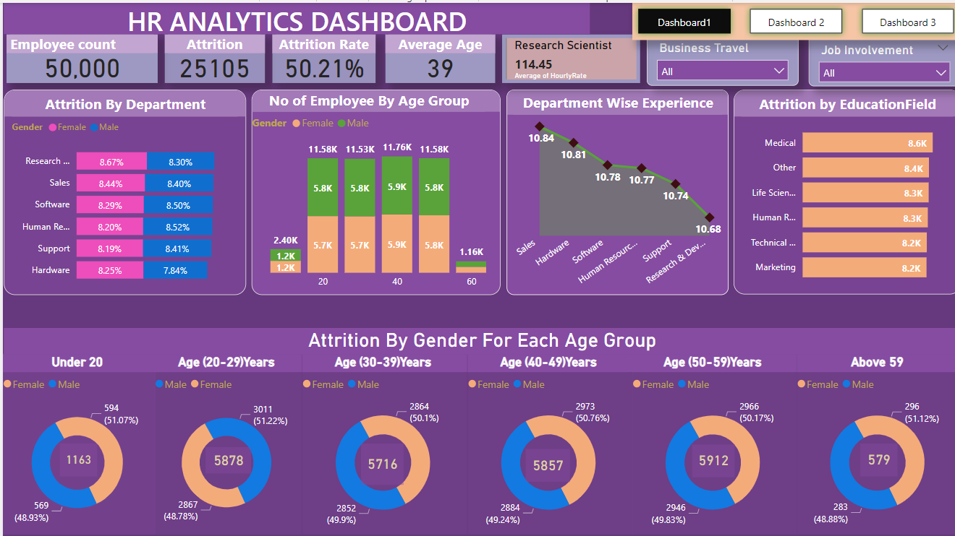

Slide 13
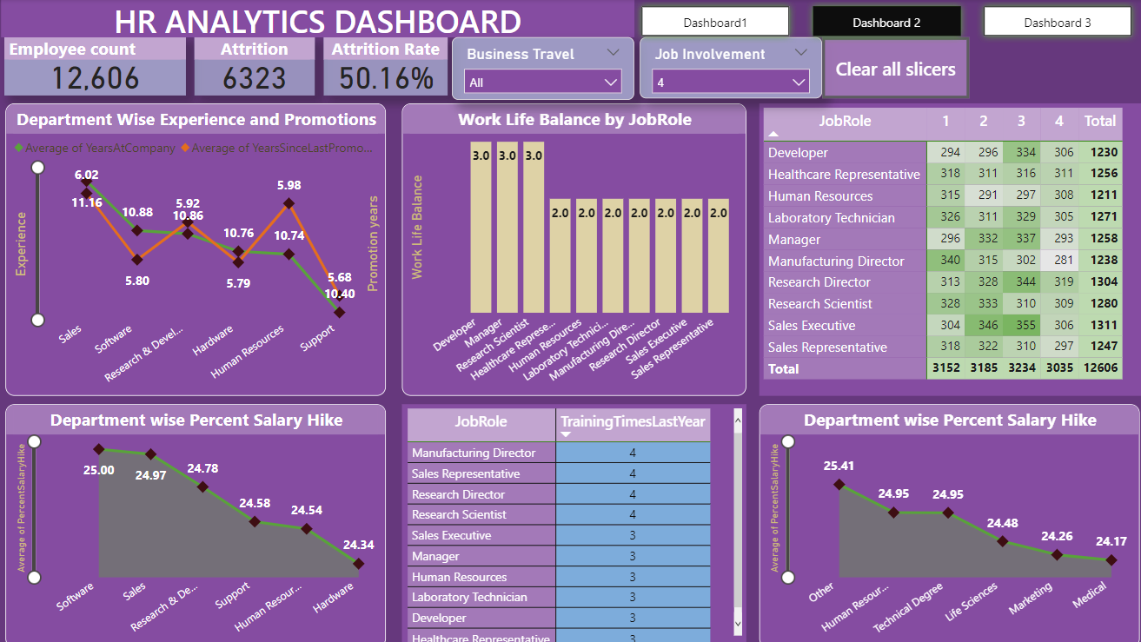
Education

Slide 14
CONCLUSIONS
Attrition Rate: The organization is facing a significant downfall of 50% in attrition across all departments, regardless of gender and job role.
Employee Satisfaction: Up to 70% of employees are dissatisfied with their working conditions, including work-life balance and job involvement.
Salary Dissatisfaction: Employees are unhappy with their salaries, with the average pay being approximately 26,000/-, and a large number of employees receiving salaries below the average.
Lack of Appreciation: There is a lack of recognition and appreciation for employees' hard work and dedication.
No Overtime Remuneration: The organization does not provide compensation for overtime work, leading to employee dissatisfaction.
Delayed Promotions: Employees experience significant delays in promotions, with an average delay of 5 years, coupled with minimal increments.
Need for Employee Involvement: The firm should involve employees in decision-making processes to foster a sense of belonging and improve overall outcomes.
Work-Life Balance: Providing employees with proper timeouts and support to balance their work and personal life can reduce the urge to seek opportunities elsewhere.
Timely Promotions and Appraisals: Conducting timely promotion and appraisal meetings can motivate employees and enhance their productivity.
Competitive Compensation: Offering reasonable pay raises or additional benefits such as transport facilities, canteen coupons, and health insurance can improve employee satisfaction.
Employee-Centric Facilities: Providing facilities and benefits that align with employees' interests can boost their happiness and engagement within the organization.
Link between Happy Employees and Success: Recognizing that happy employees contribute to the success of the company and investing in human resources accordingly.
By addressing these points and implementing employee-centric strategies, the organization can aim to improve retention rates, boost morale, and create a more positive and productive work environment.

Slide 15
THANK YOU

