Slide 1
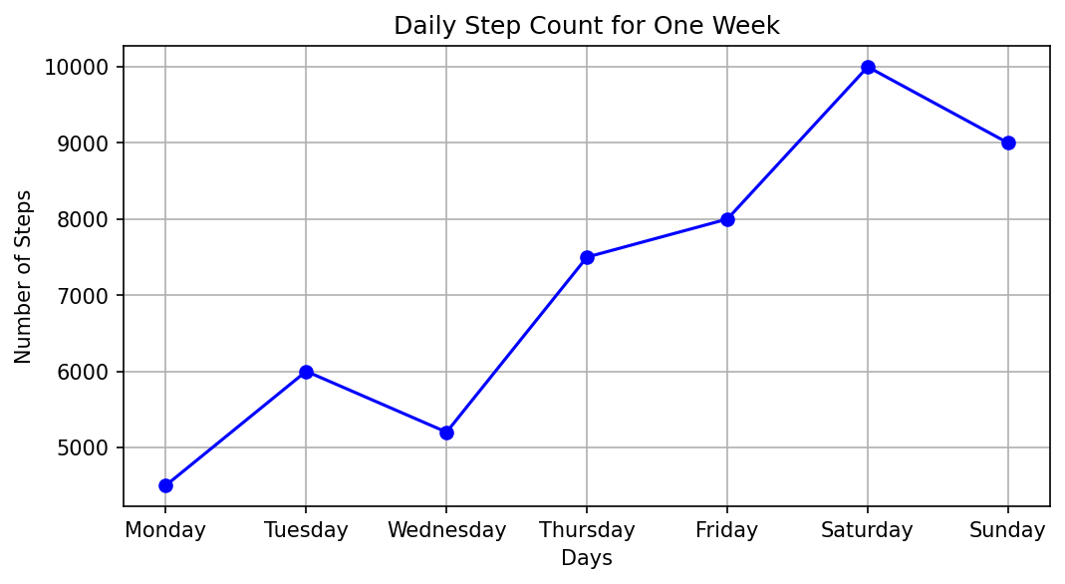
Daily Step Count for One Week

