Slide 1
Final CSCI 860 Machine Learning
Name:- Himani V. Parikh
ID#:- 1322085
Data Set:- Bank Marketing Dataset
Question:- Classifiers and Feature Selection

Slide 2
Dataset – Bank Dataset
Number of Instances: 41,188
Number of Attributes: 20
Split = 80 - 20%
Training = 32950 samples
Test = 8238 samples

Slide 3
Features in order of rank
mRMR
2 | 3 | 17 | 11 | 5 | 12 | 10 | 7 | 4 | 6 | 13 | 8 | 18 | 14 | 16 | 15 | 9 | 19
Relief
11 | 1 | 10 | 2 | 4 | 3 | 5 | 7 | 9 | 17 | 13 | 8 | 12 | 14 | 16 | 18 | 15 | 19
SFS – Kmeans – best 15
2 | 3 | 4 | 5 | 6 | 7 | 9 | 10 | 12 | 14 | 15 | 16 | 18 | 19
SFS – SVM – best 10
3 | 4 | 5 | 6 | 8 | 11 | 13 | 15 | 16 | 18

Slide 4
SFS – FCM – best 15
2 | 3 | 4 | 5 | 6 | 7 | 9 | 10 | 12 | 14 | 15 | 16 | 18 | 19
SFS – ADA – best 15
1 | 2 | 3 | 4 | 5 | 6 | 7 | 8 | 9 | 12 | 14 | 15 | 17 | 19
SFS – GB – best 15
2 | 3 | 4 | 5 | 6 | 7 | 9 | 10 | 11 | 12 | 13 | 14 | 17 | 19
SFS – XGB – best 15
2 | 3 | 4 | 5 | 6 | 7 | 9 | 10 | 11 | 12 | 13 | 14 | 17 | 19

Slide 5
SVM
Kernel = RBF, decision_function_shape = ovr (one-vs-rest ), C = 1.0
Kmeans
Clusters = 2, Method for initialization = ‘k-means++’, max_iter=300, n_init=10, random_state=42,
Algorithm = Lloyd
FCM
Clusters = 2, Degree of fuzziness=3,max_iter=300, ,n_init=10, random_state=42
ADA
n_estimators=50, learning_rate=1

Slide 6
GB
n_estimators=50, learning_rate=1
XGB
n_estimators=50, learning_rate=0.5

Slide 7
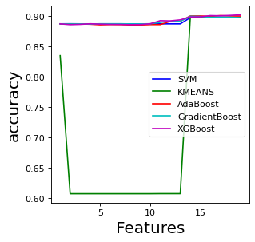
Relief Feature Selection – All classifier

Slide 8
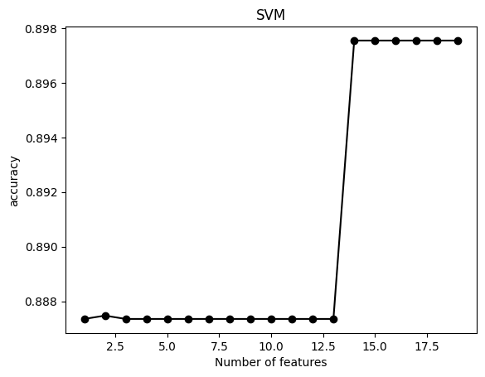
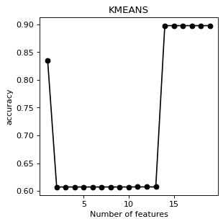
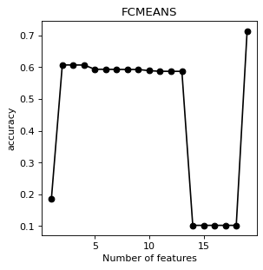
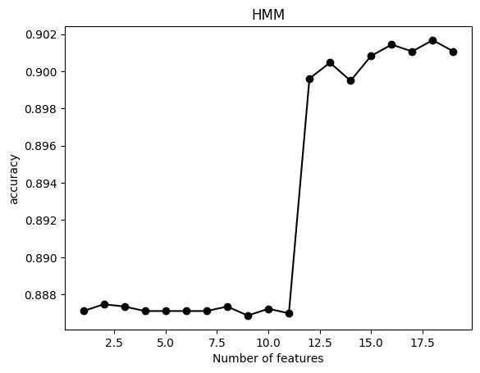
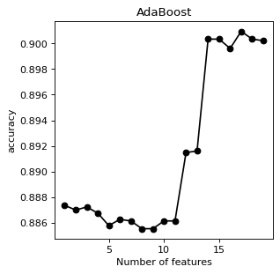
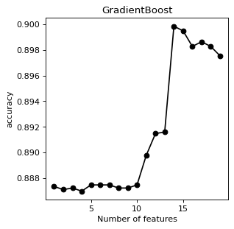
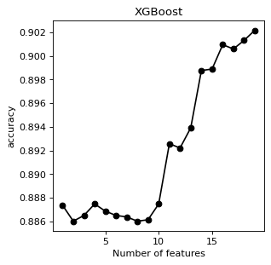
RF Selection - Individual

Slide 9
RF performance of All classifier
Relief
Classifier | Sensitivity | Specificity | AUC | F1 | Accuracy | Best # of features
SVM | 21% | 98% | 59% | 0.31 | 89% | 14
Ada Boost | 22% | 98% | 60% | 0.33 | 90% | 17
Gradient Boost | 18% | 99% | 58% | 0.29 | 89% | 14
XG Boost | 25% | 98% | 61% | 0.36 | 90% | 19
KMC, 2 clusters | 19% | 98% | 59% | 0.30 | 89% | 14
FCM, 2 clusters | 70% | 71% | 59% | 0.35 | 71% | 19
HMM | 21% | 98% | 60% | 0.32 | 89% | 19

Slide 10
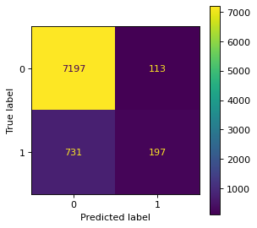
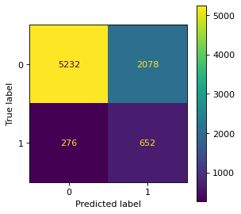




RF
Fcmeans
Gradient boost
HMM
SVM
Kmeans
Ada Boost
XG Boost

Slide 11
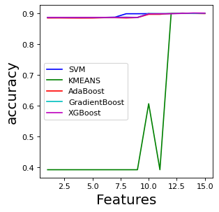
SFS Feature Selection – All classifier

Slide 12
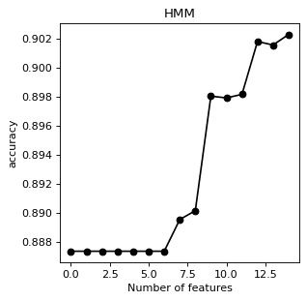
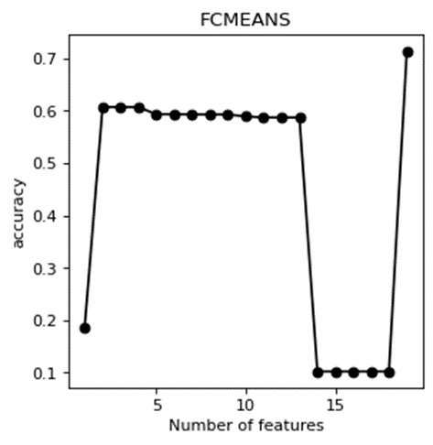
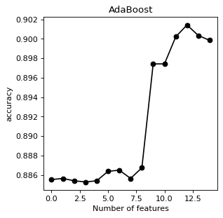
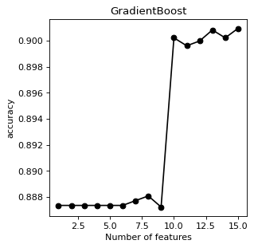
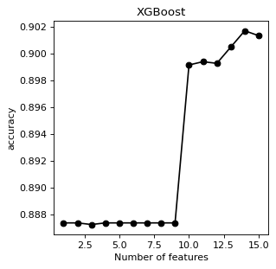
SFS - Individual

Slide 13
SFS - Performance
SFS
Classifier | Sensitivity | Specificity | AUC | F1 | Accuracy | Best # of features
SVM | 18% | 99% | 58% | 0.28 | 89% | 10
Ada Boost | 21% | 98% | 60% | 0.32 | 90% | 13
Gradient Boost | 17% | 99% | 58% | 0.27 | 90% | 15
XG Boost | 23% | 98% | 61% | 0.35 | 90% | 14
KMC, 2 clusters | 19% | 98% | 59% | 0.30 | 89% | 15
FCM, 2 clusters | 19% | 98% | 60% | 0.31 | 89% | 15
HMM | 22% | 98% | 60% | 0.34 | 90% | 15

Slide 14





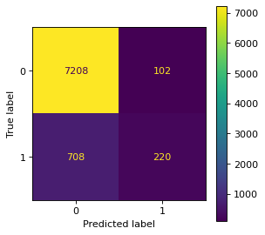
SFS
Fcmeans
Gradient boost
HMM
SVM
Kmeans
Ada Boost
XG Boost

Slide 15
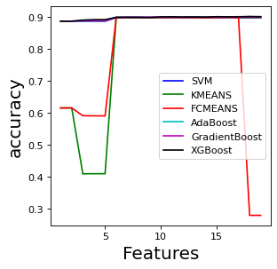
mRMR Feature Selection – All classifier

Slide 16
mRMR - Performance
mRMR
Classifier | Sensitivity | Specificity | AUC | F1 | Accuracy | Best # of features
SVM | 22% | 98% | 60% | 0.32 | 89% | 6
Ada Boost | 25% | 98% | 60% | 0.34 | 90% | 18
Gradient Boost | 18% | 99% | 58% | 0.29 | 90% | 14
XG Boost | 25% | 98% | 61% | 0.37 | 90% | 18
KMC, 2 clusters | 21% | 98% | 60% | 0.32 | 89% | 6
FCM, 2 clusters | 21% | 98% | 60% | 0.32 | 89% | 6
HMM | 18% | 99% | 58% | 0.29 | 90% | 18

Slide 17
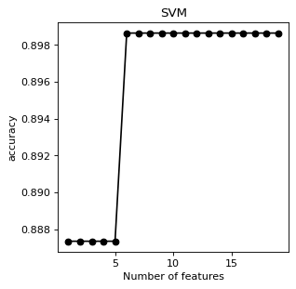
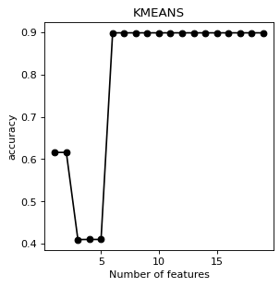
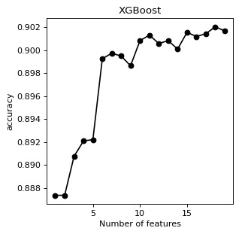
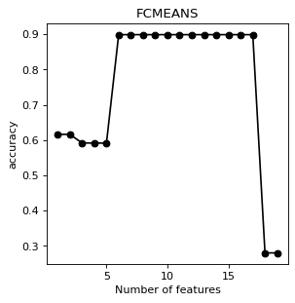
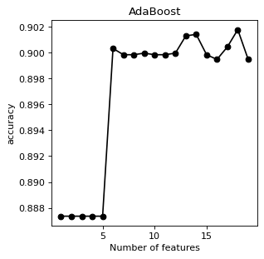
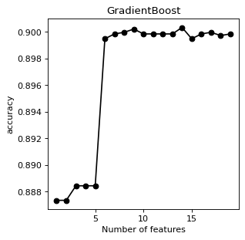
mRmR

Slide 18





mRMR
SVM
Fcmeans
Gradient boost
HMM
Kmeans
XG Boost
Ada Boost

Slide 19
Conclusion
Feature selection is applied on 19 features, for binary classification.
The dataset is not well distributed in terms of classes. ‘No’ class has over 90% of the total samples.
This is the reason for low sensitivity, specificity, AUC, and F1 score but gives high accuracy.
ADA Boost provides the best accuracy for both Relief and mRMR selection at 15 features.

Slide 20
Thank you

