Slide 1
ASSIGNMENT 1 - Naive Bayes Classification and Confusion Matrix concepts
Professor: Maryam Ravan
Members:
Furqaan Khan
Vered
Prachiti
Harsh
Himani

Slide 2
Install Dependencies
import os
import pandas as pd
import matplotlib.pyplot as plt
from sklearn.model_selection import train_test_split
from sklearn.naive_bayes import GaussianNB
from sklearn.metrics import confusion_matrix
from sklearn.metrics import ConfusionMatrixDisplay
from sklearn.preprocessing import label_binarize
from sklearn.metrics import roc_curve, auc
from itertools import cycle
from sklearn.metrics import classification_report

Slide 3
2. Load and Seperate Data
# Load dataset file
dataset = pd.read_csv('/Users/furqaankhan/Desktop/wine.data', sep = ',')
# Split the dataset into train and test sets
training_set, test_set = train_test_split(dataset, test_size = 0.3, train_size = 0.7, random_state = 42)
# Separate the Label from the Features
training_data = training_set.iloc[:,1:]
training_target = training_set.iloc[:,0]
test_data = test_set.iloc[:,1:]
test_target = test_set.iloc[:,0]
Notes:
Mobile devices do not have enough storage, and thus the need for the user of the devices to get extra space from services such as AWS. The solution will be finding an algorithm that can best address these issues. The main thing holding back the adoption of cloud computing is the ongoing issue of data security. This worry stems from the fact that personal information kept in public clouds is handled by for-profit service providers who might not be completely reliable.

Slide 4
3. Run, Fit and Confusion
# Run Naive Bayes classifier algorithm
clf_gnb = GaussianNB()
# Fit
clf_gnb.fit(training_data, training_target)
# Predict
preds_gnb = clf_gnb.predict(test_data)
# Confusion matrix
print('Confusion Matrix : \n', confusion_matrix(test_target, preds_gnb))
ConfusionMatrixDisplay.from_predictions(test_target, preds_gnb)
plt.show()

Slide 5
4. Calculate Report
# Calculate classification report
target_names = ['Class 1', 'Class 2', 'Class 3']
print(classification_report(test_target, preds_gnb, target_names=target_names))

Slide 6
4. ROC and AUC
binary_labels = label_binarize(test_target, classes=[1, 2, 3])
n_classes = binary_labels.shape[1]
score = clf_gnb.fit(training_data, training_target).predict_proba(test_data)
fpr = dict()
tpr = dict()
roc_auc = dict()
for i in range(n_classes):
fpr[i], tpr[i], _ = roc_curve(binary_labels[:, i], score[:, i])
roc_auc[i] = auc(fpr[i], tpr[i])
colors = cycle(['blue', 'red', 'green'])
for i, color in zip(range(n_classes), colors):
plt.plot(fpr[i], tpr[i], color=color, linewidth=2,
label='ROC curve of class {0} (area = {1:0.2f})'
''.format(i, roc_auc[i]))

Slide 7
4. ROC and AUC
plt.plot([0, 1], [0, 1], 'k--', linewidth=2)
plt.xlim([-0.05, 1.0])
plt.ylim([0.0, 1.05])
plt.xlabel('False Positive Rate')
plt.ylabel('True Positive Rate')
plt.legend(loc="lower right")
plt.show()

Slide 8
5. Results
Class | TP | TN | FP | FN | Accuracy (TP+ TN)/total | Sensitivity TP/(TP + FN) | Specificity TN/(TN + FN) | Precision TP/(TP + FP) | F1-score TP/(TP + 0.5(FP + FN))
1 | 18 | 35 | 0 | 1 | 0.9814 | 0.9473 | 0.9722 | 1 | 0.9729
2 | 19 | 32 | 1 | 2 | 0.9444 | 0.9047 | 0.9411 | 0.95 | 0.9429
3 | 14 | 38 | 2 | 0 | 0.9629 | 1 | 1 | 0.875 | 0.9333

Slide 9
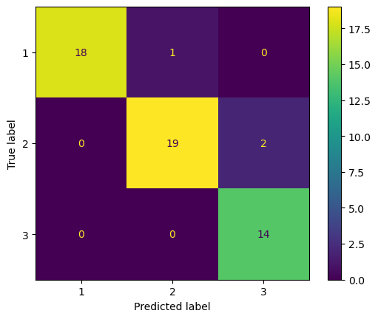
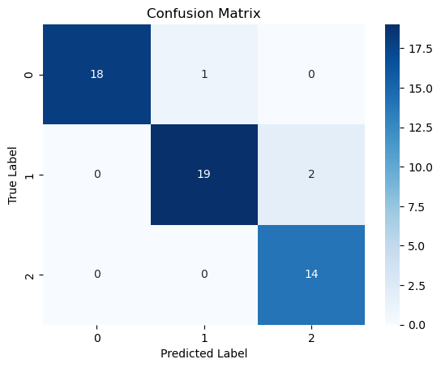
5. More Results

Slide 10
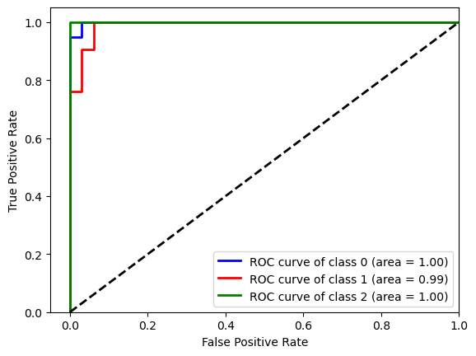
5. Finally…

Slide 11
Thank you.

