Slide 1
English Grammar
Himani Parikh – 1322085
CSCI 610 – Theory of computation
Prof. Altion simo

Slide 2
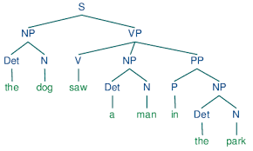
Introduction
Improve the better understanding of the social media posts.
By fixing grammar in these posts, we aim to make the information clear and accurate.
Using a technology called Natural Language Processing (NLP) helps us understand and improve the structure of sentences in these posts.
Identifying and analyze grammar in X posts on current topics.

Slide 3
Keywords
Natural language processing
Context free grammar, Parse tree
Tokenization
Stemming
Lemmatization
Part of speech tagging
Spell checker
Information Retrieval
Sentiment analysis

Slide 4
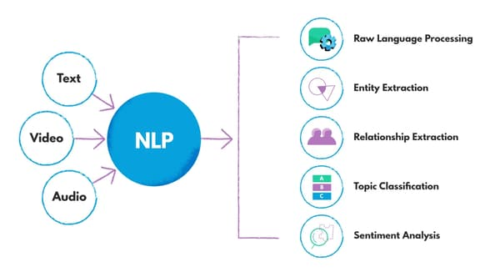
NLP
Bridge the gap between human communication and computer understanding, allowing machines to process and interact with language data.
Helps to analyze the structure of language using NLP techniques
Applications: language translation, sentiment analysis, chatbots, Grammar correction and speech recognition
Techniques: Syntax and semantic analysis

Slide 5
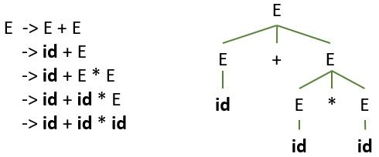
Grammar
Grammar: Set of rules for forming well-structured sentences.
Context free Grammar:
Describe the syntax or structure of a language
It consists of a set of production rules that define how sentences in the language can be constructed.
Components of a CFG:
Rules
Terminal
Non- Terminal
Root

Slide 6
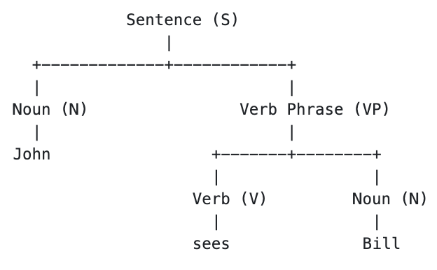
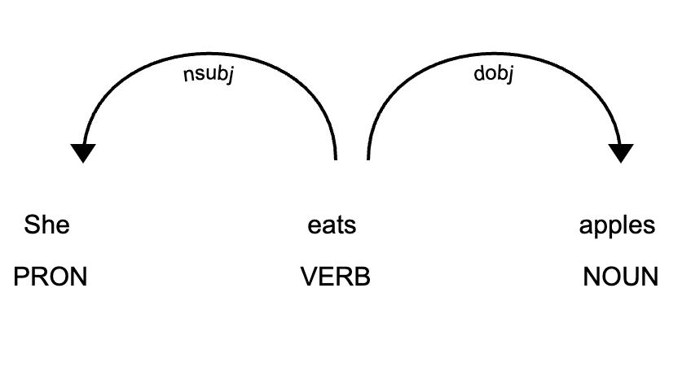
Constituency Grammar Vs Dependency Grammar
Constituency Grammar(CG)
Based on the constituency relation
Organize any sentence into its constituents using their properties
Dependency Grammar(DG)
Based on the dependency relation.
Organizes the words of a sentence according to their dependencies

Slide 7
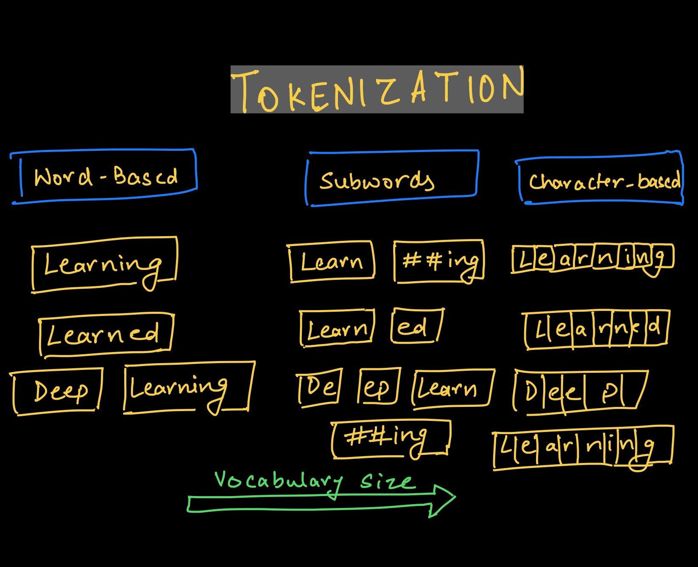
Tokenization
Tokenization is the process of breaking down a text into individual units, called tokens.
Tokens = words, phrases, symbols, or other meaningful elements

Slide 8
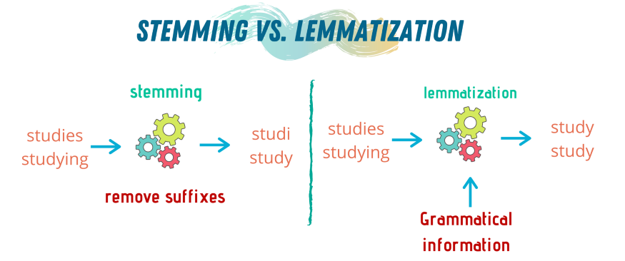
Stemming & Lemmatization
Simplifies words to their roots/Base.
Stemming
Removes last few characters from a word, often leading to incorrect meanings and spelling.
Takes less time
Lemmatization:
Considers the context and converts the word to its meaningful base form,
Uses corpus for stop words and WordNet corpus

Slide 9
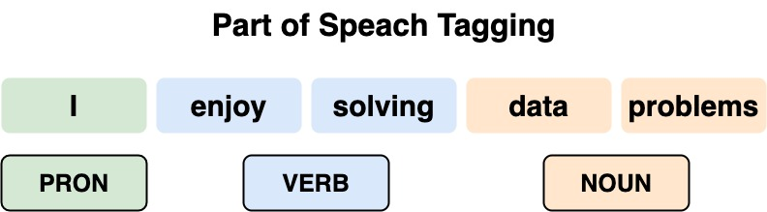
Parts of speech (POS) tagging
Provides insights into the syntactic structure of the text/sentences
Assign specific grammatical labels to individual words within a sentence
Useful for various NLP tasks
Text classification, named entity recognition, and machine translation.

Slide 10
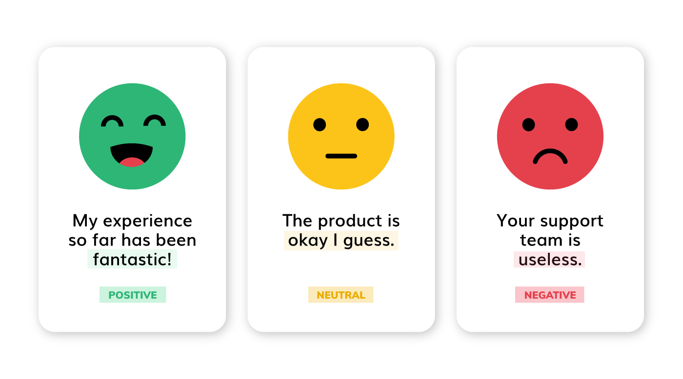
Sentiment Analysis
Classify the text based on the mood or mentality expressed in the text,
Goal : To analyze people’s opinions in a way that can help businesses expand.
Steps:
Data Gathering – Kaggle dataset for X post
Data pre-processing using NLP techniques.
Generate Sentiments from pre-processed posts i.e., a positive, negative, or neutral post.
Visualize the sentiment output

Slide 11
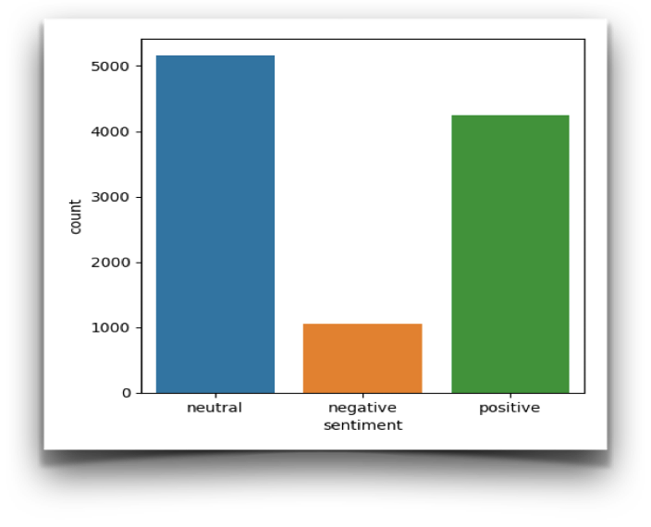
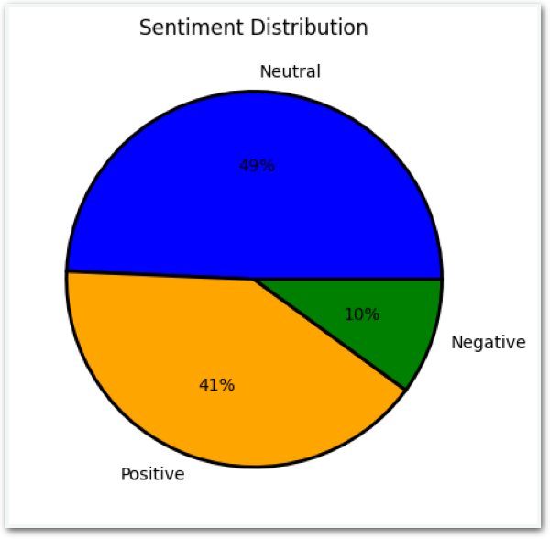
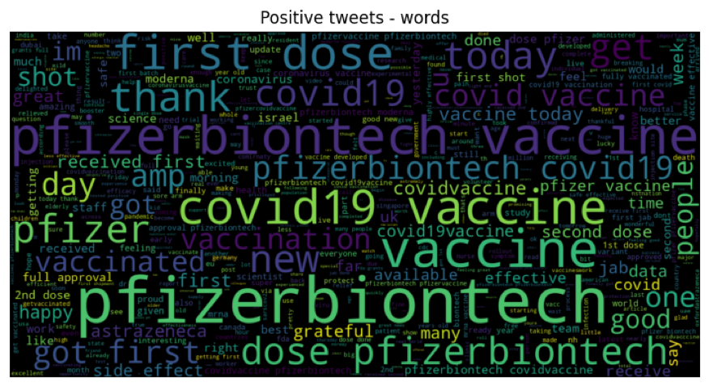
Result
Neutral Post = 5161 Positive Post = 4252 Negative Post = 1052

Slide 12
Future Work
Create grammatically structure dataset for social media Post
Perform sentiment analysis

Slide 13
Conculsion
Successfully identified Grammatical structure of social X post using NLP technique.

Slide 14
References
https://www.nltk.org/
https://textblob.readthedocs.io/en/dev/quickstart.html
https://realpython.com/natural-language-processing-spacy-python/
https://www.kaggle.com/
https://www.inf.ed.ac.uk/teaching/courses/inf2a/readings/ch07.pdf

Slide 15
Thank you!

