Slide 1
SPELLCHECKER USING LEVENSHTEIN DISTANCE AND BK TREES
By : Vinay Devarapalli
Himani Mense
Hitesh Nikam

Slide 2
What is Levenshtein Distance?
Measure of dissimilarity between two strings (aka edit distance)
The distance measures the minimum number of character edits required to transform one string to the other.
Typical 3 edits allowed - IRD(Insertion, Replacement, Deletion)
Applications : Spellchecker – detecting spelling errors in text and finding the closest correct spelling in dictionary. (and many more…)

Slide 3
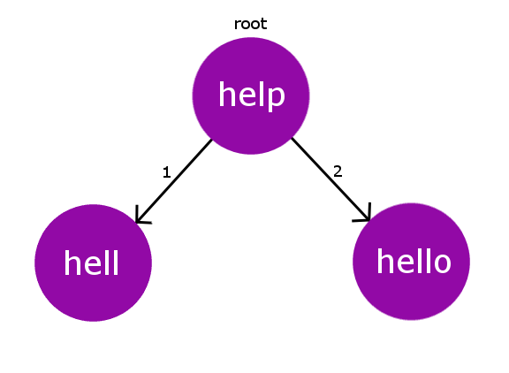
BKTree
Data structure used to perform spell check based on edit distance concept
Solution to the problem of searching a set of keys to find a key closest to given query key
Better than the naïve way since performs fewer comparisons
Complexity : O(log dictionary_size)

Slide 4
Algorithms implemented
All algorithms strive for the same goals to achieve short lookup times : reducing the number of lookups and comparisons, possibly reducing further the number of full edit distance calculations and finally reducing the computational complexity of the edit distance calculation itself, while not compromising its accuracy.
SymSpell, Peter Norvig’s approach, Faroo’s approach

Slide 5
SymSpell
faster than the standard approach(deletes+insert+replace)
Derives this speed from the symmetric delete spelling correction algorithm & prefix indexing
Opposite to other algorithms, uses only deletes
var suggestions = terms.filter(term => { return levenshtein(term, query) <= 2; }); //brute force
var index = SymSpell.from(terms); // We can now query the index easily: var suggestions = index.search(query);

Slide 6
Peter Norvig’s approach
It uses a Levenshtein Distance to find permutations within an edit distance of 2 from the original word. It then compares all permutations (insertions, deletions, replacements, and transpositions) to known words in a word frequency list. Those words that are found more often in the frequency list are more likely the correct results.

Slide 7
Faroo’s approach
for each word in the dictionary, systematically remove up to n letters (similar to SymSpell)
at lookup time, delete up to n words from the word in question
compute edit distance for each candidate word found this way
faster for ed=3

Slide 8
Progress so far & remainders
Edit distance calculation
symspell algorithm using edit distance and BKTree.
GUI
Norvig’s approach
Faroo’s approach

Slide 9
Performance Evaluation
SymSpell algorithm is independent of dictionary size but dependent on term length and maximum edit distance.
In general, SymSpell faster and less memory consumption
In our case:
Dictionary creation - 35,000 words in corpus, 12,74,000 created, retrieval time 2400ms
SymSpell : retrieval time 2ms

Slide 10

Thank you!

