Slide 1

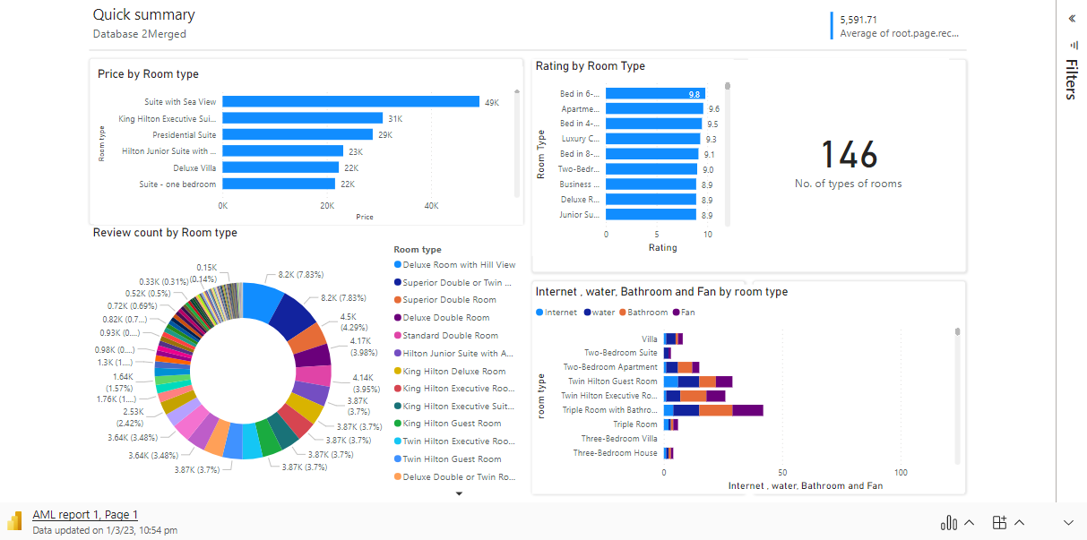
Microsoft Power BI

Slide 2

Relaunch the add-in
Microsoft Power BI
After you install the add-in, you can launch it by choosing the add-in button on the Insert tab
On the Insert tab
Insert
My Add-ins
Need more help?
Return to your internet browser or copy this link into your browser:
https://pages.store.office.com/addinsinstallpage.aspx?rs=en-US&assetid=WA200003233&isWac=True&ui=en-US&ad=US

Slide 3
https://app.powerbi.com/groups/me/apps/c10e45bd-3be7-440c-8c38-e5a709e916ed/reports/89b35b0c-aebc-4354-bbc8-36bbde9af9ae/ReportSection?bookmarkGuid=5b8b58c8-ec6f-42b4-9899-eb9709ae69bc&bookmarkUsage=1&ctid=ca0cc074-99d2-4cc1-8364-5789e0adbd82&portalSessionId=f9487d1f-4ac1-4e97-a2f1-036fd6b7b3ea&fromEntryPoint=export

