Slide 1
Game Warrior - A responsive gaming information website
- Himanish Kaushal
(2110993791)

Slide 2
Table of Contents
1. Introduction
Basic idea of the project
2. Requirements
Libraries and Tools used to make the project
3. Project Goal
Aim of the Project
4. Steps
Step-wise process of making the application
5. Snapshots
Snapshots of the code & webpage
6. Improvements
Additional things to make the project work better in future

Slide 3
Introduction
Game Warrior is a responsive, user friendly web application that helps the user to learn about the gaming environment. It provides the user with introduction to new games and latest gaming updates.
1

Slide 4
Requirements
2
HTML
Basic Framework of the Web Application is made using HTML.
20%
CSS
The design and decoration of the Web Application is done using CSS.
35%
JavaScript
It is used for the dynamic behavior of the Web Application
45%

Slide 5
3
Project Goal
Aim of the project is :
to make a user-interactive gaming information webpage.
Visually appealing information webpage.
to make users familiar with concept of games.

Slide 6
4
Steps
Step-1
Adding headers, navigation bar & buttons.
Step-2
Adding suitable images to the webpage.
Step-3
Making all the buttons, navigation bar & elements functional.
Step-4
Adding CSS and styling all the elements for an appealing look.

Slide 7
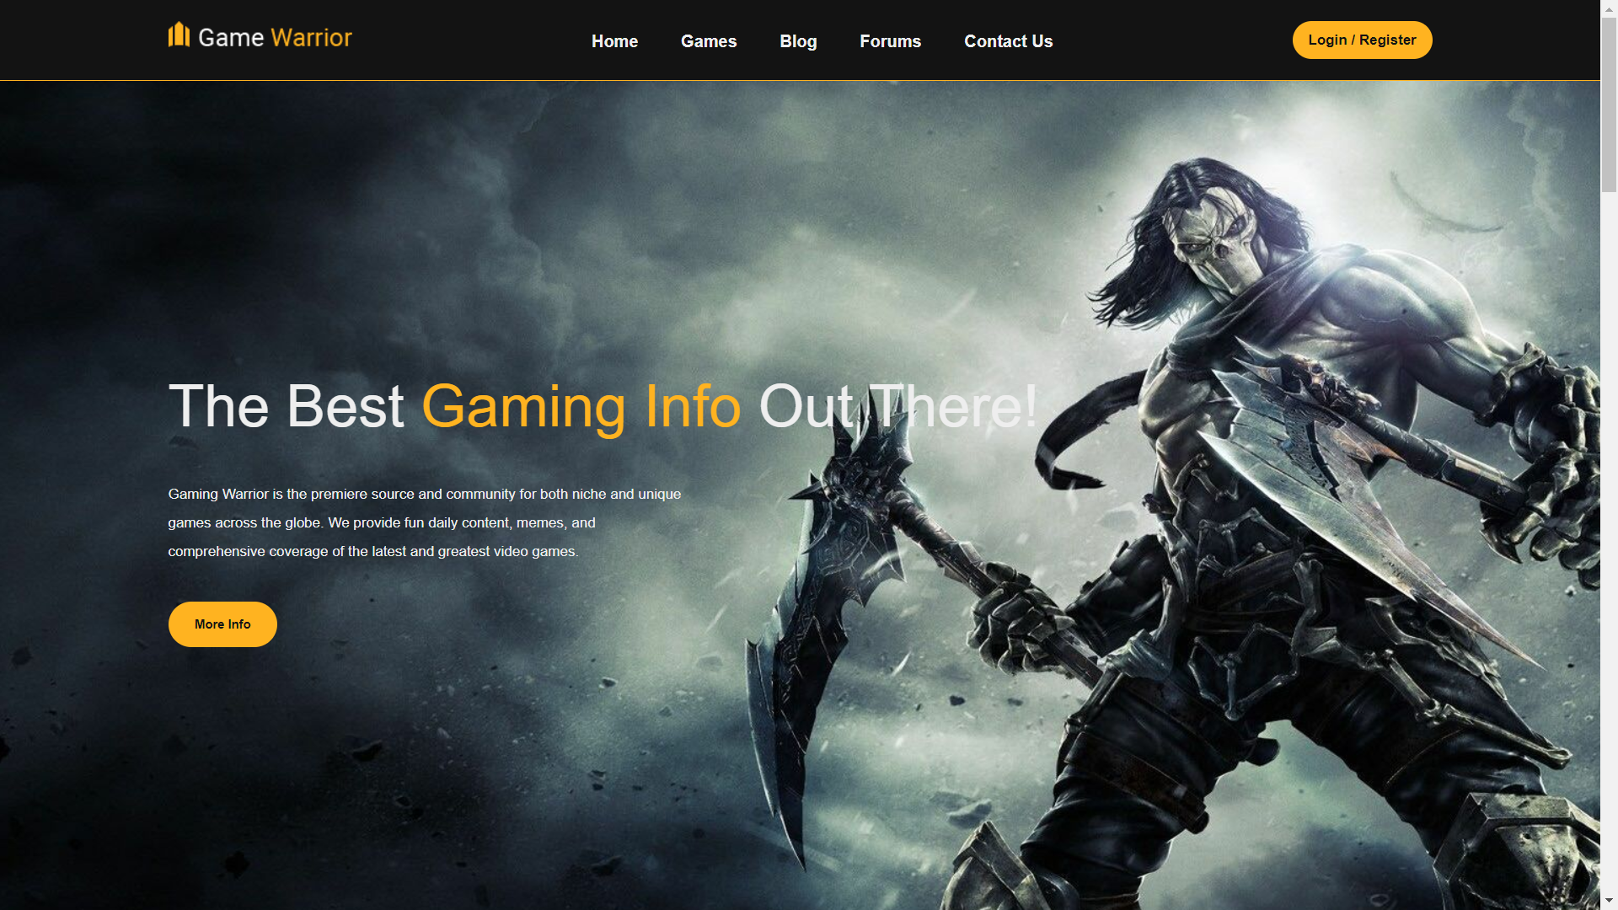
5
Snapshots
Webpage

Slide 8
6
Improvements
Add online multiplayer games to make the user experience more fun
Adding a real time chat option to communicate with other gamers throughout the globe.

Slide 9
Thank You!

