Slide 1
NodeJS
Notes:
https://www.simplilearn.com/tutorials/nodejs-tutorial/what-is-nodejs

Slide 2
prerequisite
JavaScript
Basic Client Server concept
http protocol

Slide 3
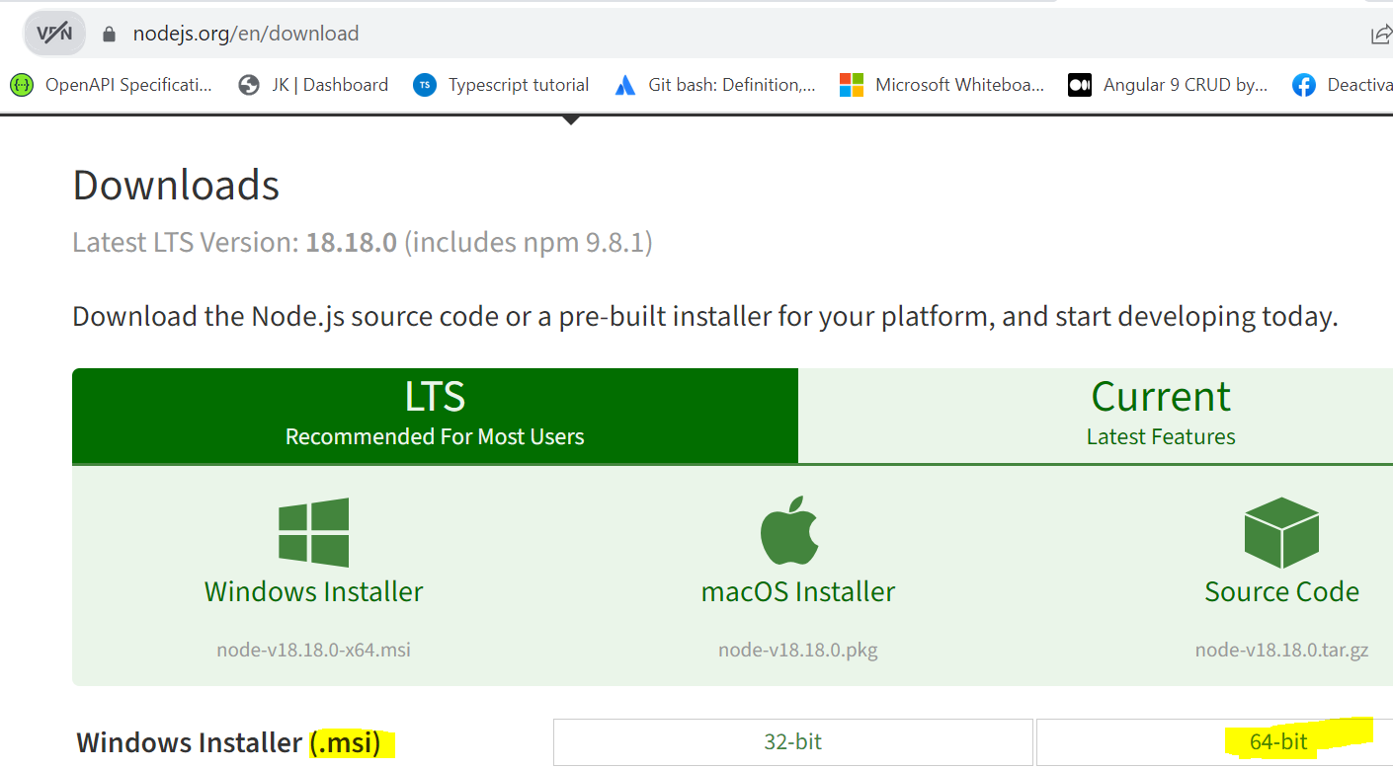


Installation
Install Node.js
Post installation check
Else add node path to
environment variables.
npm node package manager
gets installed as part of
node.js

Slide 4
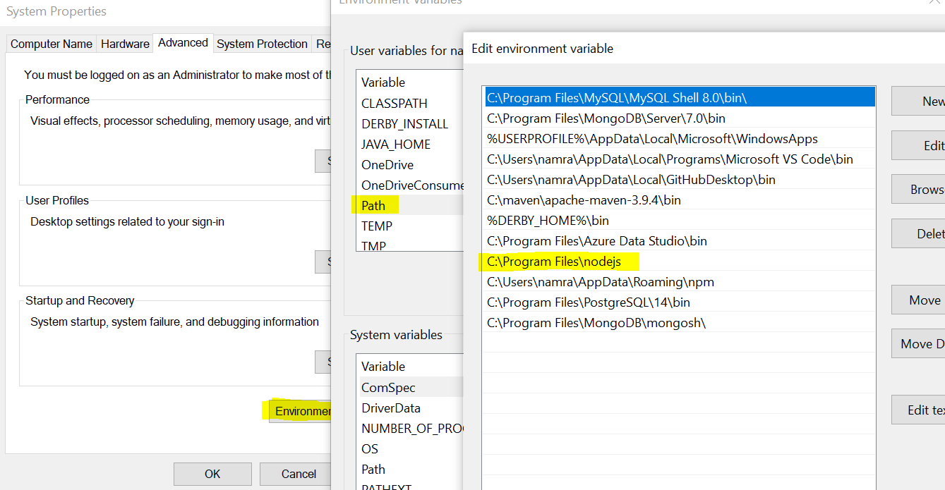
Installation

Slide 5
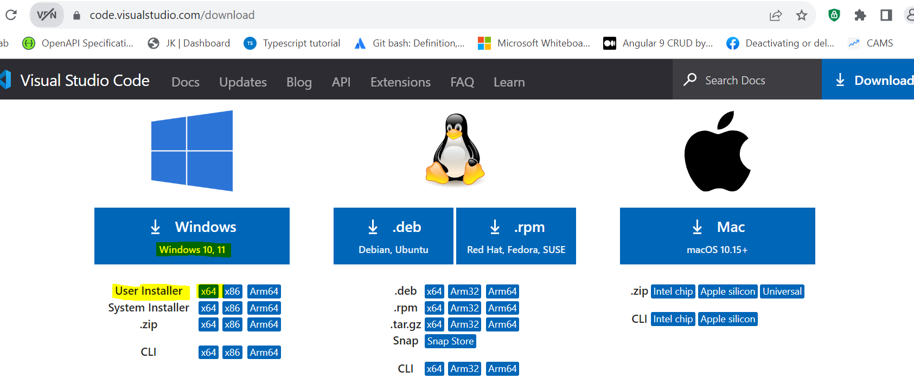
Installation
Visual Studio Code editor

Slide 6
Verify Installation
Verify installation: Executing a File
Create a js file named main.js on your machine (Windows or Linux) having the following code.
/* Hello, World! program in node.js */
console.log("Hello, World!")
Now execute main.js file using Node.js interpreter to see the result −
$ node main.js
In visual studio code, open new Terminal from Terminal menu.On the terminal go to location where js file is stored and execute above command.

Slide 7
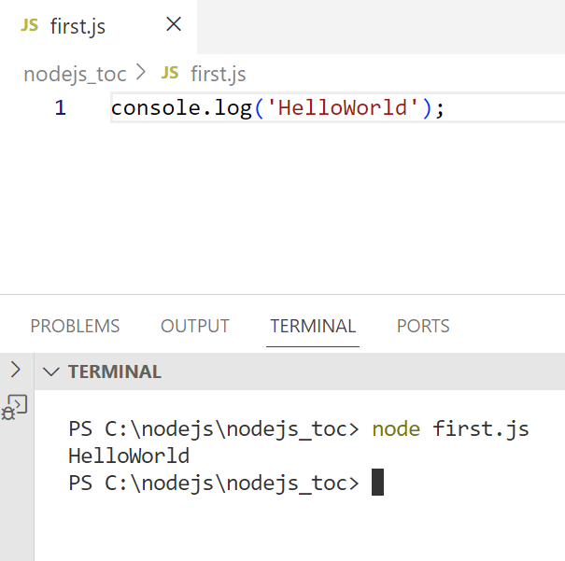
Verify Installation

Slide 8
Node.js TOC
Introduction
NodeJS Architecture – Event Loop
Module, Module import export
NodeJS Inbuilt Modules
NodeJS Event Emitter Module
NodeJS File System Module
NodeJS Path Module
NodeJS HttpServer
Web-Application – NodeJS HTTP module
Routing
ExpressJS – Web Framework
Rest Service using Express JS
Rest Service - Crud layered application using NoSQL Database - Mongo DB
MVC

Slide 9
What & Why of Node.js
Node.js is a JavaScript-based platform that is mainly used to create web applications and rest services etc.
It is built on Google Chrome’s V8 JavaScript engine.
A web application is software that runs on a server and is rendered by a client browser that accesses all of the application’s resources through the internet.
Node.js is also used to create rest-service on server-side and access it using client-side JS or client-side JS framework.
Node.js is JS option suitable for JS developers so that they don’t have to learn new programming language just for building server-side web components or rest-services.

Slide 10
First Node.js Application
The components of a Node.js application. A Node.js application consists of the following three important components −
Import required modules − We use the require directive to load Node.js modules.
Create server − A server which will listen to client's requests similar to Apache HTTP Server.
Read request and return response − The server created in an earlier step will read the HTTP request made by the client which can be a browser or a console and return the response.

Slide 11
Creating Node.js Application
Step 1 - Import Required Module
We use the require directive to load the http module and store the returned HTTP instance into an http variable as follows −
const http = require("http");

Slide 12
Creating Node.js Application
Step 2 - Create Server
We use the created http instance and call http.createServer() method to create a server instance
We then bind it at port 8081 using the listen method associated with the server instance.
Pass it a callback function with parameters request and response.
Write the sample implementation to always return "Hello World".

Slide 13
Creating Node.js Application
Step 2 - Create Server
We use the created http instance and call http.createServer() method to create a server instance
We then bind it at port 8081 using the listen method associated with the server instance.
Pass it a callback function with parameters request and response.
Write the sample implementation to always return "Hello World".

Slide 14
Creating Node.js Application
const http = require("http");
http.createServer(function (request, response) {
// Send the HTTP header
// HTTP Status: 200 : OK
// Content Type: text/plain
response.writeHead(200, {'Content-Type': 'text/plain'});
// Send the response body as "Hello World"
response.end('Hello World\n');
}).listen(8081);
// Console will print the message
console.log('Server running at http://localhost:8081/');

Slide 15
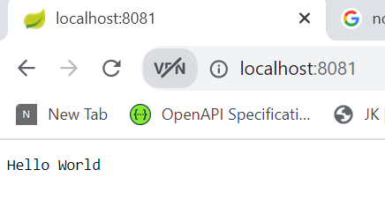
Creating Node.js Application
Step 3 – Start the server and send the request using browser.
Save the file in a folder firstnodeapp with name as app.js/main.js
Now execute the app.js to start the server as follows −
node main.js
Verify the Output. Server has started.http Server is running at http://localhost:8081/
Make a Request to the Node.js Server - Open http://localhost:8081 in any browser and observe the following result.

Slide 16
What is Callback?
What is Callback?
Callback is an asynchronous equivalent for a function.
A callback function is called at the completion of a given task.
Node makes heavy use of callbacks. All the APIs of Node are written in such a way that they support callbacks.

Slide 17
Blocking vs Non-Blocking call
Blocking Code Example
Create a text file named input.txt with the following content − (any text with 4-5 lines)
var fs = require("fs");
var data = fs.readFileSync('input.txt’); //normal synchronous function call
console.log(data.toString());
console.log("Program Ended");
Now run the main.js to see the result − $ node main.js
Verify the Output.
This is Node.js course.
We will learn how to use Node.js to create server side components
Program Ended

Slide 18
Blocking vs Non-Blocking call
Non-Blocking Code Example – (2nd arg of readFile() is callback function)
Create a text file named input.txt with the 4-5 lines of content.
var fs = require("fs");
fs.readFile('input.txt', function (err, data) {
if (err)
return console.error(err);
console.log(data.toString());
});
console.log("Program Ended");
Now run the main.js to see the result − $ node main.js
Verify the Output.
Program Ended
This is Node.js course.
We will learn how to use Node.js to create server side components

Slide 19
Blocking vs Non-Blocking call
These two examples explain the concept of blocking and non-blocking calls.
The first example shows that the program blocks until it reads the file and then only it proceeds to end the program.
The second example shows that the program does not wait for file reading to complete and proceeds to print "Program Ended“.
At the same time, the program without blocking continues reading the file.

Slide 20
Node.js Server Architecture
To manage several concurrent clients, Node.js employs a “Single Threaded Event Loop” design.
The JavaScript event-based model and the JavaScript callback mechanism are employed in the Node.js Processing Model.
It employs asynchronous model via two fundamental concepts:
Callback functions
Non-blocking of I/O operations (async calls)
These features enhance the scalability, performance, and throughput of Node.js web applications.

Slide 21
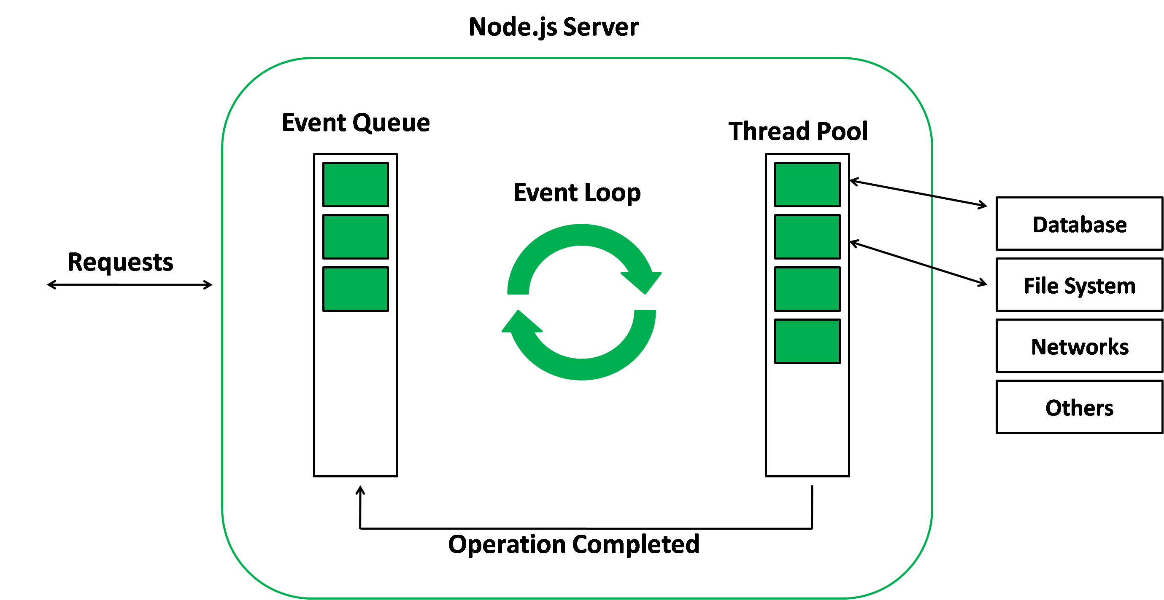
Node.js Event Loop
As Node.js is a single-threaded application, but it can support concurrency via the concept of event and callbacks.
Every API of Node.js is asynchronous and being single-threaded, it uses async function calls to maintain concurrency.
Every API has async call and a callback that is supposed to be called when async operation is completed or errored out.
Callback has code/next steps to handle successful completion of async call for e.g.: what to do with data that is read from the file or handle the failure in case async operation fails.
Actual Async call like file-IO, Network-IO might be jointly handled by Nodejs lib and OS using a special Thread pool.
The callback is pure JS function that is executed by
Node.js event loop once async call is completed by Thread in Thread-Pool.

Slide 22
Node.js Event Loop
callback
Async operation

Slide 23
Node.js Event Loop
Working of the Event loop: When Node.js starts, it initializes the event loop, processes the provided input script which may make async API calls then begins processing the event loop.
In the previous example, the readFile function has async call to read content from file and a callback to be executed once async operation completes or errors out.
When using Node.js, a special library module called libuv is used to perform async operations.
This library is also used, together with the back logic of Node, to manage a special thread pool called the libuv thread pool.
This thread pool is composed of four threads used to delegate operations (to OS) that are too heavy for the event loop.
I/O operations, Opening and closing connections, async http calls, setTimeouts are examples of operations done using such a Thread Pool.
When the thread pool completes a task (in this case IO operation of reading contents of file from hard-disk) , a callback function is called which handles the error(if any) or does some other operation.
This callback function is sent to the event queue.
When the call stack is empty, the event loop listens to the event sent through the event queue and executes the callback to the call stack.

Slide 24
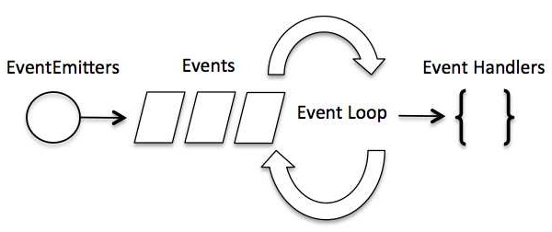
Node.js Event Loop & Event-driven programming
Node.js uses events heavily and it is also one of the reasons why Node.js is pretty fast compared to other similar technologies.
In an event-driven application, there is generally a main loop that listens for events, and then triggers a callback function when one of those events is detected.
In Node.js event-loop is the main-loop that listens for the events and triggers a callback (stored in event-queue) when event is detected.
The event could be any event like file-IO operation completed event or network-IO completed event or setTimer event

Slide 25
Node.js Event Loop
console.log('Start');
setTimeout(() => {
console.log('Timeout callback');
}, 2000);
console.log('End');
In above example, the setTimeout() function is called with a callback that will print “Timeout callback” to the console after 2000 milliseconds (2 seconds).
This callback function is added to the event queue, and the event loop will process it after the synchronous code is executed.
The output will be:
Start
End
Timeout callback

Slide 26
Modules
A module is an encapsulated and reusable chunk of code that has its own context
In Node.js each file is treated as separate module that is isolated by default.
Types of Modules:
1. Modules that we create in our application.
2. Built-in modules: modules that node.js ships with out of the box.
3. Third-party modules: modules written by other developers that we can use in our own application.

Slide 27
Modules
To load a module into another file we use a require function.
If the file in require function is JavaScript file we can skip specifying extension and JS will auto infer it.
When index.js is executed, the code in the module add.js is also executed
add.js
const add = (a,b)=> a+b;
module.exports = add; //CommonJs syntax of exporting and importing modules
index.js
const addx = require('./add');
const sum = addx(5,5);
const sum1 = addx(10,10);

Slide 28
Modules
Before a module is executed node.js wraps it inside function wrapper that provides separate (private) module scope.
Immediately Invoked Function Expression (IIFE) in Node.js
This saves us from having to worry about conflicting variables and functions.
There is proper encapsulation and reusability is unaffected.

Slide 29
Modules
batman.js
const superhero = "Batman";
console.log(superhero);
index.js
require("./batman");
require("./superman");
What will be the output?
batman
superman
superman.js
const superhero = "Superman";
console.log(superhero);
Each module (JS file) is wrapped in it’s own scope.
This avoids problems related to conflicted variables and functions in node.js

Slide 30
Module Wrapper
(function(exports,require,module,__filename,__dirname){
const superhero = "Batman";
console.log(superhero);
})();
(function(exports,require,module,__filename,__dirname){
const superhero = "Superman";
console.log(superhero);
})();

Slide 31
Module Import Exports
CommonJS way
ES6 way
Refer to ‘Module’ folder in nodejs dir for additional examples related to Module topic.
Learn – diff ways in which you can export and import module.

Slide 32
Built-in Modules
Modules that node.js ships with.
Also called as core modules.
Need to import the module before we use it.
path
events
fs
stream
http

Slide 33
Path module
Path is a utility built-in module used to work easily with file and directory paths.
The syntax for including the Path module in your application:
var path = require('path');
Path Properties and Methods
Method Description
basename() Returns the last part of a path
delimiter Returns the delimiter specified for the platform
dirname() Returns the directories of a path
extname() Returns the file extension of a path
format() Formats a path object into a path string
isAbsolute() Returns true if a path is an absolute path, otherwise false
join() Joins the specified paths into one
normalize() Normalizes the specified path
parse() Formats a path string into a path object
resolve() Resolves the specified paths into an absolute path
sep Returns the segment separator specified for the platform
* refer to pathex.js in pathmodule folder.

Slide 34
Path Module
const path = require('node:path');
//const path = require('path'); //this will also work, but its better to use prefix node: to make it clear
const data = require('./data.json');
console.log(__filename);
console.log(__dirname);
console.log(path.basename(__filename));
console.log(path.basename(__dirname));
console.log(path.extname(__filename));
console.log(path.extname(__dirname));
console.log(path.join("folder1","folder2","data.json"));
console.log(path.join(__dirname,"data.json"));
console.log(path.join("/folder1","//folder2","data.json"));
console.log(path.join("/folder1","//folder2","../data.json"));
console.log(path.isAbsolute(__filename));
console.log(path.isAbsolute('./data.json'));
console.log(path.parse(__filename));
let ob = path.parse(__filename);
console.log(path.format(ob));
console.log(path.resolve("folder1","folder2","data.json"));
console.log(path.resolve("/folder1","folder2","data.json"));
console.log(path.resolve("/folder1","//folder2","data.json"));
console.log(path.resolve("/folder1","//folder2","../data.json"));
console.log(path.resolve(__dirname,"data.json"));
console.log('os seperator:'+path.sep);

Slide 35
Node.js Event Handling
Many objects in a Node emit events, for example, a http Server emits an event each time a peer connects to it.
An filesystem’s fs.readStream() emits an event when the file is opened.
All objects which emit events are the instances of events.EventEmitter.

Slide 36
Event Emitter : Node.js Event Handling
Event Emitter class lies in the events module. It is accessible via the following code −
// Import events module
var events = require('events');
// Create an eventEmitter object
var eventEmitter = new events.EventEmitter();

Slide 37
Event Emitter : Node.js Event Handling
EventEmitter provides multiple properties like on and emit.
on property is used to bind a function with the event.
emit is used to fire an event.
Refer ‘event_emitter’ example in nodejs labs folder.

Slide 38
Event Emitter : Node.js Event Handling
//get the reference of EventEmitter class of events module
var events = require('events');
//create an object of EventEmitter class by using above reference
var em = new events.EventEmitter();
//subscribe for FirstEvent
em.on('FirstEvent', function (data) {
console.log('First subscriber: ' + data);
});
//subscribe for SecondEvent
em.on('SecEvent', function (data) {
console.log('Second subscriber: ' + data);
});
//raising FirstEvent
em.emit('FirstEvent', 'This is my first Node.js event emitter example.');
em.emit('SecEvent', 'This is my second Node.js event emitter example.');

Slide 39
Event Emitter : Node.js Event Handling
When an EventEmitter instance faces any error, it emits an 'error' event.
When a new listener is added, 'newListener' event is fired.
When a listener is removed, 'removeListener' event is fired.

Slide 40
Event Emitter : Node.js Event Handling
// Registering geek1 and geek2
eventEmitter.on('myEvent', geek1);
eventEmitter.on('myEvent', geek1);
eventEmitter.on('myEvent', geek2);
// Triggering myEvent
console.log("1st emit");
eventEmitter.emit('myEvent', "Event occurred");
// Removing listener geek1 that was
// registered on the line 13
eventEmitter.removeListener('myEvent', geek1);
// Triggering myEvent
console.log('2nd emit');
eventEmitter.emit('myEvent', "Event occurred");
// Removing all the listeners to myEvent
eventEmitter.removeAllListeners('myEvent');
// Triggering myEvent
console.log('3rd emit');
eventEmitter.emit('myEvent', "Event occurred");

Slide 41
Event Emitter : Node.js Event Handling
Extending user-defined class from EventEmitter.
Refer pizzastore example.
Many inbuilt node classes extend from EventEmitter and emit events related to some operation completion. One can register event handler using on method to listen to these emitted events.
A http Server emits an event each time a peer connects to it.
A filesystem’s fs.createReadStream() emits an event when the stream ends or data is available.
var readerStream = fs.createReadStream('input.txt’);
// Handle stream events --> data, end, and error
readerStream.on('data', function(chunk) { data += chunk; });
readerStream.on('end',function() { console.log(data); });
readerStream.on('error', function(err) { console.log(err.stack); });

Slide 42
File System (fs) Module
The fs File System module allows you to interact with File System on your computer.
fs reads data from file as stream of data. (sequence of data)
Fs can read/write/append data synchronously as well as asynchronously.
Async fs is non-blocking.it can be done using callback, promise, async-await wrapper.

Slide 43
File System (fs) Module
fs.readFileSync(…)
fs.writeFileSync(...)
fs.readFile(…)
fs.writeFile(…)

Slide 44
File System (fs) Module
//step 1: access fs module
const fs = require("node:fs");
//step 2: read file synchronously – it’s a blocking call
const readContent = fs.readFileSync("./file.txt","utf-8");
//step 3: print the content that is read.
console.log(readContent);

Slide 45
File System (fs) Module
//step 1: access the file system module
const fs = require("node:fs");
//step 2: read file asynchronously
fs.readFile("./file.txt","utf-8",(err,data)=>{
/* step 3: callback method that gets called once all file data is finally read. */
if(err)
{
console.log(err);
}
else {
console.log(data);
}
});
/*step 4: Below statement will be executed immediately after step2 as it’s non-blocking call. */
console.log('third');

Slide 46
File System (fs) Module
const fs = require("node:fs");
console.log('first');
fs.writeFileSync("./file1.txt","Hello Everyone!");
console.log('second');

Slide 47
File System (fs) Module
const content = "Hi Everyone, how are you?";
//writeFile overwrites the content
fs.writeFile("./file1.txt",content,(err)=>{
if(err)
{
console.log(err);
}
else {
console.log("file written");
}
});

Slide 48
File System (fs) Module
const fs = require("node:fs/promises");
console.log('first');
fs.readFile("file.txt","utf-8")
.then(data=>console.log(data))
.catch(error=>console.log(error));
console.log('second');

Slide 49
File System (fs) Module
async function readFile() {
try{
const data = await fs.readFile("./file.txt","utf-8");
console.log(data);
}
catch(err)
{
console.log(err);
}
}
readFile();

Slide 50
Stream module
A stream is a sequence of data that is being moved from one point to another over time.
Ex. A stream of data being transferred from one file to another file on the same computer.
Works with data in chunks instead of waiting for the entire data to be available at once.
If you are transferring file from fileA to fileB it doesn’t wait for entire file contents to be saved in temporary memory before moving it to fileB.
Instead, content is transferred in chunks over time which prevents unnecessary memory usage.
Stream is infact a built-in node module that inherits from event-emitter class.
Other modules internally use streams for their functioning.
Example: file system fs module uses stream to read and write data in chunks.

Slide 51
Stream module
Types of streams:-
Readable stream – from which we can read data. E.g. reading from file as readable stream.
Writable stream – to which we can write data. E.g. writing to a file as writable stream.
Duplex stream – that are both readable and writable. E.g. Socket
Transform stream – that can modify or transform the data as it is written and read. E.g. File compression where you can write compressed data and read de-compressed data to and from file as a transformed stream.

Slide 52
Stream module
//step 1:get node fs package
const fs = require("node:fs");
//step 2:create a readable stream
const readableStream = fs.createReadStream('input.txt');
//step 3:set the encoding to be utf8.
readableStream.setEncoding('UTF8');

Slide 53
Stream module
/* step 4: register an event listener to listen to streamed data when available in buffer */
readableStream.on("data",(chunk)=>{
//step 5: log the data to console console.log(chunk);
})
//step 6: register a listener to listen to stream end event
readableStream.on('end',function() {
console.log('read stream has ended');
});
//step 7: register a listener to listen to stream error event.
readableStream.on('error', function(err) {
console.log('error while reading a stream..')
console.log(err.stack);
});
console.log("Program Ended");

Slide 54
Stream module
Similar to read stream we can have a write stream. File copy program for large files has to use both read stream and write stream to read streamed data from 1st file and write that streamed data in chunks to 2nd file.
Refer to folder : filesystem->usingstream in NodeJS labs

Slide 55
Streams Module: Piping
What is piping?
Piping in NodeJS is useful when we need to write some data coming from a source stream to another stream.
In such a case we can use the piping algorithms provided by NodeJS instead of writing our own reading and writing logic.
We basically pipe the read stream and write stream to one another.
This can be compared with joining two water bodies using a pipe to transfer water.

Slide 56
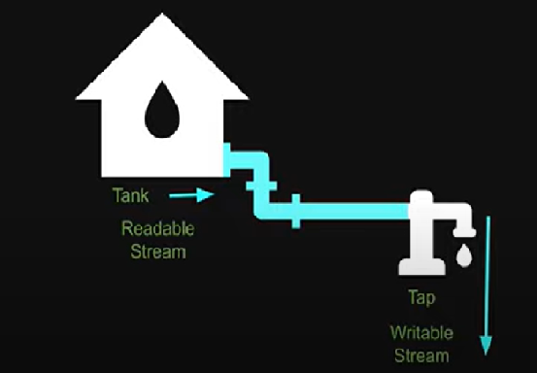
Pipes

Slide 57
Pipes
const fs = require("node:fs");
const zlib = require("node:zlib");
gzip = zlib.createGzip();
const readableStream = fs.createReadStream("./file1.txt",
{encoding:"utf-8",
highWaterMark:5 //default buffer size is 64kb, change it to 5bytes
});
//chaining with pipes
readableStream.pipe(gzip).pipe(fs.WriteStream("./file2.txt.gz"));

Slide 58
Web Module
Discuss : What is web?
http protocol.
Three Tier Architecture.

Slide 59
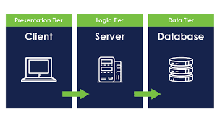
Three-Tier Architecture

Slide 60
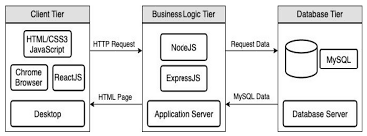
Three-Tier Architecture

Slide 61
HTTP and Node
We can create a http server using Nodejs
Nodejs has access to the OS functionality like networking
Node has event loop to run the task asynchronously and is perfect for creating web servers that can simultaneously handle large volumes of requests.
The node server we create should still respect the http format.
The HTTP module allows creation of web servers that can transfer data over http.

Slide 62
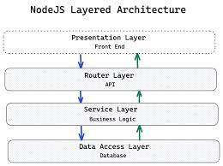
NodeJS Layered Architecture

Slide 63
Http Module so far
How to create a server.
How to access the request information.
How to send a response.
How to modify the response header.
How to set a response status.
How to respond with plain text, html templates, JSON.
How to route requests to different responses.

Slide 64
Web Framework
A framework simply abstracts the lower level code allowing you to focus on the requirements than the code itself.
For example, Angular, React, Vue are all framework / libraries that help you build user interfaces without having to rely on the lower level DOM API in JavaScript.
There are frameworks to build web or mobile applications without having to rely on the HTTP module in node.js
Ex. express, nest, hapi, koa and sails.
They build on the top of HTTP module making it easier for you to implement all the features.

Slide 65
ExpressJS
Express is a minimal and flexible Node.js web application framework that provides a robust set of features to develop web and mobile applications.
It facilitates the rapid development of Node based Web applications.
Use npm install express --save to install express locally.
Following are some of the core features of Express framework −
Allows to set up middlewares to respond to HTTP Requests.
Defines a routing table which is used to perform different actions based on HTTP Method and URL.
Allows to dynamically render HTML Pages based on passing arguments to templates.

Slide 66
Express Middleware
What is Middleware?
It is those methods/functions/operations that are called BETWEEN processing the Request and sending the Response in your application method.
https://expressjs.com/en/guide/using-middleware.html
Express have a lot of middleware bundled with it.
body-parser − This is a node.js middleware for handling JSON, Raw, Text and URL encoded form data.
cookie-parser − Parse Cookie header and populate req.cookies with an object keyed by the cookie names.
multer − This is a node.js middleware for handling multipart/form-data.

Slide 67
ExpressJS
Express is a routing and middleware web framework that has minimal functionality of its own.
An Express application is essentially a series of middleware function calls.
Middleware functions are functions that have access to the request object (req), the response object (res), and the next middleware function in the application’s request-response cycle.
The next middleware function is commonly denoted by a variable named next.
Middleware functions can perform the following tasks:
Execute any code.
Make changes to the request and the response objects.
End the request-response cycle.
Call the next middleware function in the stack.
If the current middleware function does not end the request-response cycle, it must call next() to pass control to the next middleware function. Otherwise, the request will be left hanging.
An Express application can use the following types of middleware:
Application-level middleware
Router-level middleware
Error-handling middleware
Built-in middleware
Third-party middleware

Slide 68
ExpressJS example - application level middleware
Bind application-level middleware to an instance of the app object by using the app.use() and app.httpmethod() functions.
Diff between app.use() and app.get() or app.post()
Note:
app.use(callback) – for any req path, any req method
app.use(path,callback) – for specific req path, any req method
app.post(path,callback) – for specific req path, http post method

Slide 69
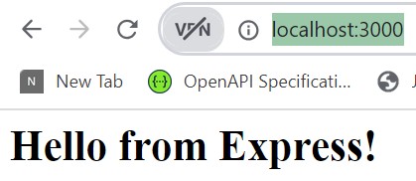
ExpressJS example - application level middleware
const http = require('http');
const express = require('express');
const app = express();
app.use((req, res, next) => {
console.log('In the middleware!');
next(); // Allows the request to continue to the next // middleware in line
});
app.use((req, res, next) => {
console.log('In another middleware!');
res.send('<h1>Hello from Express!</h1>');
});
const server = http.createServer(app);
server.listen(3000);
Run this example in visual studio code using node:-
C:\nodejs\08-expressjs-adding-middleware> node app.js
In the middleware!
In another middleware!I
In browser send request http://localhost:3000/

Slide 70
ExpressJS example - application level middleware
This example shows a middleware function with no mount path. The function is executed every time the app receives a request.
const express = require('express')
const app = express()
app.use((req, res, next) => {
console.log('Time:', Date.now())
next()
})
This example shows a middleware function mounted on the /user/:id path.
The function is executed for any type of HTTP request on the /user/:id path.
app.use('/user/:id', (req, res, next) => {
console.log('Request Type:', req.method)
next()
})
This example shows a route and its handler function (middleware system).
The function handles GET requests to the /user/:id path.
app.get('/user/:id', (req, res, next) => {
res.send('USER')
})

Slide 71
ExpressJS example - routing level middleware
Router-level middleware works in the same way as application-level middleware, except it is bound to an instance of express.Router().
const express = require(‘express’);
const router = express.Router();
Load router-level middleware by using the router.use() and router.httpmethod() functions.

Slide 72
ExpressJS example - routing level middleware
const express = require('express')
const app = express()
const router = express.Router()
// a middleware function with no mount path. This code is executed for every //request to the router
router.use((req, res, next) => {
console.log('Time:', Date.now())
next()
})
// a middleware sub-stack shows request info for any type of HTTP request to //the /user/:id path
router.use('/user/:id', (req, res, next) => {
console.log('Request URL:', req.originalUrl)
console.log('Request Type:', req.method)
next()
});
// a middleware sub-stack that handles GET requests to the /user/:id path
router.get('/user/:id', (req, res, next) => {
// if the user ID is 0, skip to the next router
if (req.params.id === '0') next('route')
// otherwise pass control to the next middleware function in this stack
else next()
}, (req, res, next) => {
// render a regular page
id = req.params.id;
res.send('<p>user with id:'+id+'</p>');
})
router.get('/user/:id', (req, res, next) => {
res.send('<p>user with id as 0 </p>');
})
// mount the router on the app
//app.use('/', router) //this is same as app.use(router);
app.use(router);
app.listen(3000);

Slide 73
Express Body-Parser
Express body-parser is express middleware used to process data sent in an HTTP request body.
Body-parser parses HTTP request body that helps you extract data sent in request body.
Used for POST, PUT HTTP request where the information you want is contained in the body.
Using body-parser allows you to access req.body from within routes and use that data.
For example: To create a user in a database.

Slide 74
Express Body-Parser
To parse application/json :- parse incoming Request Object as a JSON Object:-
app.use(express.json());
To parse application/x-www-form-urlencoded :- can only parse incoming Request Object if strings or arrays app.use(express.urlencoded({ extended: false }));
To parse incoming Request Object if object, with nested objects, or generally any type.
app.use(express.urlencoded({ extended: true }));

Slide 75
Express Body-Parser
const express = require('express');
const app = express();
//send {"type":"book","name":"core java"} in req body
app.post('/product1',express.json(),(req, res, next) => {
console.log(req.body);
let book = req.body;
console.log(book.name);
res.status(200).end("ok");
});

Slide 76

Express Body-Parser
//refer example express_body_parser/app.js
const express = require('express’); const app = express();
app.use(express.urlencoded({extended: true}));
app.use('/add-product', (req, res, next) => {
res.send('<form action="/product“ method="POST"> <input type="text" name="title"> <button type="submit">Add Product</button></form>');
});
app.post('/product',(req, res, next) => {
console.log(req.body);
console.log(req.body.title);
res.redirect('/');
});
If you send req http://localhost:300/add-product in browser and enter ‘book’ for input text-field of name as ‘title’ and submit.
Console will show output as below: sends form data in req-body as json string

Slide 77
What is REST architecture?
REST stands for REpresentational State Transfer.
REST is web standards based architecture and uses HTTP Protocol.
It revolves around resource where every component is a resource
In REST, resource is accessed over web using HTTP request and HTTP standard methods.
A REST HTTP Server simply provides access to resources (via HTTP protocol)
REST client accesses and modifies the resources using HTTP protocol.
Here each resource is identified/mapped by unique URIs.
REST uses various representation to represent a resource like text, JSON, XML but JSON is the most popular one.
Notes:
REST was first introduced by Roy Fielding in 2000.

Slide 78
HTTP methods
Following four HTTP methods are commonly used in REST based architecture.
GET − This is used to provide a read only access to a resource.
PUT − This is used to create a new resource.
DELETE − This is used to remove a resource.
POST − This is used to update a existing resource or create a new resource.

Slide 79
RESTful Web Services?
A web service is standard used for exchanging data between applications or systems.
Using web service, Software applications written in various programming languages and running on various platforms can use web services to exchange data over computer networks like the Internet.(same as inter-process communication)
This interoperability (e.g., communication between Java and Python, or Windows and Linux applications) is due to the use of open standards (like http, xml, json etc.)
Web services based on REST Architecture are known as RESTful web services.
These webservices uses HTTP methods to implement the concept of REST architecture.

