Slide 1
Malware Analysis Using Machine Learning
Group code:
B23KKS02
Mentor:
Kamalakanta Sethi
Team members:
Himanshu (S20200010077)
Sanka Vikyath (S20200010188)
Jayanth Korra (S20200010101)

Slide 2
Previously…
Installation of cuckoo sandbox and malware sample collection for analysis.
Analyzing reports of cuckoo sandbox of malware samples, Dataset generation & Data Preprocessing.
Applied ML algorithms linear regression, decision tree, Random forests on the malware dataset generated

Slide 3
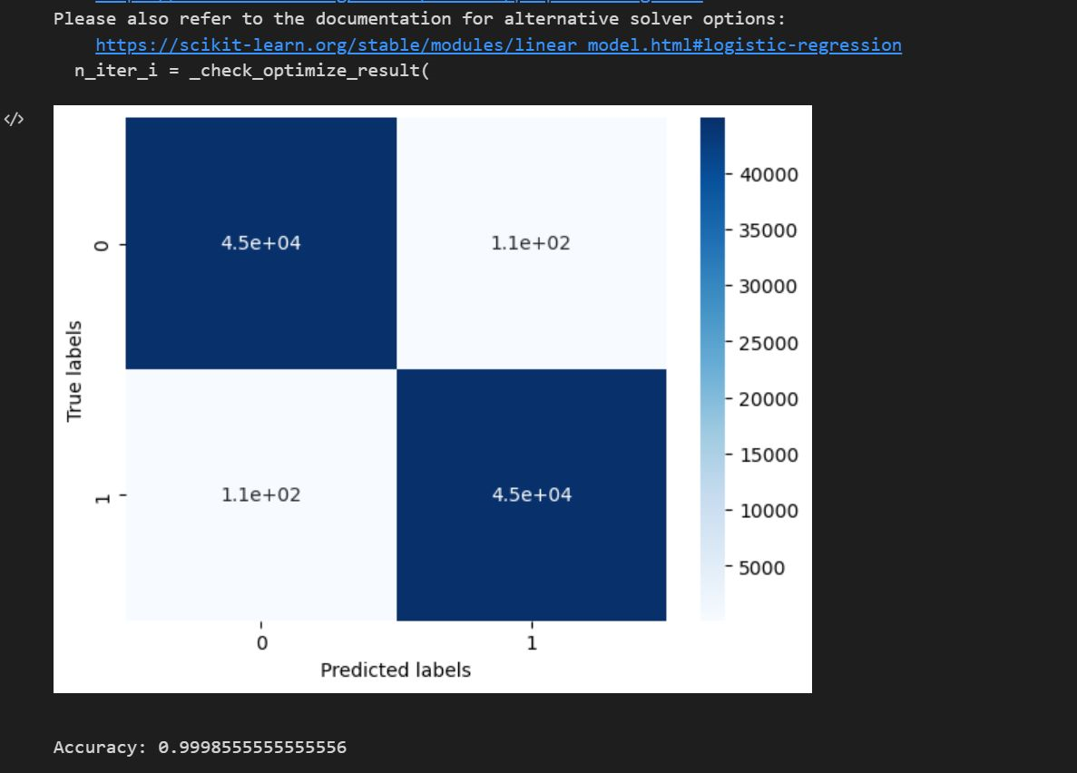
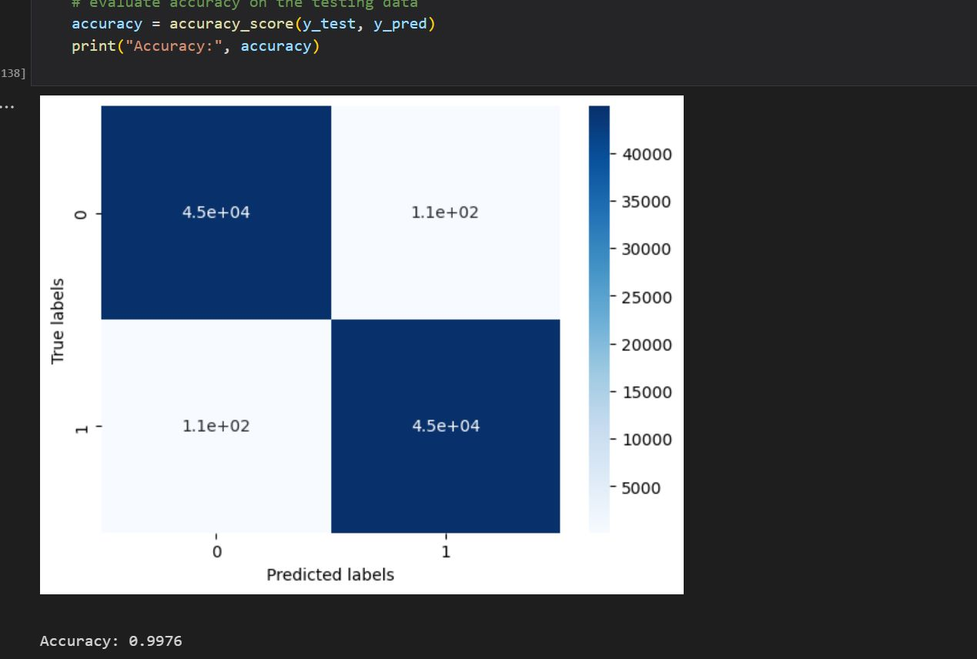
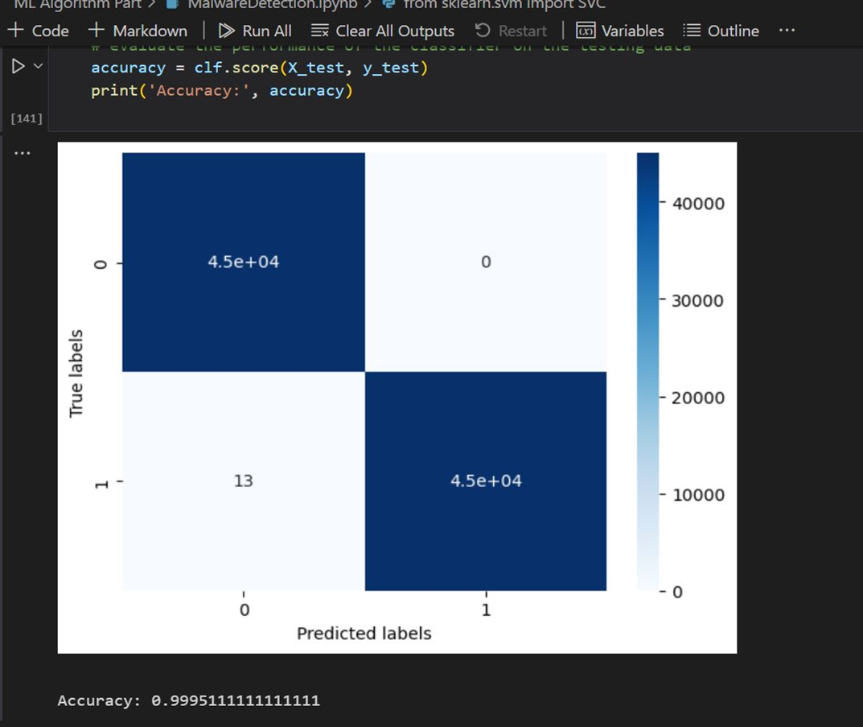
Results:
Linear Regression
Decision Tree
Random Forests
From above accuracies, we can say all models are undergoing with overfitting.

Slide 4
Reducing Overfitting using L2 Regularization
Regularization is a technique which can prevent overfitting of a model.
Overfitting occurs when a model fits too closely to the training data and is unable to generalize well to new, unseen data.
It reduces the complexity of model by adding penalty term to the loss function
Two Types:
L1 Regularization(Lasso):adds a penalty term proportional to the absolute value of the model coefficients.
L2 Regularization(Ridge):adds a penalty term proportional to square of the model coefficients.

Slide 5
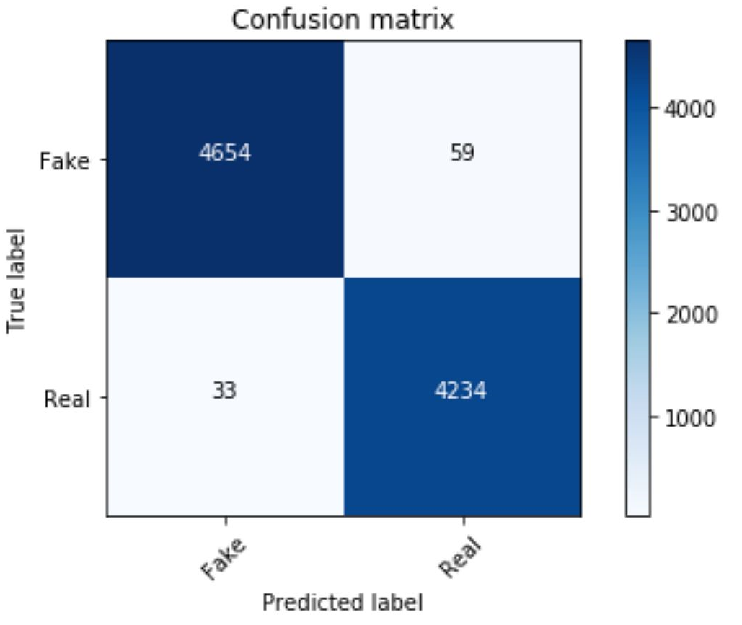
Why L2 not L1
L2 is more preferable than L1,it leads to smoother and more stable models, as it distributes the weight of the coefficients more evenly across all features(reduces noisy features)
Results after L2 regularization
Accuracy = 0.90 for linear regression.

Slide 6
Malware Analysis using Federated Learning
It is a machine learning approach where model is trained in decentralized sources, without transfer of data to centralized location.
But the parameters of decentralized sources are shared with the centralized location.

Slide 7
Approach
Data partitioning
Base and local training
Model aggregation
Model update
Results

Slide 8
How our approach is different from referred research papers
We are trying to analyse algorithms combination of federated learning and semi-supervised learning.
Base model and local model selection: we are taking combination of supervised and unsupervised algorithms for base and local models .
For base model considering random forests algorithm.
For local models considering k-mediods and DBSCAN algorithms.

Slide 9
Implementation Workflow
Start
Cuckoo host runs sample files
Analyse cuckoo reports and screenshots
Data generation & pre-processing
Results
Training Dataset Using Federated Learning
Base model(random forests) ,local model(K-mediods)
Base model(random forests),local model(DBSCAN)

Slide 10
K-Mediods algorithm
It considers a representative element rather than centroid like k-means
consider k seeds as mediods randomly
Assign point to the closest mediod
Calculates dissimilarity for each mediod and swaps with non-mediod point to lower dissimilarity until convergence, final clusters are achieved.
It is robust to outliers and handles non-Euclidean metrics like ordinal/categorical data.

Slide 11
DBSCAN algorithm
It is clustering where it groups together points that are closely packed in high density regions
isolated points far away from high density regions are considered as noise.
Consider arbitrary point, identify nearby points in the specified radius(epsilon).
If no of points exceeds a threshold(min_samples) then a cluster is formed.
It expands the clusters recursively by checking nearby points to each point in cluster.
Here we need not explicitly mention no of clusters, but radius, min_samples parameters for the algorithm.

Slide 12
Federated Learning Using DBSCAN and K-Medoids
By taking these local models we implement federated learning.
Now after model training ,we give the weights obtained by the local models to the global model(using get_parameter() & set_parameter()).
Global model is trained and updated by local model until we get convergence .

Slide 13
Scenario-1 Results
Here global model is random forests and local models is k-mediods algorithm.

Slide 14
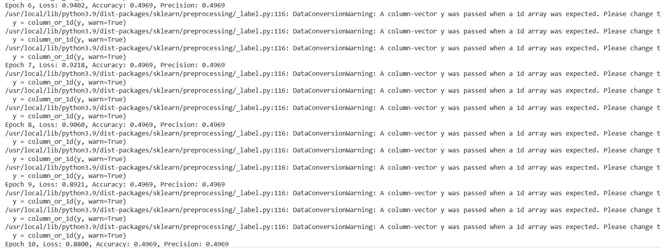
Scenario-2 Results
Here global model is random forests algorithm and local models is DBSCAN algorithm

Slide 15
References:
1.Cuckoo Sandbox-Automated Malware Analysis, ”Cuckoo Sandbox book” Available at: https://cuckoo.readthedocs.io/en/latest/ .
2. Federated Learning for Malware Detection in IoT Devices
Valerian Reya, Pedro Miguel Sánchez Sánchezb,∗, Alberto Huertas Celdránc, Gérôme Bovetd and Martin Jaggia
3. . K. Sethi, R. Kumar, L. Sethi, P. Bera and P. K. Patra, ”A Novel Machine
Learning Based Malware Detection and Classification Framework,” 2019
International Conference on Cyber Security and Protection of Digital
Services (Cyber Security), Oxford, United Kingdom, 2019, pp. 1-4.
4. Mamoun Alazab, Sitalakshmi Venkatraman, Paul Watters, and Moutaz
Alazab. 2011. Zero-day malware detection based on supervised learning algorithms of API call signatures. In Proceedings of the Ninth Australasian Data Mining Conference - Volume 121 (AusDM ’11).
Australian Computer Society, Inc., AUS, 171–182, 2011.
5. Trevor Hastie, Robert Tibshirani, Jerome H. Friedman, ”Elements of Statistical Learning- Data Mining, Inference, and Prediction” Springer Series in Statistics Available at: https://link.springer.com/book/10.1007/978-0-387-84858-7

Slide 16
Future scope
Graph based analysis.
Federated Learning using Semi Supervised Algorithms.
Application of the proposed approach in IoT and Cloud(Next Semester).
Do Something

Slide 17
THANK YOU

