Slide 1






Online Bookstore
Project on SQL
Presented by: Himanshi Chauhan

Slide 2


Objective
The aim of this project is to analyze data from an online bookstore using SQL. The focus is on understanding customer behavior, book sales, and order patterns to gain business insights.

Slide 3





About the Dataset
Books
Customers
Orders
Details of books like book ID, title, author, genre, published year, price, stock
Customer information such as customer ID, name, email, phone, city, country, location
Order- related data like order ID, customer ID, book ID, quantity, order date and total amount

Slide 4
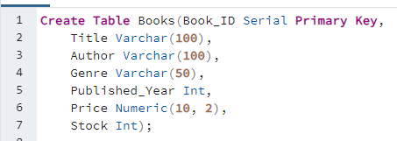
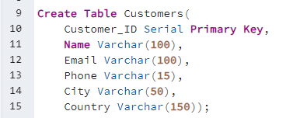
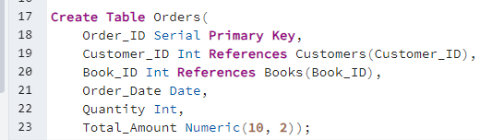


Books
Create Tables
Customers
Orders

Slide 5

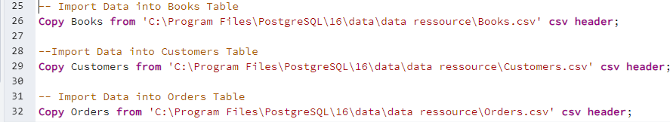

Import Data

Slide 6

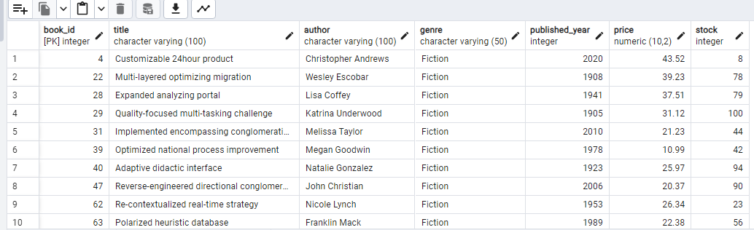


1) Retrieve all books in the "Fiction" genre:
Basic Questions

Slide 7

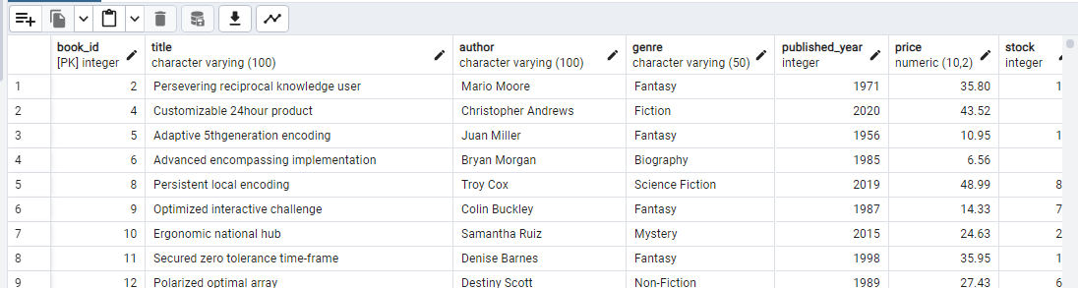
2) Find books published after the year 1950:
Basic Questions

Slide 8

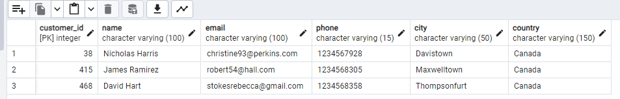

Basic Questions
3) List all customers from the Canada:

Slide 9

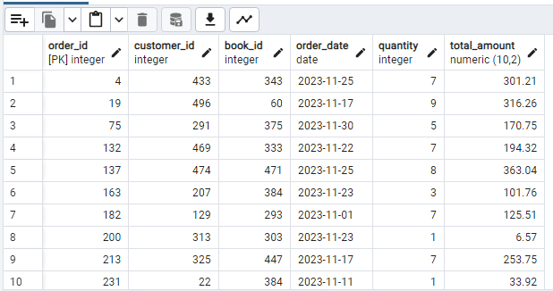
Basic Questions
4) Show orders placed in November 2023:

Slide 10
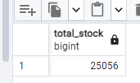


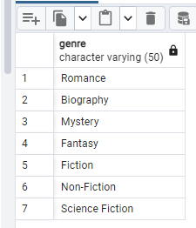
Basic Questions
5) Retrieve the total stock of books available:
6) List all genres available in the Books table:

Slide 11

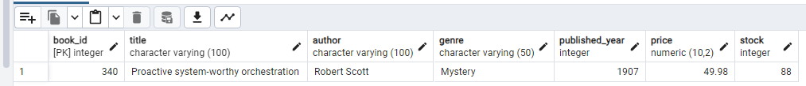
7) Find the details of the most expensive book:
Basic Questions

Slide 12

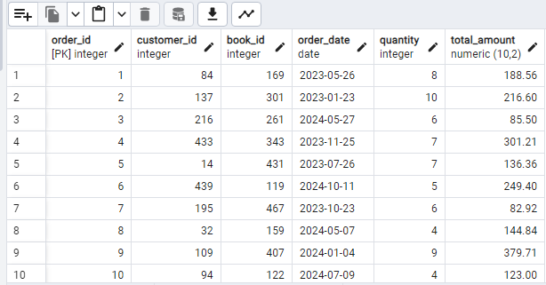
8) Show all customers who ordered more than 1 quantity of a book:
Basic Questions

Slide 13

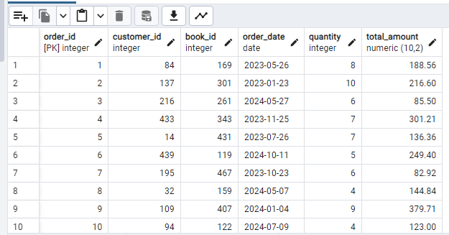
9) Retrieve all orders where the total amount exceeds $20:
Basic Questions

Slide 14

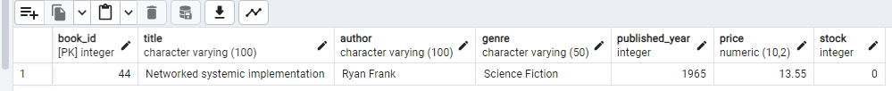


10) Find the book with the lowest stock:
Basic Questions
11) Calculate the total revenue generated from all orders:

Slide 15

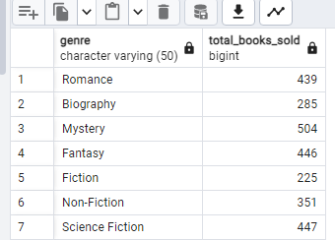

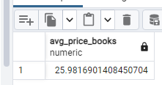
1) Retrieve the total number of books sold for each genre:
Advance Questions
2) Find the average price of books in the "Fantasy" genre:

Slide 16
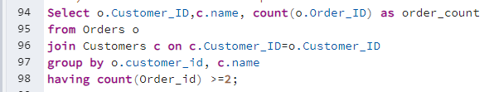
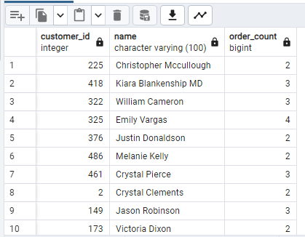
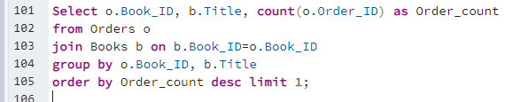

3) List customers who have placed at least 2 orders:
Advance Questions
4) Find the most frequently ordered book:

Slide 17

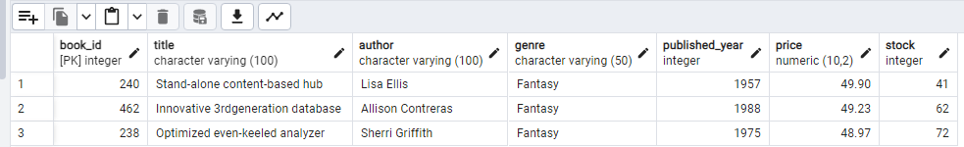
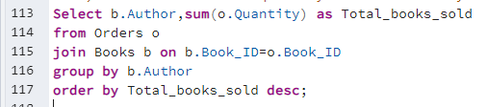
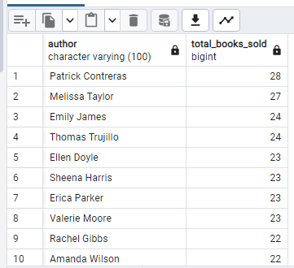
5) Show the top 3 most expensive books of 'Fantasy' Genre :
Advance Questions
6) Retrieve the total quantity of books sold by each author:

Slide 18
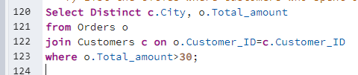
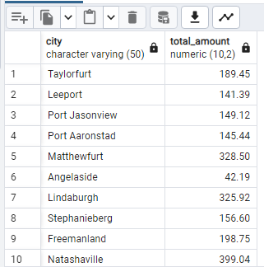
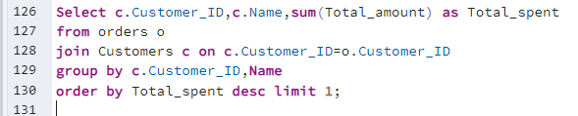
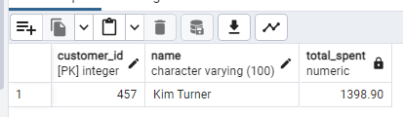
7) List the cities where customers who spent over $30 are located:
Advance Questions
8) Find the customer who spent the most on orders:

Slide 19
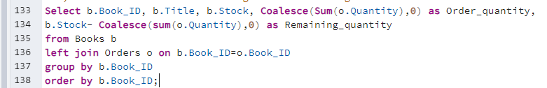
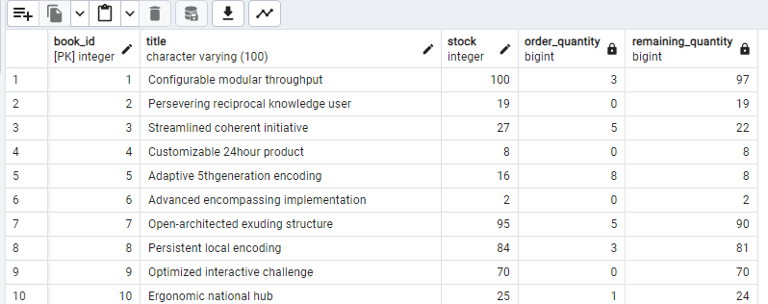
9) Calculate the stock remaining after fulfilling all orders:
Advance Questions

Slide 20

Thanks For Watching

