Slide 1
WALMART STORE PERFORMANCE ANALYSIS
A Data-Driven Review of Sales, Profitability & Regional Performance
Presented By:
T140200414 - Aditi Gurav
T140200418 - Himanshi Bhere

Slide 2
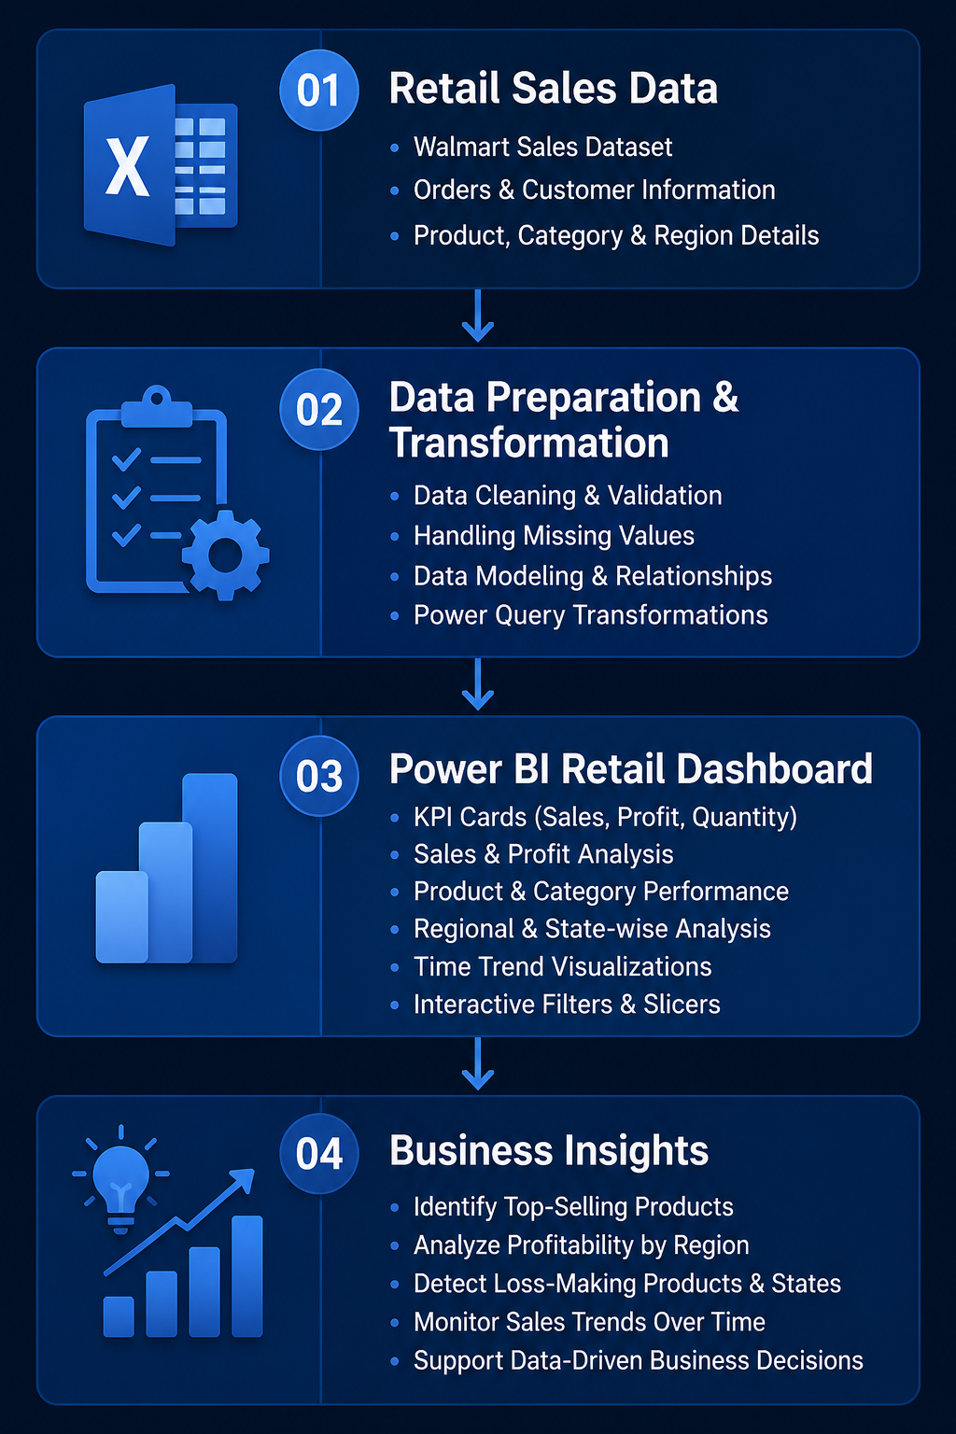
Retail stores generate large volumes of sales data across various products, customers, categories, and regions. Analyzing this data manually using spreadsheets is time-consuming and makes it difficult to identify sales trends, profitable products, regional performance, and business opportunities.
Problem Statement & Objective
Objective
Monitor overall sales, profit, and quantity sold
Identify top-performing and loss-making products
Track sales and profit trends over time
Compare performance across different states and regions
Provide actionable insights to support strategic business decision-making

Slide 3
Executive Dashboard Summary
Headline KPIs across the full reporting period
TOTAL SALES
TOTAL PROFIT
PROFIT MARGIN
TOTAL ORDERS
$725K
$108K
14.94%
1,611
$725,458
$108,418
Profit / Sales
Avg delivery 4 days
Sales Growth by Year
What this tells us
Sales climbed every year from 2011 to 2014, more than 70% growth overall.
A 14.94% blended margin is healthy, but masks big swings between categories (next slide).
California alone drives well over half of total sales — a concentration risk worth watching.

Slide 4
Geographic Distribution
Total sales by state across the footprint
REGIONAL TAKEAWAY
CALIFORNIA GENERATES 63% OF ALL SALES
.
What this tells us
California is the biggest market by far, bringing in nearly two-thirds of all sales.
Washington comes in second, but every other state contributes only a small slice individually.
Because almost all high-performing cities sit in just two states (California and Washington), the next phase of growth should focus on turning one or two promising cities in other states into strong hubs, rather than spreading thin across many new locations.
What this tells us
Sales grew every single year from 2011 to 2014, more than 70% overall growth.
Every year follows the same pattern: a small spring bump, a summer slowdown, then a strong November–December finish.
This repeating seasonal pattern means inventory, staffing, and promotions can be planned in advance rather than reactively.

Slide 5
Sales Trend Over Time
What this tells us
Sales grew every single year from 2011 to 2014, more than 70% overall growth.
Every year follows the same pattern: a small spring bump, a summer slowdown, then a strong November–December finish.
This repeating seasonal pattern means inventory, staffing, and promotions can be planned in advance rather than reactively.
Monthly sales, 2011–2014

Slide 6
Top 10 Products
Best-selling individual SKUs across the catalog
# | Product | Total Sales
1 | Canon imageCLASS 2200 Advanced Copier | $14,000
2 | High Speed Automatic Electric Letter Opener | $13,100
3 | Global Troy Executive Leather Low-Back Tilter | $10,020
4 | Fellowes PB500 Electric Punch Plastic Comb Binding Machine with Manual Bind | $8,134
5 | GuestStacker Chair with Chrome Finish Legs | $8,030
6 | Okidata MB760 Printer | $7,834
7 | Bretford Rectangular Conference Table Tops | $7,711
8 | Logitech P710e Mobile Speakerphone | $7,467
9 | Canon PC1060 Personal Laser Copier | $6,720
10 | Hewlett Packard LaserJet 3310 Copier | $6,240

Slide 7
Key Insights & Recommendations
01
Protect the Q4 surge
02
Fix two loss-making categories
Sales consistently peak in November and December every year without exception.
Stocking up and staffing ahead of this window avoids missed sales and stockouts.
Promotions timed just before this peak can amplify an already strong season.
Bookcases and Machines both show a net loss despite reasonable sales volume.
High product costs paired with heavy discounting are the likely cause.
A pricing and discount-cap review could turn these back into profitable lines.
03
Reduce California concentration risk
04
Double down on Copiers & Accessories
Over half of all revenue depends on a single state, which is a vulnerability.
Any regional slowdown or disruption in California would hit overall performance hard.
Investing in growth for Arizona, Colorado, and similar markets spreads that risk.
These categories deliver the highest profit despite a relatively modest share of sales.
They're the most efficient categories in the entire product mix.
Prioritizing marketing and shelf space for these lines offers strong return for the effort.

Slide 8
The Walmart Retail Store Analysis Dashboard converts raw retail data into actionable business intelligence through Microsoft Power BI.
Leveraging data cleaning, robust data modeling, DAX measures, and interactive visualizations, the dashboard provides a comprehensive view of sales, profit, customer purchasing patterns, and regional performance. These insights empower decision-makers to identify trends, optimize inventory and operations, and drive strategic business growth.
Thank You

