Slide 1

Meta Data
Presented By
Anuradha Bhave
Himanshi Chetwani
Omkar Vaidya

Slide 2
Introduction
Domain : Movies
Data sets : IMDb and MovieLens
Some movies tend to be a hit, while others are not successful
Aim : Predict the success of a movie by gaining insights about its features.
Data Mining Tasks : Classification and Clustering

Slide 3
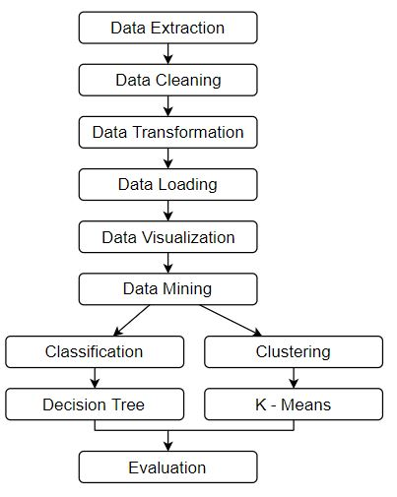
Project Design

Slide 4
Data sets
IMDb + MovieLens
Final Data set of 0.9 million records and 11 attributes

Slide 5
Data Handling
Data Collection : Collecting data from the two data sets
Data Merging: Merging data based on title
Data Cleaning: Cleaning data to handle missing values, performing label encoding to transform data
Data Loading: Loading the data in a relational database

Slide 6
Data Mining Activities
Classification
Supervised machine learning
Decision Tree Classifier
10 folds cross validation
Predicts success of a movie
Accuracy : ~93%
Clustering
Unsupervised machine learning
K-means Clustering Algorithm
Partitioning Method
Patterns related to movie features among clusters identified

Slide 7
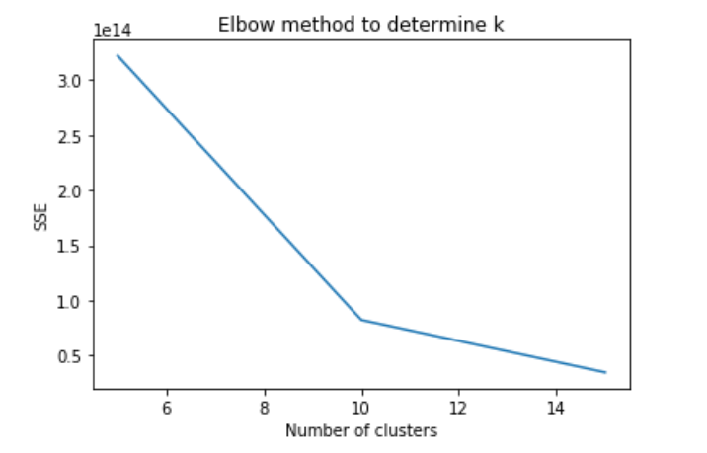
Determining Optimal Number of Clusters

Slide 8
Importance of Data Visualization
Absorbs information quickly
Understanding next steps
Finding correlations between attributes
Finding Outliers
Acting on findings

Slide 9
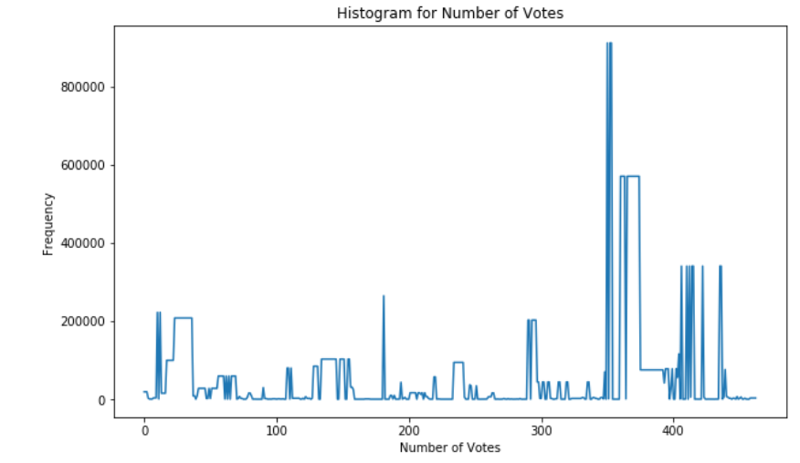
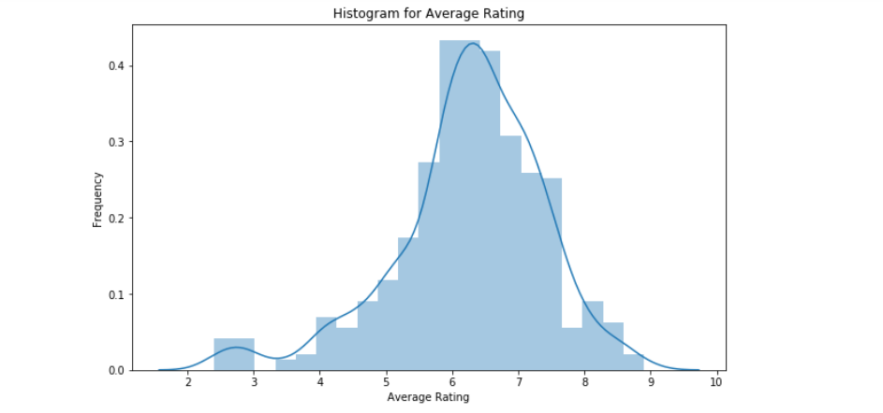
Data Visualization

Slide 10
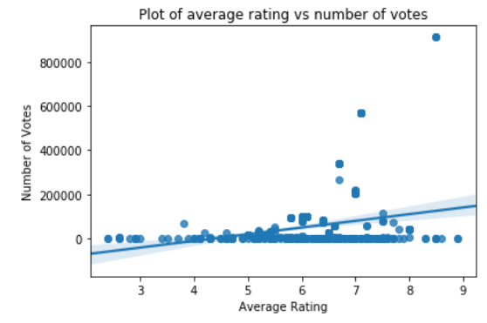
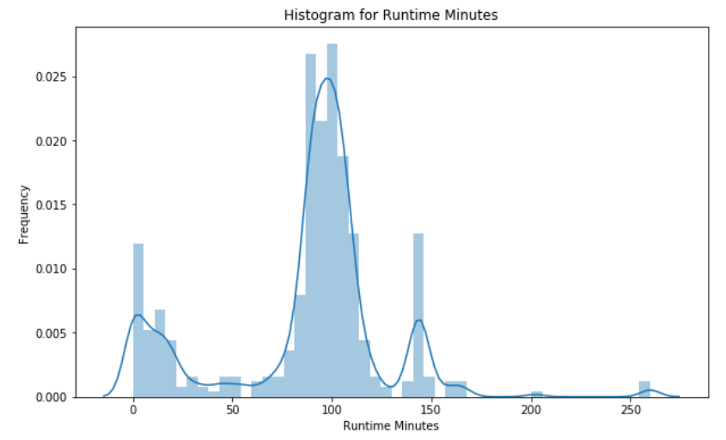
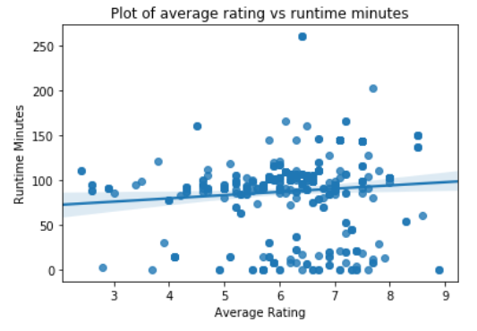
Data Visualization

Slide 11
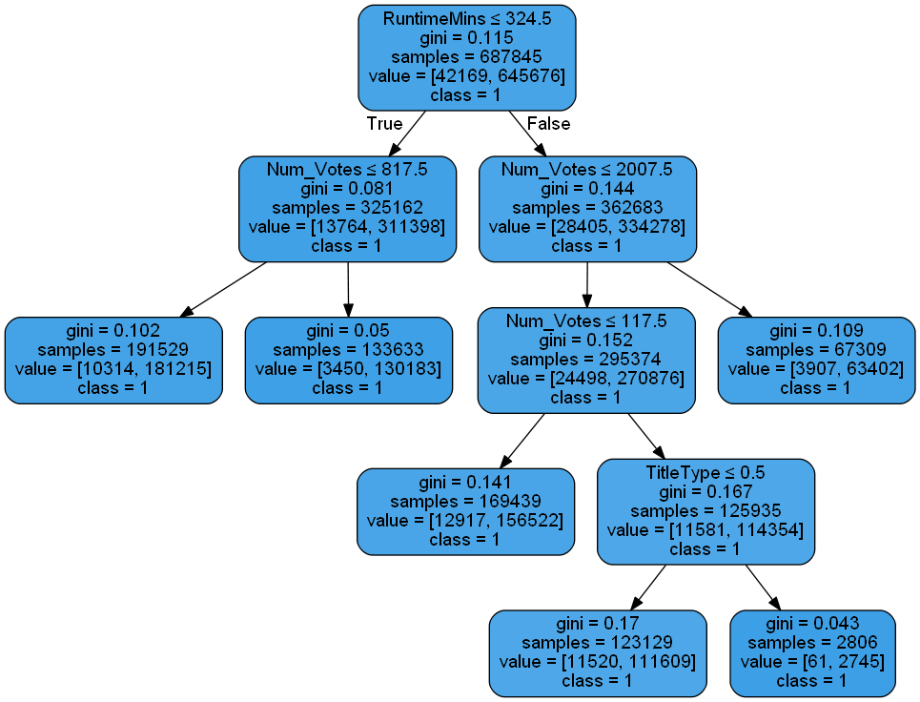
Results
Classification Result :
A pruned decision tree with depth = 3, and 6 leaf nodes.
Accuracy : 93. 82%

Slide 12
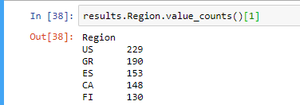

Results : Clustering
Allows us to identify characteristics of movies in a cluster
Movies of cluster 1 are made most frequently in USA, and are of the Action – Adventure genre

Slide 13
Conclusion
The movie industry is a profitable industry
Predicting the success of a movie can help predict its monetary business
Predicting the movie’s failure can help producer recover production costs
Data Mining can help us in this identification

Slide 14
Thank You!

