Slide 1
COA Lab Project (2016-17) The LNMIIT, Jaipur
FERRIS WHEEL
Nishita Gupta (15UCC022)
Himanshi Khandelwal (15UCC015)
Riddhi Gupta (15UCC029)
Itika Agrawal (15UCC044)

Slide 2
Introduction
Ferris wheel, is a nonbuilding structure consisting of a rotating upright wheel with multiple passenger-carrying capsules ( in our case 5 ) attached to the rim in such a way that as the wheel turns, they are kept upright, usually by gravity.
Working Principle : The Ferris wheel spins upwards with the help of gears and propeller, while gravity pulls the wheel back down again. This cycle continues for the duration of the ride.

Slide 3
Functions
Password_Authentication : Only specified persons can set the machine on ‘On’ state .
Get_Details : Gets the age from the user.
Give_Ticket : Provides the age qualified people with unique id(ticket).
Door_Switch : Restricts the wheel from rotating until every door of the capsule is closed.
Weight_Overload : Checks if the total weight of the persons seated in the machine are under the max limit.
Speed_Controller: Sets the speed for the wheel per rotation.
Propeller : It provides the info of thrust with which the propeller has to move to rotate the wheel.
Light : Function to turn the light of the capsule.
Power_Consumed : Notifies the owner about the total power consumed by the wheel.
Rating : Gets the ratings from the users.

Slide 4
Memory Model
Little Endian Addressing
16 bit machine
2^16 memory addresses
Aligned word memory
Byte addressable

Slide 5
Registers
TOTAL REGISTERS = 16
General Purpose Registers
10 registers
Special Purpose Registers
6 registers
Program Counter
Instruction Register
Flag Register
MAR
MDR
Stack Pointer

Slide 6
Instruction Format
Two Address Instruction
0 1 2 3 4 5 6 7 8 9 10 11 12 13 14 15
2^8 instructions
Instruction Operand Operand
One Address Instruction
0 1 2 3 4 5 6 7 8 9 10 11 12 13 14 15
2^12 instructions
Instruction Operand
Zero Address Instruction
0 1 2 3 4 5 6 7 8 9 10 11 12 13 14 15
2^16 instructions
Instruction

Slide 7
Instruction Design
2 Address Instructions
MOV Reg1,Reg2 011
MOV1 Value,Reg1 00000010
CMP Reg1,Reg2 100
CMP1 Value,Reg2 00000011
MULT1 Value,Reg1 00000100
MULT Reg1,Reg2 101
ADD 110

Slide 8
1 Address Instructions
INC Reg 000001010000
JMP 000001010001
JGT 000001010010
JLT 000001010011
THRUST 000001010100
ADDW 000001010101
ESCAPE CODE for 0 address instruction is 000010000110
0 Address Instructions
HLT 0000010101010000
WGTO 0000010101010001

Slide 9
Instruction Types
DATA MOVEMENT :
LOAD Immediate, Register
LOAD1 Register, Register
COMPARISION AND CONDITIONAL :
CMP1 Register, Register
CMP Immediate, Register
MONADIC OPERATIONS :
INC Register

Slide 10
LOOP CONTROL :
JMP
JGT
JLT
HLT
DIADIC OPERATIONS:
MUL Register, Register
THRUST Immediate, Register
MUL Immediate, Register

Slide 11
Data Types
Numeric Data Type | Non-Numeric Data Type
Integer(unsigned) | String

Slide 12
Addressing Modes
Immediate Addressing Mode
Register Addressing Mode
Direct Addressing Mode

Slide 13
Flow of Control Handling
Sequential flow of control and Branching
It will check, which LABEL provides the name for a
particular address, where jump statements are used
to change or control the flow of program.

Slide 14
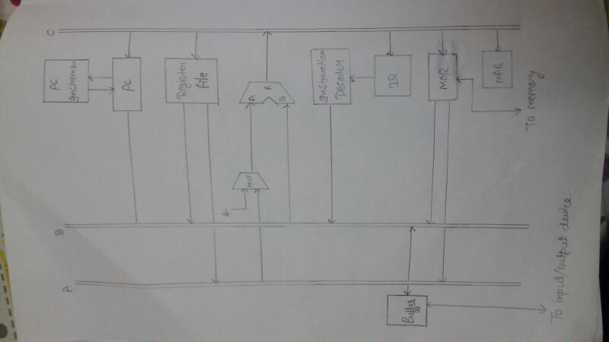

Slide 15
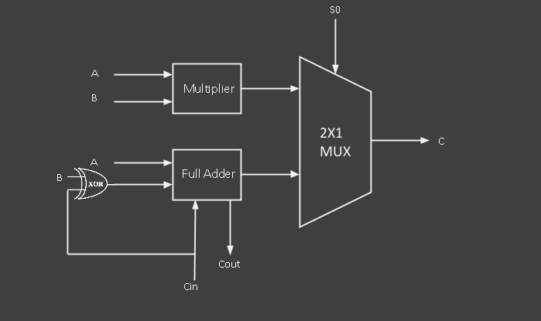

Slide 16
MOV R1,R2
PCout, R=B, MARin, IncPC, READ
WMFC
MDRin, MDRout, R=B, IRin
R1outB, R=B , R2in, END

Slide 17
MOV1 VALUE,R1
PCout, R=B, MARin, IncPC, READ
WMFC
MDRin, MDRout, R=B, IRin
IMMEDIATE VALUE OF IRout, R=B, R2in, END

Slide 18
CMP R1,R2
PCout, R=B, MARin, IncPC, READ
WMFC
MDRin, MDRout, R=B, IRin
R1outA, R1outB, SELECT A, SUBTRACT, END

Slide 19
CMP1 VALUE,R1
PCout, R=B, MARin, IncPC, READ
WMFC
MDRin, MDRout, R=B, IRin
IMMEDIATE VALUE OF IRout, R1outA,SELECT A, SUBTRACT, END

Slide 20
MULT1 VALUE,R1
PCout, R=B, MARin, IncPC, READ
WMFC
MDRin, MDRout, R=B, IRin
IMMEDIATE VALUE OF IRout, R1outA, SELECT A, MULTIPLY, R1in, END

Slide 21
MULT R1,R2
PCout, R=B, MARin, IncPC, READ
WMFC
MDRin, MDRout, R=B, IRin
R2outB, R1outA, SELECT A, MULTIPLY, R2in, END

Slide 22
THRUST R1
PCout, R=B, MARin, IncPC, READ
WMFC
MDRin, MDRout, R=B, IRin
R1outA, R1outB, SELECT A, MULTIPLY, R1in, END

Slide 23
ADD VALUE,R1
PCout, R=B, MARin, IncPC, READ
WMFC
MDRin, MDRout, R=B, IRin
IMMEDIATE VALUE OF IRout, R1outA, SELECT A, ADD, R1in, END

Slide 24
INC R1
PCout, R=B, MARin, IncPC, READ
WMFC
MDRin, MDRout, R=B, IRin
IMMEDIATE VALUE OF IRout(1), R1outA, SELECT A, ADD, R1in, END

Slide 25
JMP
PCout, R=B, MARin, IncPC, READ
WMFC
MDRin, MDRout, R=B, IRin
OFFSET IRout, R=B, PCin, END

Slide 26
JGT
PCout, R=B, MARin, IncPC, READ
WMFC
MDRin, MDRout, R=B, IRin
OFFSET VALUE OF IRout, R=B , IF P=0, END
PCin, END

Slide 27
JLT
PCout, R=B, MARin, IncPC, READ
WMFC
MDRin, MDRout, R=B, IRin
OFFSET VALUE OF IRout, R=B , IF N=0, END
PCin, END

Slide 28
ADDW R1
PCout, R=B, MARin, IncPC, READ
WMFC
MDRin, MDRout, R=B, IRin,
BFoutB, R1outA , SELECT A, ADD, R1in, END

Slide 29
HLT
PCout, R=B, MARin, IncPC, READ
WMFC
MDRin, MDRout, R=B, IRin
END

Slide 30
WGTLO
PCout, R=B, MARin, IncPC, READ
WMFC
MDRin, MDRout, R=B, IRin
IF P=1, BFout=1, END

Slide 31
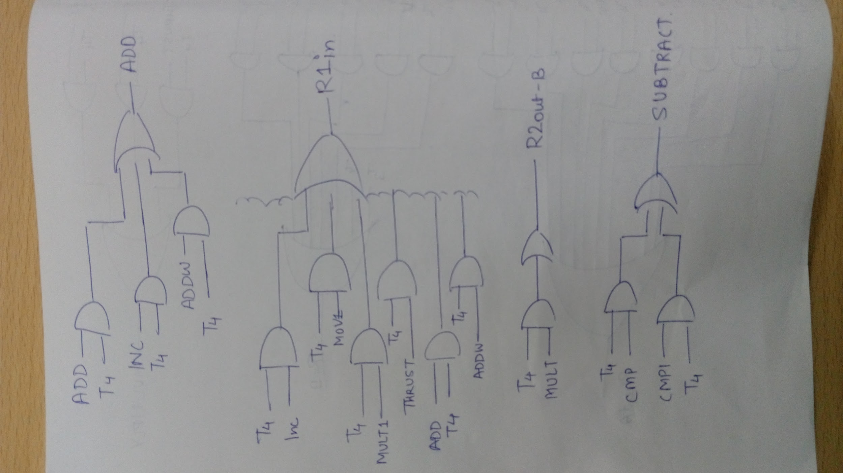

Slide 32
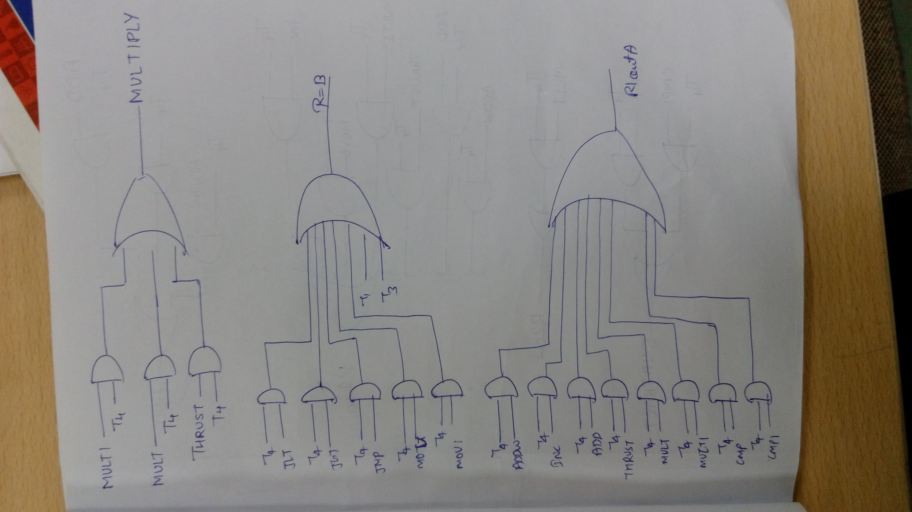

Slide 33
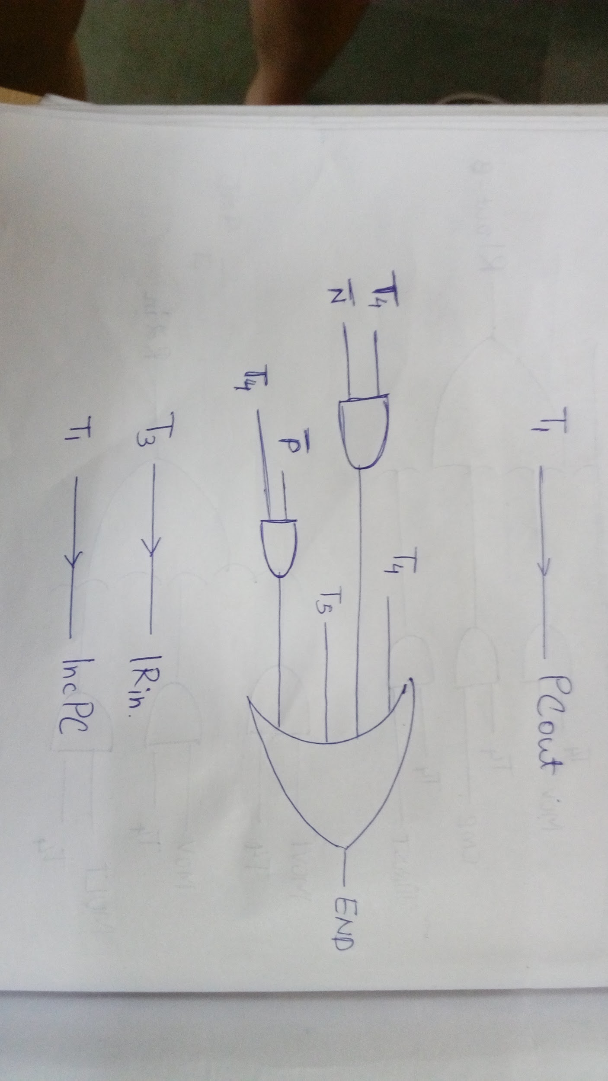

Slide 34
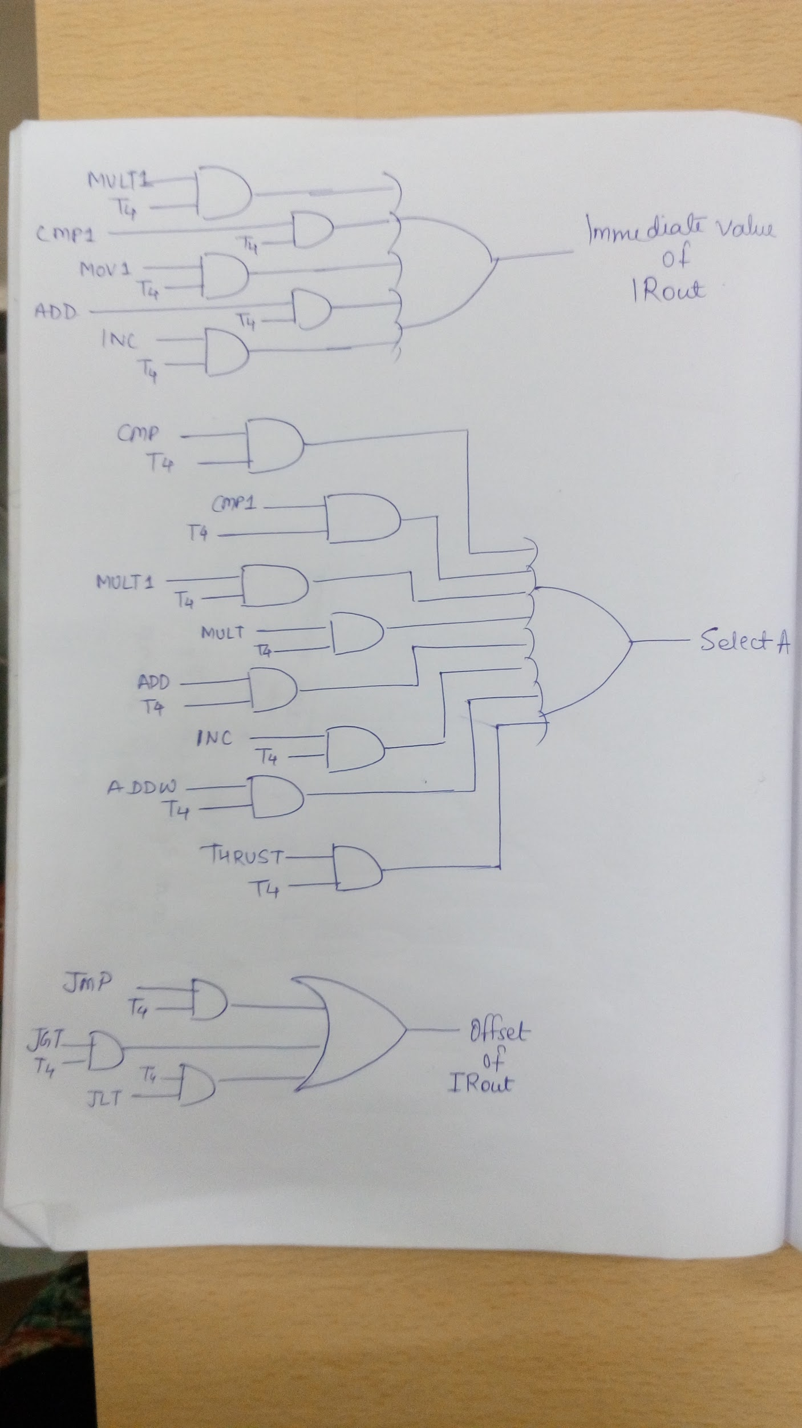

Slide 35
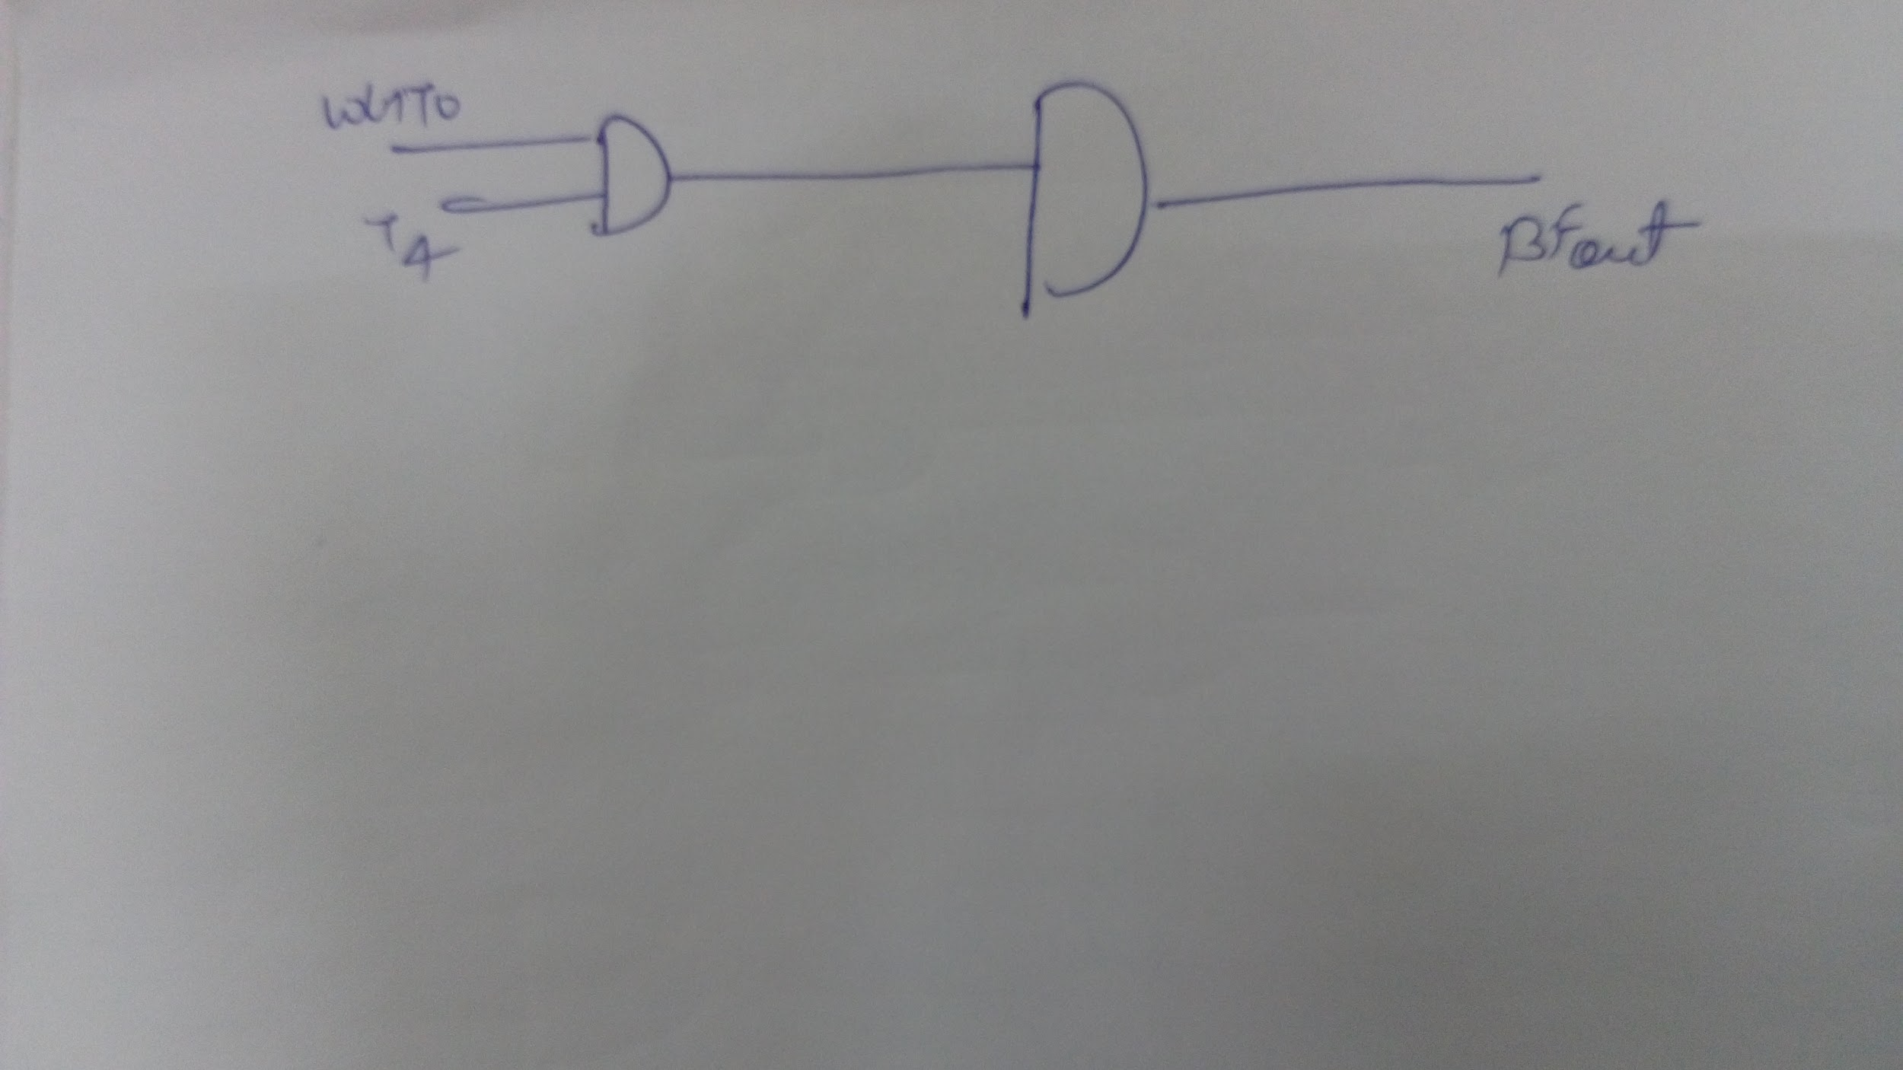
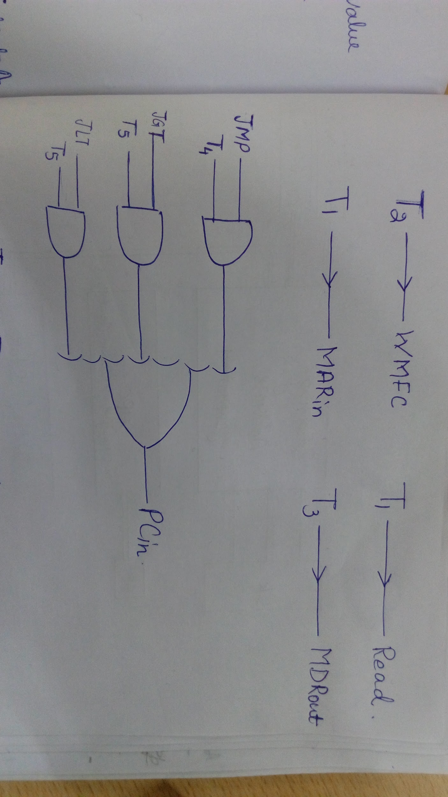

Slide 36
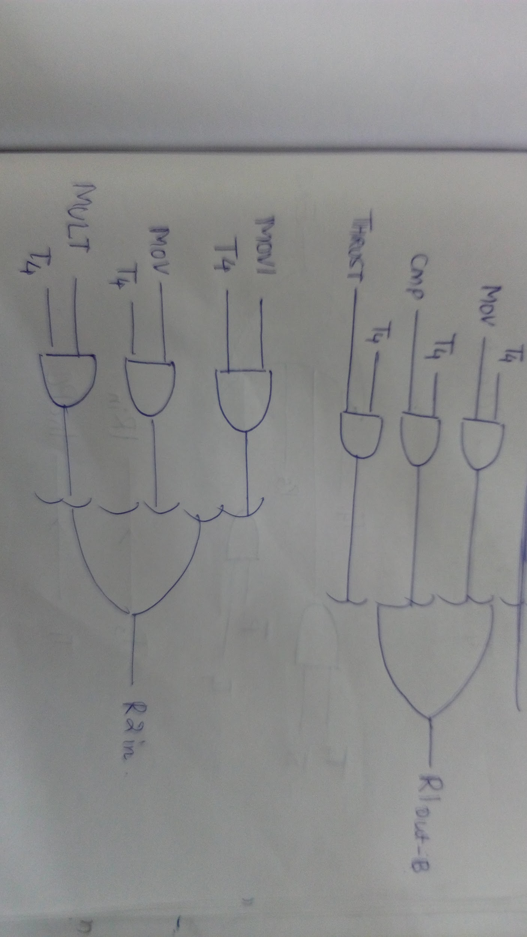

Slide 37
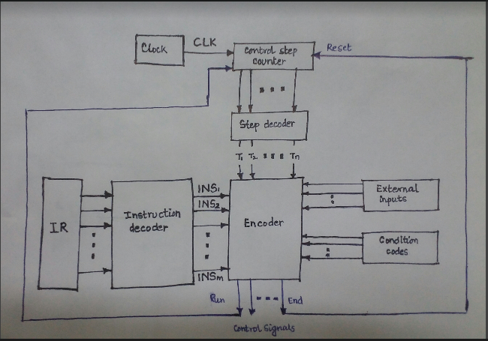

Slide 38
THE END

