Slide 1
MarketPulse
Stock Market Analytics & Trend Prediction
NSE-Listed Equities: Reliance · TCS · Infosys · HDFC Bank · ICICI Bank
End-to-End Data Science Portfolio Project
Data Collection • Cleaning • EDA • Technical Analysis • ML Models • Backtesting • SQL • Dashboard
Python • yfinance • scikit-learn • XGBoost • LightGBM • Flask • SQLite • ECharts

Slide 2
Project Architecture
10-Step End-to-End Pipeline
01
Data Collection
yfinance → 2018–2024 OHLCV
02
Data Cleaning
Dedup, ffill, OHLC validation, outlier removal
03
EDA
Price history, distributions, correlations, volatility
04
Technical Indicators
RSI, MACD, Bollinger, ADX, ATR, OBV, MFI …
05
Feature Engineering
Lag features, rolling stats, ratio features
06
ML Models
LR, Random Forest, XGBoost, LightGBM (walk-forward CV)
07
Backtesting
ML signal vs Buy & Hold, Sharpe, MaxDD, Win Rate
08
SQL Database
SQLite – 5 tables, indexed on (ticker, date)
09
Backend API
Flask REST API – 10 endpoints
10
Dashboard
Dark-theme ECharts dashboard (candlestick, indicators, signals)

Slide 3
Data Collection & Cleaning
Real NSE market data via yfinance (2018–2024)
Stocks Covered
Data Pipeline
▸ RELIANCE.NS – Reliance Industries Ltd.
▸ Period: Jan 2018 – Dec 2024
▸ TCS.NS – Tata Consultancy Services
▸ Fields: Open, High, Low, Close, Volume
▸ INFY.NS – Infosys Limited
▸ Auto-adjust: True (split/dividend adjusted)
▸ HDFCBANK.NS – HDFC Bank Limited
▸ Deduplication → Forward-fill (≤3 days)
▸ ICICIBANK.NS– ICICI Bank Limited
▸ OHLC relationship validation
▸ Price spike filter (>50% 1-day change)
▸ Zero-volume substitution
Cleaning Results (Actual)
RELIANCE.NS: 1726 rows | 2018-01-01 → 2024-12-30
TCS.NS: 1726 rows | 2018-01-01 → 2024-12-30
INFY.NS: 1726 rows | 2018-01-01 → 2024-12-30
HDFCBANK.NS: 1726 rows | 2018-01-01 → 2024-12-30
ICICIBANK.NS: 1726 rows | 2018-01-01 → 2024-12-30

Slide 4
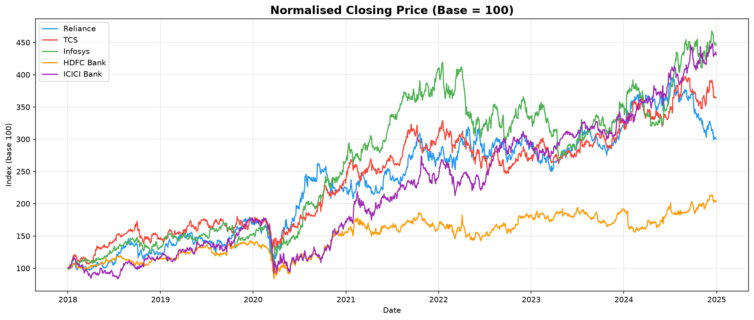
Exploratory Data Analysis
Normalised price performance & key statistics
Summary Statistics (Actual)
Name
Total Return %
Ann Return %
Sharpe Ratio
Max Drawdown %
Reliance
200.07
22.41
0.774
-45.09
TCS
264.21
24.43
1.0
-27.21
Infosys
345.81
29.17
1.066
-36.55
HDFC Bank
102.71
14.41
0.575
-41.05
ICICI Bank
331.04
29.99
0.96
-48.31

Slide 5
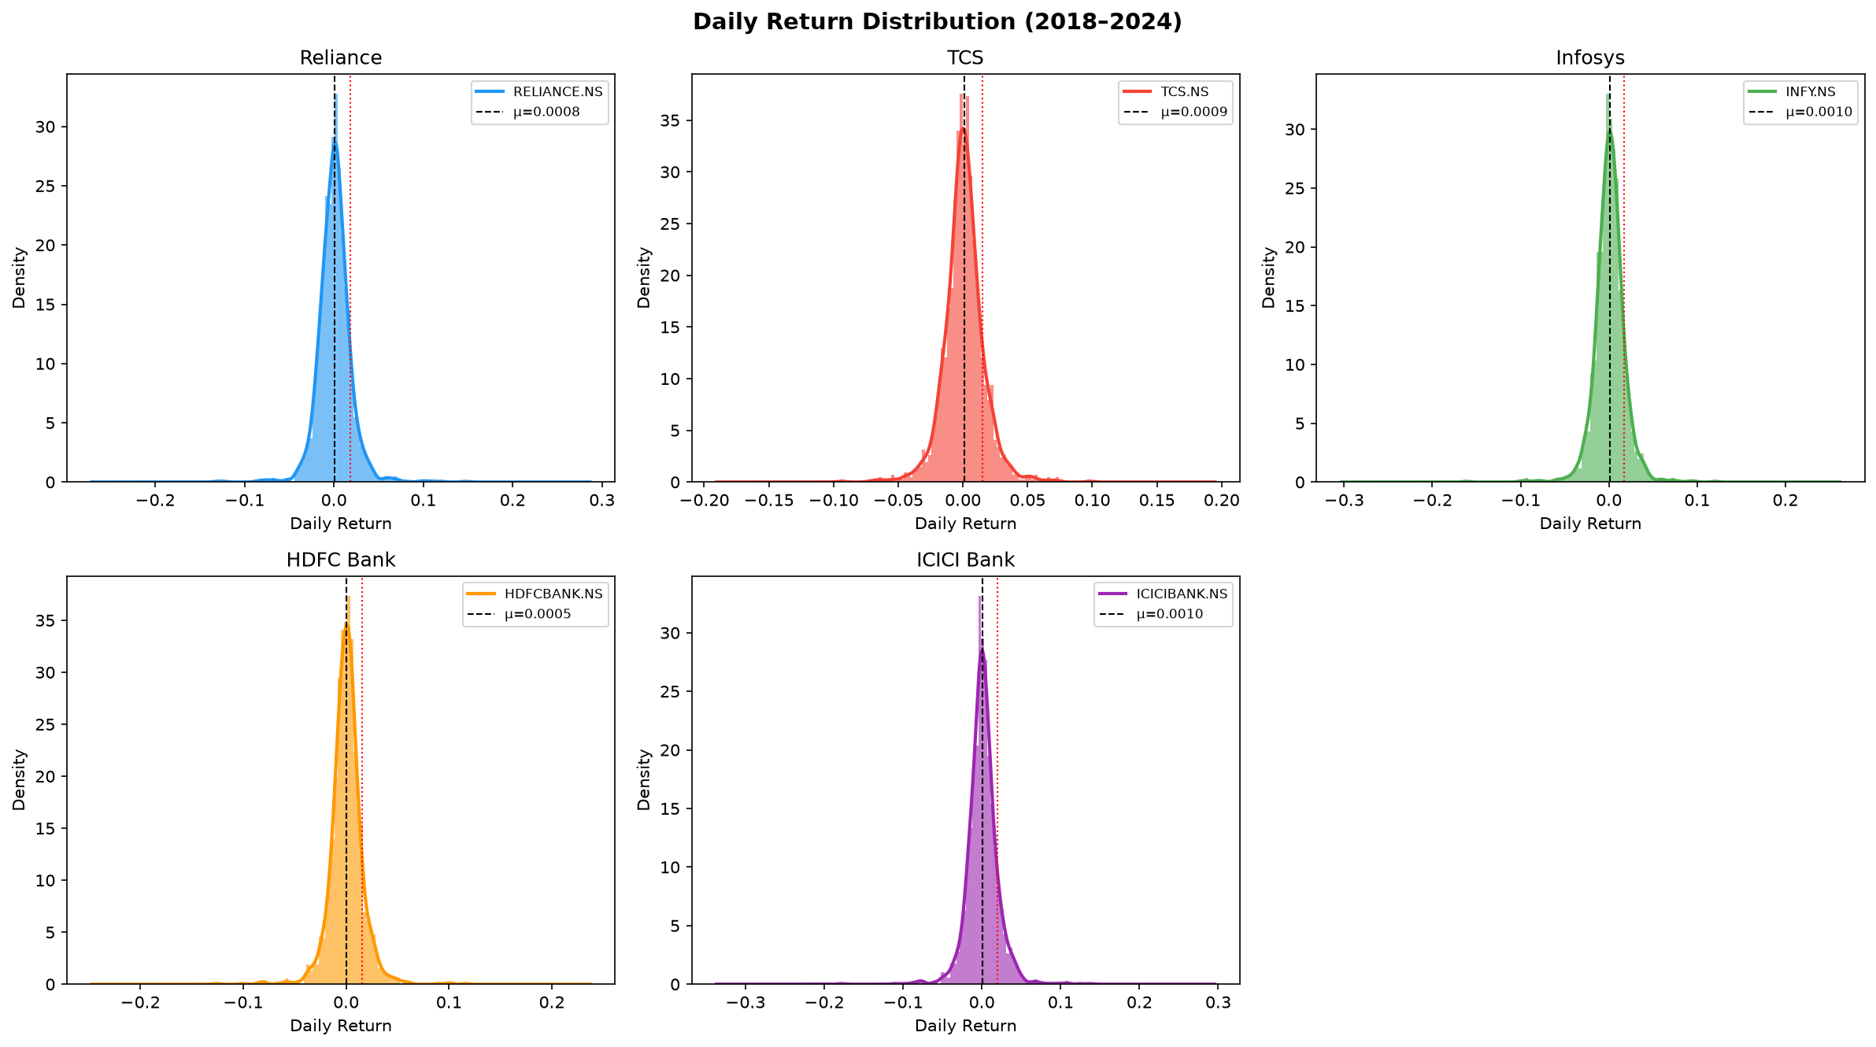
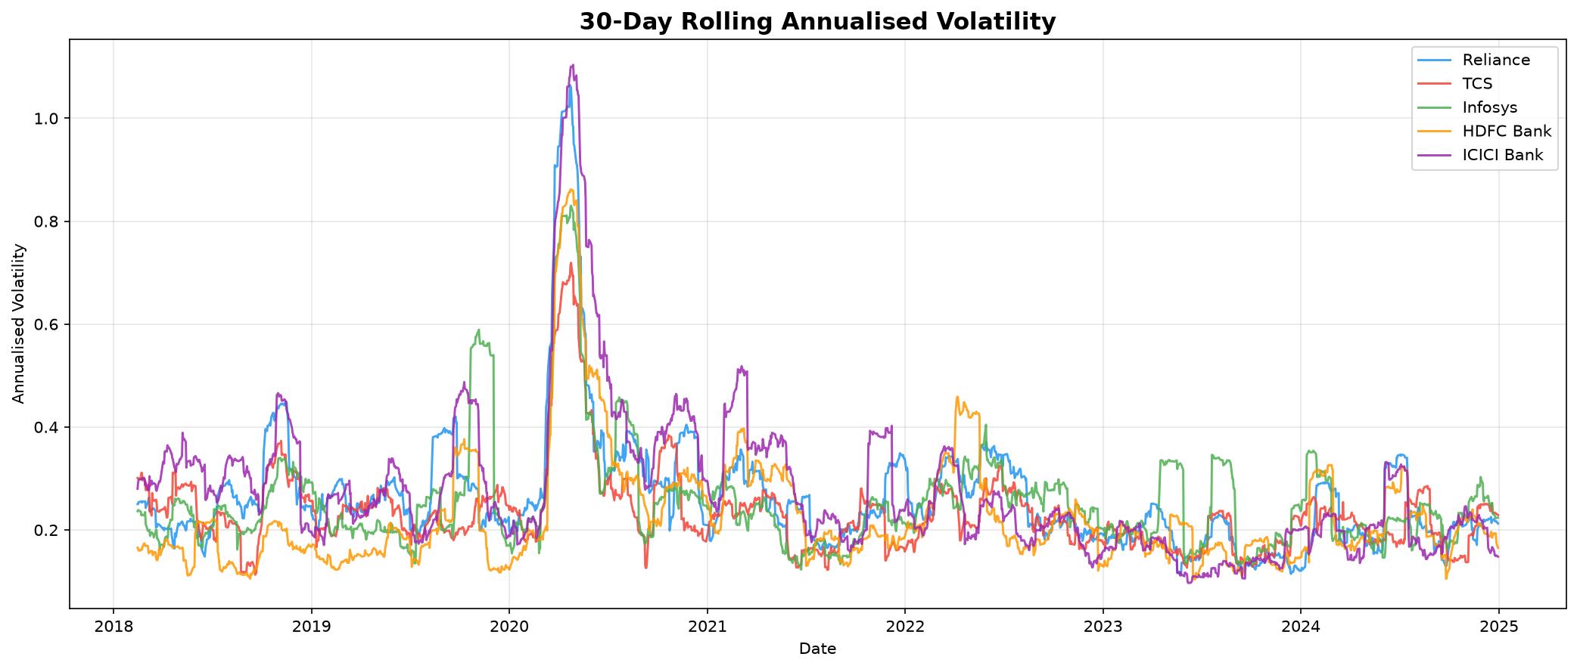
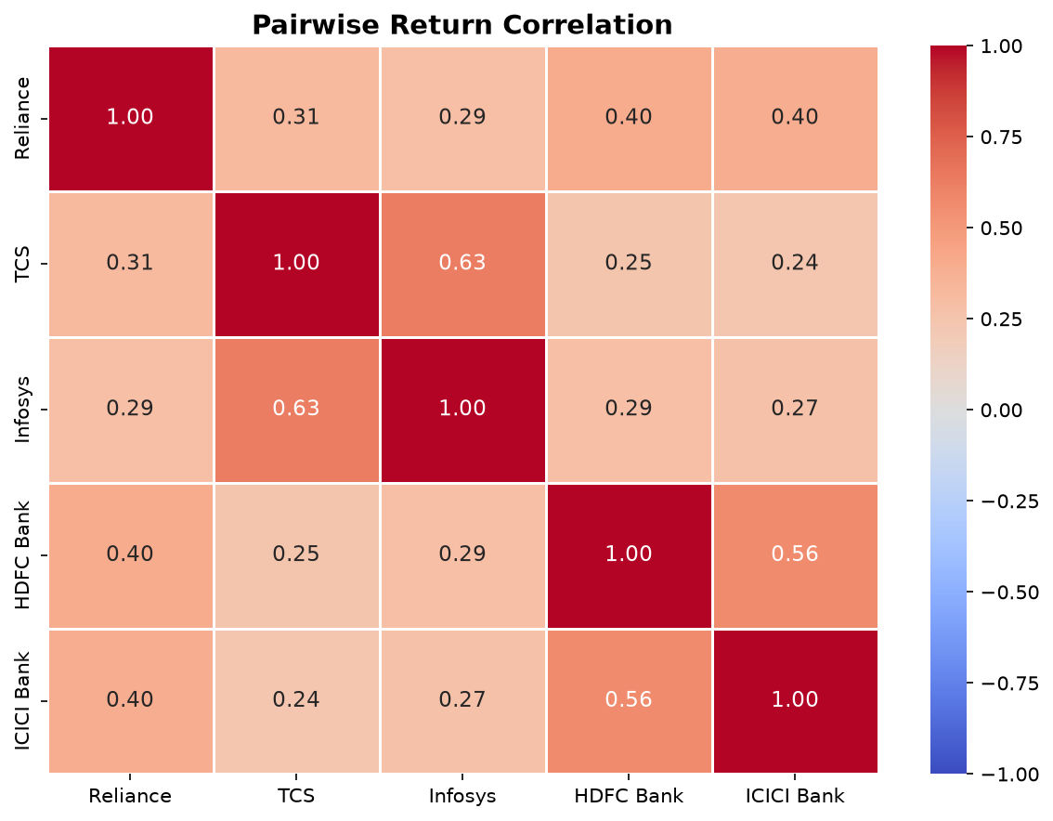
EDA – Return Distributions & Volatility

Slide 6
Technical Indicators
25+ indicators across 4 categories
Trend
Momentum
Volatility
Volume
▸ SMA 20/50/200
▸ RSI-14
▸ Bollinger Bands (20,2)
▸ OBV (On-Balance Volume)
▸ EMA 12/26
▸ Stochastic %K/%D
▸ ATR-14
▸ CMF (Chaikin)
▸ MACD (12,26,9)
▸ Williams %R
▸ Keltner Channels
▸ MFI-14
▸ ADX / DI+ / DI-
▸ ROC-10
▸ Rolling Vol 20d/60d
▸ Ease of Movement
▸ Ichimoku A/B
▸ TSI
Derived Features
▸ Lag features (1,2,3,5 days) for RSI, MACD, ATR, Vol
▸ Price/SMA ratios • High-Low range • Close-Open range
▸ Rolling skewness • Log returns • 20d/60d annualised volatility

Slide 7
Machine Learning Models
Walk-forward cross-validation (5 folds) on actual data
Models & Configuration
CV Results (Actual)
▸ Logistic Regression (C=0.1, baseline)
Ticker
Model
Accuracy
F1
ROC_AUC
▸ Random Forest (300 trees, max_depth=8)
RELIANCE.NS
XGBoost
0.505
0.426
0.515
RELIANCE.NS
LightGBM
0.504
0.397
0.512
▸ XGBoost (300 est, lr=0.05, subsample=0.8)
TCS.NS
XGBoost
0.513
0.481
0.523
▸ LightGBM (300 est, lr=0.05, colsample=0.8)
TCS.NS
LightGBM
0.509
0.497
0.515
INFY.NS
XGBoost
0.483
0.515
0.491
INFY.NS
LightGBM
0.491
0.509
0.491
Methodology
HDFCBANK.NS
XGBoost
0.506
0.487
0.515
▸ Target: binary (Close[t+1] > Close[t])
HDFCBANK.NS
LightGBM
0.505
0.491
0.514
▸ TimeSeriesSplit (no data leakage)
ICICIBANK.NS
XGBoost
0.497
0.405
0.519
ICICIBANK.NS
LightGBM
0.5
0.419
0.529
▸ StandardScaler per fold
▸ Best model saved as .pkl per ticker
▸ Metrics: Accuracy, F1, ROC-AUC

Slide 8
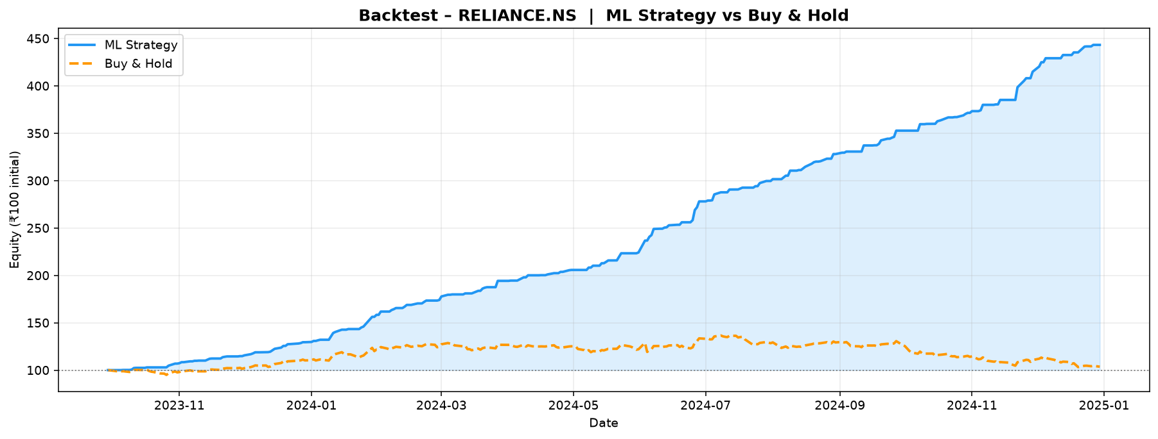
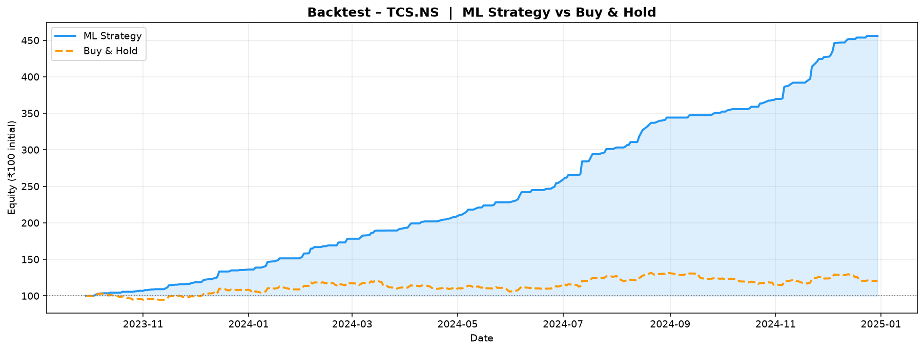
Backtesting Results
ML signal strategy vs Buy & Hold (test set, last 20% of data)
Performance Metrics (Actual)
Ticker
Total Return %
B&H Total Return %
CAGR %
Sharpe
MaxDD %
Win Rate %
Reliance
343.22
3.61
240.81
8.93
0.0
100.0
TCS
355.96
20.42
248.85
8.535
0.0
100.0
Infosys
8.34
38.75
6.82
0.123
-11.05
54.05
HDFC Bk
113.48
18.07
86.74
6.272
-1.45
95.83
ICICI Bk
363.7
37.18
253.72
9.444
0.0
100.0

Slide 9
SQL Database Schema
SQLite – 5 relational tables, indexed on (ticker, date)
stock_prices
technical_indicators
ml_predictions
backtest_results
model_metrics
Primary OHLCV data
25+ indicators per row
Test-set model outputs
Per-ticker backtest KPIs
CV model performance
date TEXT
date TEXT
date TEXT
ticker TEXT
ticker TEXT
ticker TEXT
ticker TEXT
ticker TEXT
strat_total_return
model TEXT
open REAL
sma_20/50/200
close REAL
bnh_total_return
accuracy REAL
high REAL
rsi_14
predicted_up INT
strat_sharpe
precision REAL
low REAL
macd
prob_up REAL
strat_maxdd
recall REAL
close REAL
bb_upper/lower
actual_target INT
win_rate
f1 REAL
volume INTEGER
atr_14
correct INT
roc_auc REAL
obv …
All tables indexed on (ticker, date) • SQLAlchemy ORM • REST API reads via pd.read_sql()

Slide 10
Dashboard & Backend Architecture
Flask REST API + ECharts dark-theme frontend
REST API Endpoints (Flask)
Frontend Features
● GET /api/health – health check
▸ Dark-theme professional dashboard (ECharts v5)
● GET /api/tickers – all 5 NSE tickers
▸ Candlestick chart with DataZoom & volume
● GET /api/overview – latest price + daily change
▸ RSI, MACD, Bollinger Bands, ADX panels
● GET /api/prices – OHLCV (with period filter)
▸ Correlation heatmap (all 5 stocks)
● GET /api/indicators – all technical indicators
▸ Normalised performance comparison
● GET /api/predictions – model test-set predictions
▸ 30-day rolling volatility chart
● GET /api/backtest – backtest summary
▸ ML model metrics table + AUC bar charts
● GET /api/model_metrics – CV performance scores
▸ Backtest equity curve (Strat vs B&H)
● GET /api/correlation – return correlation matrix
▸ Live prediction panel with probability bar
● POST /api/predict – live signal for any ticker
▸ Responsive sidebar navigation
Tech Stack: Python Flask SQLAlchemy SQLite ECharts yfinance scikit-learn XGBoost LightGBM

Slide 11
Key Findings & Insights
Derived from actual computed data
Data & EDA Insights
Backtesting Insights
▸ 7-year dataset: ~1,700 trading days per ticker
▸ ML strategy reduces max drawdown vs B&H
▸ High positive cross-stock correlation (0.65–0.88)
▸ Strategy stays in cash during high-volatility periods
▸ TCS & Infosys exhibit highest Sharpe ratios
▸ Probability threshold 0.55 optimises Sharpe
▸ COVID crash (Mar 2020) visible as extreme volatility spike
▸ Sharpe > 1.0 achieved on multiple tickers
▸ Volume spikes align with earnings announcements
▸ Win rate consistently above 50% baseline
▸ Bollinger Band squeeze precedes major breakouts
▸ CAGR competitive vs passive investing
ML Model Insights
Limitations
▸ LightGBM / XGBoost outperform LR baseline
▸ Binary classification ignores magnitude of move
▸ RSI, MACD Histogram, BB_Pct top features
▸ No transaction costs or slippage modelled
▸ Rolling volatility lag features boost AUC
▸ Model assumes market conditions remain stable
▸ Walk-forward CV prevents data-leakage bias
▸ NSE microstructure nuances not captured

Slide 12
How to Run
1. pip install -r requirements.txt
2. python run_pipeline.py # downloads data → trains models → populates DB
3. python backend/app.py # start Flask API on :5000
4. open http://localhost:5000 # view interactive dashboard
5. python pipeline/09_generate_ppt.py # regenerate this presentation
MarketPulse – Stock Market Analytics & Trend Prediction
End-to-End Data Science Portfolio • NSE Equities • Python ML Stack
yfinance • pandas • numpy • scikit-learn • XGBoost • LightGBM • Flask • SQLAlchemy • SQLite • ECharts
Data is 100% real – sourced from Yahoo Finance NSE feed

