Slide 1
Laundry

Slide 2
Members
NAME | EMPLOYEE ID
Hitankshi Vira | 46108487
Himanshi Metta | 46108486
Laxmi Maranabasari | 46108248
Neel Dantara | 46108274
Srigowri A N | 46108360
Vir Navalkar | 46108495

Slide 3
Problem Statement
To Create an Application for online dry clean booking
Customer should be able to view available services.
Customer should be able to choose pickup or drop off service .
Customer should be able to cancel service request.
Customer should be able to view order status.
Customer should be able to pay online.

Slide 4
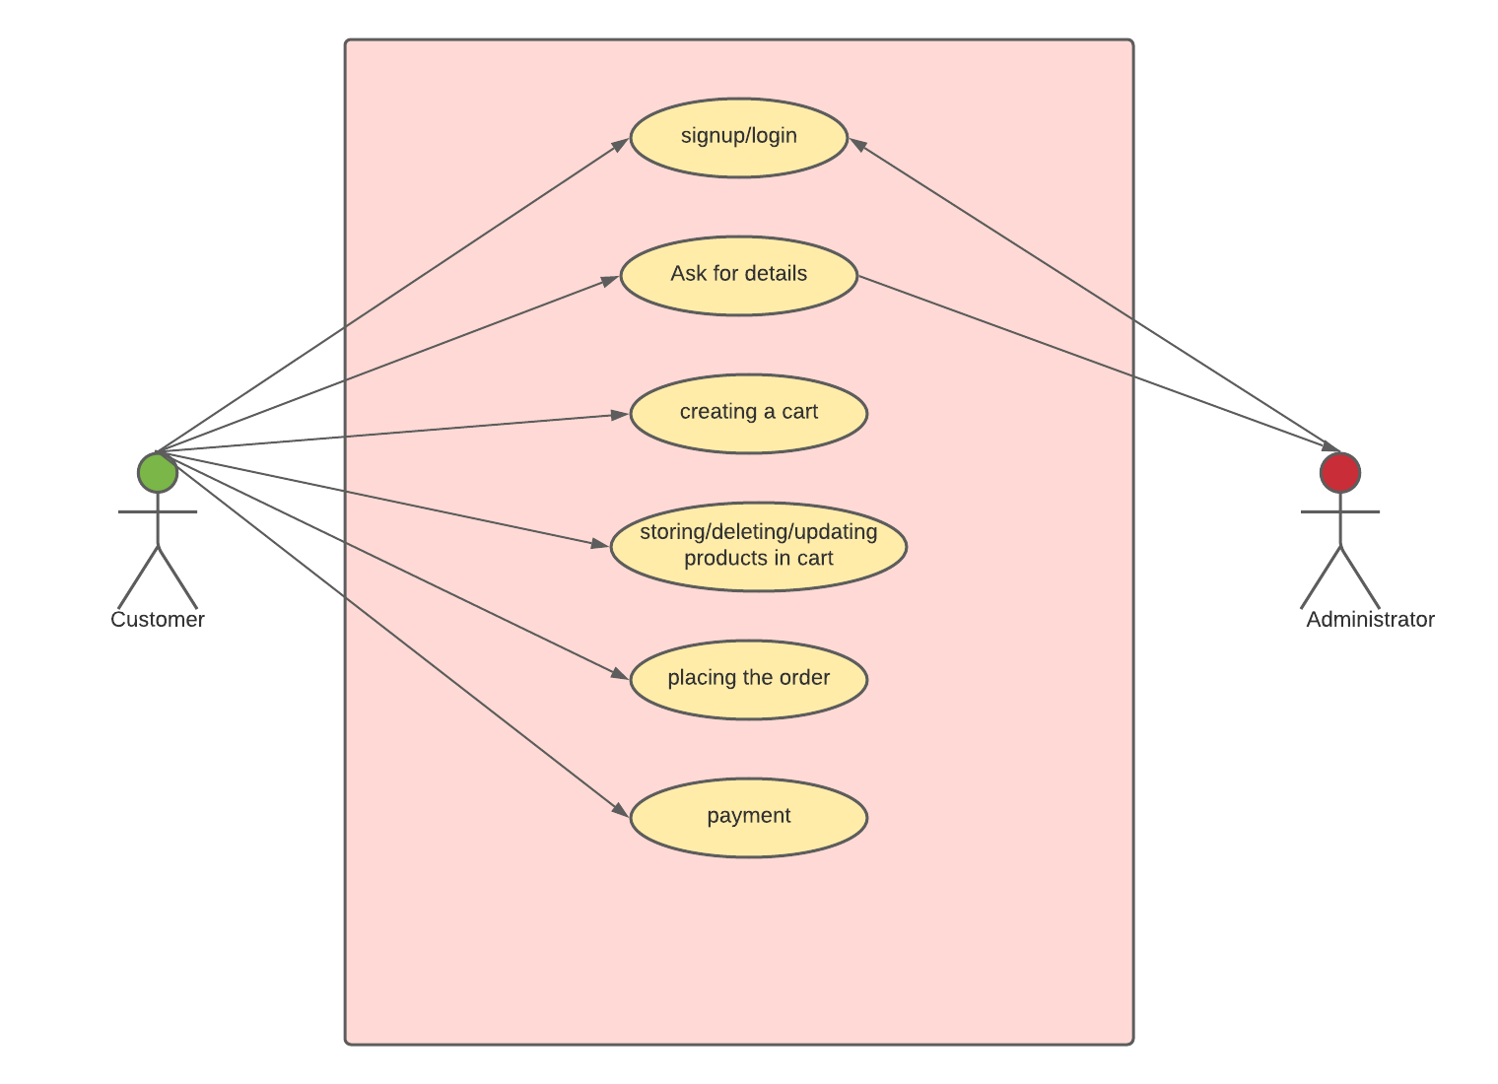
Use Case Diagram

Slide 5
Class Diagram
USER
product
order
Id: interger
Name:string
Password:string
Contact no:string
emailId:string
Address:string
productId:integer
Category:string
Description:string
Quantity: integer
Material:string
Price:integer
Id:integer
orderDate:LocalDate
orderTime:LocalTime
cart
card
Id:integer
Total:integer
cardId:integer
bankName:string
cardNumber:string
expiryDate:string
Cvv:string

Slide 6
Service Interface
cartServiceImpl
orderServiceImpl
ProductServiceImpl
Create cart
Delete cart
Update cart
Delete from cart
Set cart
Set order
Add product
Remove product
Update product
Get product
Get product by cart

Slide 7
Controller slide
User controller
Product controller
Card controller
addProduct
removeProduct
updateProduct
getProduct
getProductByCustomer
addCard
addCustomer
getUsers

Slide 8

Thankyou

