Slide 1

Mongodb Basic Commands

Slide 2
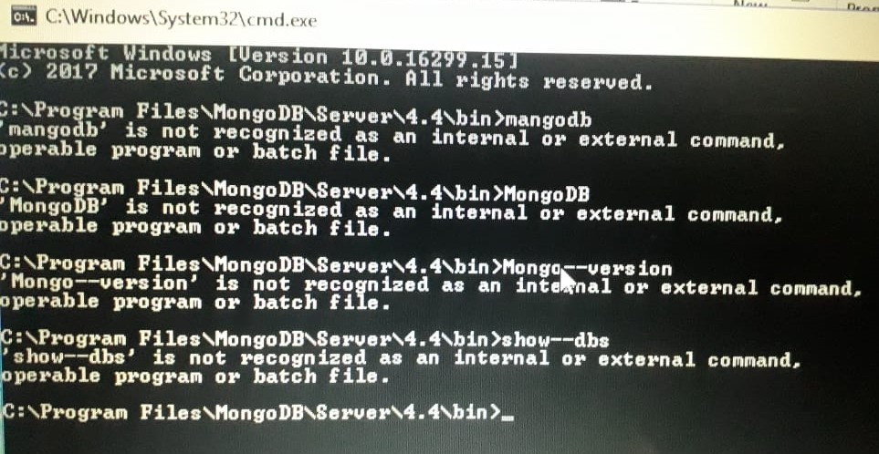
mongod -> To start the mongo database mongo--version -> Use to know the current version. mongo -> Use to enter the database

Slide 3

show dbs -> Use to check all the db in the server use database_name -> Use to create the newdatabase and allow to work on the existing database (for eg. Use students) db -> Use to check the current database

Slide 4
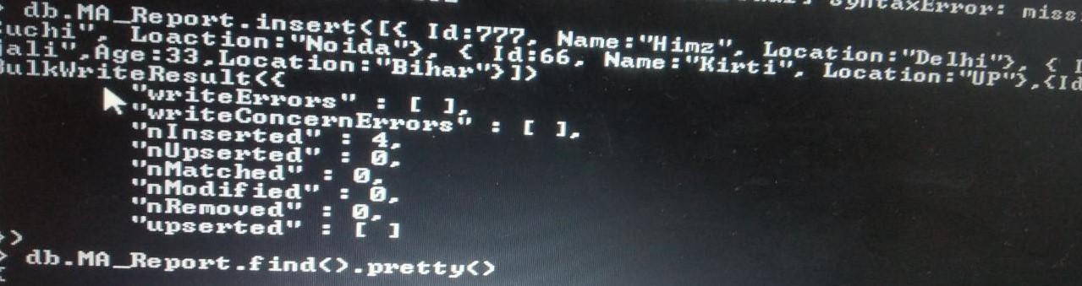
Let’s Start to Insert documents on the database
To insert a single document use the command:-
db. Collection_name.insert({ }) -> This command is used to insert documents in a database.
To insert many documents use the command:-
db.collection_name.insert([{ }, { } ]) -> This command is used to insert multiple documents in a database.
OR
db.collection_name.insertMany([{ }, { } ])

Slide 5

Let’s Display the Records
db.collection_name.find().pretty() -> Use to display your records in easy and read format.
To check whether a value present in the collection use{$in} :-
db.collection_name.find({key:{$in:[value]}})
To display the records greater, less and equal than the documents use{$gt-greater},($lt for less},($eq):-
db.collection_name.find({key:{$gt:value}})

Slide 6
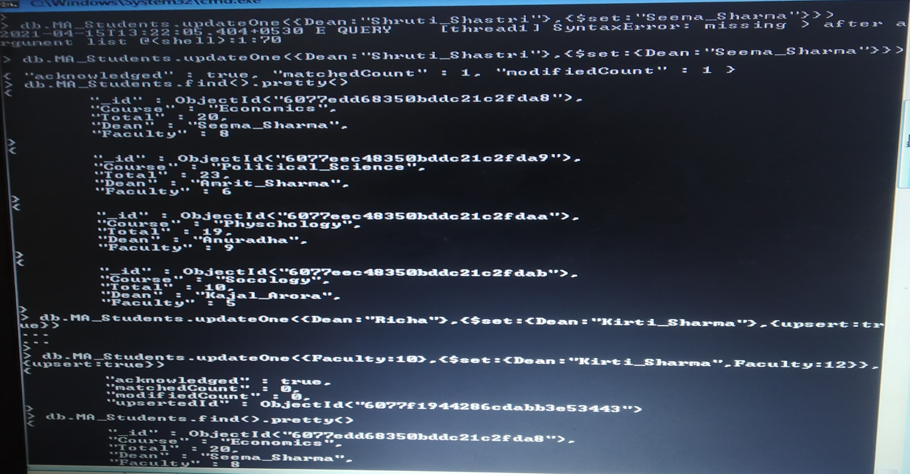
Lets Update the Documents
To update the single documents:-
db.collection_name.update({key:value},{$set:{key:value}})
To update the multiple documents:-
db.collection_name.update({key:value},{$set:{key:value}},{multi:true})

Slide 7
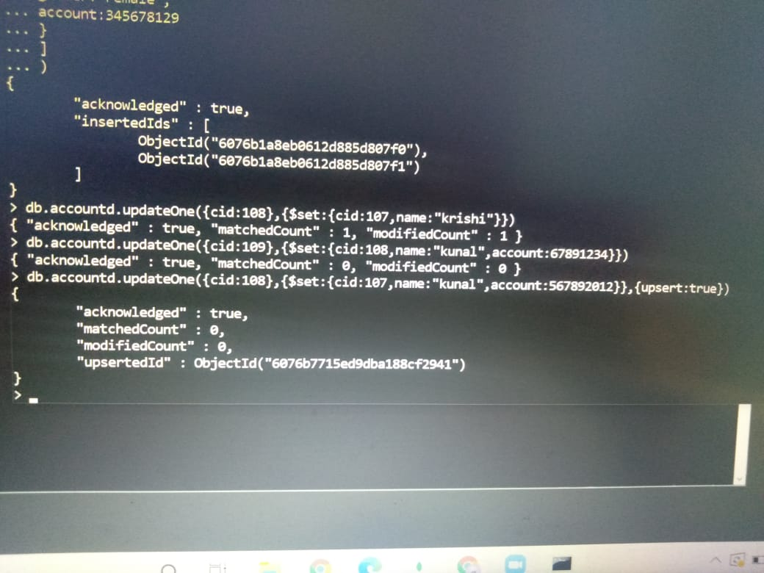
Lets Upsert on the Document
db.collection_name.update({key:value},{$set:{key:value}},{upsert:true}) ->This command is used to upsert on the document if the data is not available on the documents

Slide 8

Let’s Sort the Documents
Sort is used to arranged the data
To sort the data into ascending order:-
db.collection_name.find().sort({key:1}) -> This command help to arrange the data into ascending order and here 1 denote the ascending.
To sort the data into descending order:-
db.collection_name.find().sort({key:-1}) -> -1 is used for descending

Slide 9

Lets use Limit and Skip command
Limit:- Limit command is used to specify the number of documents required from the collection_name
db.collection_name.find().limit(value)
Skip:- Skip command is used to skip the value and return the rest of the documents
db.collection_name.find().limit(skip)

Slide 10
More commands use in mongodb
Logical Operations
$and – Both the condition should be true
$or – One of the condition should be true
$not – Reverse the output if condition is true we get false and vice-versa
To remove the documents
db.collection_name.remove({key:value})

Slide 11

Thank You

