Slide 1

BLOCKCHAIN PROJECT
Submitted to
Mr. KRISH NAIK
BY
PRACHI GOPALANI -B2019034
SUSHANT MEHTA- B2019055 HIMANSHI SWAROOP- B2019077
PARUL KHURANA- B2019085
SHIVANI SINGH – B20190103

Slide 2

WHAT IS THE PROBLEM STATEMENT?

Slide 3
PROBLEM STATEMENT
“Indian Govt comes to you to create Blockchain. Transaction obviously be secured. Add Pan card number in Transactions. If transaction is happening from A to B. Pan numbers of both has to be there. If Any user won’t have PAN number, transaction won’t happen. Use any other algorithm like SHA512 or SHA1024”

Slide 4


Slide 5
Building the Blockchain
Transaction
Decentralizing our Blockchain
Creating & Connecting With Database
Mining

Slide 6
Added Features
PAN Verification
Sender and receiver enters the PAN number
Transaction Limit
First we verify if it is in the correct format i.e. First 5 alphabets next 4 number followed by an alphabet
We have created a dummy database in MySQL the data received from the user is verified from the database, if the information matches, then only the transaction would take place.
To prevent large fraudulent transactions , only those transactions that are below 20000 INR would be approved, and appended in the database.
SHA512
SHA512 algorithm is used to generate the hash
The hash generated is of 512 bits. Each hexadecimal no. takes 4 bits. Therefore there are 128 hexadecimal nos. In our hash generated.

Slide 7
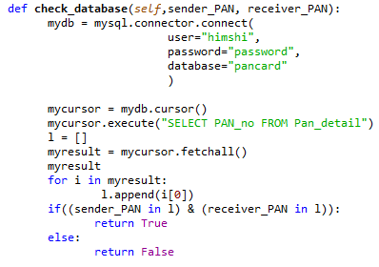
CREATING & CONNECTING WITH DATABASE
Database was created using MySql – It contains information like –Name, PAN Card No. of both and Phone No.
Connected the Database with our Blockchain using MySql – Connector Package

Slide 8
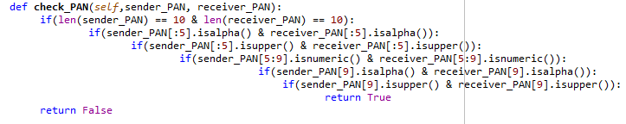
“PAN CARD AUTHENTICATION FUNCTION”
We created a function where user needs to enter the PAN-CARD number in correct order.
Out of the first five characters, the first three characters represent the alphabetic series running from AAA to ZZZ.

Slide 9
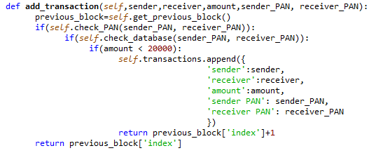
CREATING TRANSACTION FUNCTION
Created a function called add_transaction.
User needs to add Transaction Amount which can’t be more than INR 20,000/-
Sender and Receiver PAN card details will be verified then only Transaction will be completed.

Slide 10
Future Scope
Smart Contracts-A third party to validate all the transactions, this leads to accurately and flawless recording of transactions.
PAN Authentication- Since PAN has lots of combinations , however for simplicity we are only checking one basic pattern.
SMS- We have the phone numbers stored in the database along with PAN, therefore whenever a transaction happens the sender and receiver receives a message with the amount of transaction.
01
02
03

Slide 11


