Slide 1

Statistics
BY Himanshi kumari

Slide 2
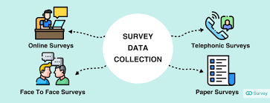


What is Statistics?
A branch of mathematics dealing with the collection, analysis, interpretation, and presentation of masses of numerical data.
Data collection
Data Organization
Data Interpretation

Slide 3
Why we use Statistics?
Gain a better understanding of the world around us.
Make decisions using data.
Make predictions about the future using data.
To understand correlation.

Slide 4
Where we use Statistics?
Business
Marketing
Media
Finance
Insurance
Government
Healthcare
Manufacturing and Engineering.

Slide 5
Types of Statistics
Descriptive statistics
Inferential statistics
Descriptive statistics are used to analysis data or summarize data then organize it in the form of numbers and graphs.
Here we use different types of charts like pie-chart, bar chart , Histogram etc.
We also use arithmetic operation here like mean, median, mode, central tendency etc.
Inferential statistics are used to derive conclusion by making sample from the entire population.
Here we use different kind of testing like ANOVA testing , Hypothesis testing etc.
We also use Z test , T test, Chi square test etc.

Slide 6
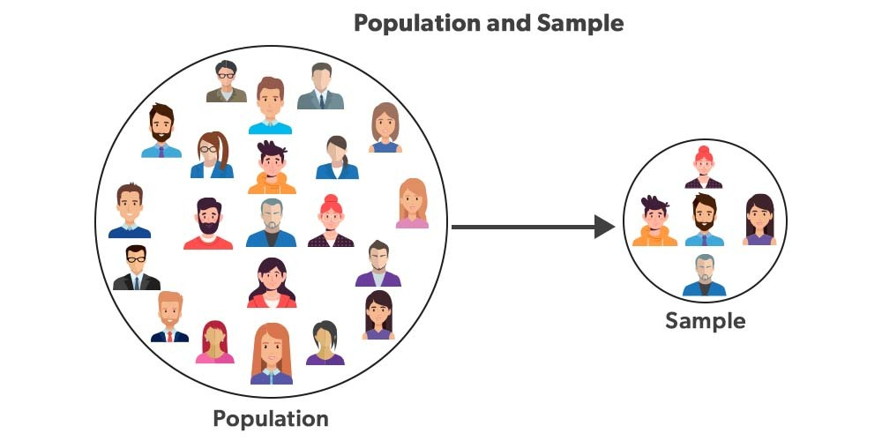
Difference between Population and Sample
POPULATION (N) : A population is the entire group that you want to draw conclusions about.
SAMPLE (n) : A sample is the specific group that you will collect data from.

Slide 7
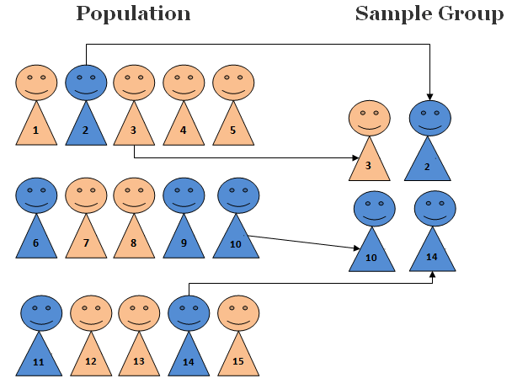
Sampling Techniques
1.Simple Random Sampling : A simple random sample is a subset of a statistical population in which each member of the subset has an equal probability of being chosen. A simple random sample is meant to be an unbiased representation of a group.

Slide 8
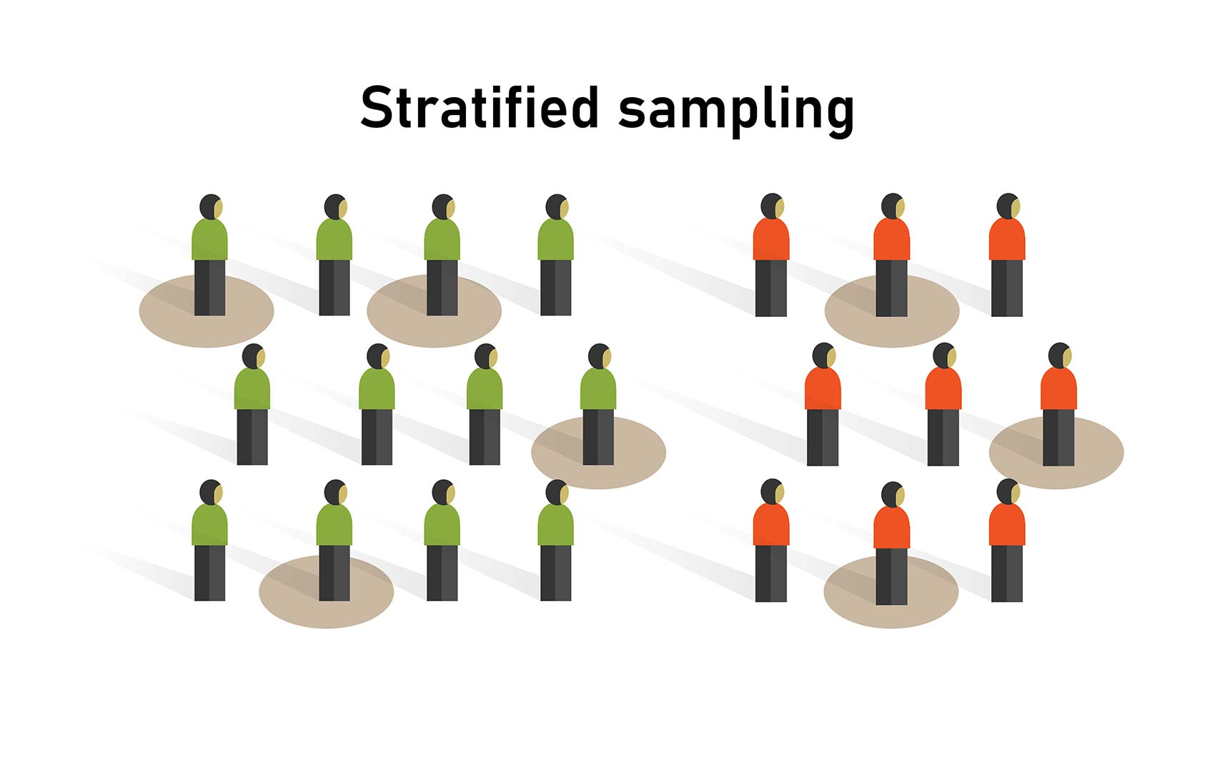
2. Stratified Sampling
Stratified random sampling is a method of sampling that involves the division of a population into smaller sub-groups known as strata. And groups are divided such as there is no overlapping between them.

Slide 9
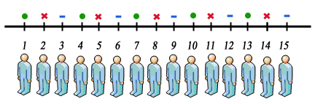
3.Systematic Sampling
Systematic sampling is a type of probability sampling method in which sample members from a larger population are selected according to a random starting point but with a fixed, periodic interval. That is every nth person is being selected for sampling.

Slide 10
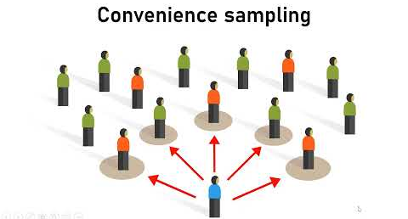
4.Convenience Sampling
Convenience sampling is a method of collecting samples by taking samples that are conveniently located around a location or Internet service. In this sampling technique we take expert or people having knowledge in that field in which we are doing study.

Slide 11
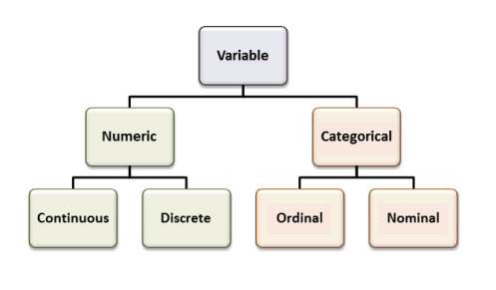

Slide 12
Variable:
A variable is a property that can take on any value.
Types of variable :
Quantitative Variable :- Variable that can be measured for example height, weight, age etc.
Discrete Quantitative variable :- It contains whole number.
For Example Bank account number,age
Continuous Quantitative variable :- It contains decimal value in it.
For example: Height=125.5,126.5,127.5,128.0

Slide 13
Qualitative /Categorical Variable :- Based on some characteristics we can derive categorical variable for example Male/Female.
Types Of Qualitative variable:
Nominal :-A nominal variable has no intrinsic ordering to its categories. For example, gender is a categorical variable having two categories (male and female) with no intrinsic ordering to the categories.
Ordinal :- An ordinal number is numeric data which is mainly used to give rank to data . The example of ordinal variable can be Grading in school, Feedback giving etc.

Slide 14
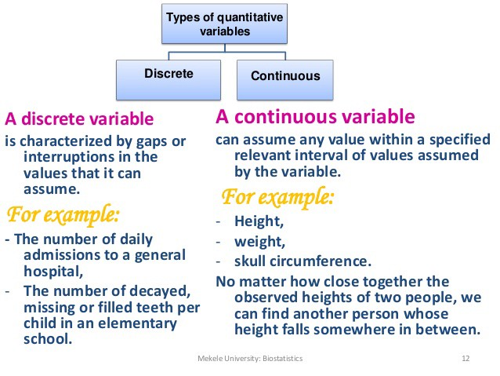

Slide 15
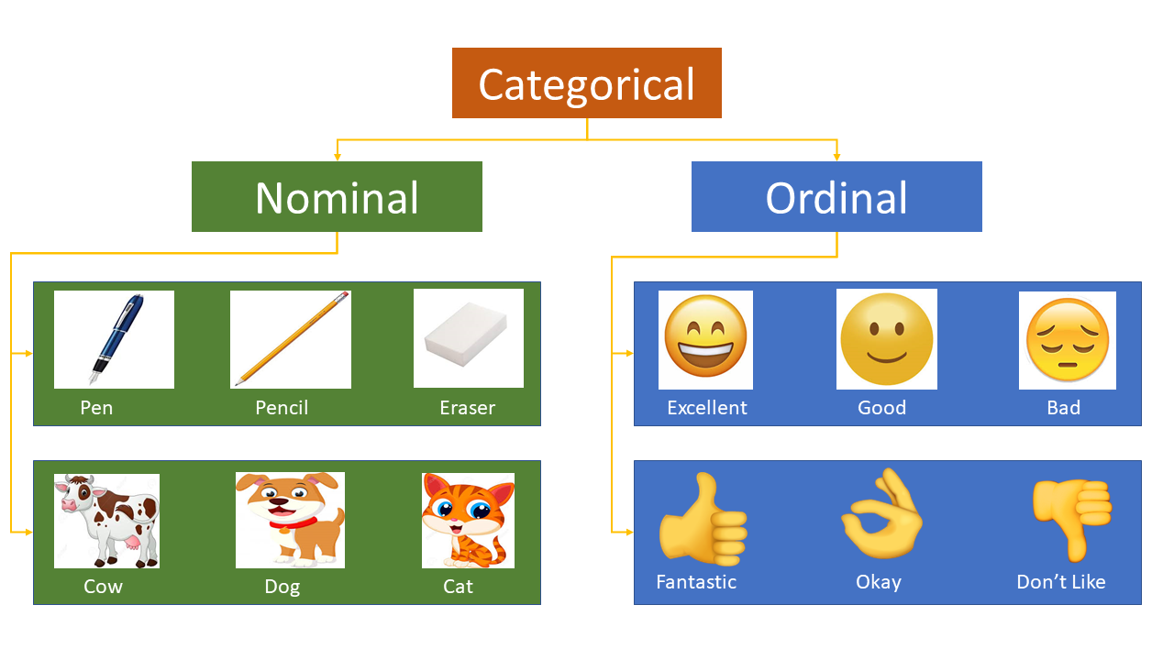

Slide 16



