Slide 1
TESLA
Providing You The Online Quizes

Slide 2
About
Test for electronics and logical aptitude or you can TESLA is a joint attempt of IEEE BIT Mesra Student Chapter along with EEE SOC to give you the exposure of GATE level Electronics, Electrical and Logical Aptitude. Starting from the basics and step by step going to deeper concepts of core and tricky logical reasoning is what you can expect from this platform.
It is written in HTML,CSS,JAVASCRIPT and CODEIGNITER

Slide 3
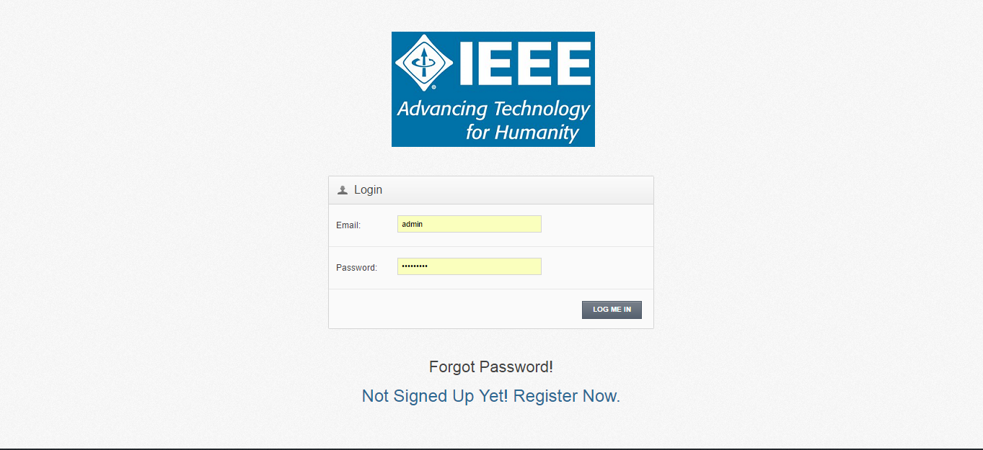
LOGIN/SIGNUP

Slide 4
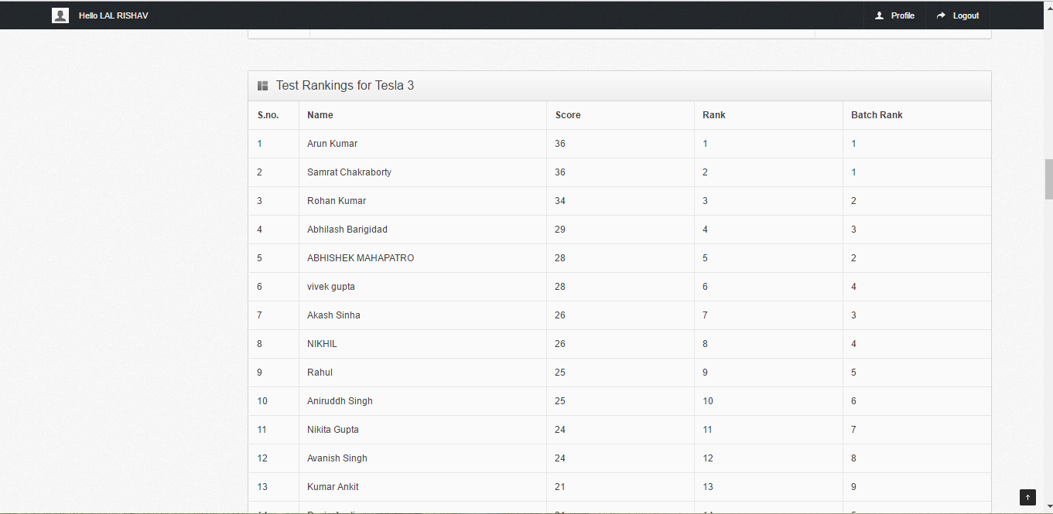
RANKINGS

Slide 5
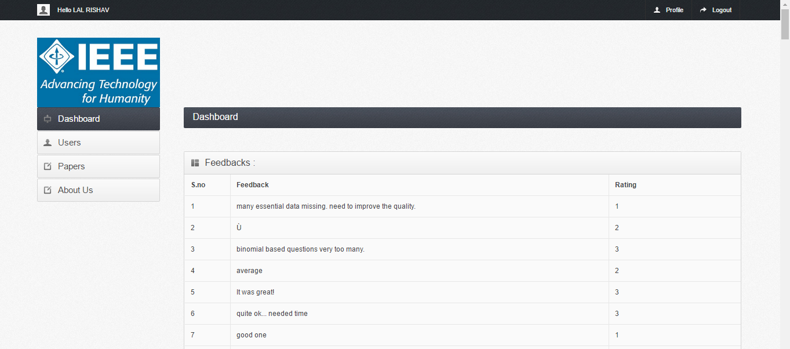
FEEDBACKS

Slide 6
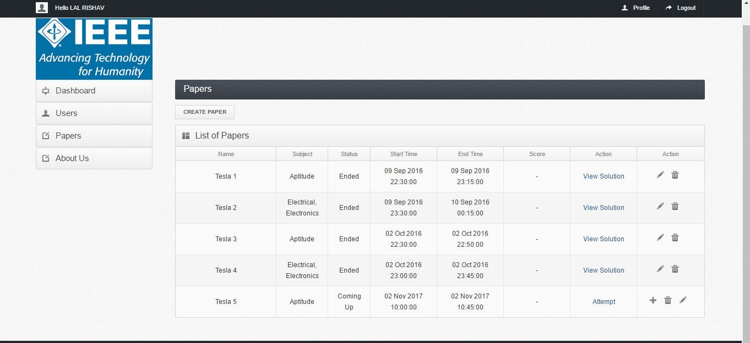
PAPER DETAILS

Slide 7
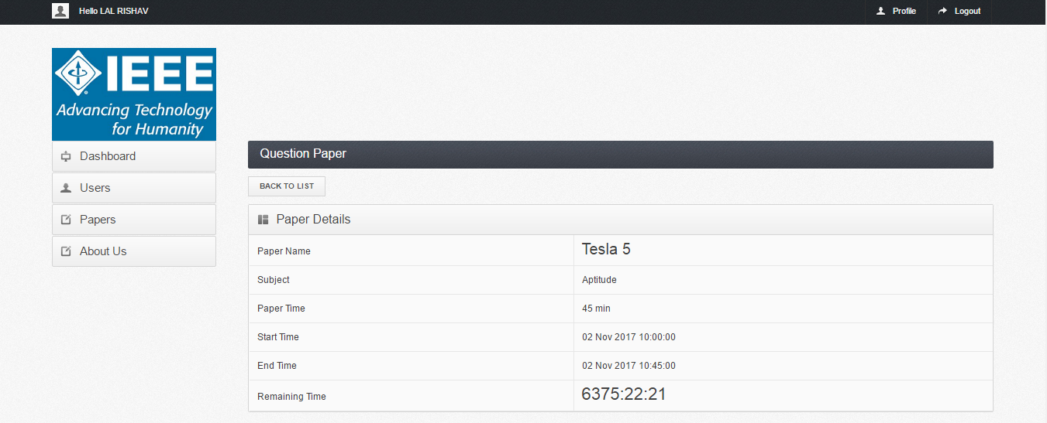
ACTIVE PAPER DETAILS

Slide 8
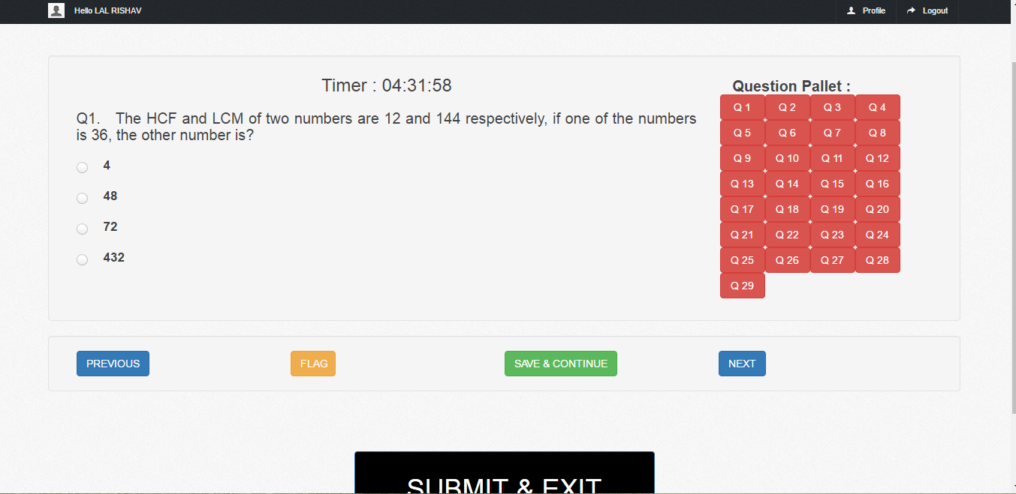
QUESTION PALLET

Slide 9
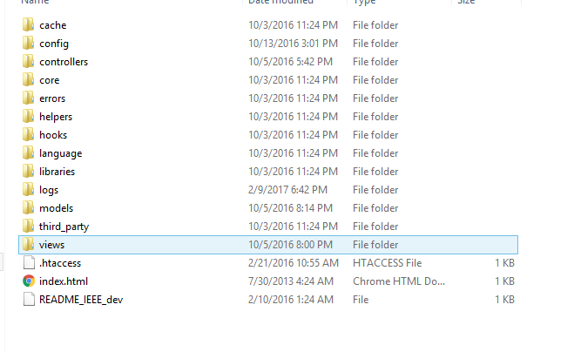
MVC FRAMEWORK

Slide 10
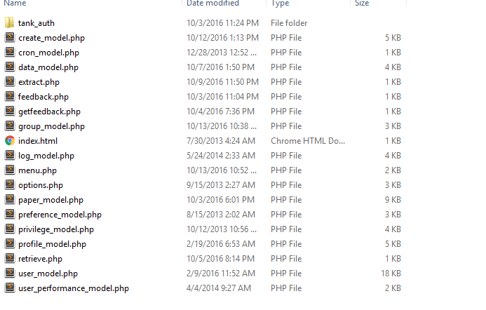
MODELS

Slide 11
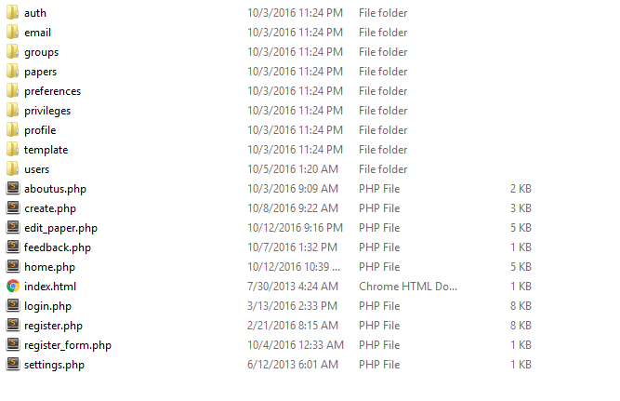
VIEWS

Slide 12
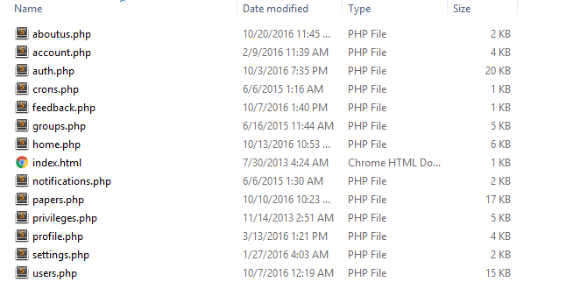
CONTROLLERS

