Slide 1
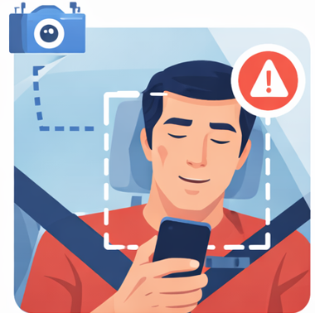
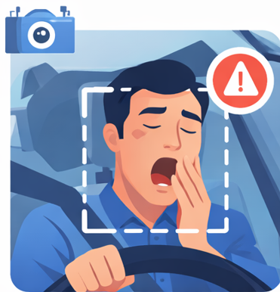
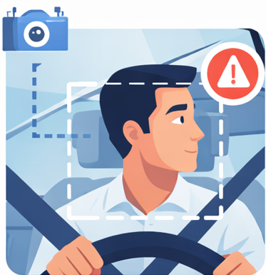
Driver Drowsiness & Distraction Detection System
Team Name: Group-3
Program: PGDM AI & DS
Team Member 1 : Jayati Vyas
Team Member 2 : Shyam Radadia
Team Member 3: Mahi Maheshwari
Team Member 4 : Himanshu Pradhan
Team Member 5 : Durva Pandya

Slide 2
Problem
Driver fatigue and lack of attention are major causes of road accidents worldwide, contributing to over 25% of fatal cases.
Drowsiness acts as a “silent killer,” where drivers experience micro-sleeps without realizing the danger.
Modern distractions like smartphones and infotainment systems further reduce driver focus, increasing accident risk.
Micro-sleeps (1–5 seconds) can occur without warning, and even a few seconds of sleep can lead to serious accidents.

Slide 3
Proposed Solution
Capture video input and convert it into frames
Uses face & eye detection (MediaPipe) to track fatigue
Detects yawing and eye closure for drowsiness
Uses YOLOv8 model to detect phone usage
Combines all detections in single pipeline
Generates real-time alerts on screen (HUD warings)

Slide 4
Architecture
Input Capture
Camera capture real-time video of the driver.
Face & Landmark Detection
Detect face,eyes, and mouth points
Feature Extraction
Eye closure (EAR)
Yawing (MAR)
Head pose
Phone detection
Processing & Analsis
Each feature is analyzed frame-by-frame
Decision System
Combine all signals-generate alert
Alert System
Sound or visual alert given to driver
output/:safe/Warning/critical

Slide 5
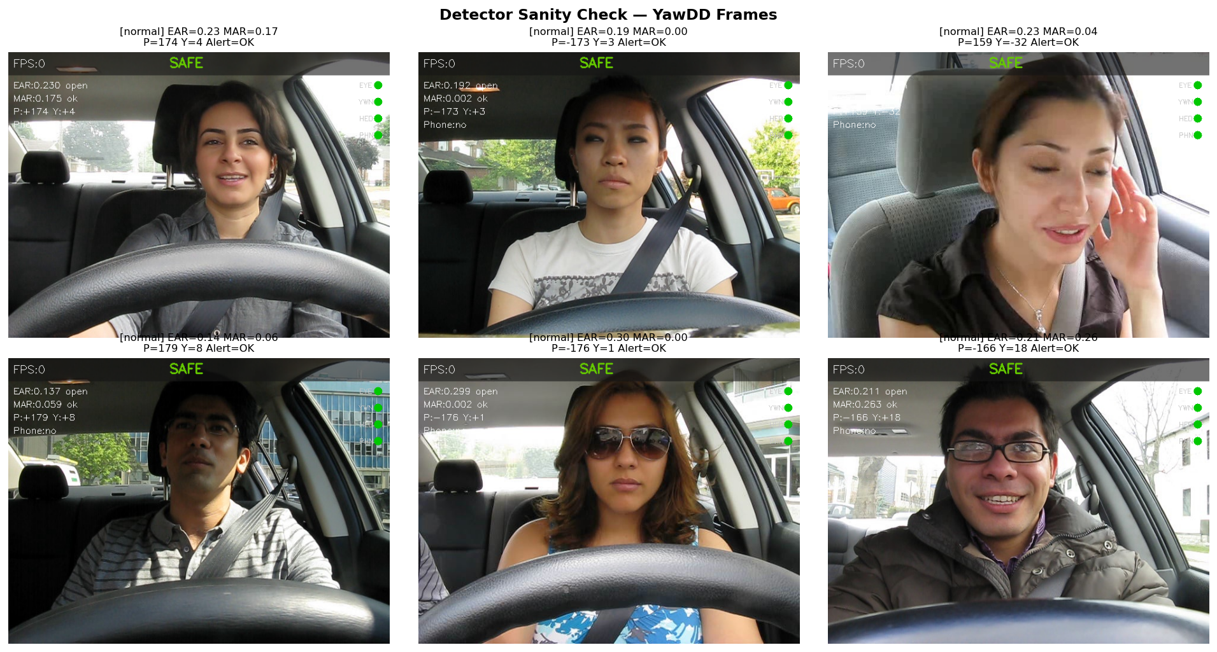
Training Data
Trained on real driver data (YawDD), the system analyzes live video and generates intelligent safety alerts.
YawDD: 348 video is used to train data

Slide 6
Tools used
Mediapipe
Used for face, eye, and mouth tracking
- Fast and lightweight
- Works well in real-time
Yolov8
Used for phone detection
- High accuracy object detection
Detects small objects like mobile phones
Numpy
Used for calculations EAR, MAR, angles
-Fast numerical computations
Solvepnp
Used to detect where driver is looking
- Helps identify attention level.
OpenCV
Used for video processing
- Captures frames from camera
- Handles image operations

Slide 7
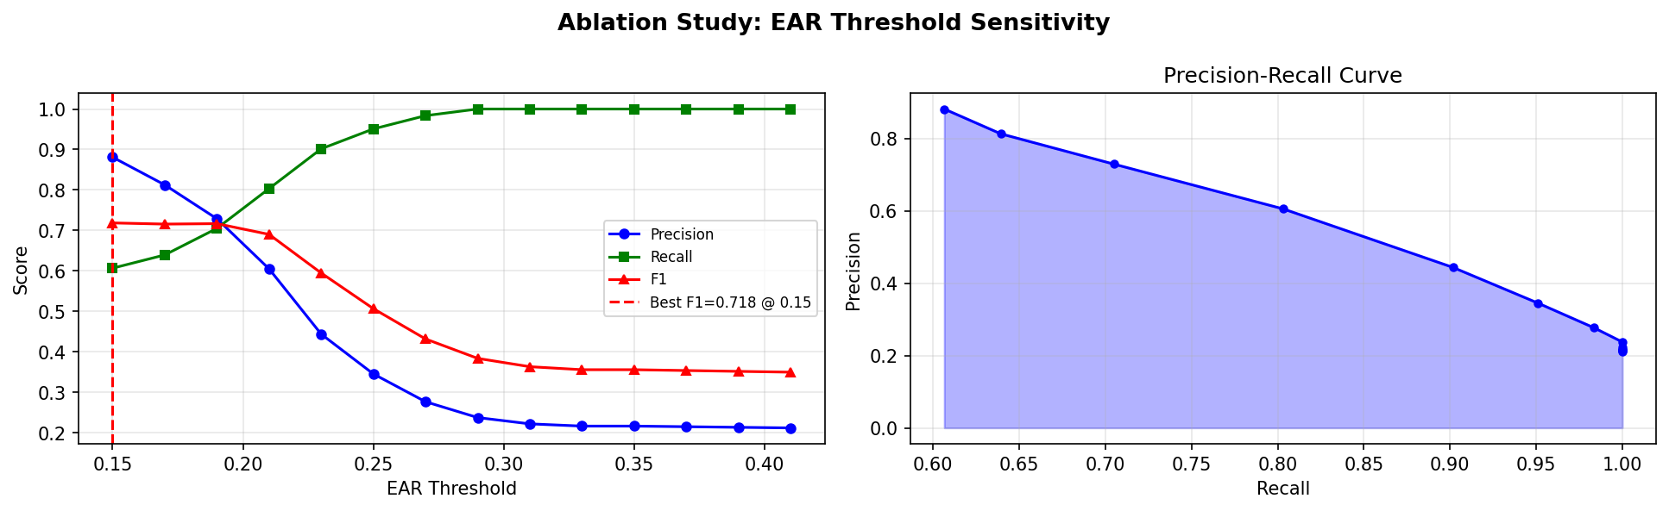
EAR = 0.15 is the optimal threshold
It gives the best balance between:
Detecting drowsiness
Avoiding false alarms

Slide 8
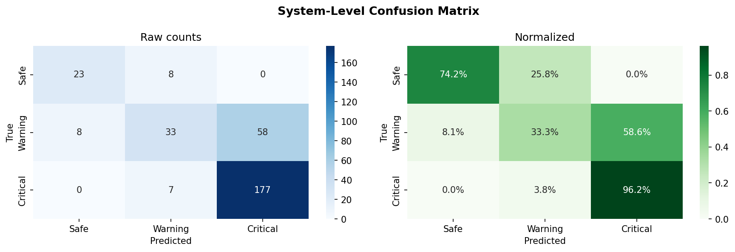
Confusion Matrix
Safe: 74.2% correctly predicted, but 25.8% wrongly classified as Warning
Warning: Only 33.3% correct → most (58.6%) misclassified as Critical
Critical: Very accurate → 96.2% correctly predicted

Slide 9
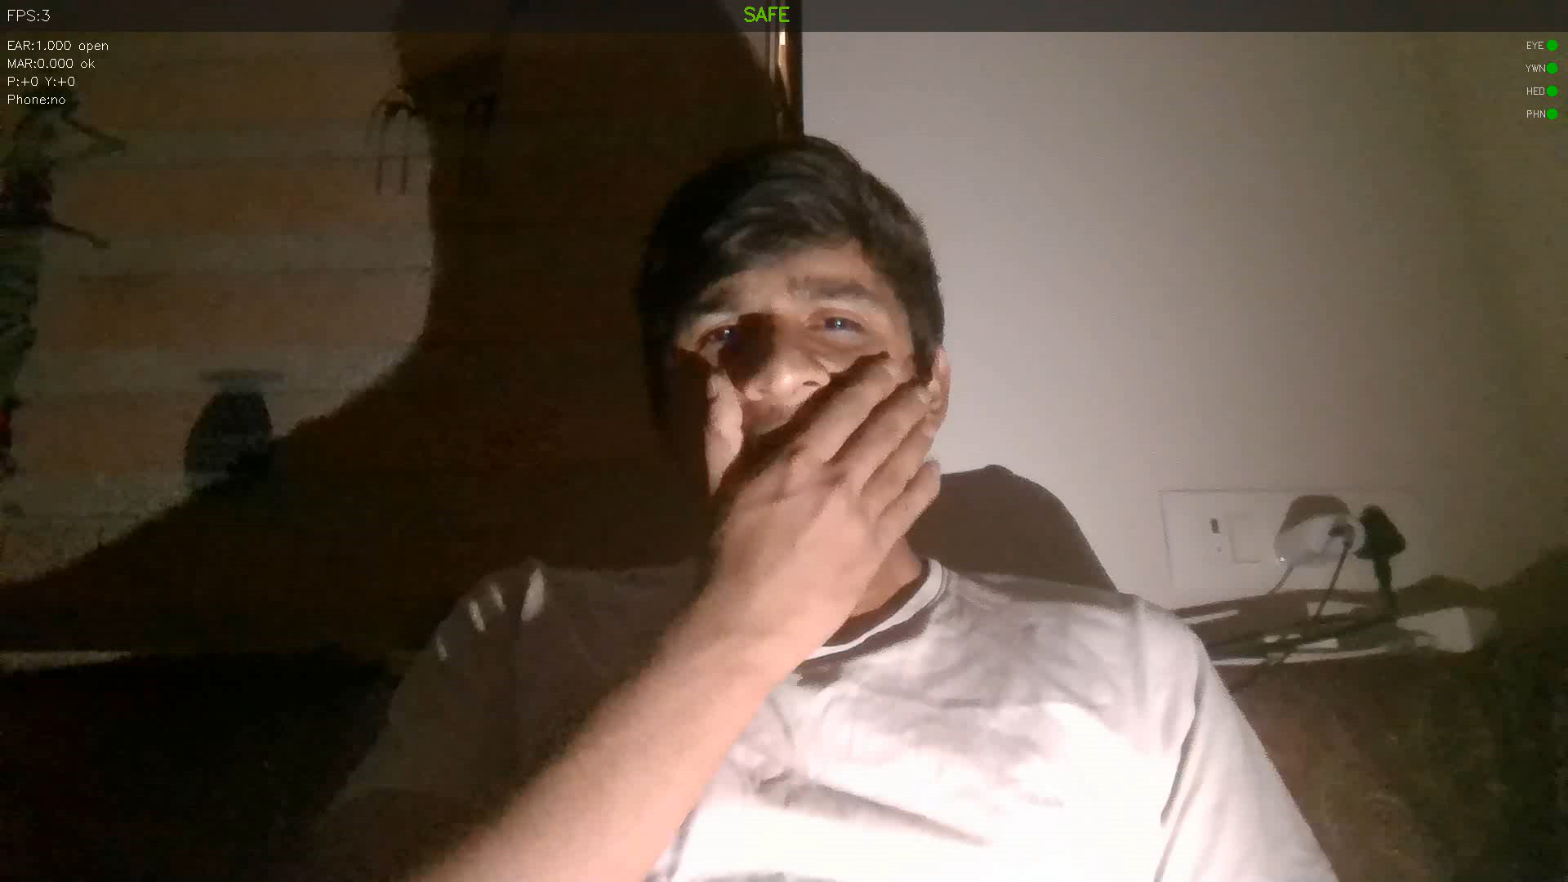
Output

Slide 10
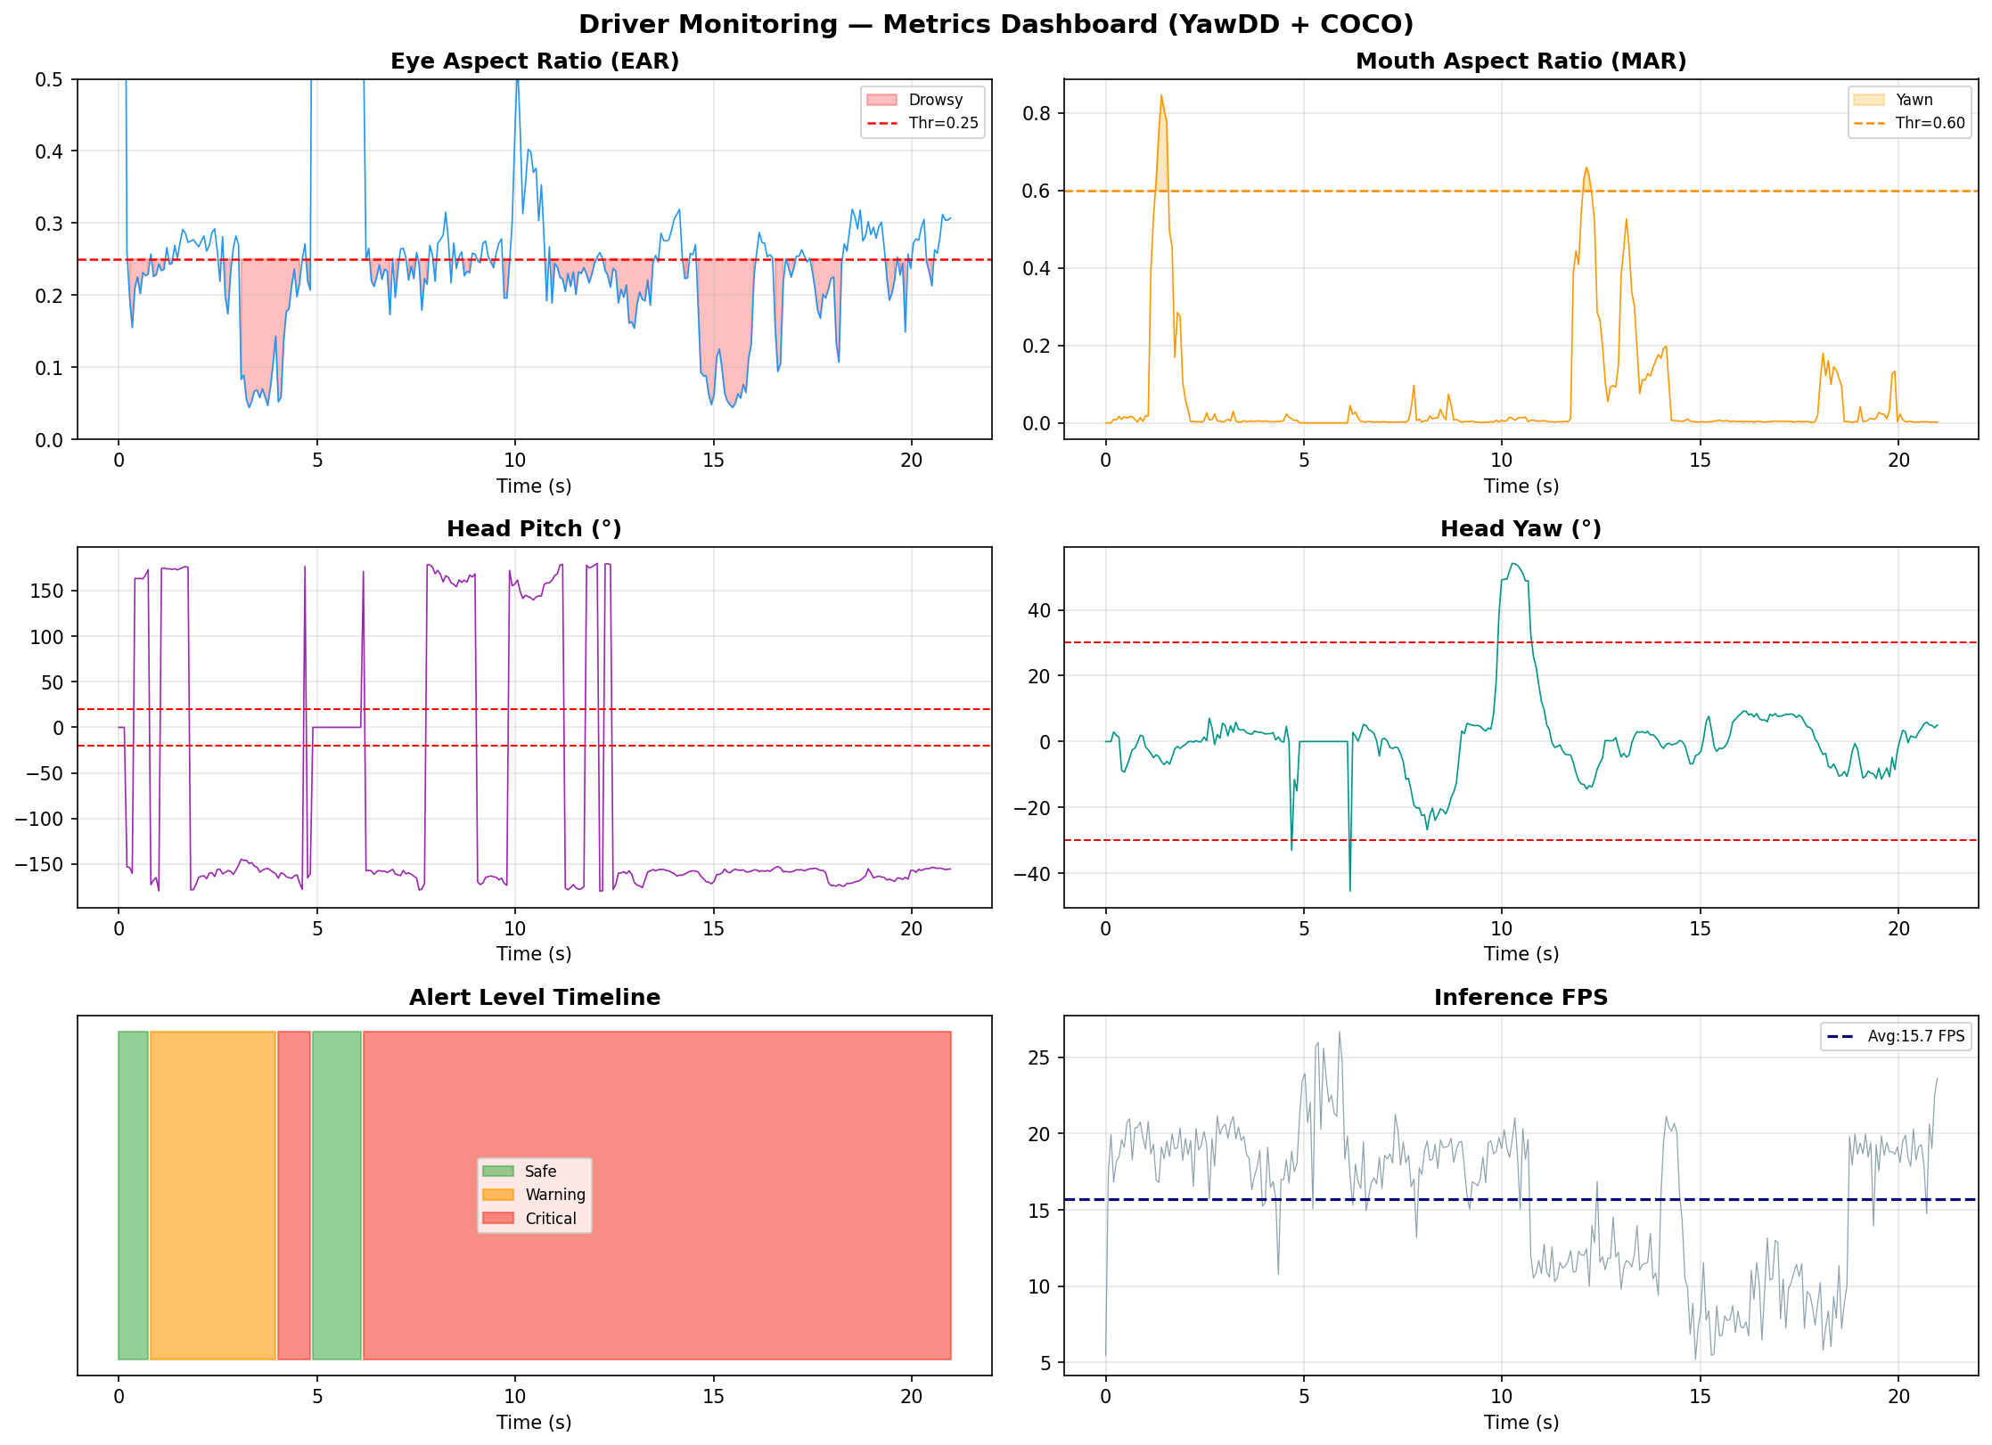
Output Metrics

Slide 11
Impact
improves Road Safety
Detects drowsiness, distraction, and inattention in real-time
Helps prevent accidents before they happen
Wide Applicability
Can be used in cars, trucks, taxis, and public transport.
Useful for both personal and commercial vehicles
Multi-Signal Accuracy
Uses eye, mouth, head, and phone detection together.
More reliable than single detection systems
Real-Time Alerts
Instant warnings (Safe / Warning / Critical)
Gives driver time to react and correct behavior

Slide 12
Conclusion
Performance Proof
High detection accuracy (~96% critical cases)
Real-time performance (~15 FPS on CPU)
Intelligent Decision Making
Uses fusion of multiple signals
Generates reliable alerts instead of single-trigger errors
Real-World Impact
Can save lives by preventing accidents
Supports safer driving behavior
Multi-signal system reduces false detection

Slide 13
Thank you

