Slide 1
IBM University Engagement Project Submission
“Exploring the Power of Agentic AI with IBM Granite and LangFlow”

Slide 2

Project Tile – Smart Study Generator Agent
Domain of Project – Education
Student Name | Recent Passport Photo | Email ID | Mobile number [WhatsApp]
Himanshu Aggarwal |  | himanshuagg318@gmail.com | 9289483221

Slide 3
Problem Statement -
Problem Statement : Smart Study Generator Agent
The Challenge
Students today face an overwhelming flood of information—lecture notes, textbooks, research papers, YouTube tutorials, and online resources. This content is scattered, unorganized, and often not personalized to their learning pace or style. As a result, students struggle with finding the right study material, summarizing key concepts, and staying exam-ready. Traditional study tools only provide static notes or flashcards, failing to adapt dynamically to student needs. The challenge is to move beyond static resources toward an intelligent, adaptive study companion.
The Objective
Build an agentic AI-powered Smart Study Generator that personalizes and streamlines learning for students. The solution should:
Fuse Learning Resources: Aggregate content from class notes, textbooks, research articles, and online tutorials into structured, easy-to-digest study material.
Enable Multimodal Input: Allow students to upload notes, voice queries, or images (e.g., textbook pages), and generate concise summaries, flashcards, or concept maps.
Create a Predictive & Agentic Layer: Recommend personalized study plans, highlight important topics based on syllabus or past exams, and provide predictive alerts (e.g., “Focus on Topic X—frequently asked in exams”).
Visualize Study Progress: Offer a real-time dashboard showing learning milestones, weak areas, practice quizzes, and performance forecasts.

Slide 4
Proposed Solution -
Proposed Solution - Smart Study Generator Agent
StudyGen AI – Agentic Smart Study Assistant
StudyGen AI is an AI-powered educational assistant built using IBM Granite Models and watsonx.ai.
The system uses multiple specialized AI agents to process study materials, retrieve knowledge, generate summaries, create quizzes, answer doubts, and build personalized study plans.
Key Features:
PDF & Notes Upload
RAG-Based Question Answering
Smart Summaries
Quiz & Flashcard Generation
Personalized Study Planner
Interactive Learning Dashboard
The solution helps students learn faster, revise efficiently, and improve academic performance.

Slide 5
Technology Used
Core Technologies
IBM BOB
IBM watsonx.ai
IBM Granite 4.0 Instruct
Python Flask
FAISS Vector Database
Retrieval-Augmented Generation (RAG)
Bootstrap 5
HTML, CSS, JavaScript

Slide 6
Langflow component Used -
Chat Input- Student queries and commands
File Upload – Component Upload PDFs and notes
Retriever Component – Retrieves relevant content
Vector Store (FAISS) – Stores document embeddings
IBM Granite Agent – Generates intelligent responses
Prompt Component – Controls agent behavior
Chat Output – Displays results to users

Slide 7
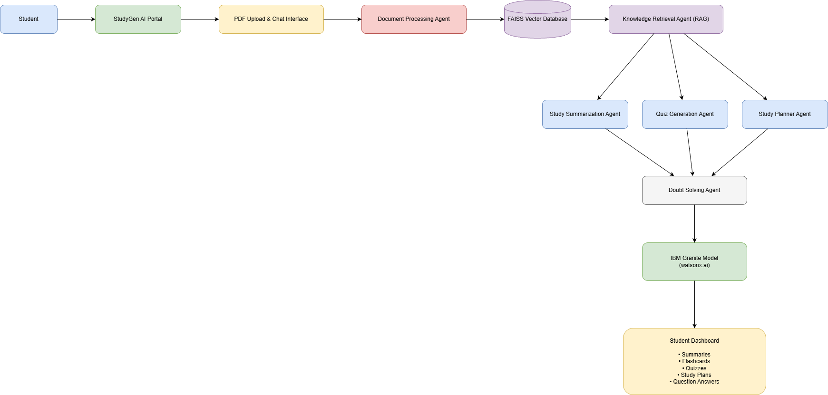
Architecture blueprint

Slide 8

Role of Agentic AI in the solution
Role of Agentic AI in Smart Study Generator Agent
Agentic AI enables StudyGen AI to operate as an intelligent educational assistant rather than a simple chatbot.
The system uses multiple specialized agents that collaborate to perform different tasks:
Document Processing Agent
Knowledge Retrieval Agent
Summarization Agent
Quiz Generation Agent
Study Planner Agent
Doubt Solving Agent
Each agent contributes to a specific learning objective while sharing contextual information with other agents.
This collaborative approach enables personalized learning, adaptive study support, and intelligent academic guidance.

Slide 9
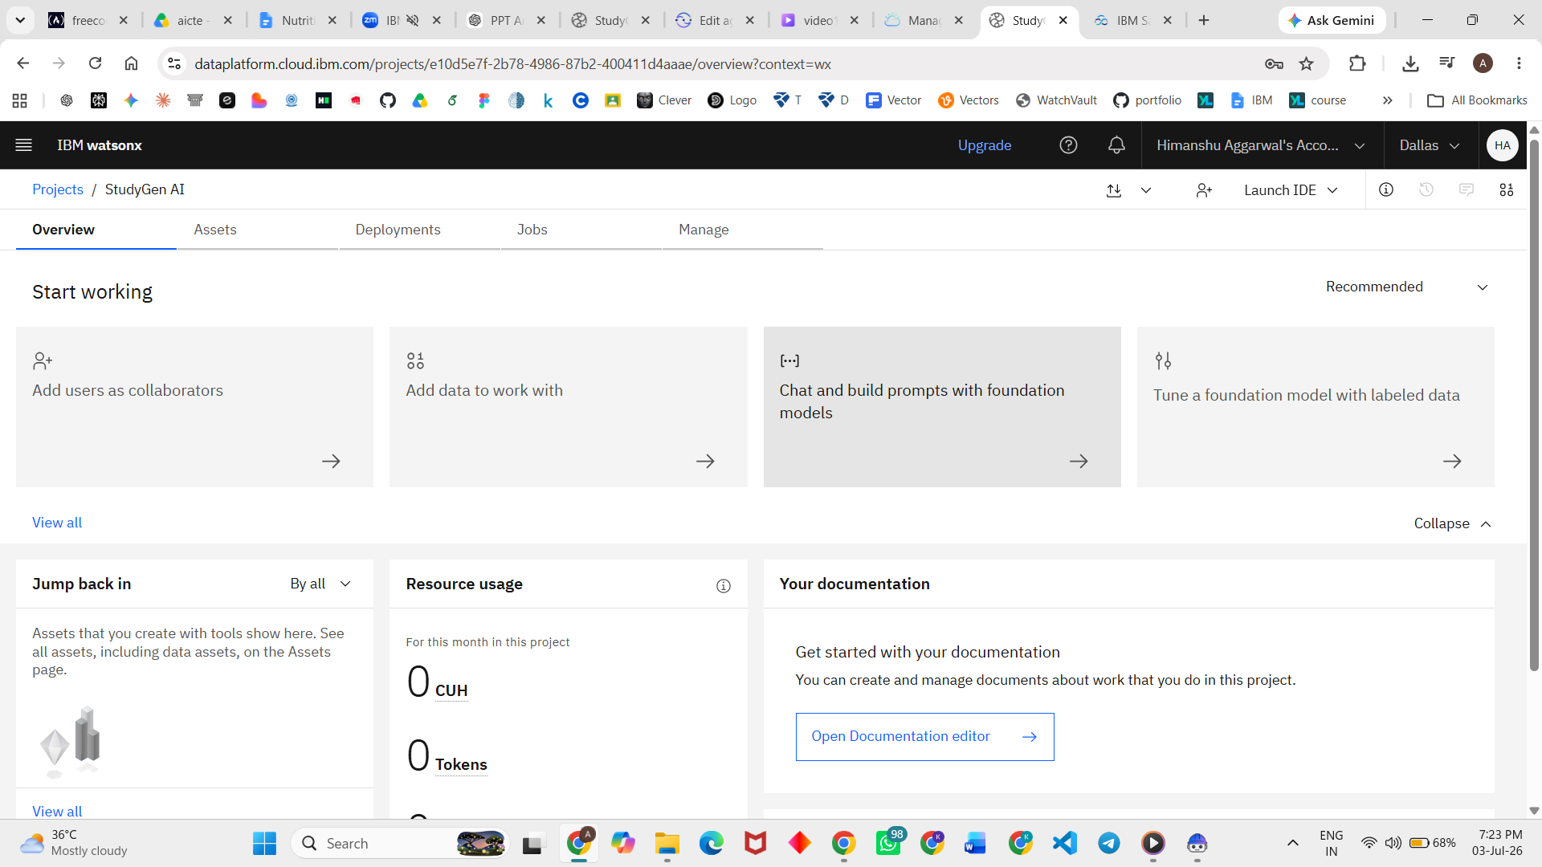
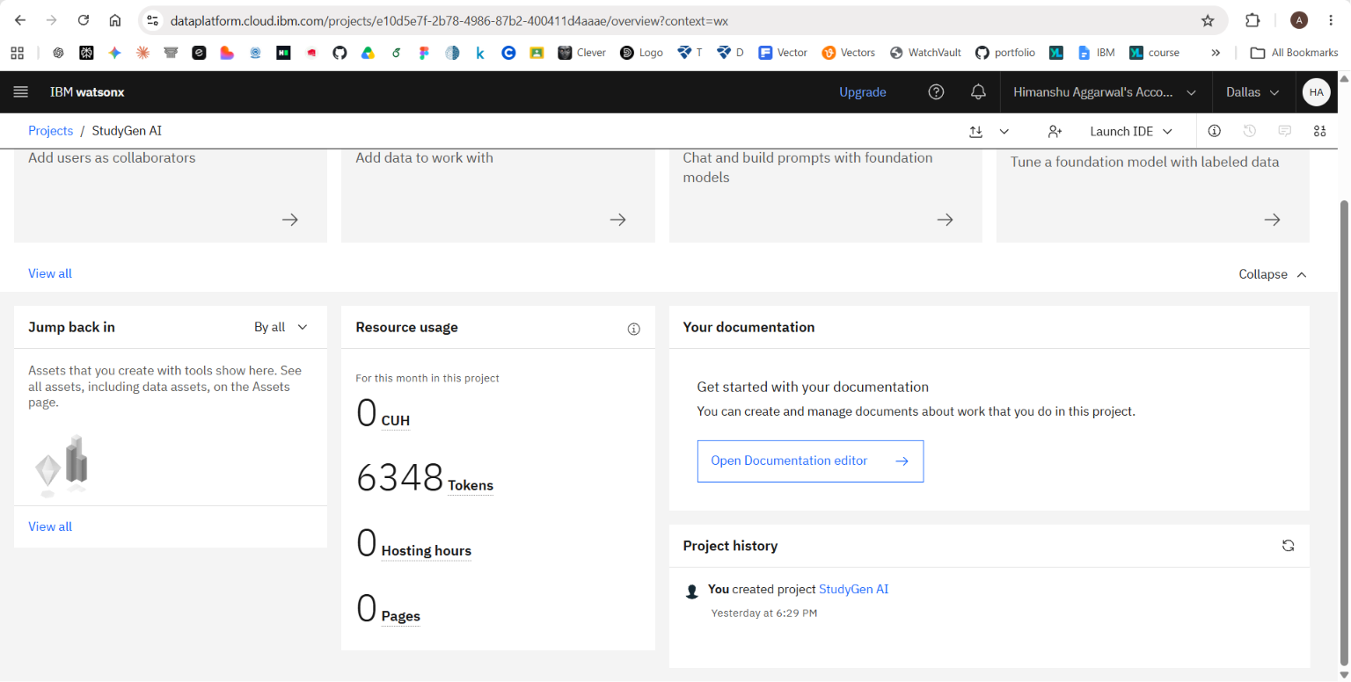
Token Usage
6,348 token are used
Before Prompt
After the Prompt
·
·
·

Slide 10
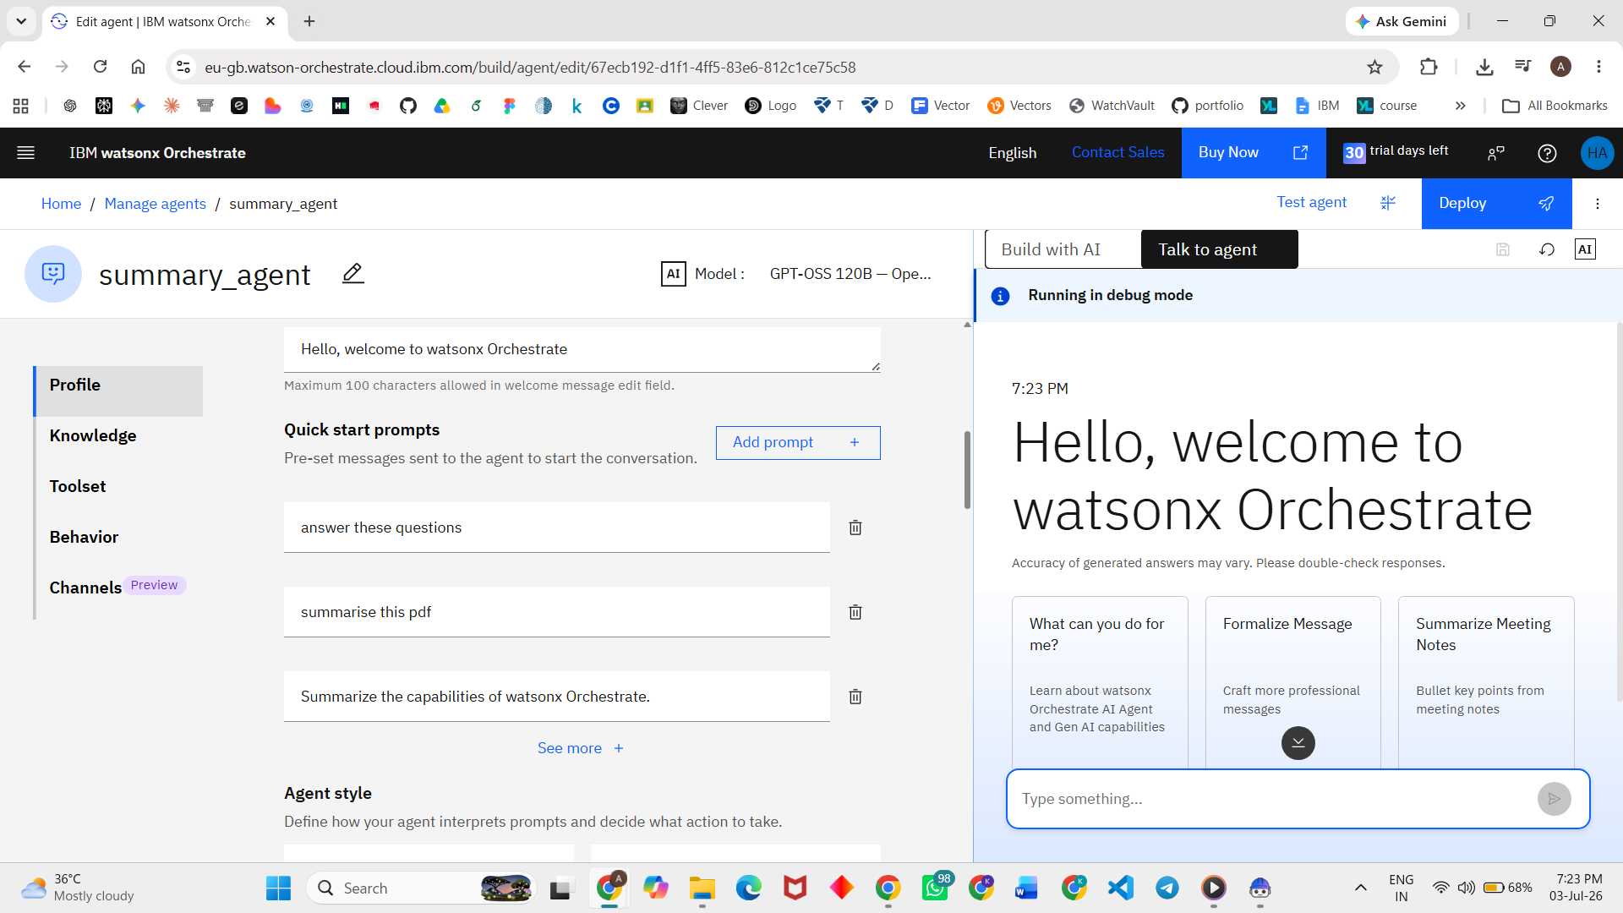
Screenshots

Slide 11
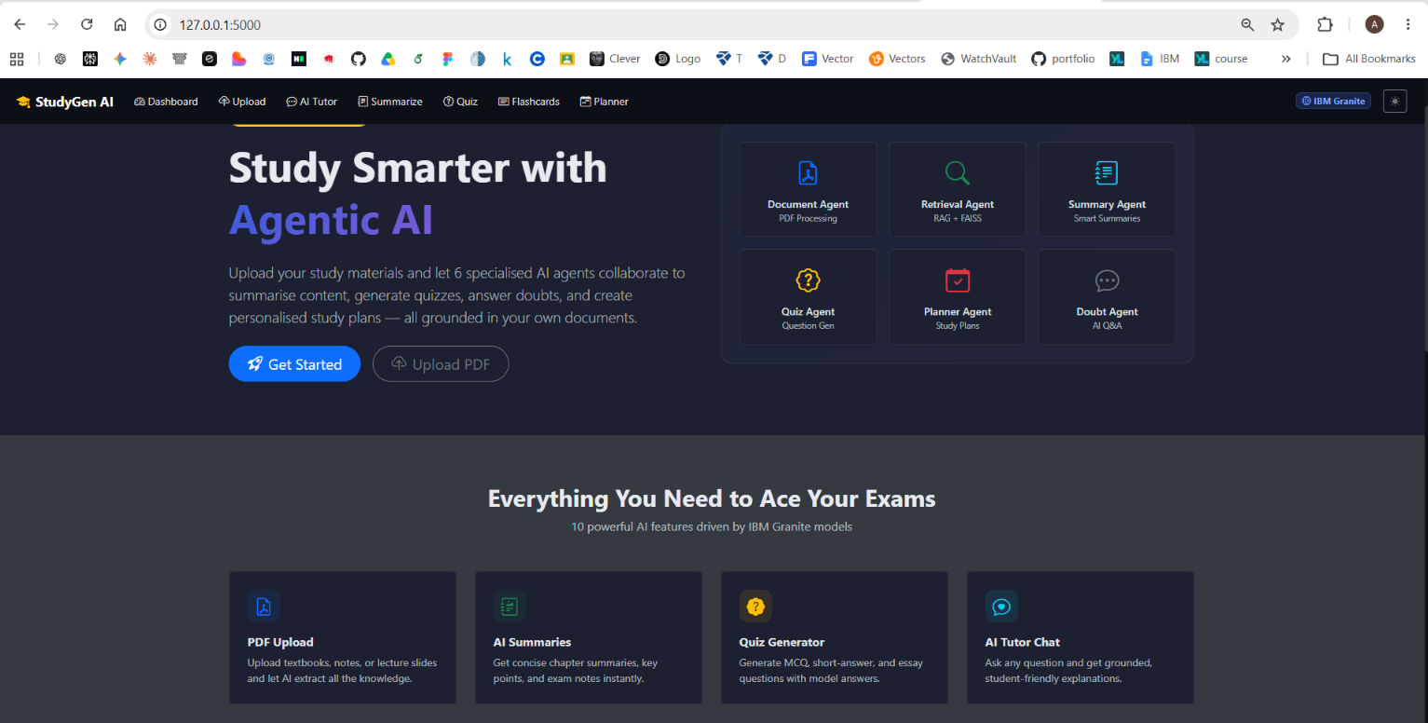
Screenshots

Slide 12
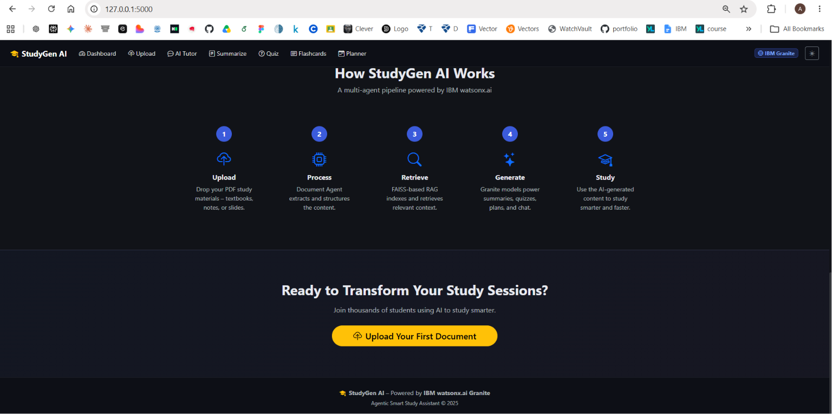
Screenshots

Slide 13
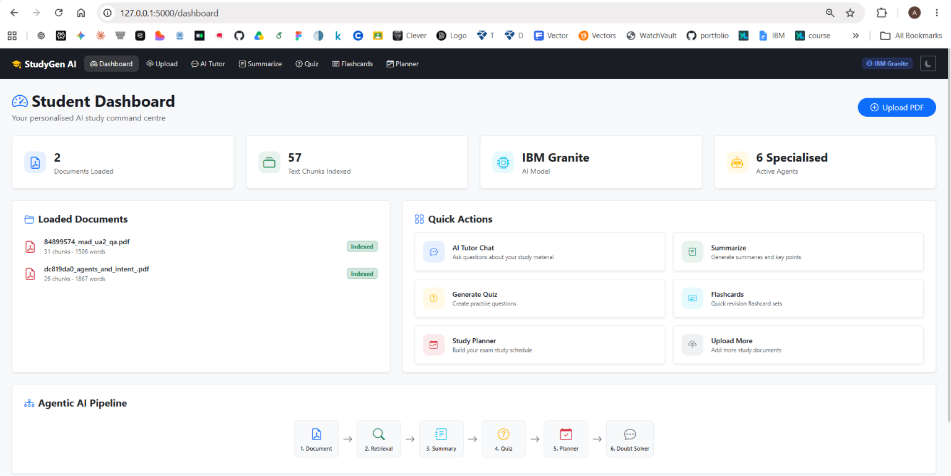
Screenshots

Slide 14
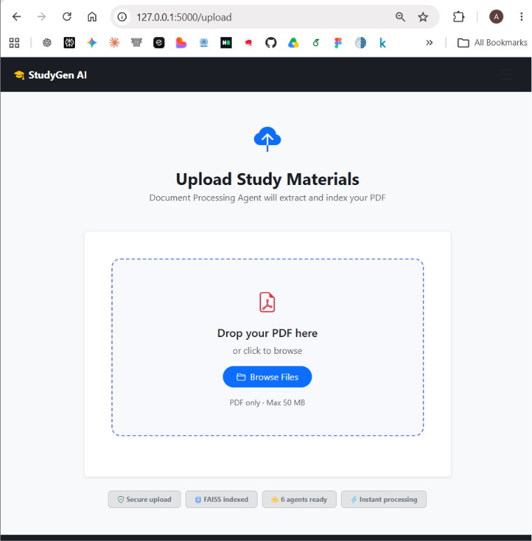
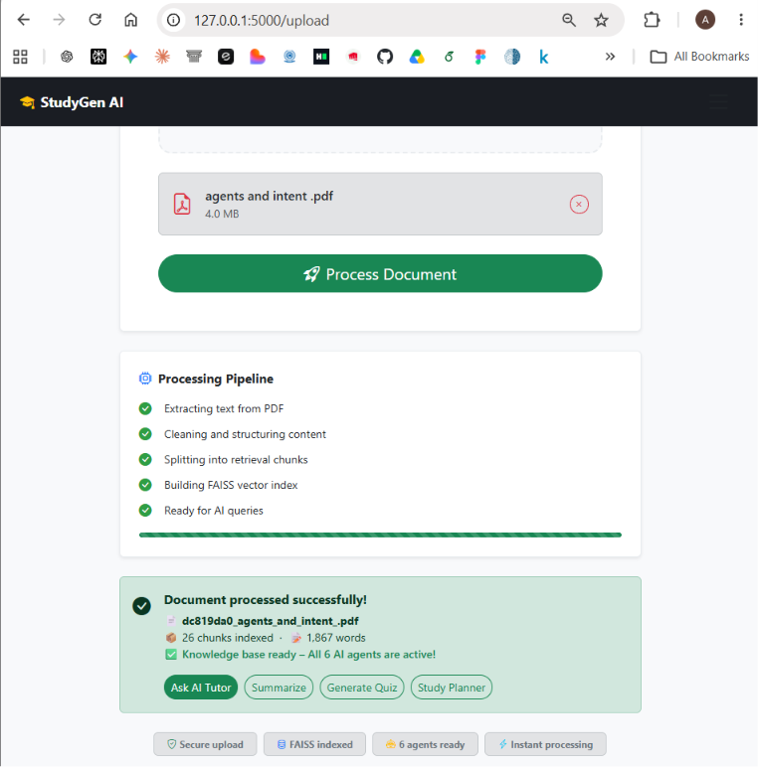
Screenshots

Slide 15
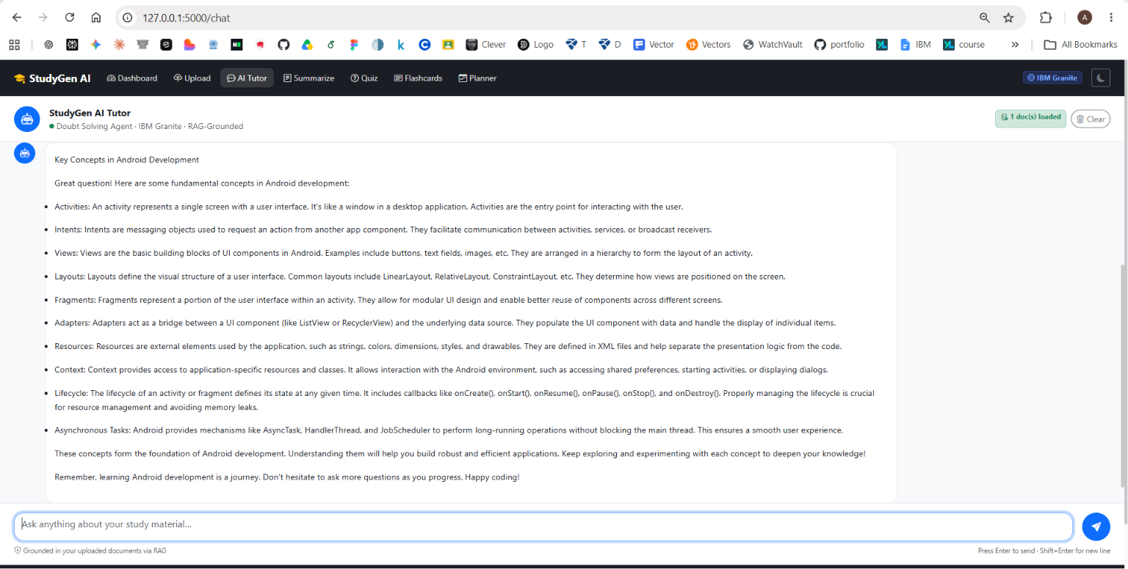
Screenshots

Slide 16
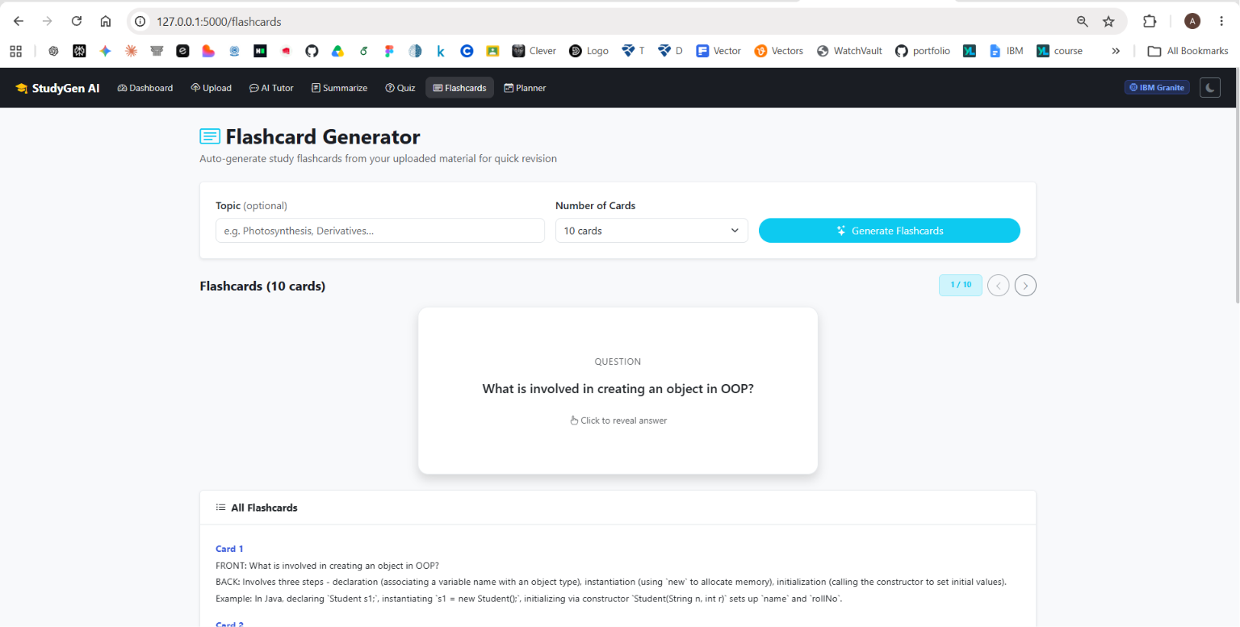
Screenshots

Slide 17
Novelty and Uniqueness
Key Innovations
Multi-Agent Learning Assistant
RAG-Based Knowledge Retrieval
Personalized Study Planning
Automated Quiz & Flashcard Generation
Context-Aware Doubt Resolution
Exam-Focused Revision Support
Adaptive Learning Recommendations
IBM Granite-Powered Reasoning
Subject Independent Architecture
Student-Centric Interactive Dashboard
StudyGen AI acts as a complete AI-powered study companion rather than a traditional educational chatbot.

Slide 18
Git Hub Link
Github URL – https://github.com/Himanshu-Aggarwal30/StudyGen-AI
Github repository includes:-
app.py file
problemstatement.pdf file
HimanshuAggarwal.pptx file
Requirements.txt file
Readme.md file
Other project related files

Slide 19
Future Scope
1: Voice-Based AI Tutor & Multilingual Learning
StudyGen AI can be enhanced with a voice-enabled AI tutor that allows students to interact using natural speech instead of typing. The system can support multiple languages, enabling students from diverse backgrounds to learn in their preferred language. Voice explanations, real-time doubt resolution, and multilingual summaries will improve accessibility and create a more personalized learning experience.
2: Predictive Learning Analytics & Exam Readiness Assessment
Future versions of StudyGen AI can incorporate advanced learning analytics to monitor student performance, identify weak topics, and predict exam readiness. By analyzing quiz results, study habits, and syllabus coverage, the system can provide personalized recommendations, prioritize important topics, and generate predictive alerts such as "Focus on Machine Learning Algorithms – High probability of appearing in upcoming exams." This will help students prepare more effectively and improve academic outcomes.
·
·

Slide 20
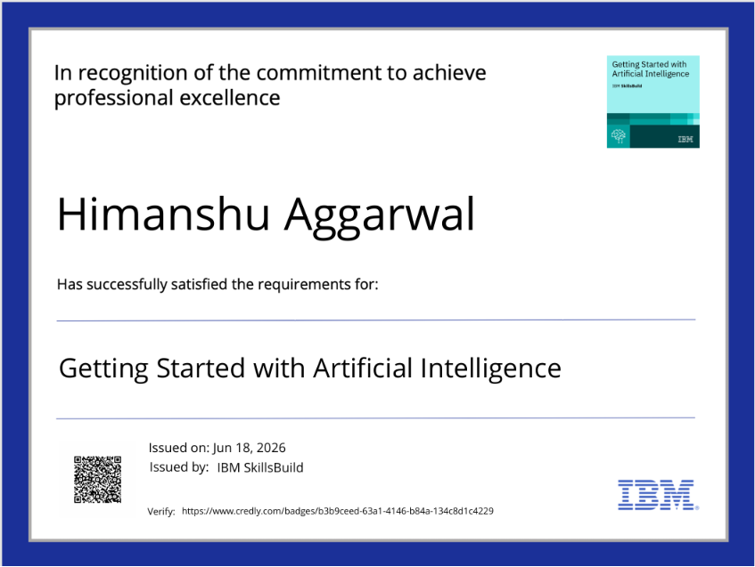
Certificates Earned:

Slide 21
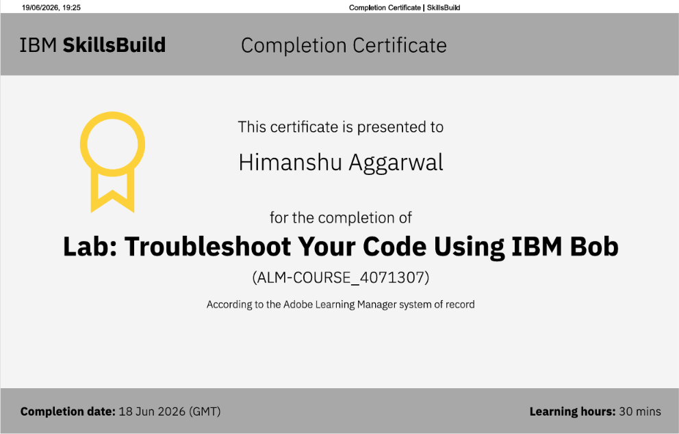
Certificates Earned:​

Slide 22


