Slide 1


TATHASTU
TATHASTU is a gesture controlled virtual mouse and ai enabled chatbot

Slide 2


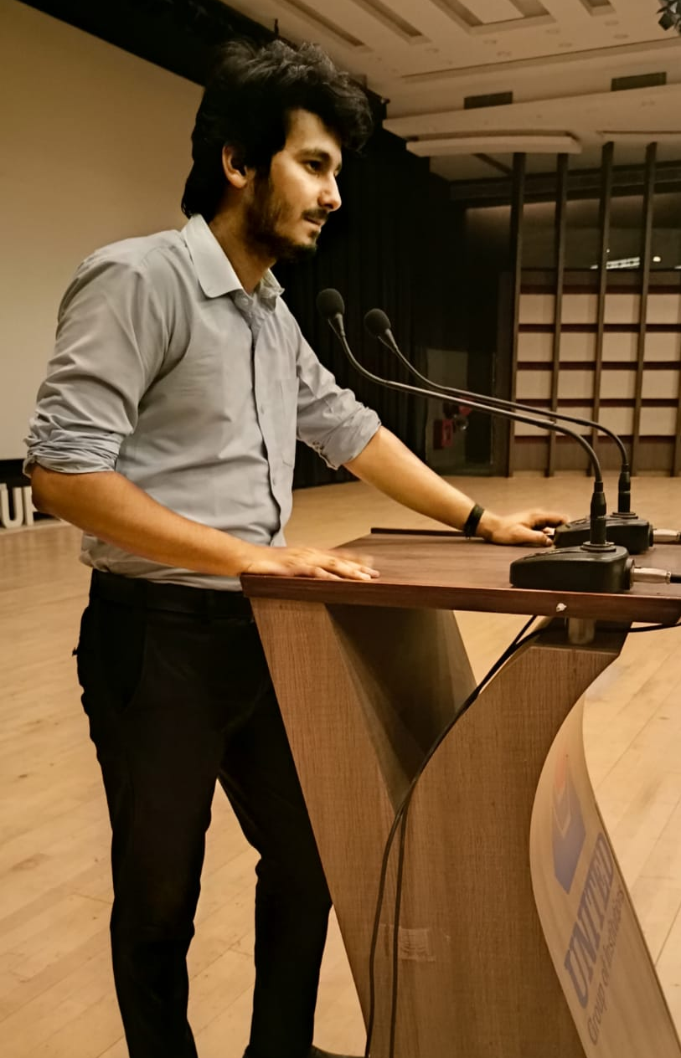
TATHASTU-TEAM
Harsh
Gupta
Anshul Rawat
Himanshu Dwivedi

Slide 3
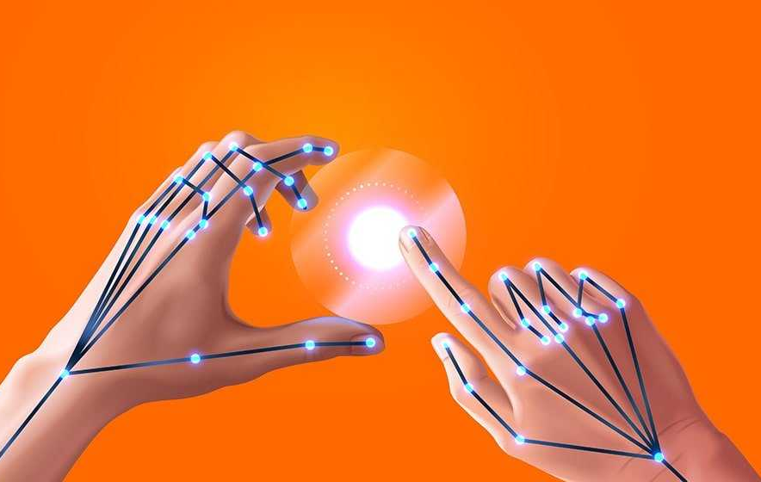
Abstract
This project takes forward the approach of the Human Computer Interaction (HCI) by controlling cursor movement through hand movement and voice commands using a real-time camera and microphone.
Virtual mouse acts as a contactless mouse, thus can be more useful and time saving.
Specially abled people with some problem in their hands can use this virtual mouse to control the mouse functions in the computer.
Can be used for distance controlling of systems in robots, classrooms, war emunisions, AR and VR game, etc.

Slide 4
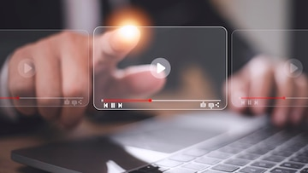
Objective
Design for operation of a mouse with the help of a webcam which is responsible for capturing the video in real-time.
Convert hand gesture/motion into mouse function and the cursor is set to a particular screen position. The Virtual Mouse application is programmed to detect the position of ﬁngertips and knuckles where it will be set as the position of the mouse pointers.
Develop a multi user independent speech recognition system that captures voice in real-time with the help of a microphone and is able to retrieve folders, sub-folders, documents, copy, paste, left click, right click and double click by taking voice command and checking its validity.
Design a voice controlled mouse system that is integrated with the gesture controlled system.

Slide 5

In 1990, an early hardware-based system was introduced by Quam; in this system, it was mandatory for the user to wear a DataGlove.
Zhengyou et al. (2001), proposed an interface system named Visual Panel that utilize arbitrary quadrangle-shaped planar object as a panel to allow the user to use any tip-pointer tools.
Kamran Niyazi et al. (2012), proposed color tracking mouse stimulation. . The said system tracks colour tapes on the user fingers by utilizing the computer vision technology.
Kazim Sekeroglu (2010), the system requires three fingers with three colour pointers to simulate
the click events.
Chu-Feng Lien (2015), proposed method that requires only finger-tips to control the mouse cursor and clIck events. The proposed system doesn't requires hand-gestures nor colour tracking in order to interact with the system, instead it utilize a feature name Motion History Images(MHI).
S. Shriram(2021);the model makes use
RELATED WORK

Slide 6
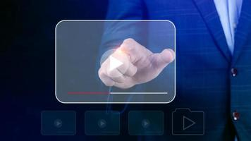

01 | Move Cursor
02 | Left Click
03 | Right Click
04 | Double Click
05 | Scrolling
06 | Drag and Drop
07 | Multiple Item Selection
08 | Volume Control
09 | Brightness Control
Features of
Virtual mouse

Slide 7
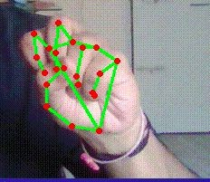
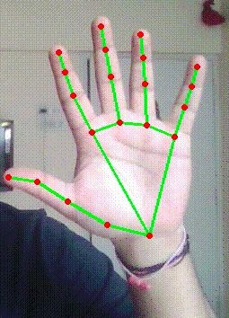
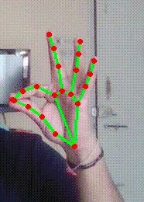
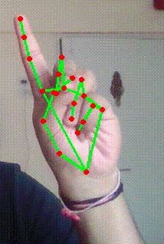
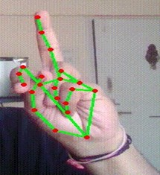
Features of
Virtual mouse
Volume/Brightness
Control
Right Click
Left Click
Drag and Drop

Slide 8
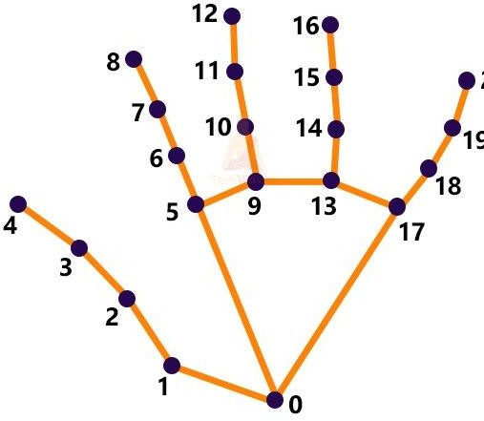
Methodology for gesture control
Computer Vision technology is applied for Object identiﬁcation and object video capturing in BGR format which is done by OpenCV.
Captured hand object processed by MediaPipe using two models-
Palm Detection Model
Hand Landmark Model
MediaPipe renders 21 coordinates located on a detected hand in a 2.5D space as an output.

Slide 9
Subsequently ids are assigned to each ﬁnger of the right hand in the rendered output landmark.
Corresponding coordinated of all the required ids are calculated and different operations are performed based on the distances and angles between the points
In order for the mouse to perform a left click:
In the ﬁrst frame, the index ﬁnger with Tip ID 1 and the middle ﬁnger with Tip ID 2 must be up, followed by Index Finger (Tip Id 1) down and Middle ﬁnger (Tip id2) up in the second frame, with both producing an angle greater than 33.5°.
Methodology for Gesture Control

Slide 10
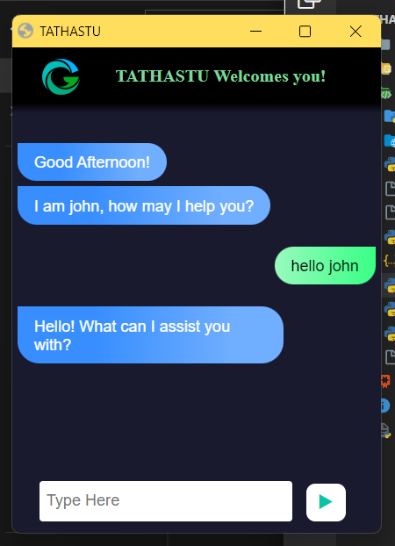

Methodology for Voice controller
Launch John on your monitor (John - name of our voice assistant)
Give command to be followed.
Speech recognition library detects your speech and Jhon will perform the operations as given in the next slide.

Slide 11
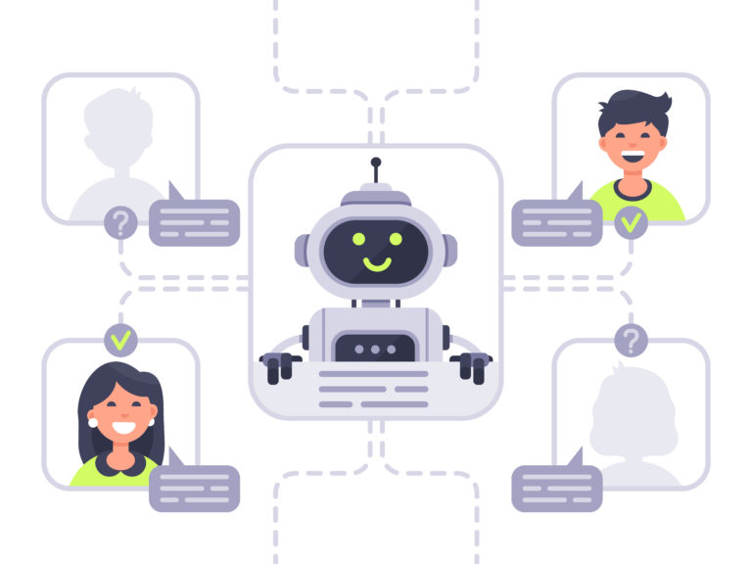
Features of
ChatBot
01 | Launch/stop gesture recognition
02 | Google search
03 | Asking Joke
04 | Copy and paste
05 | Exit

Slide 12
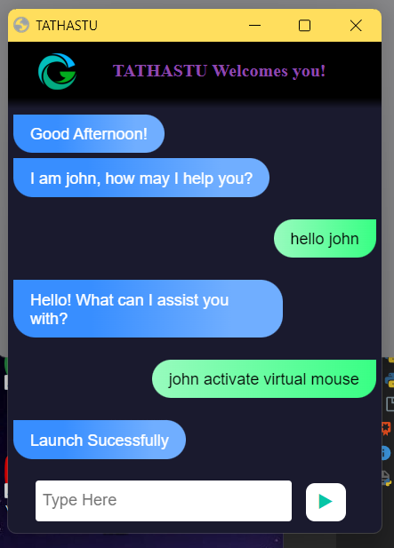
FEATURES OF
CHATBOT

Slide 13
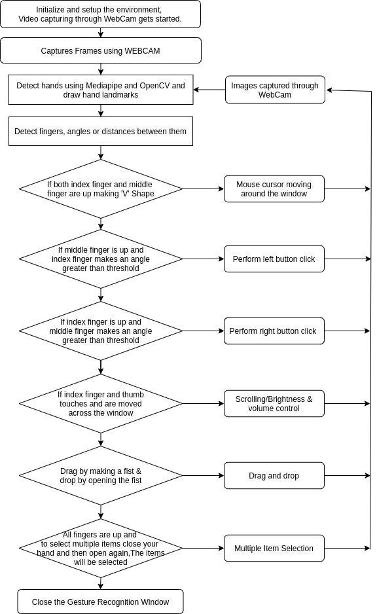
Flow-Chart
Gesture Control

Slide 14
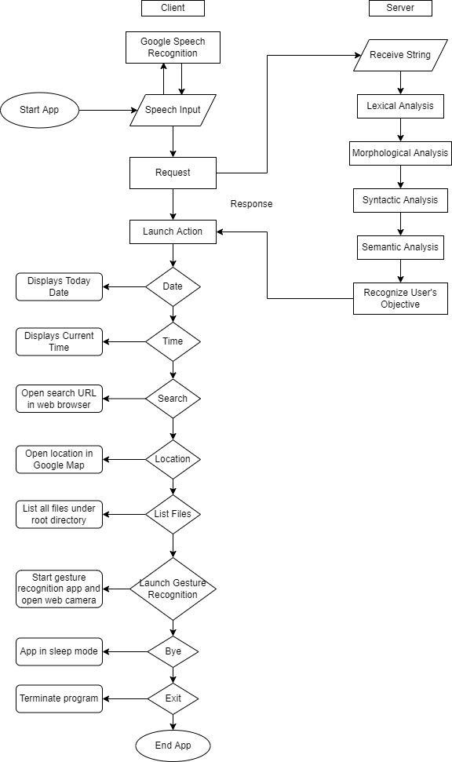
Flow Chart-
Voice Controller

Slide 15
Can reduce physical stress on the body that is responsible for causing back pain, weak eyesight, posture defect, etc.
Can be used for distance controlling of systems in robots, classrooms, war emunisions, AR and VR game, etc.
Amidst the COVID-19 situation when it is unsafe to use the devices by touching, the proposed virtual mouse can be used to control the PC mouse functions hand free.
Virtual mouse can be used to play virtual reality and augmented reality based games without the wireless or wired mouse devices
Persons with some problems in their hands can use this virtual mouse to control the mouse functions in the computer
APPLICATION

Slide 16
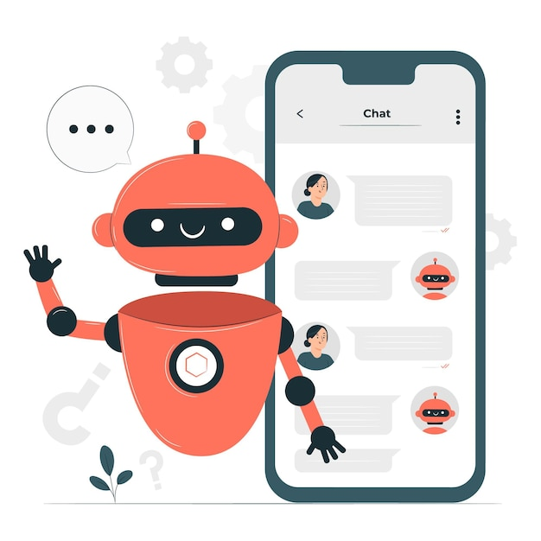
FUTURE SCOPE
Virtual Mouse will soon be introduced to replace the physical computer mouse to promote convenience while still being able to accurately interact and control the computer system.
More features such as enlarging and shrinking window, closing windows, etc can be added by using palm and multiple ﬁngers.
Better efﬁciency of gesture recognition can be achieved when it can detect hand gestures in different types of lightings, different hand complexions and distance from camera.
Virtual mouse can be designed to perform other complex tasks such as doing calculations by verbal commands etc.
Voice recognition can be more efﬁcient if it can correctly process different accents and can ignore background noise.

Slide 17
Web Cam: 1.3 megapixel resolution
Processor : Core2Duo (2nd generation)
Main Memory : 2GB RAM
Hard Disk : 320GB
Microphone
Python.
OpenCV
MediaPipe
HARDWARE & SOFTWARE REQUIREMENTS (MINIMUM)

Slide 18
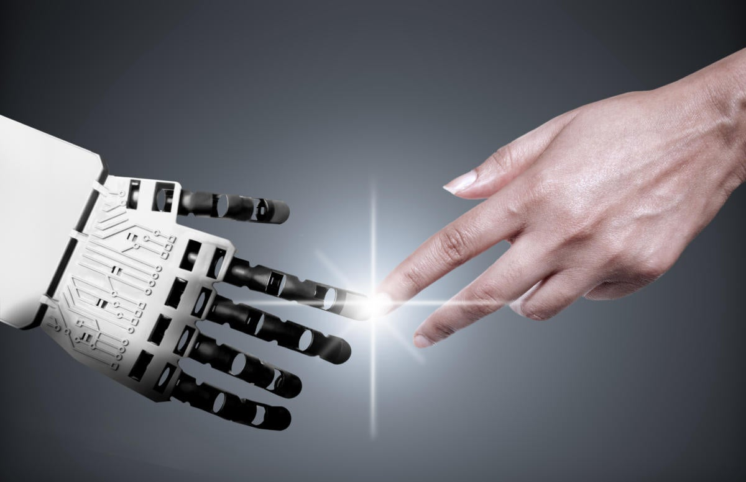
CONCLUSION
The main objective of the virtual mouse system is to control the mouse cursor functions by using hand gestures and voice commands instead of using a physical mouse.
The proposed virtual mouse system performs well and has greater accuracy compared to the existing models and also the model overcomes most of the limitations of the existing systems.
Virtual mouse can be used for real-world applications. Since the proposed mouse system can be used virtually using hand gestures and voice commands, it can be useful in preventing the spread of COVID-19. Virtual mouse can be very useful to specially abled people
It can help in simplifying user interactions with personal computers and hardware systems. It can create possibility of distance controlling of robots, AR and VR etc.

Slide 19
THANK YOU

