Slide 1
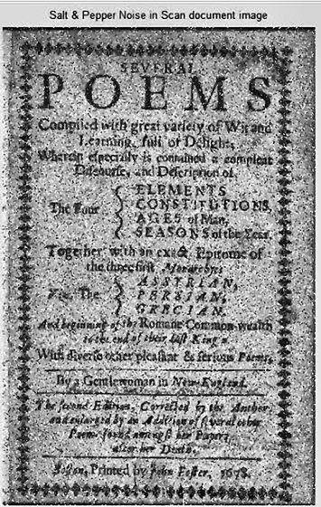
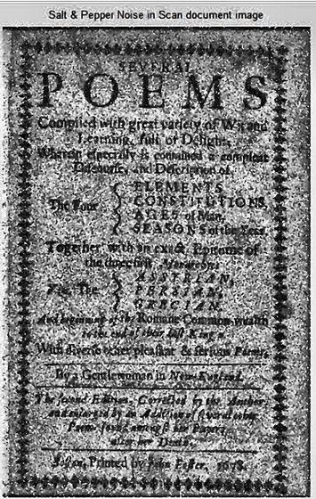
IMAGE & VIDEO PROCESSING · 702EX0E020 · SEMESTER V
SmartScan Studio PRO
Cleaning up damaged document scans with classical image processing, step by step
Parth Chaturvedi (E235) · Divyansh Karel (E236) · Himanshu Garg (E250)
MPSTME, NMIMS University
https://github.com/Himanshugarg2401/SmartScan-IVP-Studio
Input scan
Restored output (2×)

Slide 2
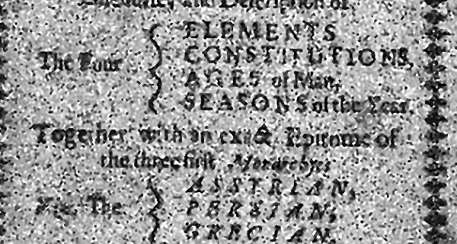
THE PROBLEM
What is wrong with this scan?
Three separate defects, each needing a different tool
Salt-and-pepper noise
1
Random black and white specks from the sensor or paper. They sit on top of the letters and break strokes apart.
Uneven background
2
Paper brightness drifts across the page, so no single cut-off separates ink from paper everywhere.
Same crop of the test scan used throughout this deck
Low contrast ink
3
Text grey levels sit close to the paper level, so letters look faded and soft.
Goal: remove noise, even out contrast and sharpen strokes without destroying the letter shapes.

Slide 3
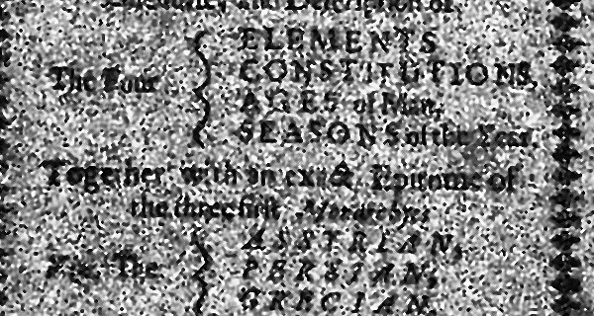
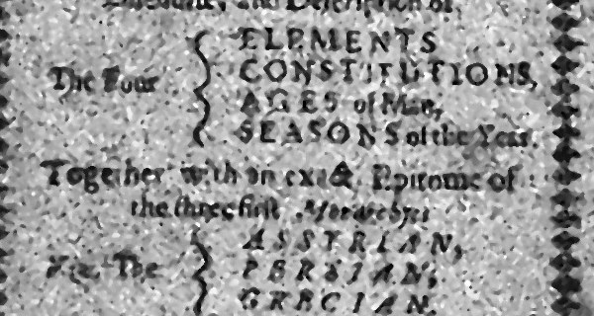
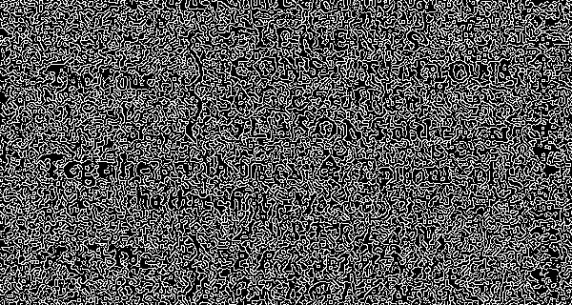
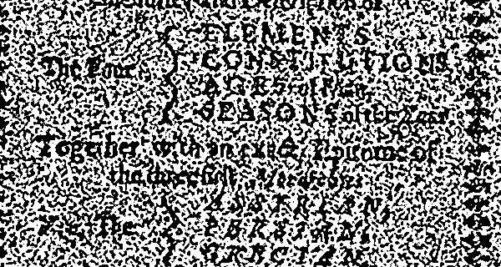
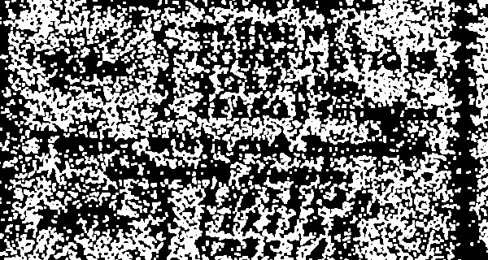

THE BIG PICTURE
Seven stages from raw scan to restored page
Each stage is a unit of the syllabus, and each output is a card in the web app
UNIT 1-2
UNIT 3-4
UNIT 5
UNIT 6
UNIT 7
MORPH + DFT
MASTER
Represent
Enhance
Filter
Edges
Segment
Clean + analyse
Restore
›
›
›
›
›
›
Gray + colour spaces
Gamma, histograms
Remove noise
Find stroke outlines
Ink vs paper
Shapes and frequencies
2× HD output
How it connects: every stage starts from the same grayscale image. Edge, morphology and threshold steps then reuse the CLAHE-sharpened version. The master engine works on the original colour image.

Slide 4

UNITS 1 & 2 · REPRESENTATION
Where does the text actually live?
In brightness (luminance), not in colour
WHAT HAPPENS
A colour pixel has 3 numbers (24 bit). Grayscale keeps one number (8 bit) as a weighted sum of R, G, B. Green gets the most weight because our eyes are most sensitive to it.
WHY IT MATTERS
Grayscale 8-bit luminance
HSV Value brightness channel
Letters are visible in the luminance channel. The chroma channel (Cr) is almost flat, so colour can be left alone while only brightness is sharpened. That is the idea behind the LAB step in the master engine.
Y = 0.299 R + 0.587 G + 0.114 B
YCrCb: Y luma, carries the text
YCrCb: Cr chroma, nearly flat

Slide 5
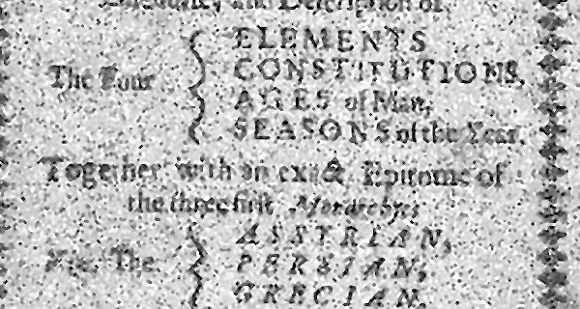
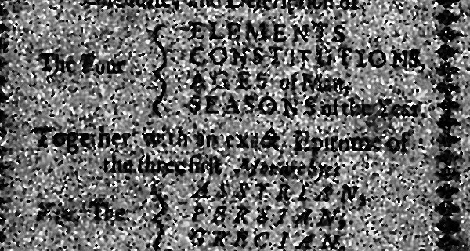
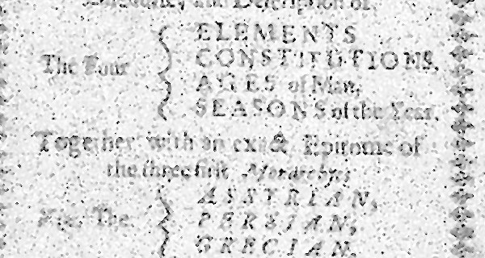
UNIT 3 · POINT PROCESSING
Change each pixel on its own
The output depends only on that pixel's input value
WHAT HAPPENS
Every gray level r is mapped to a new level s by one formula. A power law with γ below 1 lifts dark tones, γ above 1 pushes bright tones down.
ALSO IN THE APP
Digital negative s = 255 − r, contrast stretch (map min..max to 0..255) and intensity slicing of the 100-180 band.
Original reference
γ = 0.5 dark areas lifted
Gamma: s = c · r^γ
Log: s = c · log(1 + r)
γ = 2.0 highlights suppressed
Log expands dark range

Slide 6
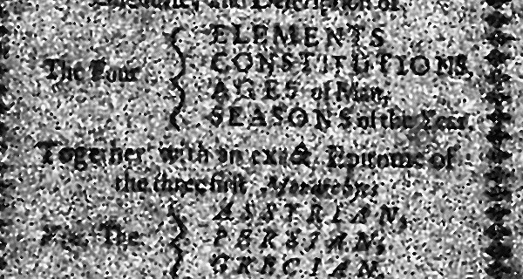
UNIT 4 · HISTOGRAMS
Spread the grays out, locally
Global equalization vs CLAHE
GLOBAL EQUALIZATION
Uses the cumulative histogram to stretch gray levels over the full range. One mapping for the whole page, so noise in flat paper gets stretched too.
CLAHE
Original low contrast
Global HE whole-page mapping
Splits the page into 8×8 tiles, equalizes each tile, and clips tall histogram bars at 2.0 so noise is not amplified. Tile borders are blended by bilinear interpolation.
CLAHE clip 2.0, 8×8 tiles
Histogram of each result (% of pixels per bin)

Slide 7

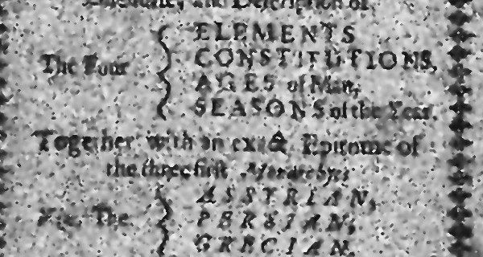
UNIT 5 · SPATIAL FILTERING
Why the median beats the average for specks
A tiny worked example
THE 3×3 EXAMPLE
Window values: 12, 14, 255, 13, 11, 0, 15, 12, 14. The 255 and 0 are noise.
MEAN (Gaussian-like)
346 ÷ 9 ≈ 38. The speck smears into its neighbours.
Noisy input specks on letters
Gaussian 7×7 specks blurred, text softened
MEDIAN
Sort, take the middle: 0, 11, 12, 12, 13, 14, 14, 15, 255 → 13. The speck vanishes.
Bilateral = spatial distance × intensity difference, so it smooths flat paper but keeps edges
Median 5×5 specks removed, edges kept
Bilateral edge-preserving smoothing

Slide 8
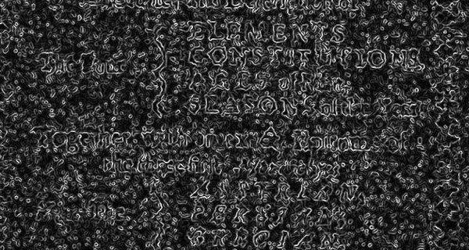

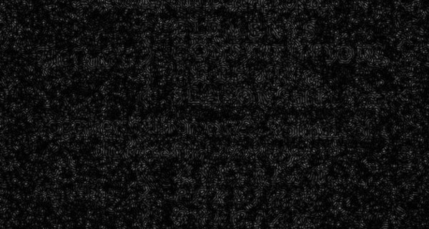
UNIT 6 · EDGES
Finding where brightness changes fast
Gradient operators measure how steep the change is
FIRST ORDER
Sobel and Prewitt combine Gx and Gy masks into a gradient magnitude.
SECOND ORDER
LoG marks zero crossings of the second derivative. It needs a blur first or noise explodes.
Sobel magnitude, noise shows up
Prewitt unweighted masks
CANNY
Gradient, thin to 1 pixel, keep strong edges plus weak ones linked to them (50 / 150).
|∇f| = √(Gx² + Gy²)
LoG second derivative
Canny thin, connected edges

Slide 9
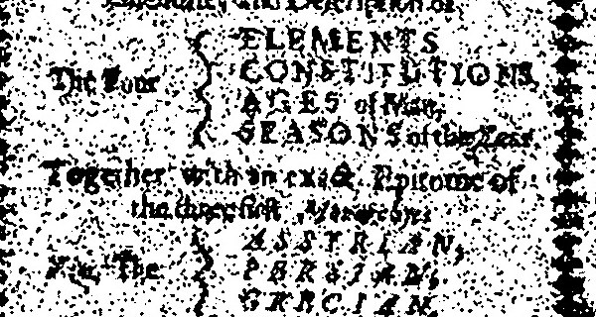
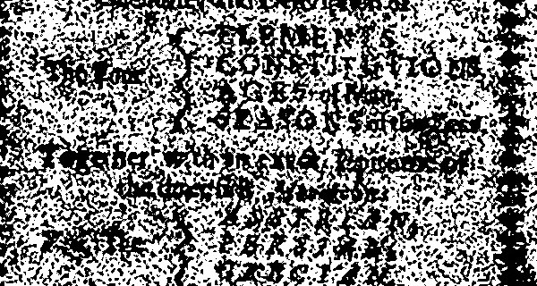
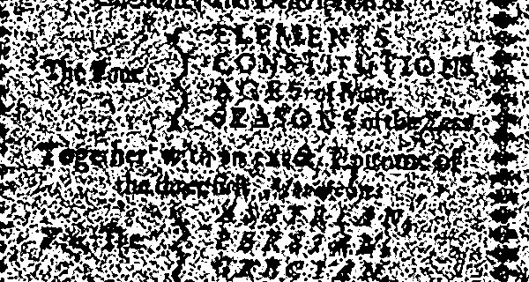
UNIT 7 · SEGMENTATION
Deciding what is ink and what is paper
One global cut-off vs a cut-off for every neighbourhood
GLOBAL
A fixed T = 127, or Otsu, which picks the T that best separates two groups. Fine when lighting is even, fails when shadows drift across the page.
LOCAL ADAPTIVE
Fixed T = 127 simplest baseline
Otsu global, automatic T
Each pixel is compared with a Gaussian-weighted average of its 31×31 neighbourhood, minus 10. Shadows move the average too, so text survives.
Otsu: maximize σB²(t) = ω₀ω₁(μ₀ − μ₁)²
Adaptive: T(x,y) = local mean − C
Adaptive Gaussian 31×31 window, C = 10
Adaptive Mean plain average window

Slide 10
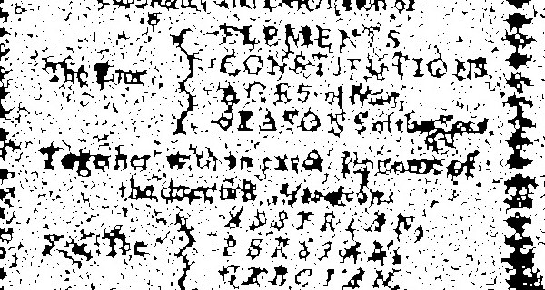
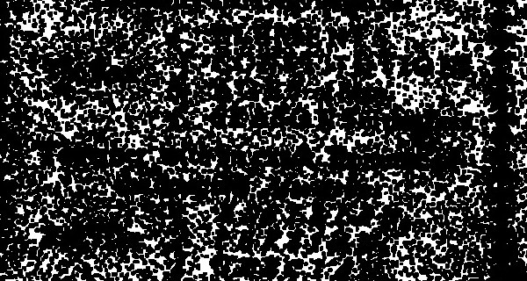

MORPHOLOGY
Reshaping the binary text with a small stencil
A 3×3 structuring element slides over the image
THE BASICS
Dilation grows white regions, erosion shrinks them. Opening (erode then dilate) deletes small specks. Closing (dilate then erode) fills small gaps.
WATCH THE DIRECTION
Dilation white grows, ink thins
Erosion white shrinks, ink thickens
Our text is dark on white. Dilating the white background therefore makes the ink look thinner, and erosion makes it look bolder.
Opening: A ∘ B = (A ⊖ B) ⊕ B
Closing: A • B = (A ⊕ B) ⊖ B
Opening removes isolated specks
Closing bridges small gaps

Slide 11
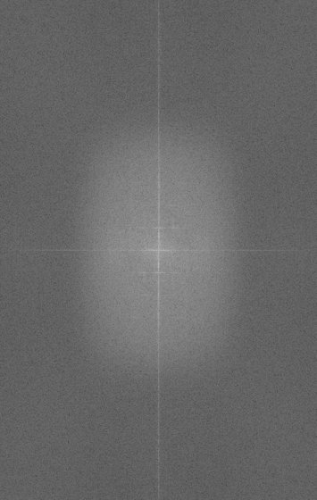
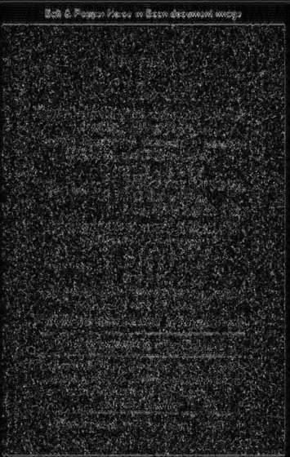
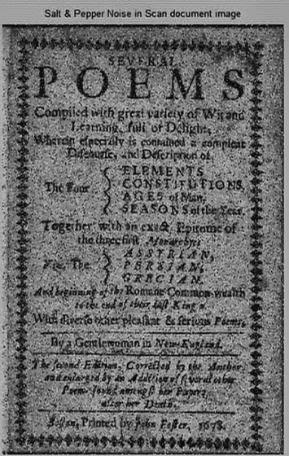
FREQUENCY DOMAIN
Seeing the image as waves
The 2D DFT splits an image into slow and fast variation
WHAT HAPPENS
The FFT turns the page into frequencies. After centring, low frequencies (smooth paper) are near the middle and high frequencies (edges, noise) are far out.
FILTERING
Zero a circle in the middle and invert: only edges remain (high-pass). Keep only the circle: a blurred page (low-pass).
Log spectrum centred
High-pass edges only
Low-pass smooth, blurred
Spectrum = 20 · log(|F(u,v)| + 1)

Slide 12
THE MASTER ENGINE
Six steps from noisy scan to 2× restored page
Every step is chosen to fix one defect without hurting the others
1
2
3
4
5
6
2× Lanczos-4 upscale
Median 3×3
LAB split
Bilateral
CLAHE 2.2
Unsharp ×2
more pixels first
kills specks
work on brightness only
smooth paper, keep edges
even out contrast
σ 0.8, then σ 2.0
Input 712 × 1122 px
Restored 1424 × 2244 px, same region

Slide 13
RESULTS
What the numbers say, and what they do not
Measured by running the app on this test scan
20.83 dB
1.16×
1.0 s
1424 × 2244
PSNR, output vs input
CIR = std(out) ÷ std(in)
full 44-output run
output resolution
HOW TO READ THEM
LIMITS AND NEXT STEPS
PSNR here compares the result with the input, since no clean original exists. It shows how much the page changed, not how good it is.
CIR above 1 means more contrast: the pixel spread widened by about 16%.
A true quality test needs a clean reference image with synthetic noise added.
Purely algorithmic: it does not read the text (no OCR).
Next: Tesseract OCR to measure the real accuracy gain.
Next: deep-learning dewarping (DocUNet) and a mobile app.
https://github.com/Himanshugarg2401/SmartScan-IVP-Studio

