Slide 1
PLAY NOW

Slide 2
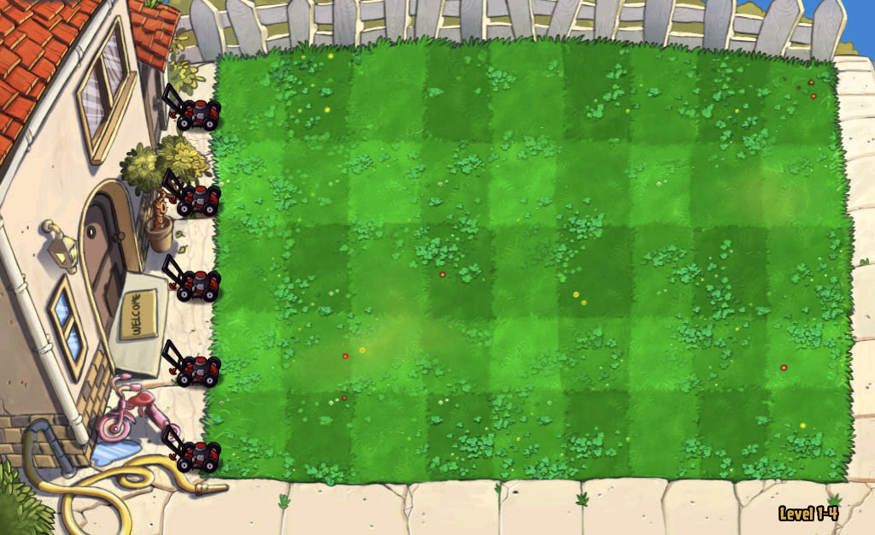
Made by – Himanshu and Udit

Slide 3
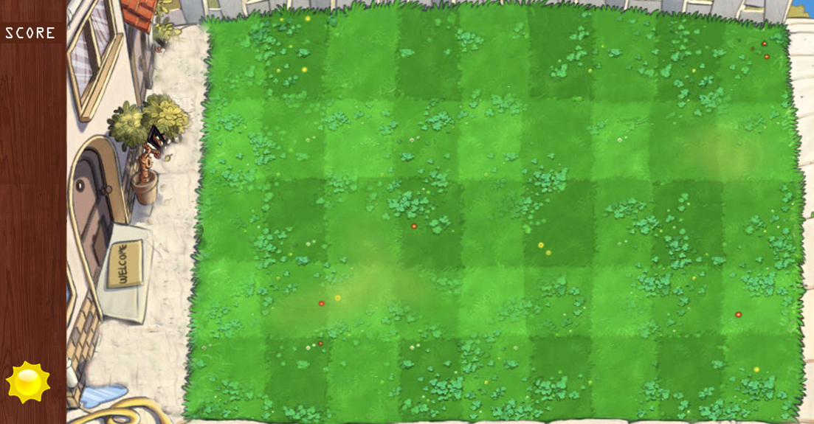

Slide 4
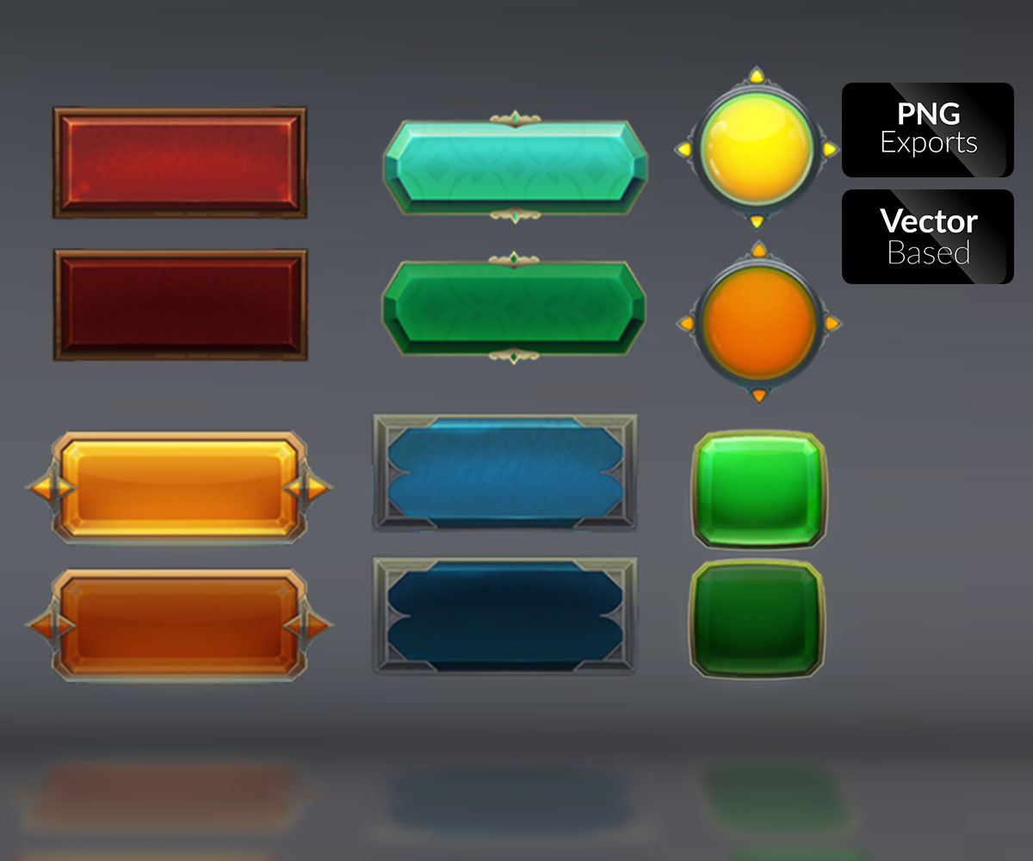
SAVE
RESTART
LOAD GAME
NEW GAME
EXIT

